Slide 1
Asthma
A summary of asthma prevalence, outcomes and risk factors in Camden
Profile

Slide 2

Key points

Slide 3

Key points
Recorded asthma prevalence in Camden is stable and slightly below the NCL ICB and London averages.
Camden’s under-19 asthma-related emergency admission rate has consistently been similar to that of NCL ICB and rarely significantly different from that of London.
While there is no evidence of a trend in emergency admissions by IMD quintile, there is a stronger association between a higher deprivation quintile and the rate of emergency department attendances.
The prevalence of certain risk factors has reduced over time in Camden, including smoking among residents aged over 14, air pollution and fuel poverty.

Slide 4
Introduction

Slide 5
Introduction
Asthma is a long-term respiratory condition caused by a combination of genetic, antenatal and environmental factors. It is characterised by inflammation and narrowing of the airways, leading to symptoms such as wheezing, breathlessness, chest tightness, and coughing. Asthma can vary in severity and may be triggered by allergens, air pollution, respiratory infections, or physical activity.
The UK has some of the highest prevalence, emergency admissions and death rates for childhood asthma in Europe. Around 1 in 10 UK children has asthma, and every 20 minutes, a child is admitted to a UK hospital because of an asthma attack.(England 2021) Early exposure to tobacco smoke, air pollution, poor housing conditions, and respiratory infections during infancy increases the risk of developing asthma, so prevention must start early.
The strategic vision for asthma in Camden is a system that:
Improves early diagnosis of asthma
Improves outcomes for those with asthma including reducing episodes of acute exacerbation of asthma (“Scenario,” n.d.)
Reduces risk factors both clinical and related to wider determinants

Slide 6
Asthma Prevalence (6+ years)

Slide 7
Asthma Prevalence (6+ years)
Asthma prevalence in Camden in 2024/25 was 3.98%, significantly lower than the estimate of 4.51% for North Central London (NCL) ICB, and below most other inner London boroughs. The prevalence estimates across the three higher-level geographies have remained fairly consistent over the last five years.
Although recorded asthma prevalence in Camden appears lower than in many other boroughs, this does not necessarily reflect a lower true prevalence and so should be interpreted with caution. Camden has historically had limited access to children and young people’s (CYP) respiratory diagnostic services, which may have contributed to under-diagnosis and artificially lower prevalence estimates.
A borough-wide CYP respiratory diagnostic service for children aged 6 and over was recently established. Alongside ongoing work to address the backlog of objective asthma testing, recorded prevalence may rise in future years, as a reflection of improved diagnostic processes rather than a true change in asthma prevalence.

Slide 8
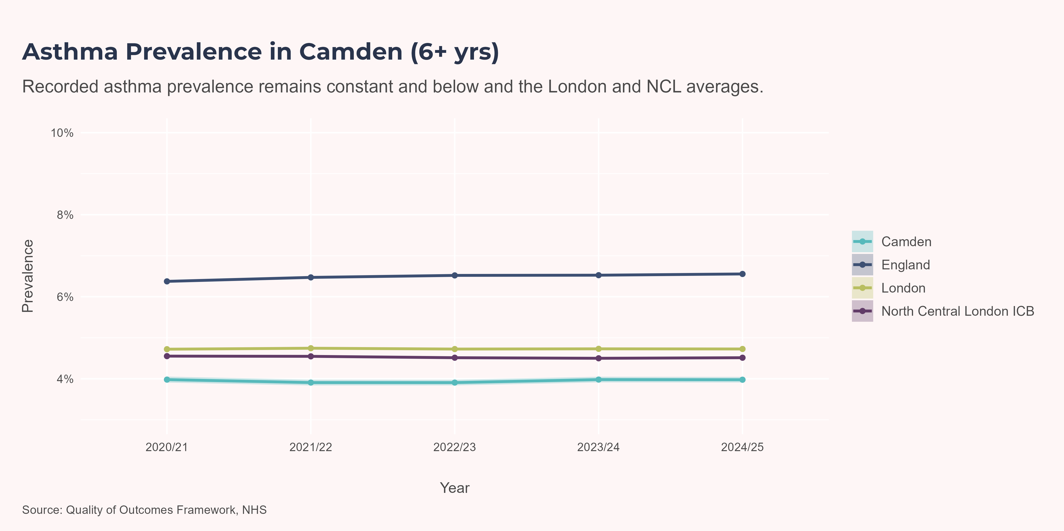
Comparison - Higher Geographies

Slide 9
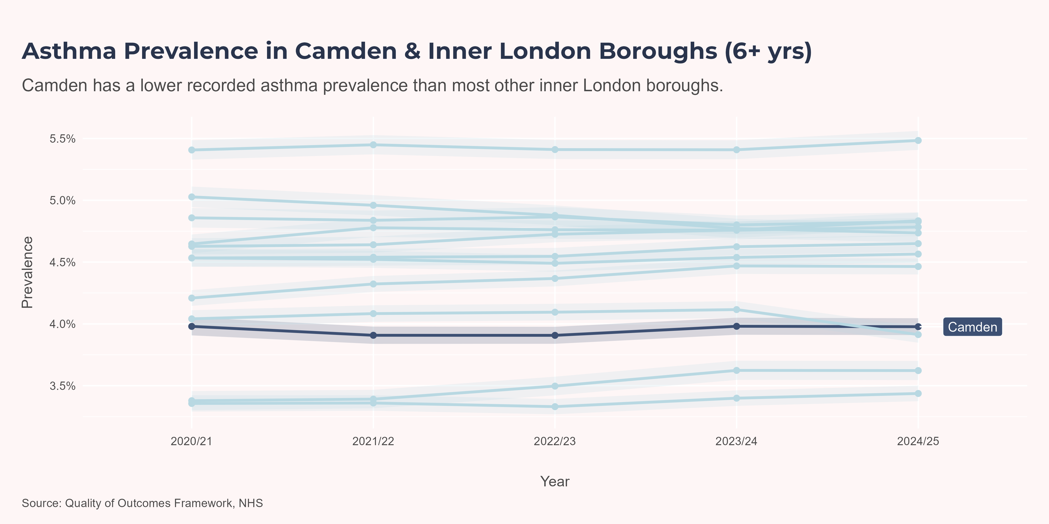
Comparison - Inner-London Boroughs

Slide 10
Ward-level Prevalence (6+ years)
Residents registered with a GP in the East Neighbourhood (Kentish Town North, Camden Square, Gospel Oak and Haverstock), had some of the highest asthma prevalence at 4.9%, 4.9%, 5.1% and 5.5%, respectively. This is consistent with the East Neighbourhood’s poorer health outcomes on other indicators such as adult obesity, alcohol dependence and smoking prevalence. Highgate, in the North Neighbourhood, has a similarly high prevalence at 5.3%. This is consistent with its broader health profile, which is more similar to the East Neighbourhood than to the other north wards, with high levels of alcohol dependence, depression and hypertension.
Although King’s Cross is a relatively deprived area, it has a low level of asthma prevalence at 2.8%.

Slide 11
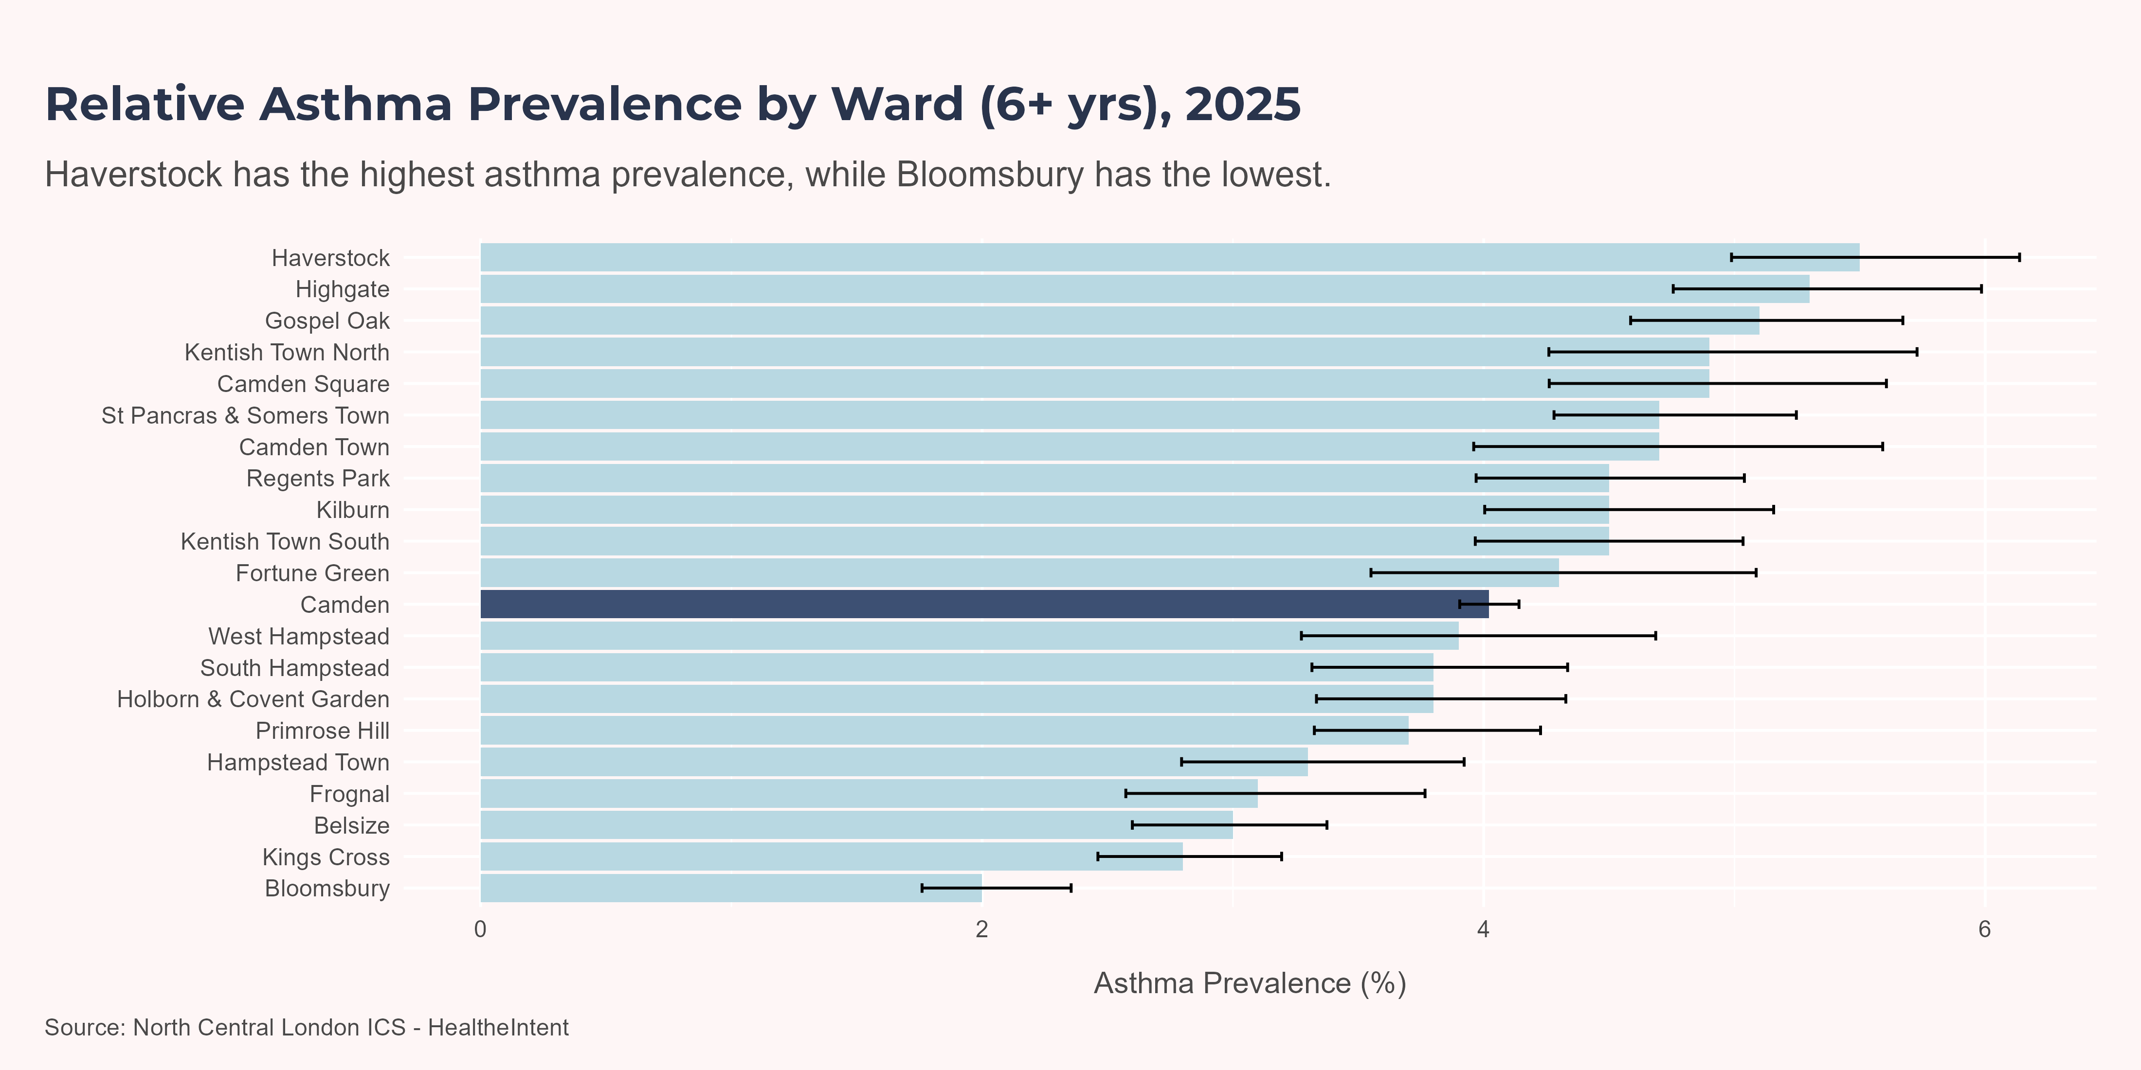
Chart
Note
People with asthma are counted in a ward if they are registered with a GP based in this ward. This is not based on resident postcode data.

Slide 12
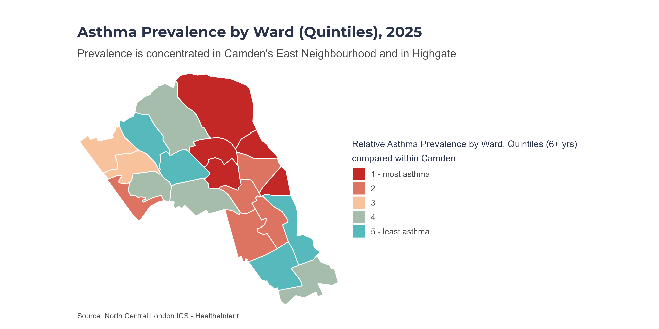
Map
Note
Quintiles are calculated within Camden only. All Camden wards are ranked by prevalence; then the ranked list is split into five (roughly) equal-sized groups (“quintiles”). Colours therefore show how a ward compares to other wards in Camden, not across the whole of England.

Slide 13
Asthma-related Emergency Admissions (0-18 years)

Slide 14
Over time
Following the pandemic, when asthma-related admissions dropped suddenly, rates across all three geographies have shown a steady rise, but have not yet returned to pre-pandemic levels. The leading theory for reduction in rates during the pandemic is reduced exposure to respiratory viruses which are common triggers of asthma exacerbations.(Shah et al. 2022)
The count of asthma-related admissions for Camden is fairly small, ranging from 35 in 2020/21 and 2022/23, to 80 in 2014/15, 2015/16 and 2017/18. Consequently, the confidence intervals are very large, meaning we cannot confidently conclude that the Camden rates are significantly lower than London rates.

Slide 15
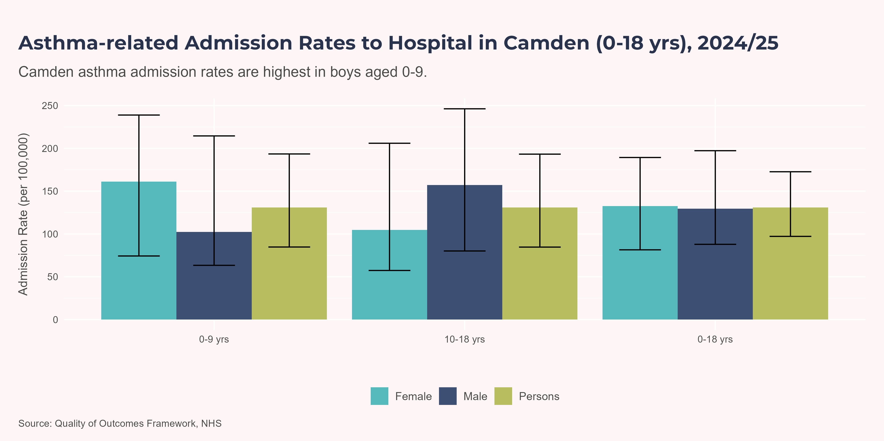
Sex & Age
During childhood, asthma is more prevalent in boys; however, in adulthood, women exhibit both higher prevalence and greater severity. (Chowdhury et al. 2021)
In Camden, fewer than five girls under the age of 8 were admitted to hospital for asthma in 2024/25. However, between the ages of 10 and 18, admission rates for both boys and girls were much more similar. Across all under 18 admissions, boys had a higher admission rates than girls.

Slide 16
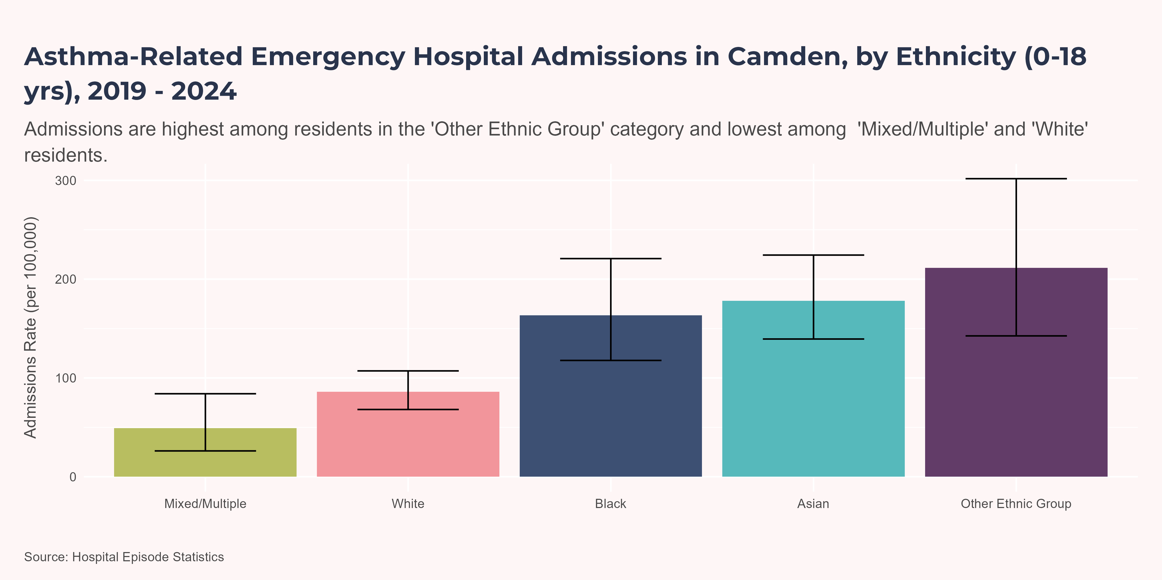
Ethnicity
Note
Counts below 7 have been suppressed and all counts and rates have been rounded to the nearest 5.
The ‘Other Ethnic Group’ ethnic group observed the highest admissions rate at 211.34 admissions per 100,000. The ‘Mixed/Multiple’ ethnic group observed the lowest admissions rate at 49.12 admissions per 100,000.
Statistically significant differences were found between the following Ethnic Groups:
‘Asian’ and ‘Mixed/Multiple’
‘Asian’ and ‘White’
‘Black’ and ‘Mixed/Multiple’
‘Black’ and ‘White’
‘Mixed/Multiple’ and ‘Other Ethnic Group’
‘Other Ethnic Group’ and ‘White’

Slide 17
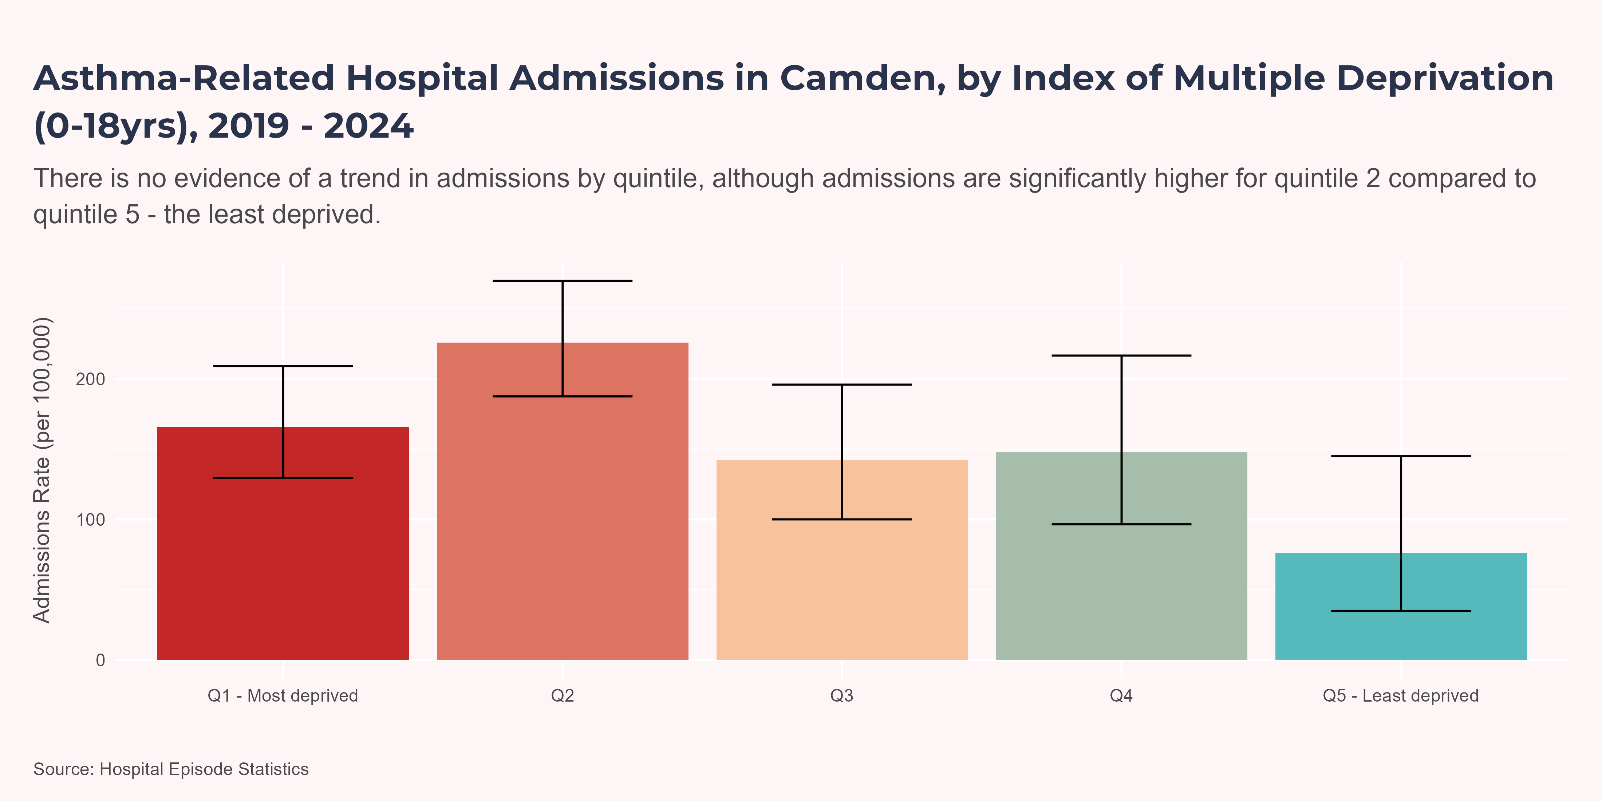
Index of Multiple Deprivation
Note
Counts below 7 have been suppressed and all counts and rates have been rounded to the nearest 5.
Quintile ‘Q2’ had the highest admission rate at 225.88 admissions per 100,000. Quintile ‘Q5 - Least deprived’ had the lowest admission rate at 76.37 admissions per 100,000.
Statistically significant differences were found between the following quintiles:
Q2 and Q5 - Least deprived

Slide 18
Asthma-related Emergency Department Attendance (0-18 years)

Slide 19
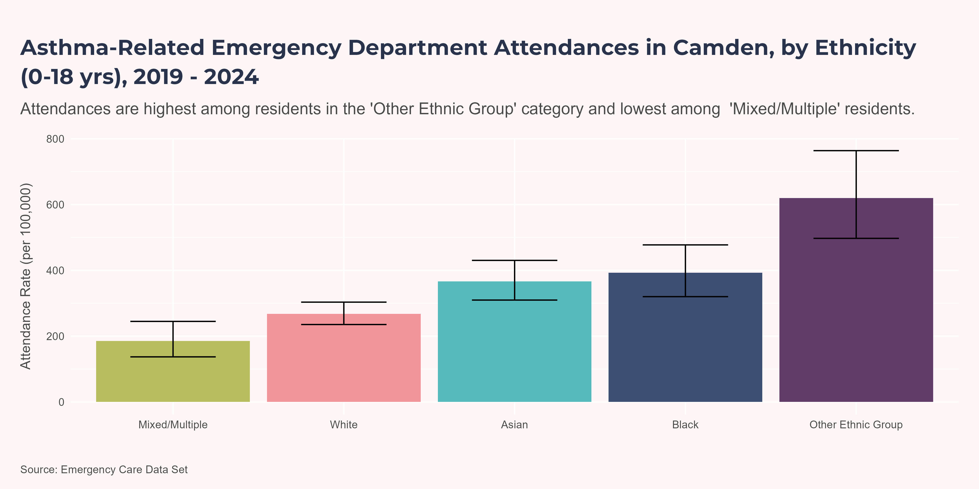
Ethnicity
Note
Counts below 7 have been suppressed and all counts and rates have been rounded to the nearest 5.
The ‘Other Ethnic Group’ ethnic group observed the highest attendance rate at 619.94 attendances per 100,000. The ‘Mixed/Multiple’ ethnic group observed the lowest attendance rate at 185.15 attendances per 100,000.
Statistically significant differences were found between the following Ethnic Groups:
‘Asian’ and ‘Mixed/Multiple’
‘Asian’ and ‘Other Ethnic Group’
‘Asian’ and ‘White’
‘Black’ and ‘Mixed/Multiple’
‘Black’ and ‘Other Ethnic Group’
‘Black’ and ‘White’
‘Mixed/Multiple’ and ‘Other Ethnic Group’
‘Other Ethnic Group’ and ‘White’

Slide 20
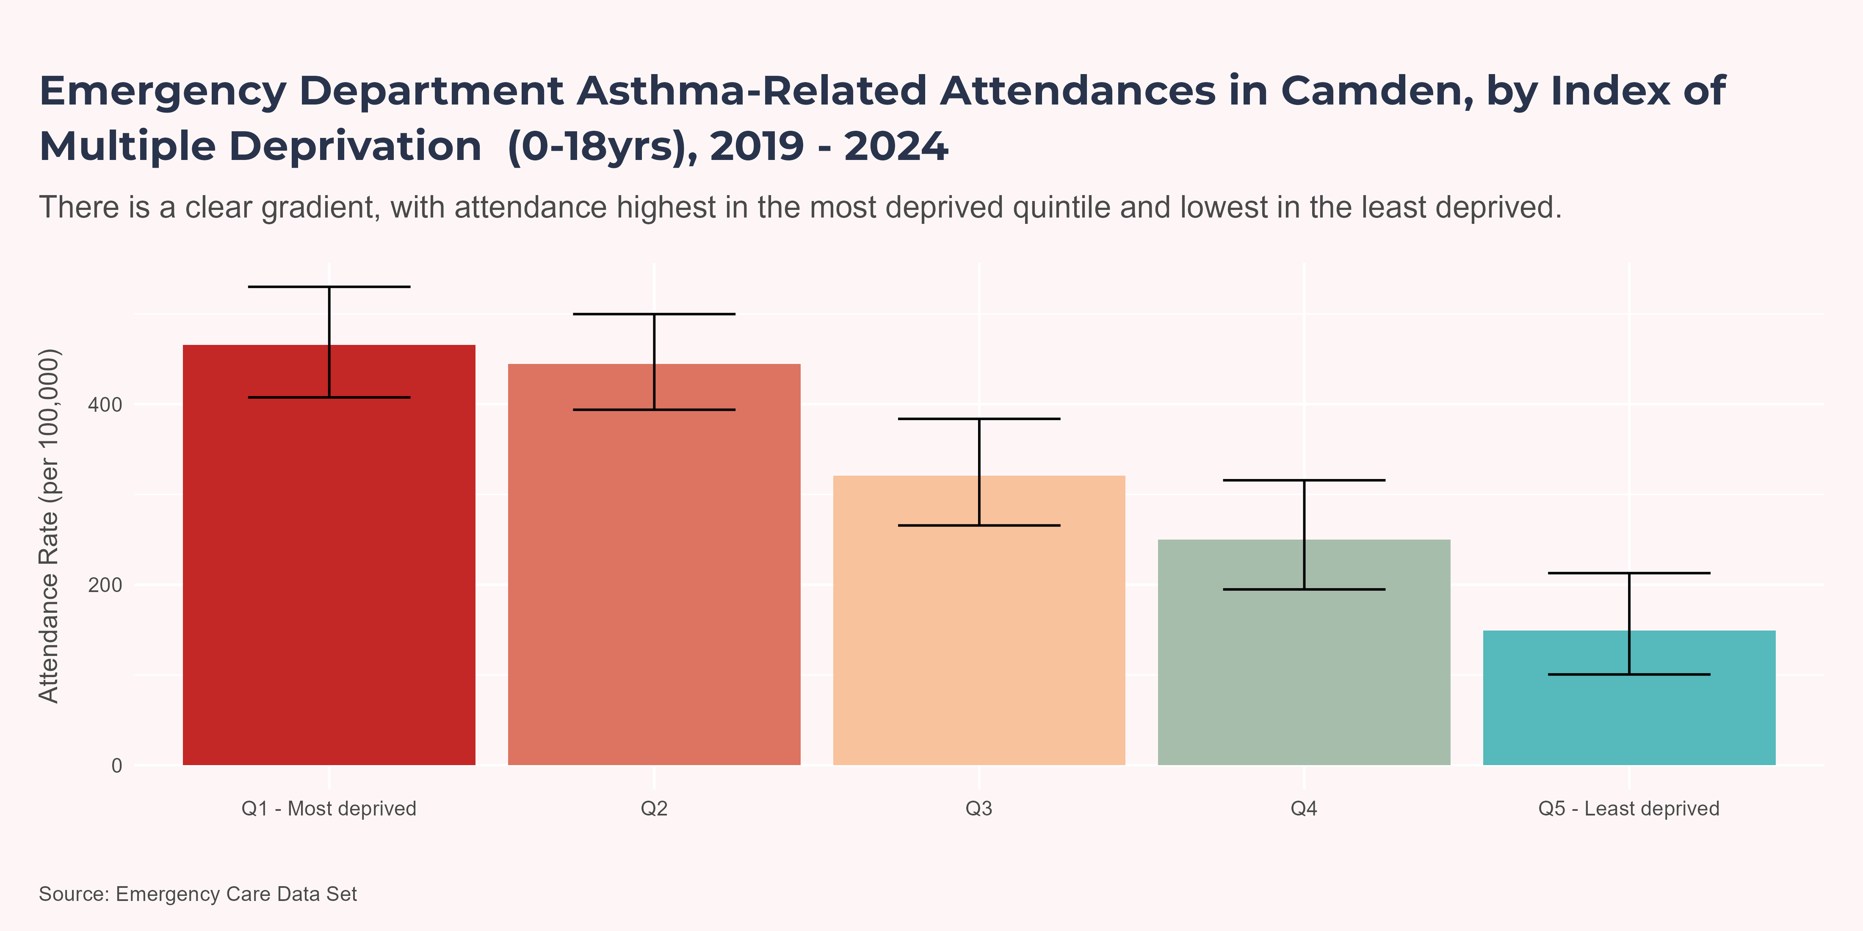
Index of Multiple Deprivation
Note
Counts below 7 have been suppressed and all counts and rates have been rounded to the nearest 5.
Quintile ‘Q1 - Most deprived’ had the highest attendance rate at 465.78 attendances per 100,000. Quintile ‘Q5 - Least deprived’ had the lowest attendance rate at 149.07 attendances per 100,000.
Statistically significant differences were found between the following quintiles:
Q1 - Most deprived and Q3
Q1 - Most deprived and Q4
Q1 - Most deprived and Q5 - Least deprived
Q2 and Q3
Q2 and Q4
Q2 and Q5 - Least deprived
Q3 and Q5 - Least deprived

Slide 21
Risk Factors

Slide 22
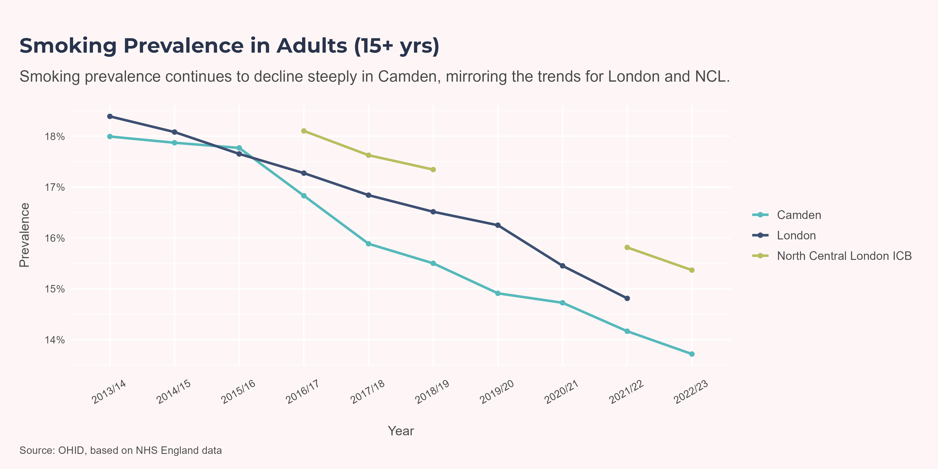
Smoking
In 2023/24, 82% of children and young people (CYP) with asthma in NCL ICB either smoked or were exposed to second-hand smoke, the same value as for London.(Digital, n.d.) This is compared to 79% of CYP across the whole of England.(Digital, n.d.)
Camden smoking prevalence has followed a similar trend to London and NCL ICB in falling consistently since 2013/14, reaching a low of 13.72% in 2022/23. Smoking prevalence in Camden is slightly lower than in London as a whole and even lower than in the NCL ICB.

Slide 23
Ward-level Smoking Prevalence
Residents registered with a GP in the East Neighbourhood (Kentish Town North, Camden Square, Camden Town and Haverstock) were in the top 20% of wards for smoking prevalence. In the West, Kilburn and West Hampstead had the highest and fourth-highest smoking prevalence at 18.9% and 17.5% respectively.

Slide 24
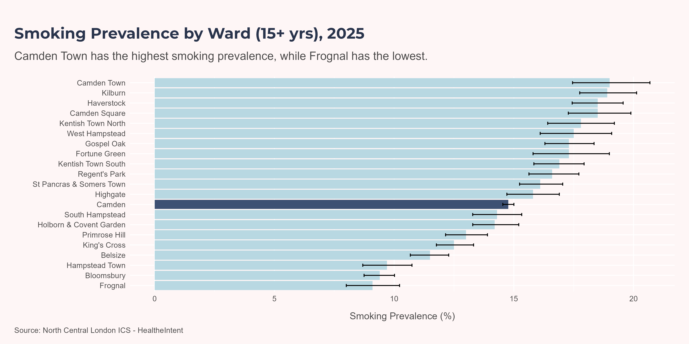
Chart
Note
People with asthma are counted in a ward if they are registered with a GP based in this ward. This is not based on resident postcode data.

Slide 25
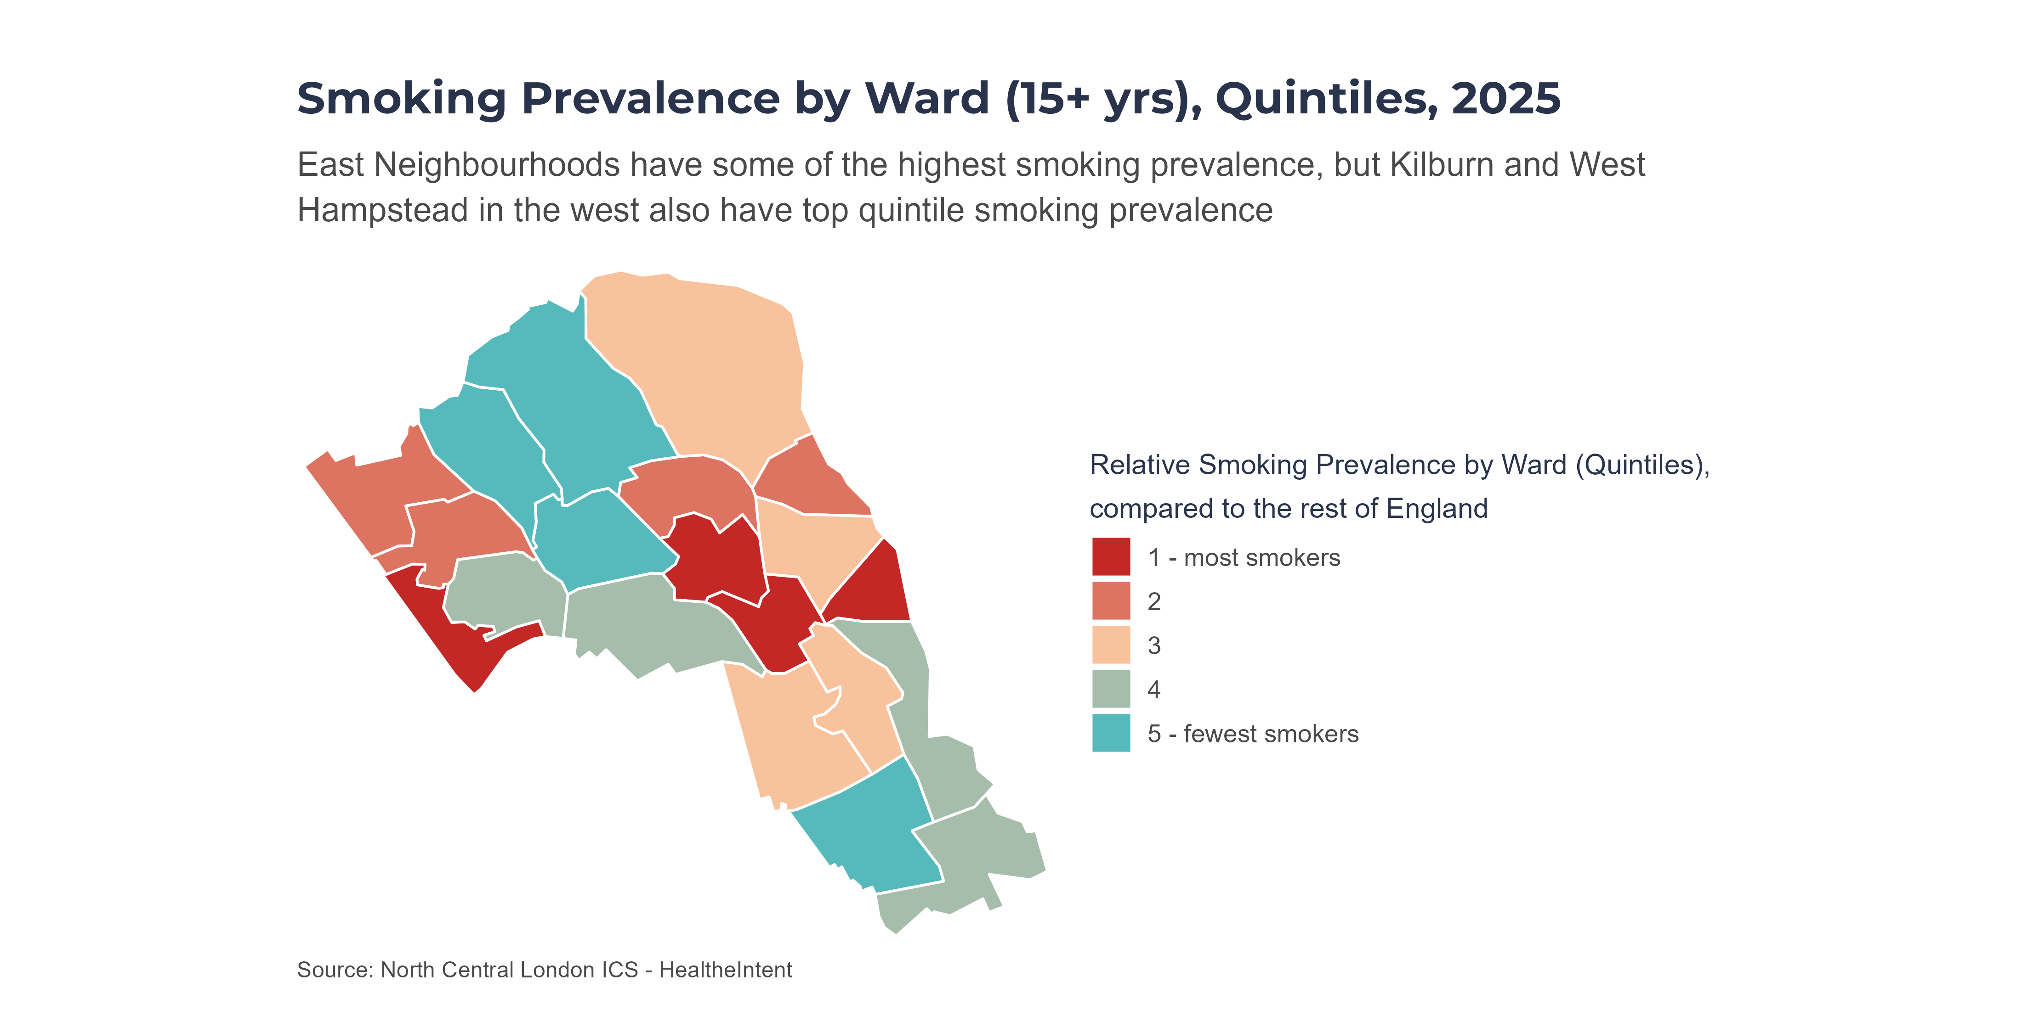
Map
Note
People with asthma are counted in a ward if they are registered with a GP based in this ward. This is not based on resident postcode data.
Quintiles are calculated within Camden only. All Camden wards are ranked by prevalence; then the ranked list is split into five (roughly) equal-sized groups (“quintiles”). Colours therefore show how a ward compares to other wards in Camden, not across the whole of England.

Slide 26
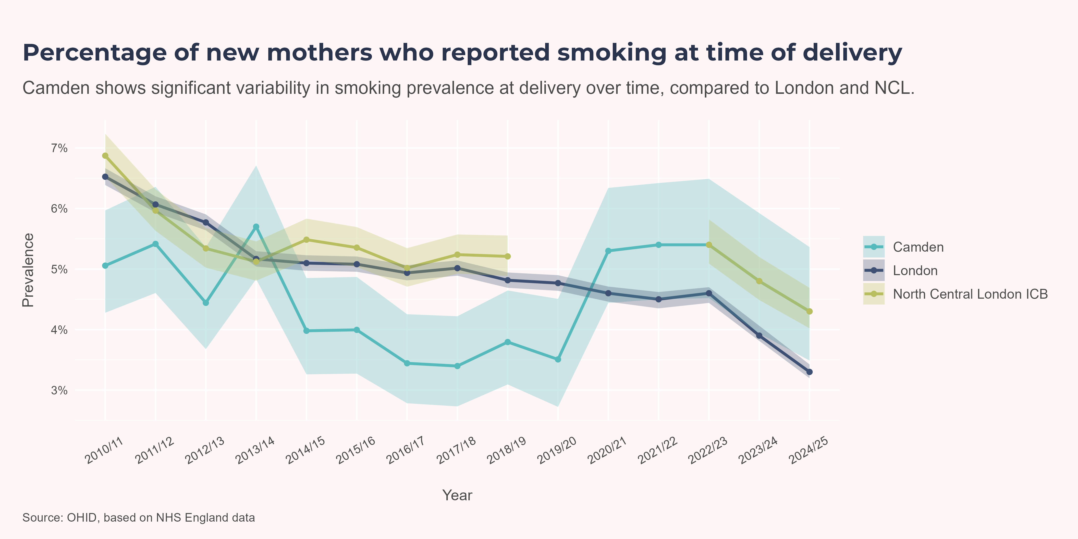
Smoking at Delivery
Smoking at delivery records the smoking status of the mother when she gives birth. It is used as the measure, for England, of the proportion of maternities where the mother was known be a smoker at the time of delivery. Smoking during pregnancy is associated with asthma via three mechanisms:(Zacharasiewicz 2016)
Nicotine stymies foetal lung development
Effect on later immune functioning - increased infection rate
Epigenetic (transgenerational) effects
In 2024/25, the proportion of Camden mothers delivering a baby who smoked was estimated at 4.3%.
The Camden smoking prevalence at time of delivery appeared to drop suddenly in 2014/15 to 3.98% (below the NCL ICB and London averages), and rise again in 2020/21 to 5.3, a level similar to the NCL ICB and at least as high as the London average. The reasons for this sudden decrease and subsequent sudden increase are unclear, though it should be noted that this indicator is based on observation and therefore susceptible to measurement bias.

Slide 27
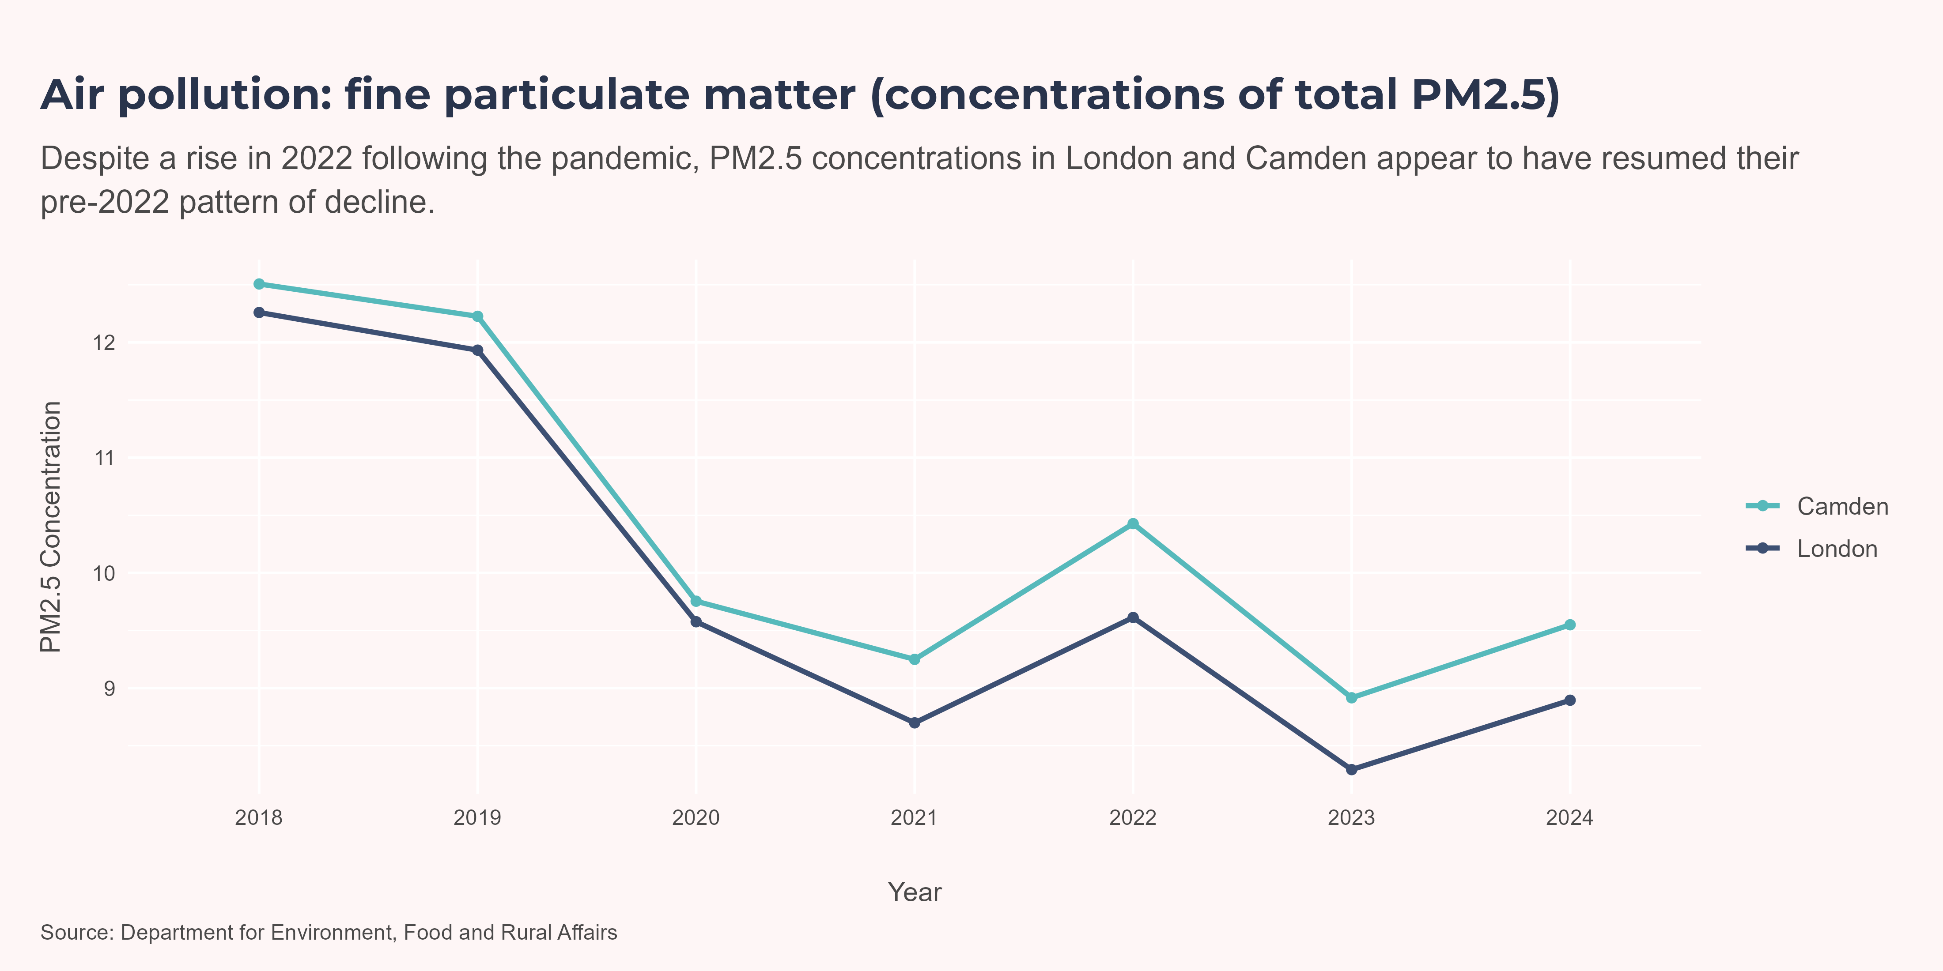
Air Pollution
Exposure to both indoor and outdoor air pollution is linked to an increased risk of asthma development and exacerbation. (Zhou et al. 2024)
Air quality has improved significantly in London in recent years thanks to programmes such as ULEZ, cleaner taxi and bus fleets, programmes to encourage cycling and electric vehicle usage, funding for London boroughs’ projects through the Mayor’s Air Quality Fund.((GLA) 2024)
Between 2016 and 2023, annual average roadside concentrations of NO2 dropped by 49%, compared to 35% in the rest of England. Preliminary evidence suggests 2023 was the lowest ever recorded year for NO2 concentrations. In 2016, 56 (around one third) of London’s monitoring sites exceeded the legal limit for NO2, compared to just 5 in 2023. For PM2.5, 2023 was the first year concentrations did not exceed the interim WHO air quality target.((GLA) 2024)
Currently, borough-level estimates of air pollution are available only for PM2.5, not for NO2. Defra estimates of PM2.5 concentrations in Camden have decreased substantially in the last 6 years, from 12.51µg/m³ in 2018, to 9.55µg/m³ in 2024. Nevertheless, the concentration remains above the estimate for London - a gap which has widened since 2020.

Slide 28
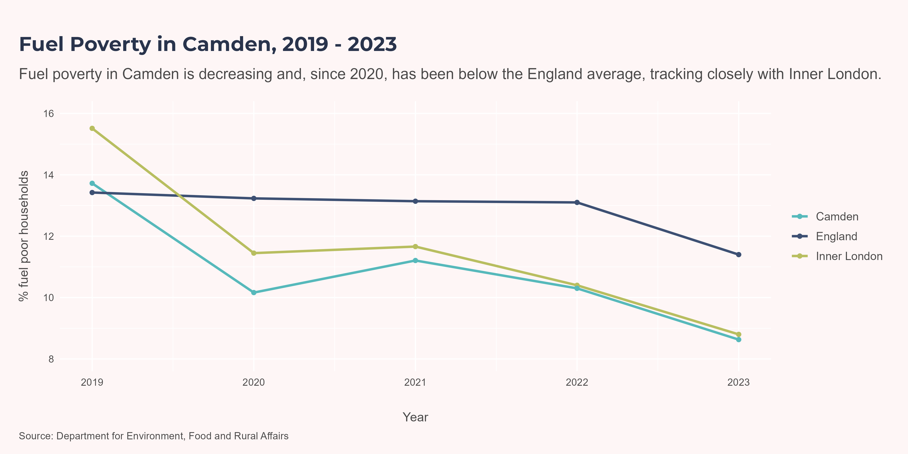
Fuel Poverty
For England, the government uses the Low Income Low Energy Efficiency (LILEE) definition of fuel poverty. Under the LILEE definition, a household is considered to be fuel poor if it meets both of the following criteria:
The property has an energy efficiency rating of band D or lower; and
After spending the amount needed to adequately heat their home, the household’s remaining income falls below the official poverty threshold.((NEA), n.d.)
If a household is in fuel poverty, their home is more likely to be cold. To keep heat in, windows and doors remain closed in cold homes, with this poor ventilation causing damp, mould and a proliferation of house dust mites.(Barrett et al. 2022) This increases the risk of developing asthma and experiencing an acute asthma attack.(Gray-French et al. 2022)
Across England, lone-parent families have the highest prevalence of fuel poverty: 24.7% in 2024. 34.5% of all fuel poor households had one or more dependent children.(Energy Security and Net Zero, n.d.)
In 2023, 8.6% of Camden households were in fuel poverty, 2.8 percentage points lower than the average of 11.4% for England.

Slide 29
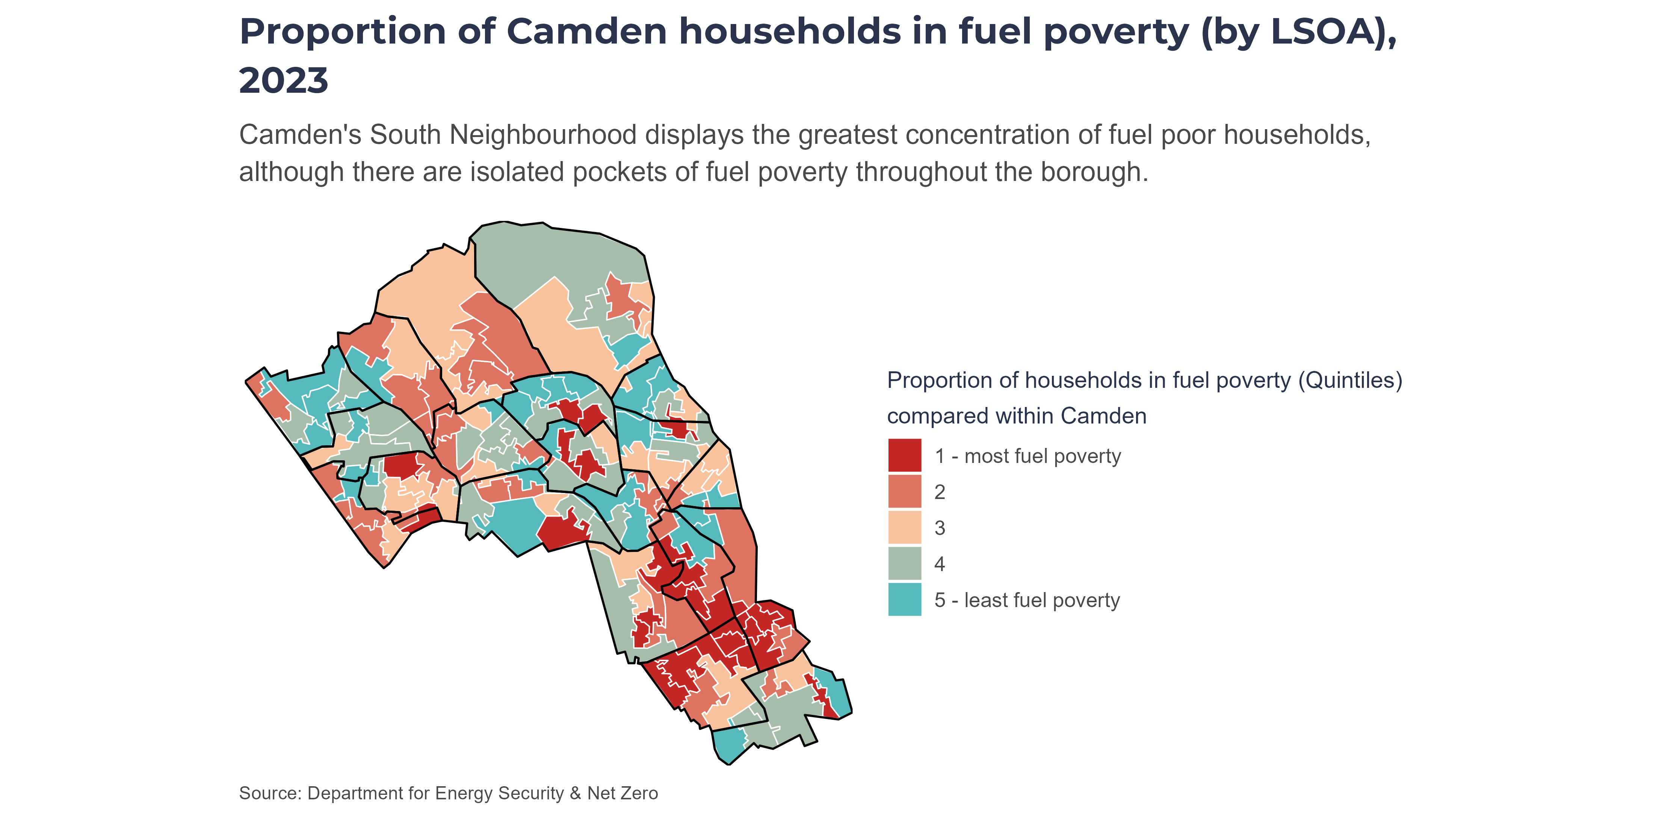
The map below visualises relative rankings of fuel poverty prevalence by LSOA. Wards with the highest prevalence of fuel poverty were King’s Cross, St Pancras and Somers Town, and Bloomsbury - all in the South of the borough. There are also pockets of top-quintile fuel poverty across Central and West.
Note
Quintiles are calculated within Camden only. All Camden wards are ranked by prevalence; then the ranked list is split into five equally-sized groups (“quintiles”). Colours therefore show how a ward compares to other wards in Camden, not across the whole of England.

Slide 30
Appendix - Neighbourhood and Ward Overview

Slide 31
Appendix - Neighbourhood and Ward Overview
This appendix provides a high‑level overview of neighbourhood and ward‑level patterns across a range of measures, offering a quick comparison against the borough‑wide position (Camden Total).
Interpreting colours in the tables
The colours show a within‑row gradient from lowest to highest:
light blue → dark blue
= lowest → highest values within that measure (row)
red → peach → teal
= worst → best values within that measure (row)
This gradient helps to show relative positioning between neighbourhoods or between wards. It does not correspond to statistical significance.

Slide 32
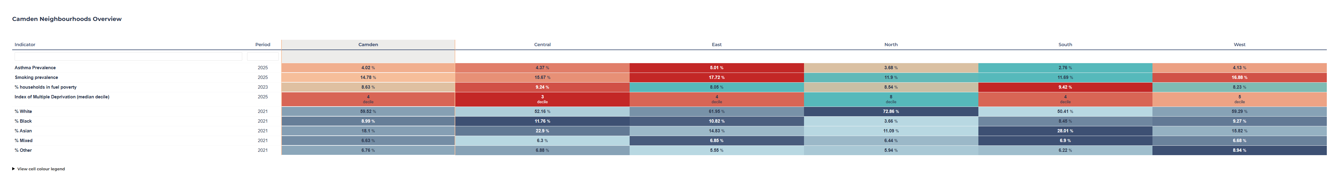
Camden Neighbourhoods

Slide 33
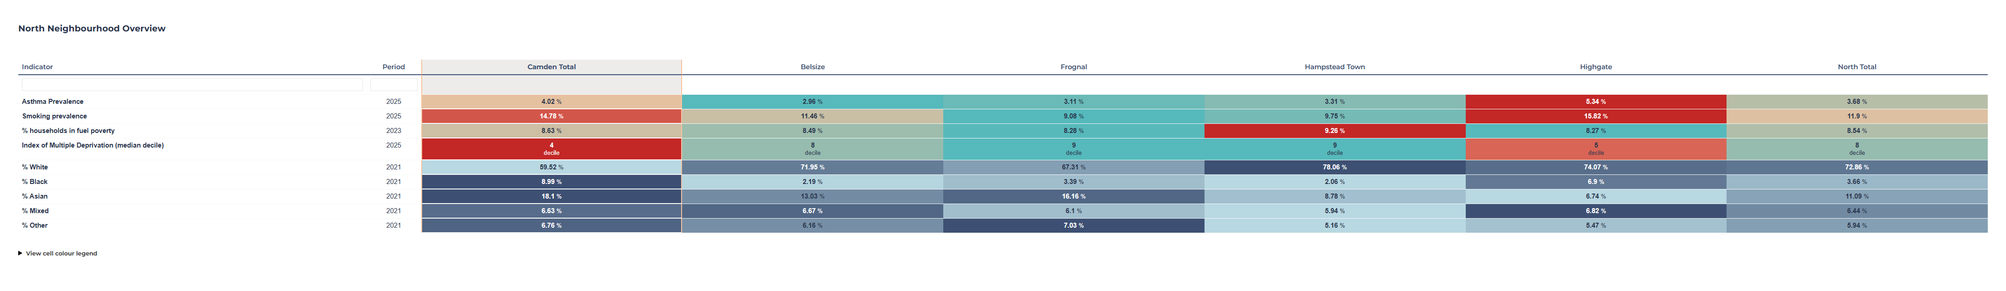
North Neighbourhood

Slide 34
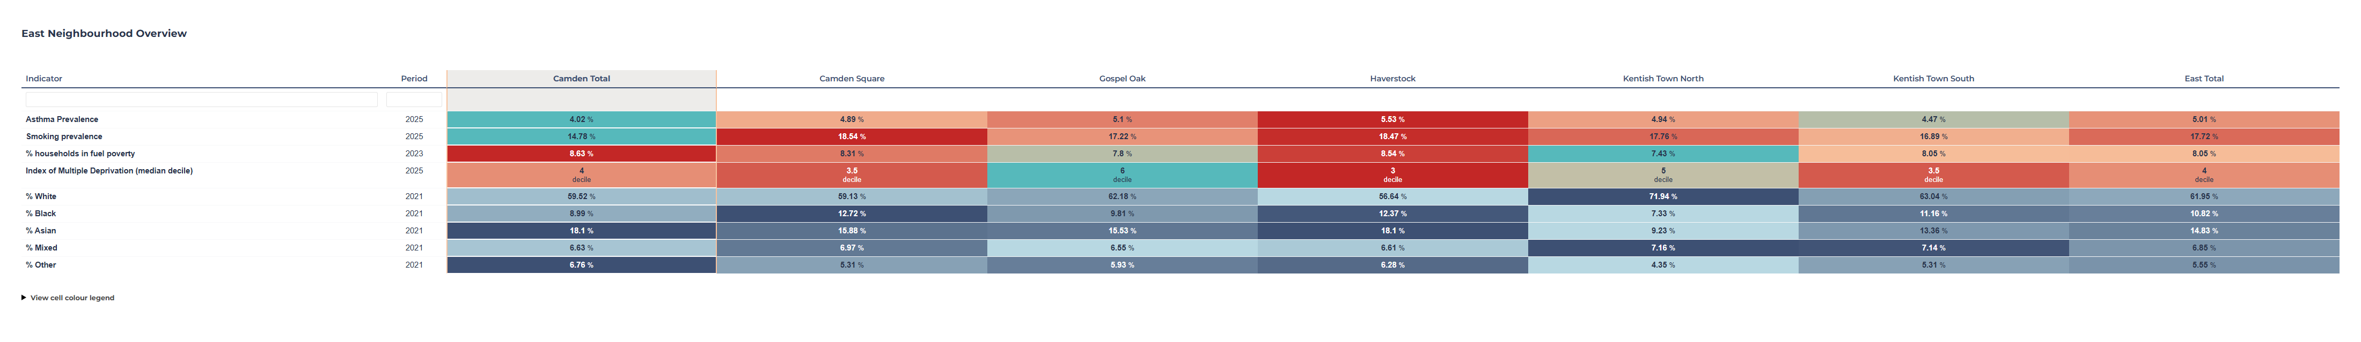
East Neighbourhood

Slide 35
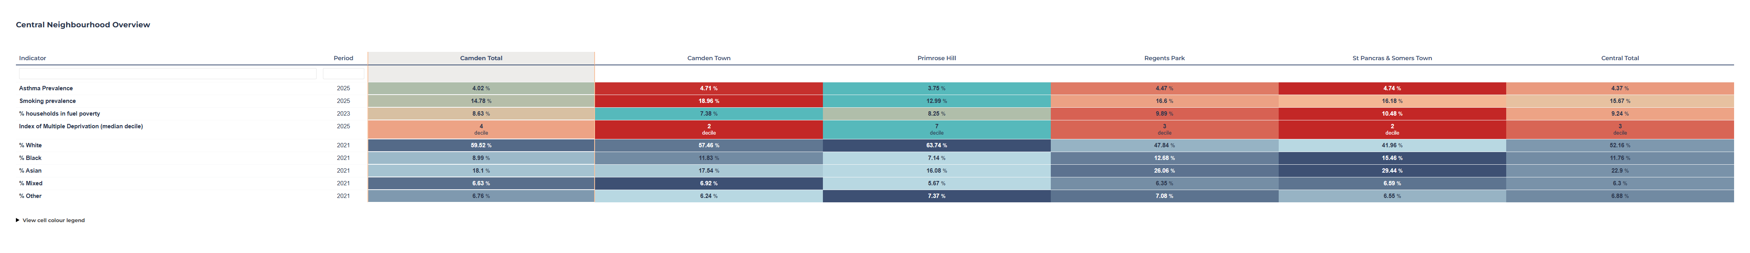
Central Neighbourhood

Slide 36
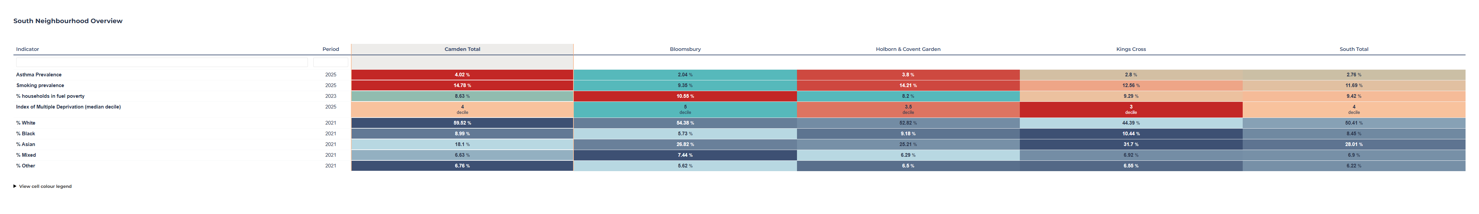
South Neighbourhood

Slide 37
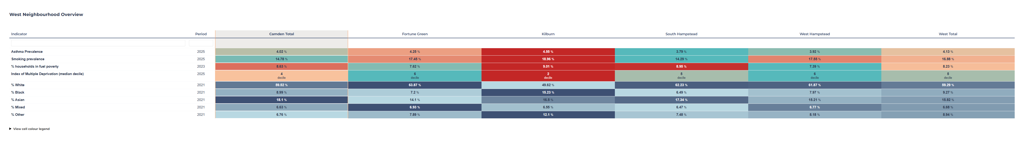
West Neighbourhood

Slide 38
Barrett, Cassandra, Alice R. Lee, Elissa M. Abrams, Sarah J. Mayell, Daniel B. Hawcutt, and Ian P. Sinha. 2022. “Eat or Heat: Fuel Poverty and Childhood Respiratory Health.” The Lancet Respiratory Medicine 10 (3): 229. https://doi.org/10.1016/S2213-2600(21)00584-1.
Chowdhury, Nowrin U., Vamsi P. Guntur, Dawn C. Newcomb, and Michael E. Wechsler. 2021. “Sex and Gender in Asthma.” European Respiratory Review 30 (162): 210067. https://doi.org/10.1183/16000617.0067-2021.
Digital, NHS. n.d. “Quality and Outcomes Framework, 2023-24.” NHS England Digital. Accessed July 7, 2025. https://digital.nhs.uk/data-and-information/publications/statistical/quality-and-outcomes-framework-achievement-prevalence-and-exceptions-data/2023-24.
Energy Security and Net Zero, Department for. n.d. “Annual Fuel Poverty Statistics Report: 2025.” GOV.UK. Accessed July 7, 2025. https://www.gov.uk/government/statistics/annual-fuel-poverty-statistics-report-2025.
England, NHS. 2021. “NHS England » National Bundle of Care for Children and Young People with Asthma.” September 23. https://www.england.nhs.uk/publication/national-bundle-of-care-for-children-and-young-people-with-asthma/.
(GLA), Greater London Authority. 2024. “Air Quality in London 2016-2024 | London City Hall.” March 8. https://www.london.gov.uk/programmes-strategies/environment-and-climate-change/environment-and-climate-change-publications/air-quality-london-2016-2024.
Gray-French, Madeleine, Ricardo M. Fernandes, Ian P. Sinha, and Elissa M. Abrams. 2022. “Allergen Management in Children with Type 2-High Asthma.” Journal of Asthma and Allergy 15: 381–94. https://doi.org/10.2147/JAA.S276994.
(NEA), National Energy Action. n.d. “What Is Fuel Poverty?” Accessed July 7, 2025. https://www.nea.org.uk/what-is-fuel-poverty/.
“Scenario: Acute Exacerbation of Asthma | Management | Asthma | CKS | NICE.” n.d. Accessed March 16, 2026. https://cks.nice.org.uk/topics/asthma/management/acute-exacerbation-of-asthma/.
Shah, Syed Ahmar, Jennifer K. Quint, and Aziz Sheikh. 2022. “Impact of COVID-19 Pandemic on Asthma Exacerbations: Retrospective Cohort Study of over 500,000 Patients in a National English Primary Care Database.” The Lancet Regional Health – Europe 19 (August). https://doi.org/10.1016/j.lanepe.2022.100428.
Zacharasiewicz, Angela. 2016. “Maternal Smoking in Pregnancy and Its Influence on Childhood Asthma.” ERJ Open Research 2 (3): 00042–2016. https://doi.org/10.1183/23120541.00042-2016.
Zhou, Xiaoying, Vanitha Sampath, and Kari C. Nadeau. 2024. “Effect of Air Pollution on Asthma.” Annals of Allergy, Asthma & Immunology 132 (4): 426–32. https://doi.org/10.1016/j.anai.2024.01.017.

