Slide 1
Cardiovascular Disease
An overview of cardiovascular disease in the borough of Camden
Profile

Slide 2

Key points

Slide 3

Key points
Cardiovascular disease (CVD) is one of the primary causes of ill health, disability and death in England, despite the fact that many cardiovascular conditions are preventable.
In Camden, the leading risk factors driving risk associated with CVD are high blood pressure, high cholesterol and obesity, as the impact of particulate matter and smoking has decreased over the previous 10 to 15 years.
Since the turn of the century rates of mortality linked to CVD (including stroke and heart disease) in Camden, London and England have decreased, though the rate of decline has levelled off over the last decade.
The prevalence of disease and risk factors (such as hypertension) remain stable and in some cases have increased, in some circumstances this is due to more successful identification and diagnosis.
CVD impacts certain cohorts of the population disproportionately. Rates of mortality linked to CVD are higher in males than it is in females, whilst those living in more deprived areas are two times more likely to die prematurely as a result of CVD.

Slide 4
Why it matters

Slide 5
Why it matters
Cardiovascular disease (CVD) is an umbrella term for all diseases of the heart and blood vessels. This includes everything from conditions that are inherited or occur from birth, to those that develop later, such as coronary heart disease, atrial fibrillation, heart failure, and stroke.(British Heart Foundation 2025a) Over 6.4 million people in England are living with CVD and it causes just over a quarter of all deaths in England – an average of 390 people each day or one death every four minutes.(British Heart Foundation 2025a) The British Heart Foundation estimates the healthcare costs relating to heart and circulatory diseases in England at £10 billion each year.(British Heart Foundation 2025a)
CVD remains a significant public health challenge in London, mirroring national trends across the UK. It is one of the leading causes of premature mortality and a major contributor to health inequalities.(British Heart Foundation 2025d) There is a disproportionate burden in certain communities, particularly in areas of high socioeconomic deprivation and among some ethnic groups;risk factors such as hypertension, obesity, smoking, and physical inactivity are disproportionately represented in these communities, fuelling the health inequality gap.(British Heart Foundation 2025d; Commission on Race and Ethnic Disparities 2021)

Slide 6
Why it matters continued
Targeted public health strategies, improved access to preventive care, and culturally tailored health interventions are essential to reducing the impact of cardiovascular disease and addressing the disparities that exist within London’s population.(Thomas, Health, and correspondent 2024)

Slide 7
Causes and risk factors

Slide 8
Causes and risk factors
There are numerous risk factors that contribute to the onset of cardiovascular disease. The Global Burden of Disease (GBD) study outlines the relative risk associated with the burden of cardiovascular disease in Camden.(“GBD Compare” 2015) The following ranks the risks and shows how the extent of the risk changed between 2011 and 2021.

Slide 9
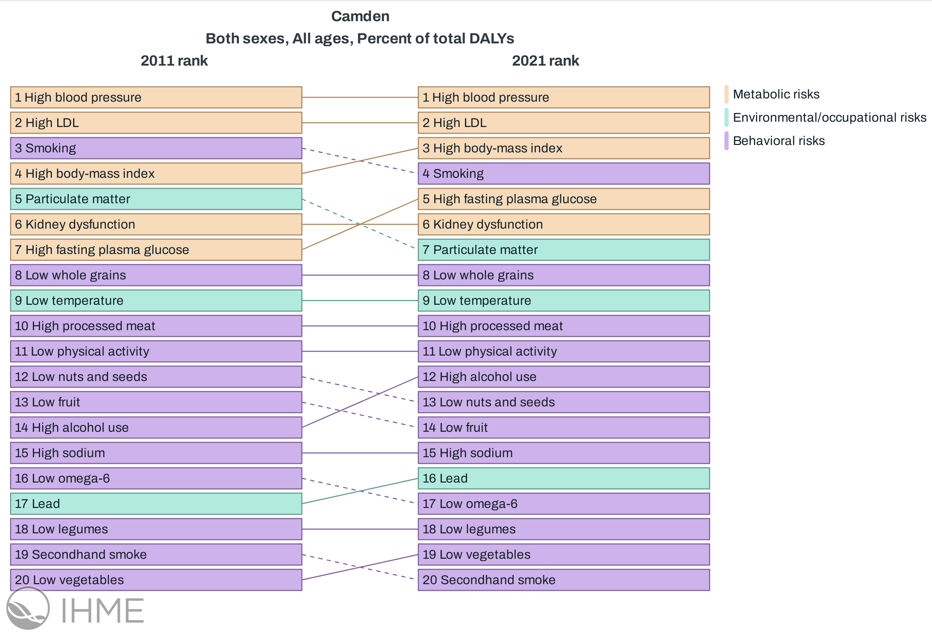
Global Burden of Disease CVD risks in Camden
High blood pressure and high LDL were the two largest risk factors contributing to disability-adjusted life years (DALY) linked to CVD, which reflected the narrative ten years prior in 2011. Smoking and high body-mass index were also in the top five risk factors in both 2011 and 2021. In 2011, particulate matter pollution was ranked in the top five risk factors, however this was displaced in 2021 by high fasting plasma glucose (hyperglycemia).
Global Burden of Disease CVD risks in Camden

Slide 10
Hypertension
Hypertension is defined as a level of blood pressure consistently above 140/90 mmHg.(National Institue for Health and Care Excellence 2025) This is itself impacted by multiple lifestyle factors, including smoking status and physical activity, as well as certain demographic factors, including socioeconomic group and ethnicity.
High blood pressure increases risks of cardiovascular disease, including heart disease, strokes and heart failure. The following graphs outline the prevalence of hypertension in Camden over time.

Slide 11
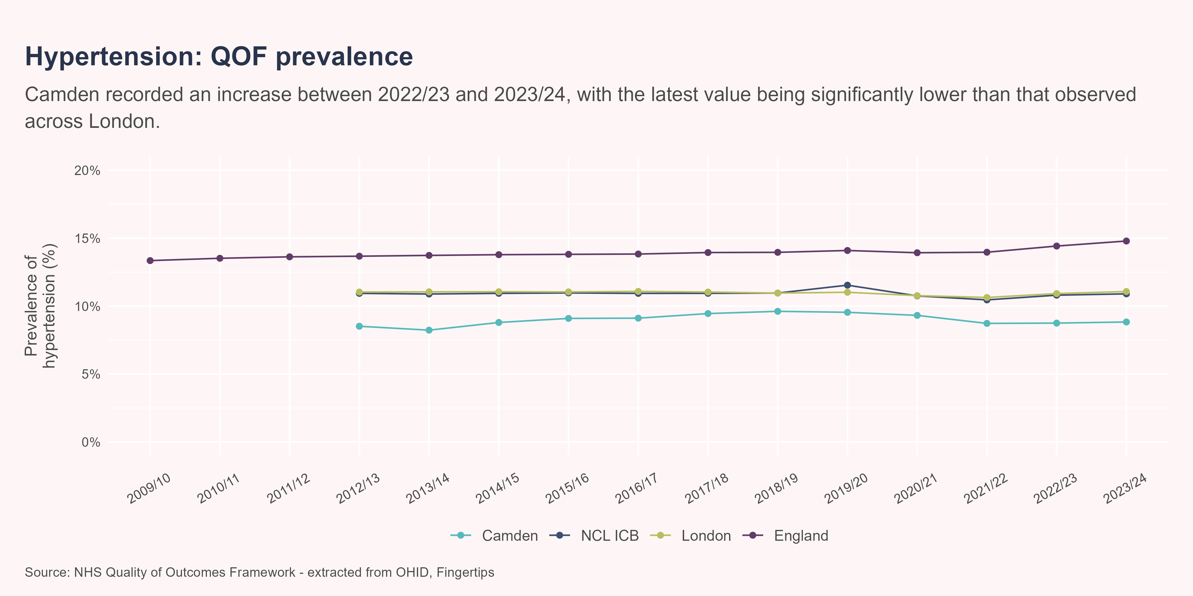
Hypertension prevalence
Between 2022/23 and 2023/24, Camden experienced an increase in the prevalence of hypertension from 8.75% to 8.83%. This was not a significant change. NCL ICB, London and England observed prevalences of hypertension that were significantly greater than the Camden geography, which may be explained by the younger age demographic in Camden. It is important to note that a proportion of individuals may be living with undiagnosed hypertension. The Health Survey for England found that London has an estimated 36% hypertension prevalence, based on surveys conducted within private households.(Office for National Statistics 2023)

Slide 12
High cholesterol
Cholesterol is a fatty substance in your blood which your body can produce naturally as well as obtain from foods that we eat. Smoking, physical activity and diet all have an effect on the amount of cholesterol in the blood (as well as uncontrollable factors such as ageing). The build up of bad cholesterol (non-high density lipo-proteins or non-HDL) in the bloods leads to the narrowing of blood vessels, which in turn increases the likelihood of cardiovascular disease, along with added risk of a stroke and a heart attack in particular.
The QRISK score is a tool used by the NHS to determine the risk individuals will have a stroke or heart attack in the next 10 years, based on known risk factors (e.g. age, gender, ethnicity, smoking status and others). The higher the percentage score, the higher the risk of cardiovascular disease. Individuals with a score greater than 20% are at the highest risk.
The following chart depicts the proportion of patients in Camden PCN’s that have a QRISK score of at least 20% and are currently on lipid-lowering treatment (LLT). NHS Operational Planning Guidance 2023/24 established the primary prevention objective of increasing the proportion of patients with a high QRisk score prescribed LLT to 65%.(NHS England 2024) The below graph presents the proportion of those at risk of CVD recorded to be on lipid-lowering treatment at the Camden and at the ICB level. To note, the counts and denominator for Camden have been established by summing the suppressed values across the PCN’s within Camden.

Slide 13
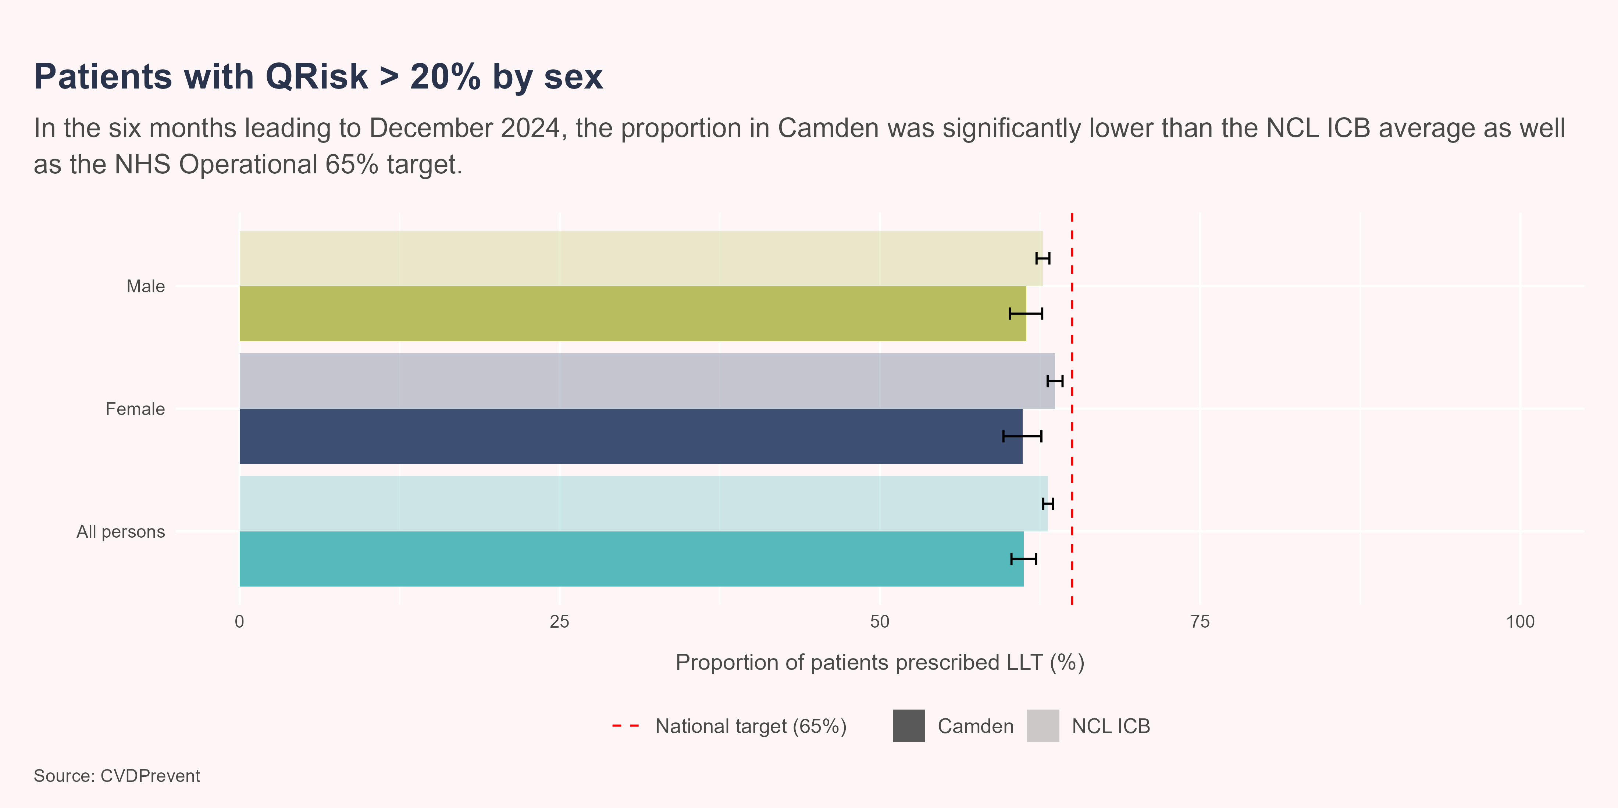
At risk prescribed LLT - Sex
.
Those with a QRisk of >20% within the female population of Camden already on LLT (61.1%) was significantly lower than the NCL ICB average (63.7%). The proportion of the female population with a QRisk score of >20% already on LLT was significantly lower than the 65% NHS target. There was no significant difference in the male population with a QRisk score of >20% already on LLT between Camden and NCL ICB. The proportion of the male population with a QRisk score of >20% already on LLT was significantly lower than the 65% NHS target.

Slide 14
At risk prescribed LLT - Ethnicity
In the six months leading to December 2024, all ethnic groups except for the multiple/mixed population had a significantly greater proportion of their at risk populations prescribed LLT compared to the white ethnic group. Comparisons against the NCL average and the NHS operational target are outlined below the graph.

Slide 15
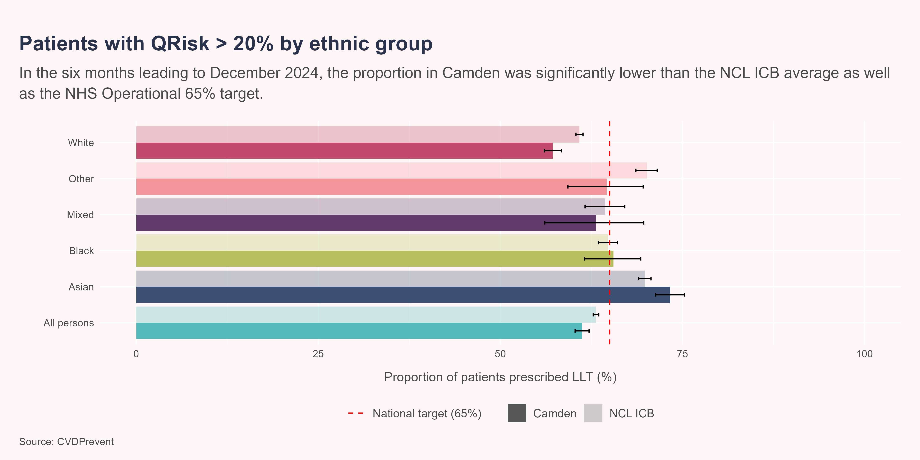
At risk prescribed LLT - Ethnicity graph

Slide 16
At risk prescribed LLT - Ethnicity continued
Asian:
In the latest time period, those with a QRisk of >20% within the asian population of Camden already on LLT (73.4%) was significantly greater than the NCL ICB average (69.8%). The proportion of the asian population with a QRisk score of >20% already on LLT was significantly greater than the 65% NHS target.
Black:
There was no significant difference in the black population with a QRisk score of >20% already on LLT between Camden and NCL ICB. The proportion of the black population with a QRisk score of >20% already on LLT was statistically similar to the 65% NHS target.
Mixed/Multiple Ethnic Groups:
There was no significant difference in the multiple ethnic groups population with a QRisk score of >20% already on LLT between Camden and NCL ICB. The proportion of the multiple ethnic groups population with a QRisk score of >20% already on LLT was statistically similar to the 65% NHS target.
Other Ethnic Group:
There was no significant difference in the other ethnic group population with a QRisk score of >20% already on LLT between Camden and NCL ICB. The proportion of the other ethnic group population with a QRisk score of >20% already on LLT was statistically similar to the 65% NHS target.
White:
In the latest time period, those with a QRisk of >20% within the white population of Camden already on LLT (57.2%) was significantly lower than the NCL ICB average (60.9%). The proportion of the white population with a QRisk score of >20% already on LLT was significantly lower than the 65% NHS target.

Slide 17
NHS Health Check
The NHS Health Check is a free service offered to those aged between 40 - 74 who do not have any pre-existing diagnoses of heart disease, CKD, hypertension and other conditions. These checks result in a risk score for cardiovascular events like a heart attack or stroke. These checks aim to encourage a patient to take action in improving their health, which may involve taking medication or making lifestyle changes.
The following graph depicts the proportion of the eligible population that have received an NHS health check. The eligible population is the estimated number of Camden’s residents aged between 40 - 74, minus the estimated number of individuals who are already on a health register. Visit OHID Fingertips for more details on NHS Health Checks.

Slide 18
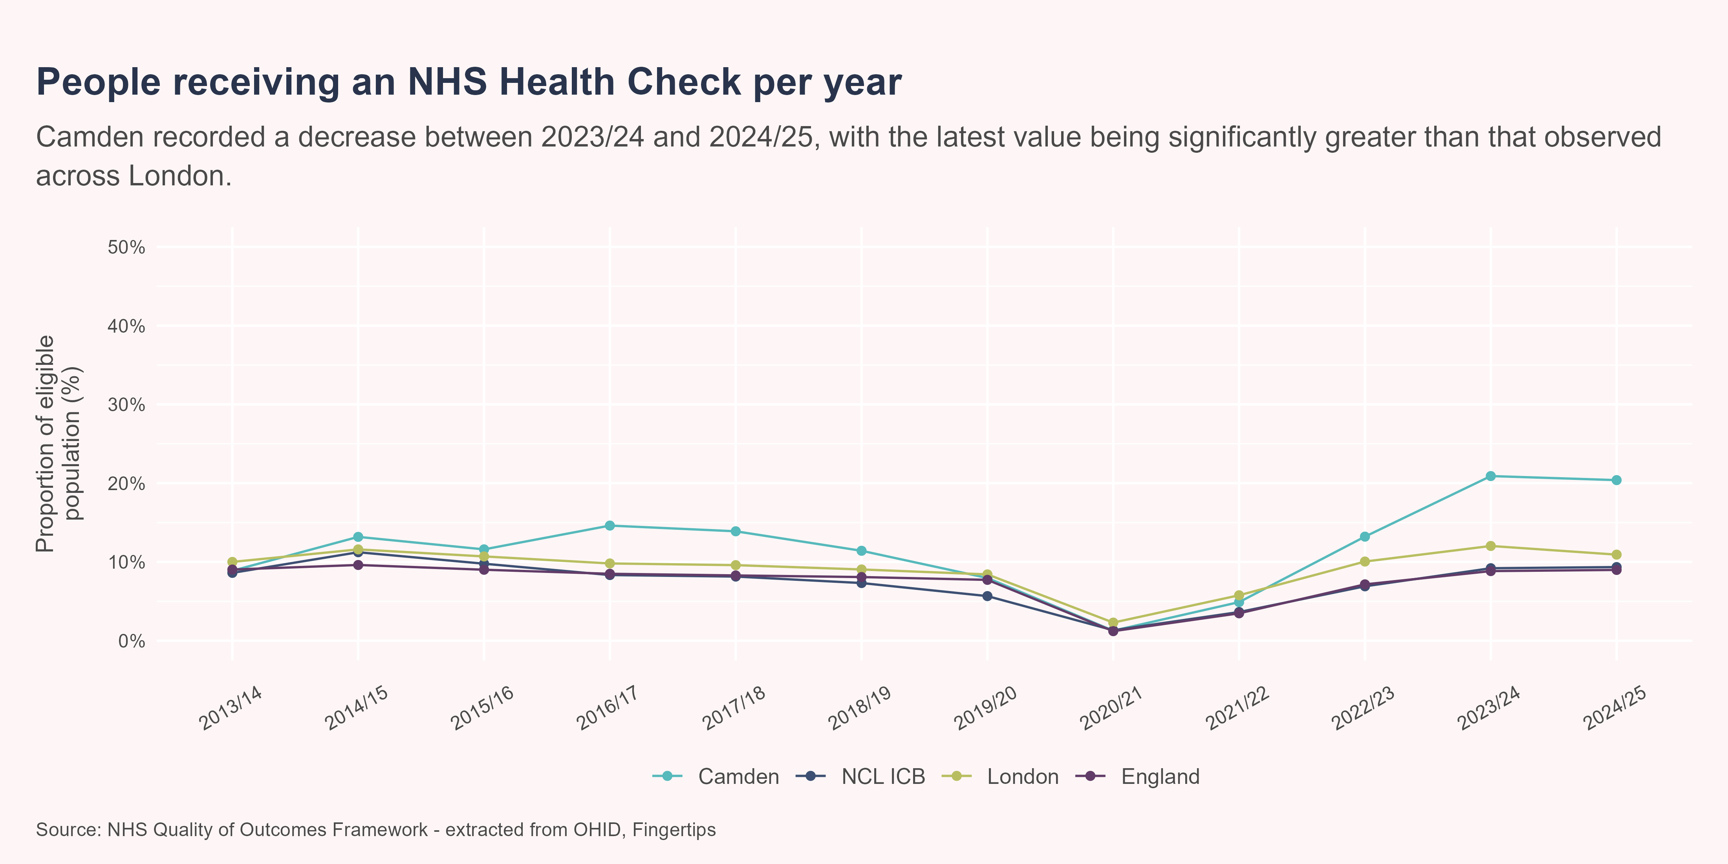
NHS Health Check - Analysis
Between 2023/24 and 2024/25, Camden experienced a decrease in the proportion of patients that have received an NHS Health Check from 20.9% to 20.4%. This was not a significant change. In 2024/25 the proportion of patients that have received an NHS Health Check in Camden was significantly greater than that observed in London, with a value of 20.4% compared to a value of 10.9%.

Slide 19
Other risk factors
There are a range of other factors that increase the risk of developing cardiovascular disease. Smoking cigarettes is well known in its aiding of the build-up in fatty material in blood vessels. The clogging of these arteries can lead to both heart attacks and strokes. By reducing the prevalence of smoking, CVD can also be reduced. In the 20 years leading up to 2015, a 35% decline in smoking prevalence was linked to 24% fewer deaths due to Coronary Heart Disease in Finland.(Keto et al. 2016) This aligns with predictions made by The Health Foundation, anticipating that the prevalence of CVD will decrease by 2040, with the primary driver behind this being a reduction in smoking.(The Health Foundation 2024)
Levels of physical activity and obesity influence the risk of CVD. The British Heart Foundation estimate that exercising can reduce the risk of CVD by 35%, along with other benefits towards mental health, weight and sleep quality. Furthermore, increasing your level of activity from relatively active to the recommended levels (150 minutes of moderate-intensity aerobic activity) can reduce mortality linked to CVD by 23%, while also reducing incidence by 17%.(Wahid et al. 2016)

Slide 20

What the data shows us

Slide 21

Hospital admissions - overview
Cardiovascular disease is a large contributor to overall hospital admissions across the country, with 100,000 admissions a year related to heart attacks.(British Heart Foundation 2025b) During 2023/24, there were a total of 2225 admissions linked to residents from the Camden borough.
The following uses Hospital Episode Statistics (HES) data and explores how admissions vary through time and across different groups of individuals. The extract includes any secondary care-based activity that requires a hospital bed for treatment.(Herbert et al. 2017)

Slide 22
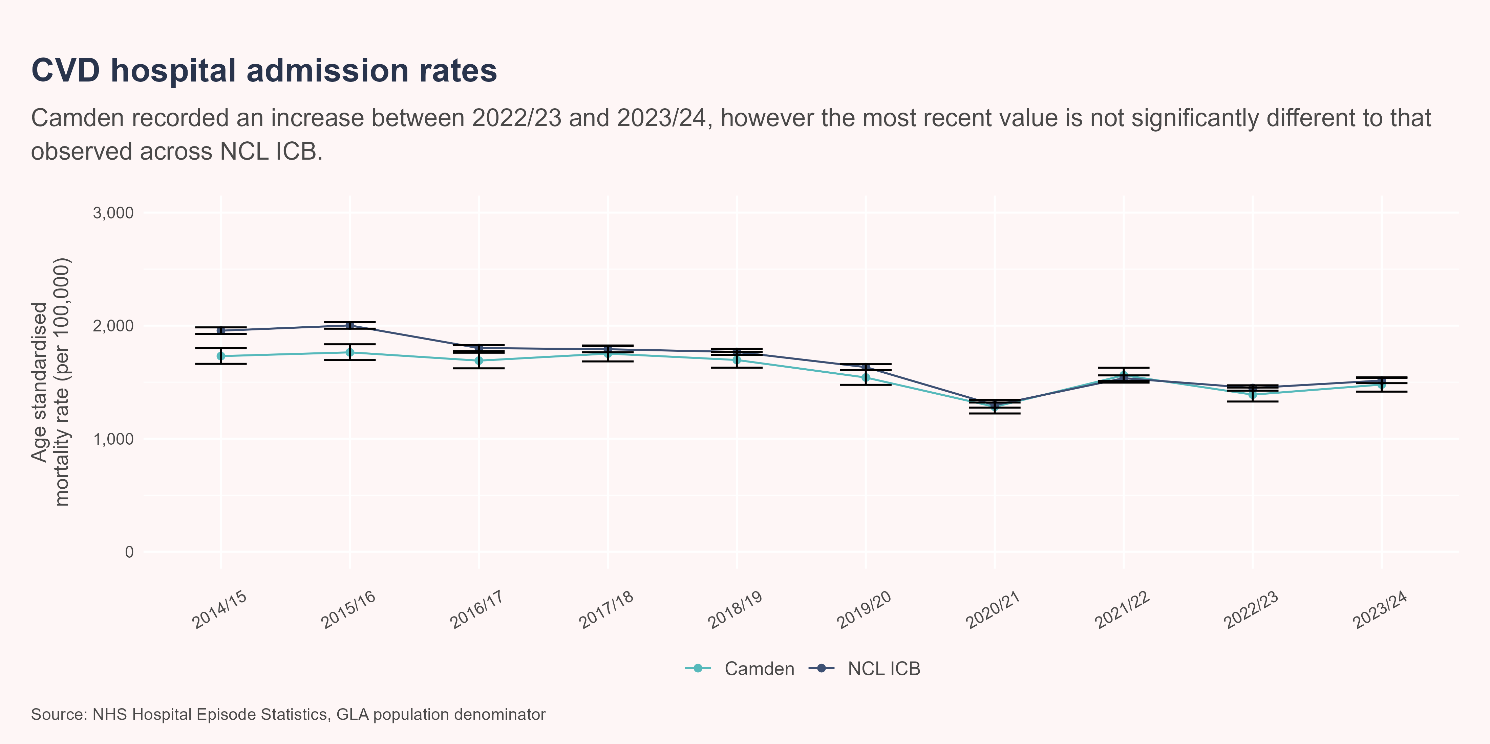
Admission rates at population level
Between 2022/23 and 2023/24, Camden experienced an increase in the rate of hospital admissions from 1389.4 per 100,000 to 1478.5 per 100,000. This was not a significant change. In 2023/24 the rate of hospital admissions in Camden was statistically similar to that observed in NCL ICB, with values of 1478.5 per 100,000 and 1514.3 per 100,000 respectively.

Slide 23
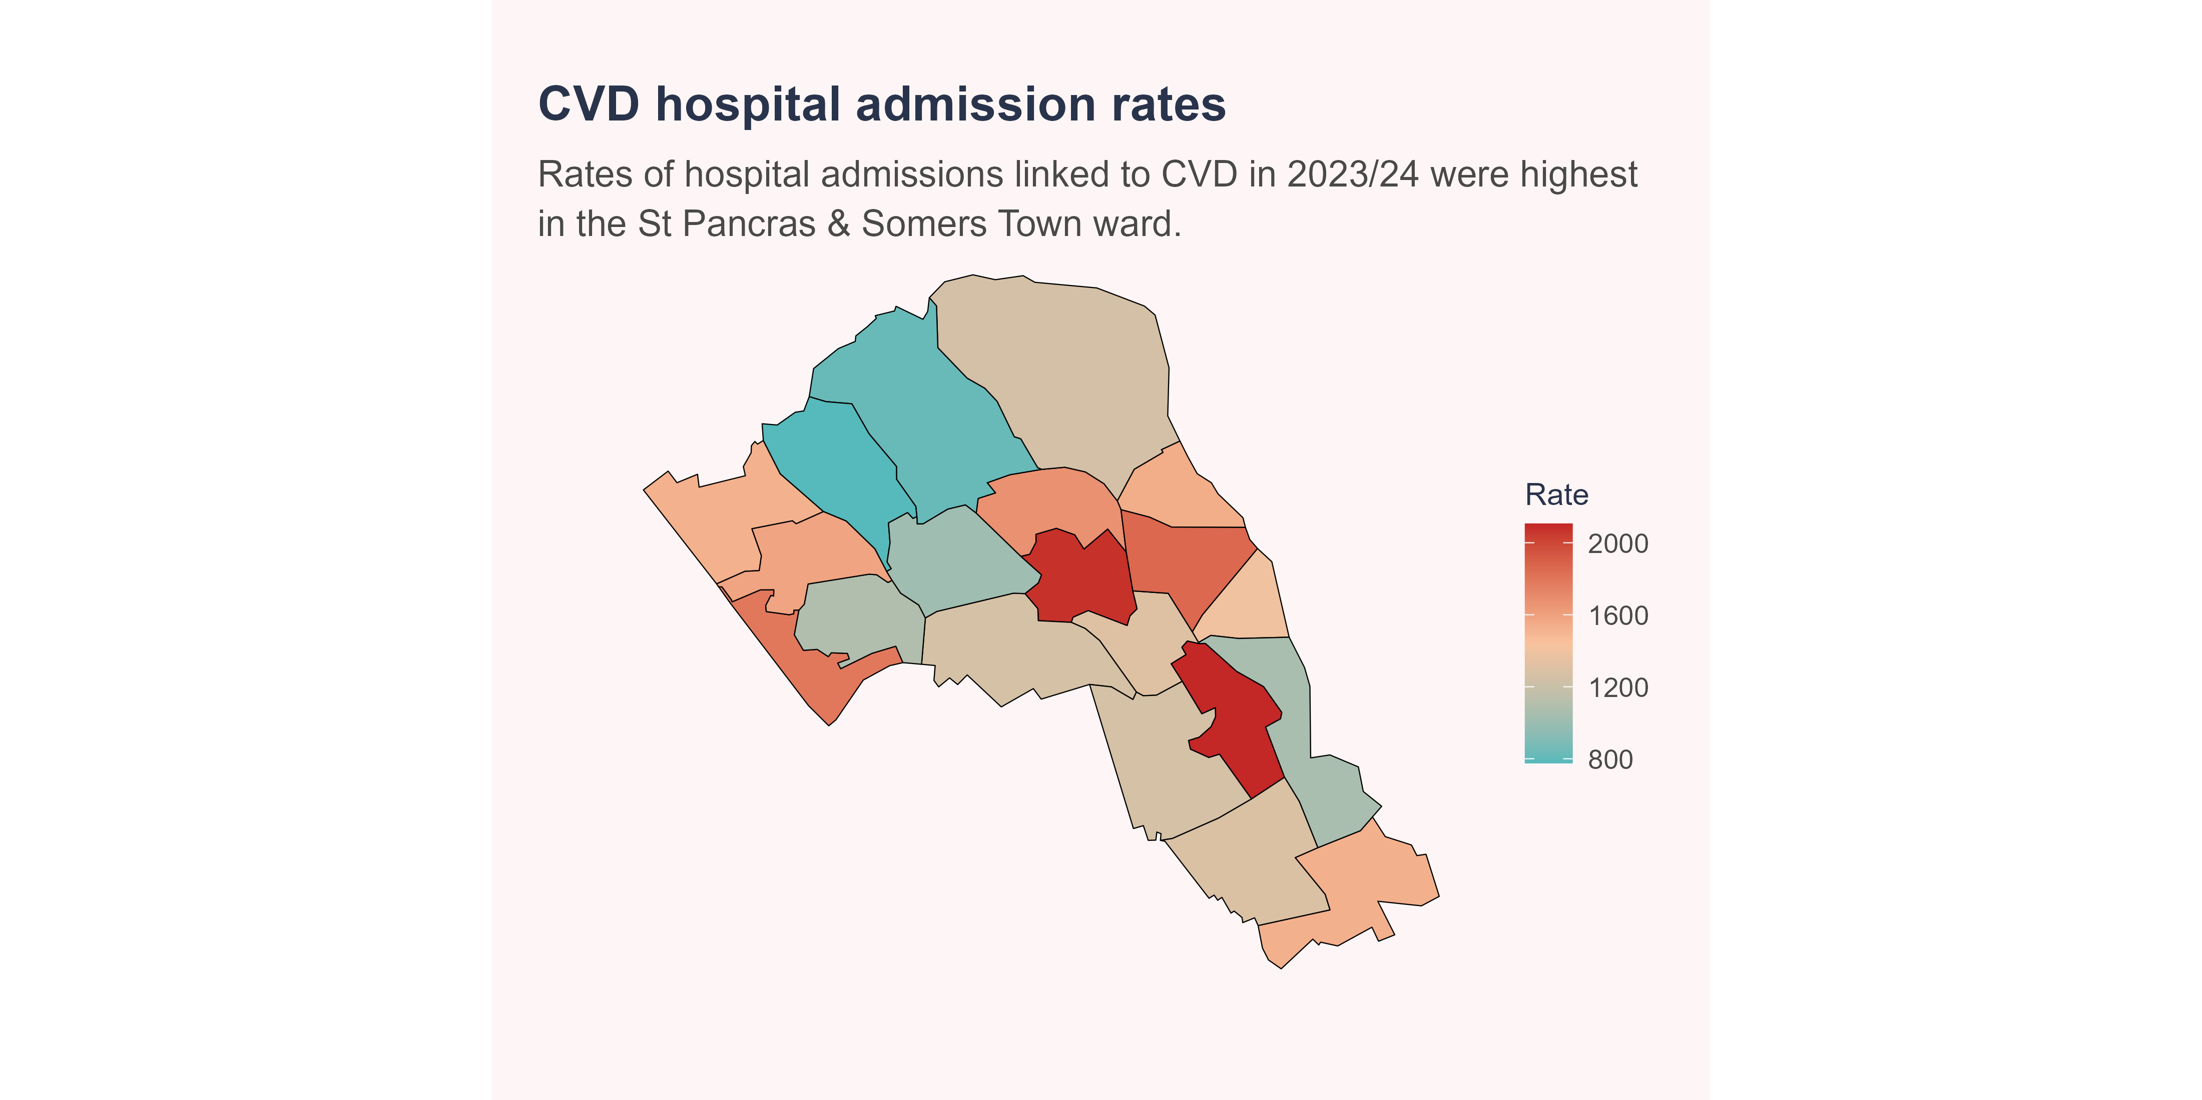
Admission rates by ward (latest year)
The following map presents admission rates observed across the wards of Camden. Hover over graph to explore admission rates in the latest year as well as proportional change experienced since the previous year. The lower the rank, the higher the percentage increase in admission rate (i.e. rank 1 indicates the highest increase in admissions rate since the previous year).

Slide 24
Ward summary
The ward with the highest hospital admissions rate in 2023/24 was St Pancras & Somers Town, with a value of 2105.2 per 100,000 population. The ward with the lowest hospital admissions rate in was Frognal, with a value of 776.28 per 100,000 population.

Slide 25
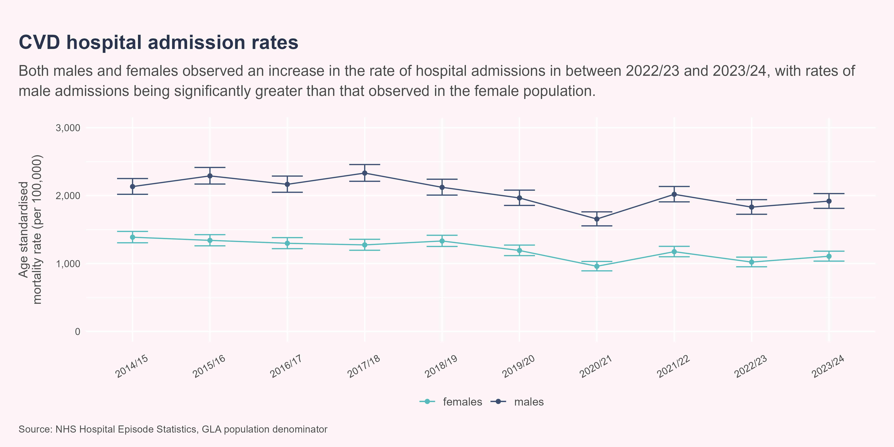
Admission rates by sex
Between 2022/23 and 2023/24, males experienced an increase in the rate of hospital admissions from 1831 per 100,000 to 1919.3 per 100,000. This was not a significant change. Females experienced an increase in the rate of hospital admissions from 1021.9 per 100,000 to 1107.2 per 100,000. This was not a significant change. In 2023/24 the rate of hospital admissions in males was significantly greater than that observed in females, with a value of 1919.3 per 100,000 compared to a value of 1107.2 per 100,000

Slide 26
Admission rates by ethnic group
The following explores how rates of hospital admissions vary by ethnic group. In the latest year of available data (2023/24), 15% of admitted patients had an unknown or not stated ethnicity. This may mean some ethnic groups are under or over-represented.
The population used to derive the following rates were obtained from the ONS, based on the 2021 Census.

Slide 27
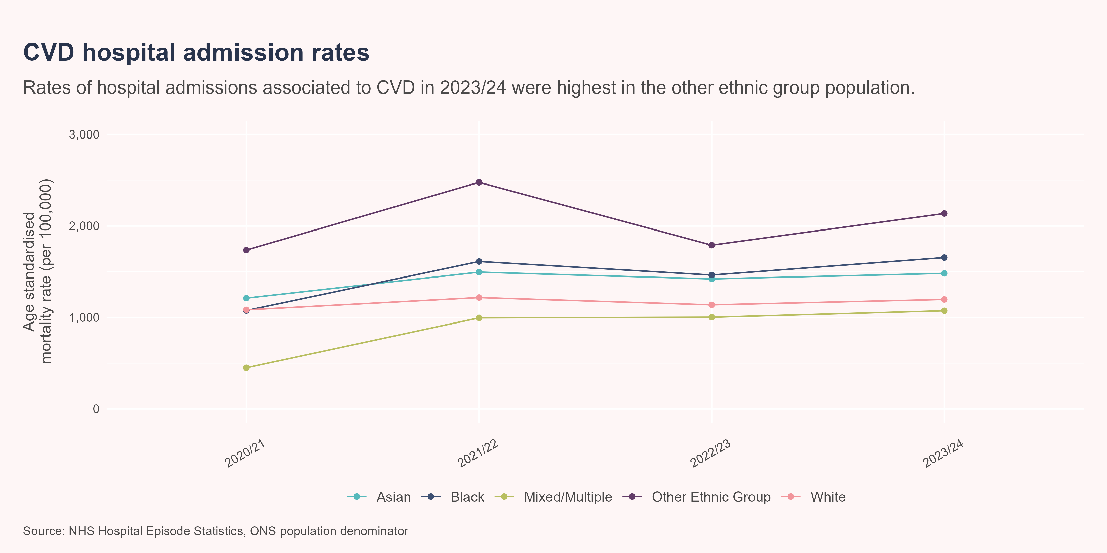
Ethnicity continued
In the latest period (2023/24), no groups included in the graph recorded hospital admission rates significantly lower than the white ethnic group. The asian ethnic group, black ethnic group and other ethnic group observed hospital admission rates that were significantly greater than the white ethnic group.

Slide 28
Admission rates by deprivation quintile
Population estimates are unavailable for the latest year of admissions data - estimates of admission rates are included on the graph and are highlighted by a dotted line. Because the population used in the calculation is that of the previous year, admission rates should be interpreted with caution. Text summaries below refer to the period 2022/23, where both admission figures and population estimates exist.

Slide 29
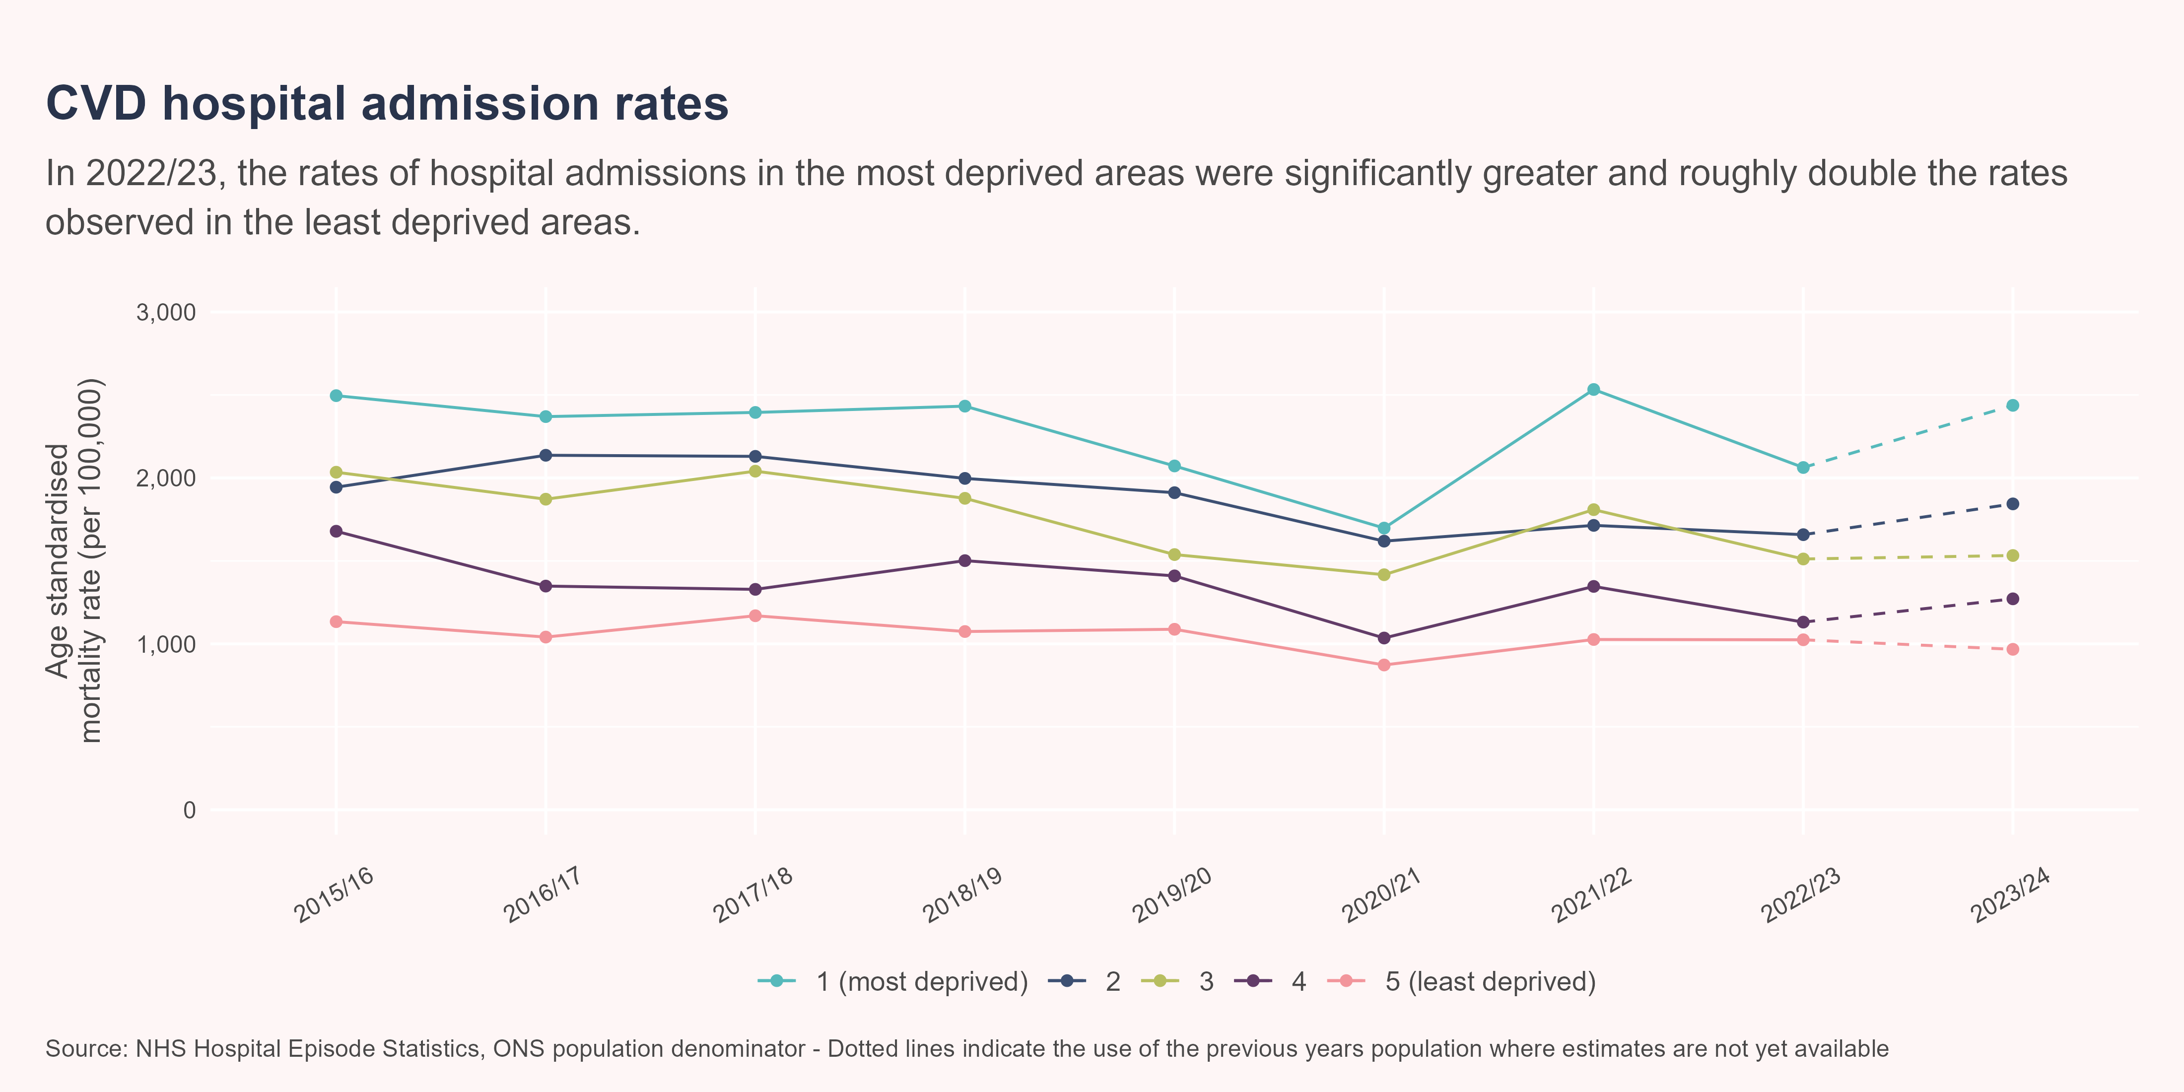
Admission rates by deprivation quintile
Between 2021/22 and 2022/23, quintile 1 (most deprived) experienced a decrease in the rate of hospital admissions from 2533 per 100,000 to 2062.8 per 100,000. This was a significant change. Quintile 5 (least deprived) experienced a decrease in the rate of hospital admissions from 1026.3 per 100,000 to 1024.6 per 100,000. This was not a significant change. In 2022/23 the rate of hospital admissions in quintile 1 (most deprived) was significantly greater than that observed in quintile 5 (least deprived), with a value of 2062.8 per 100,000 compared to a value of 1024.6 per 100,000

Slide 30
Mortality - overview
Cardiovascular disease is responsible for a large proportion of deaths across the globe. In 2021, CVD caused an estimated 20 million deaths, equating to roughly 1 out of 3 deaths globally.(British Heart Foundation 2025c)
In the UK, CVD accounts for a quarter of deaths in the under 75 age group.(Merritt 2025) The following looks at preventable cardiovascular mortality from Fingertips. The following looks at U75 mortality linked to CVD by sex.

Slide 31
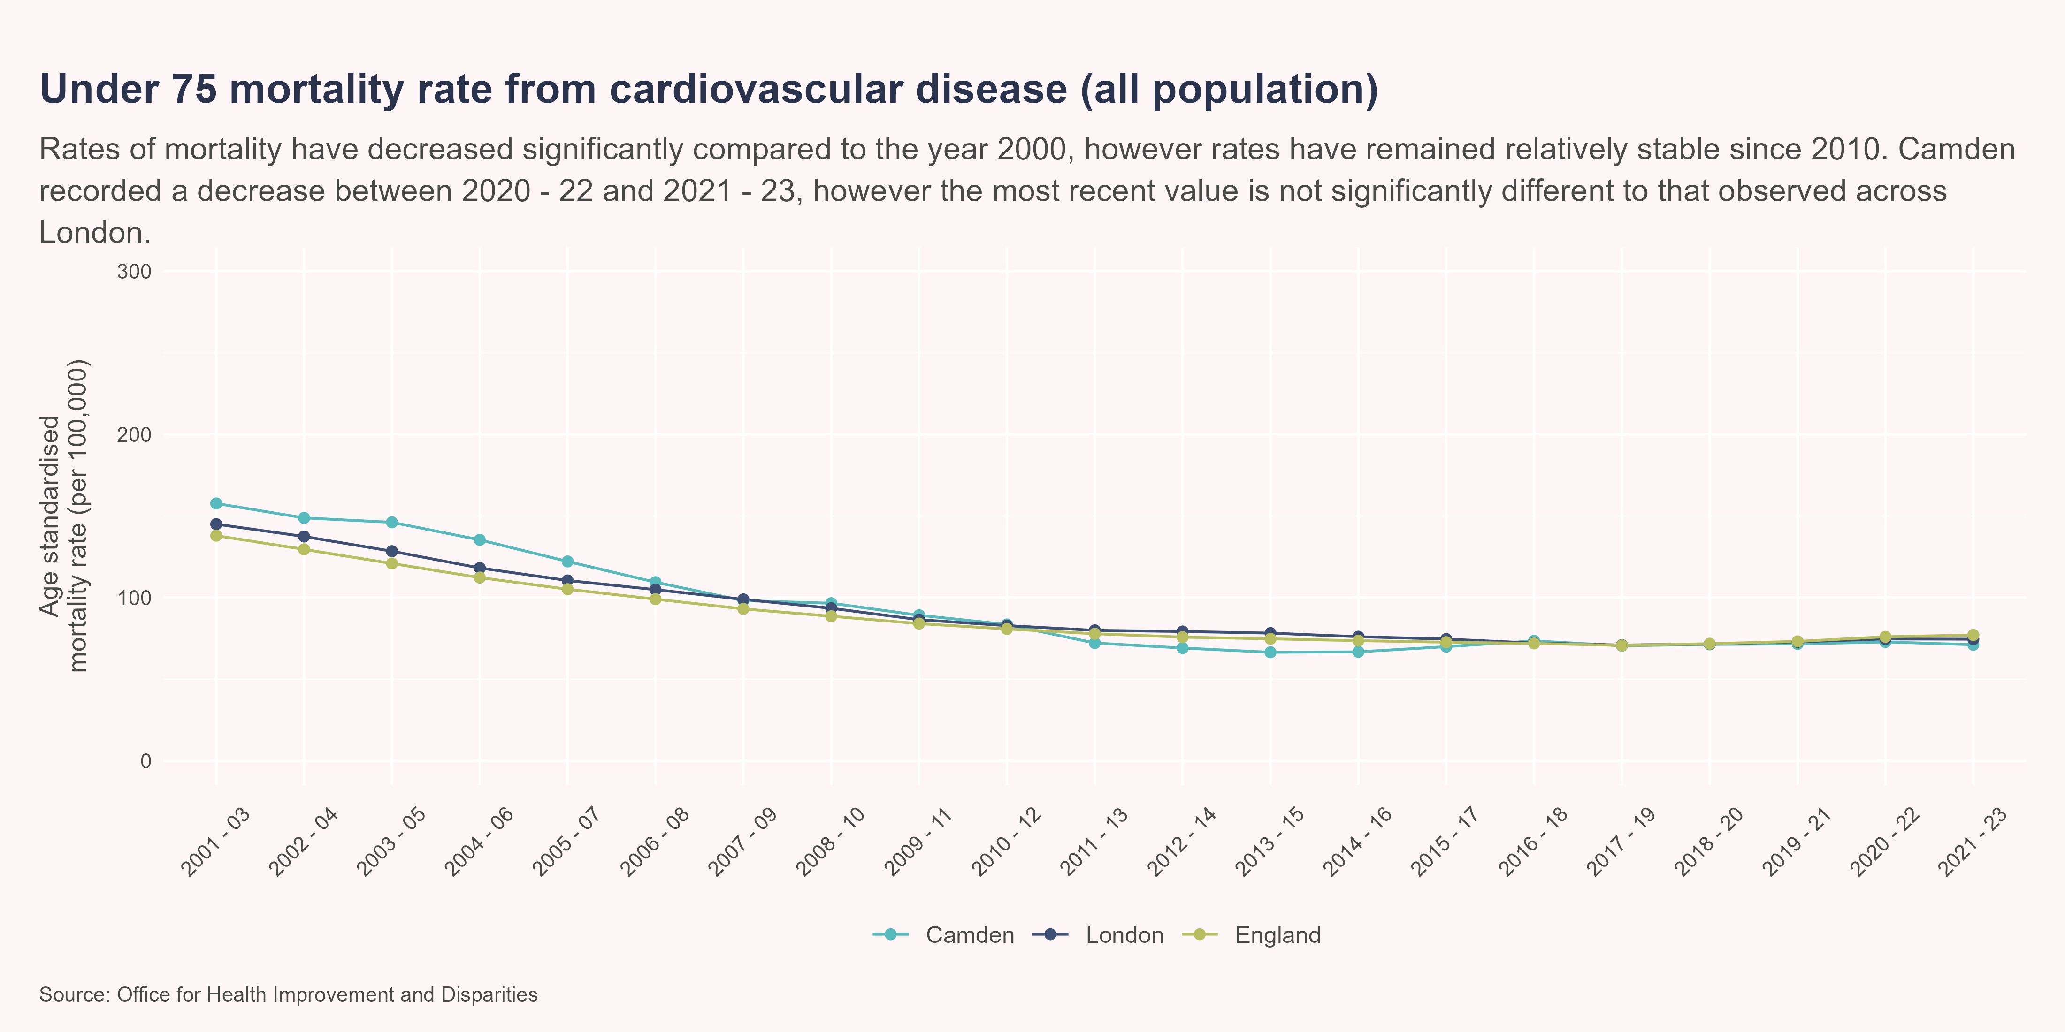
Under 75 CVD mortality - all persons
Between 2020 - 22 and 2021 - 23, Camden experienced a decrease in the under 75 CVD mortality rate (all population) from 72.8 per 100,000 to 71.1 per 100,000. This was not a significant change. In 2021 - 23 the under 75 CVD mortality rate (all population) in Camden was statistically similar to that observed in London, with values of 71.1 per 100,000 and 74.5 per 100,000 respectively.

Slide 32
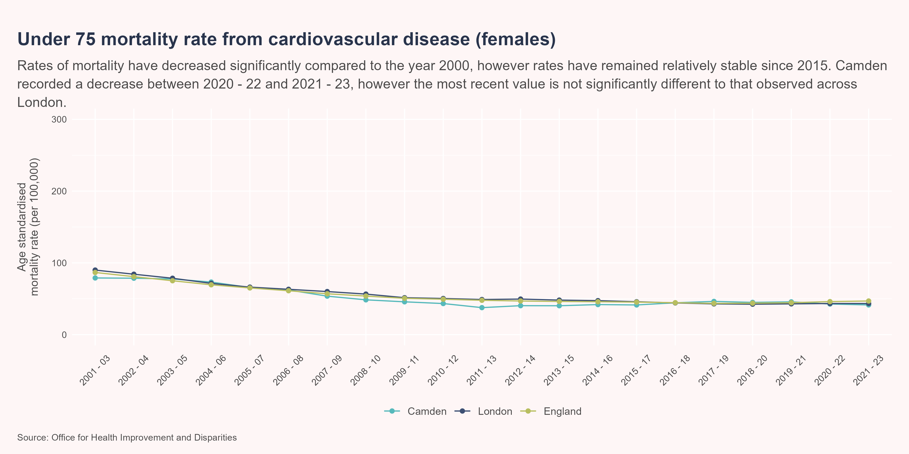
Under 75 CVD mortality - females
Between 2020 - 22 and 2021 - 23, Camden experienced a decrease in the under 75 CVD mortality rate (females) from 42.7 per 100,000 to 41.4 per 100,000. This was not a significant change. In 2021 - 23 the under 75 CVD mortality rate (females) in Camden was statistically similar to that observed in London, with values of 41.4 per 100,000 and 43.4 per 100,000 respectively.

Slide 33
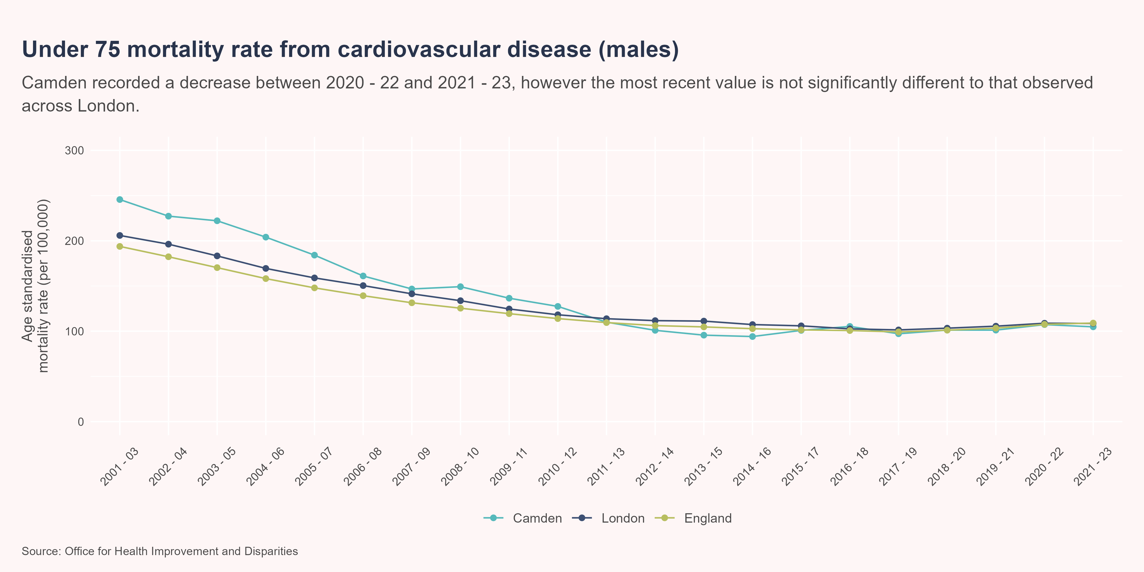
Under 75 CVD mortality - males
Between 2020 - 22 and 2021 - 23, Camden experienced a decrease in the under 75 CVD mortality rate (males) from 107 per 100,000 to 105 per 100,000. This was not a significant change. In 2021 - 23 the under 75 CVD mortality rate (males) in Camden was statistically similar to that observed in London, with values of 105 per 100,000 and 109 per 100,000 respectively.

Slide 34
Preventable mortality - overview
The following explores mortality that is linked to preventable death. A death is considered preventable if the underlying cuase, in the light of the understanding the determinants of health at the time of death, could have mainly been avoided with effective public health or primary prevention intervention. For further information in regard to the rationale behind preventable mortality, visit OHID Fingertips.

Slide 35
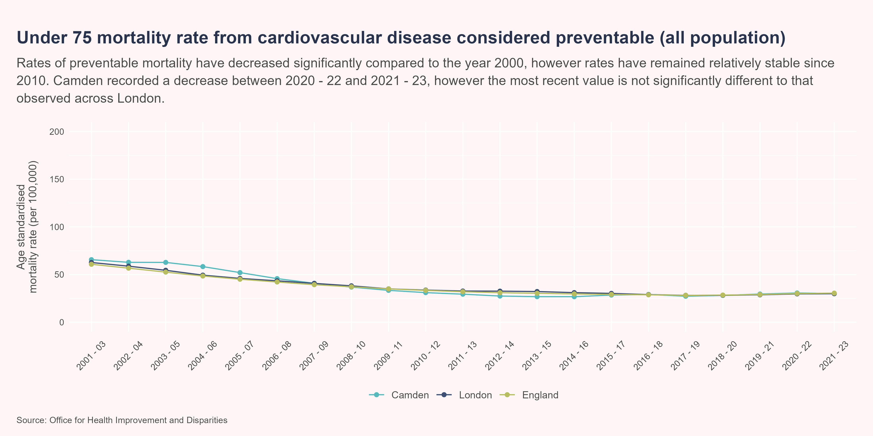
Preventable CVD mortality - all persons
Between 2020 - 22 and 2021 - 23, Camden experienced a decrease in the rate of preventable under 75 mortality from 30.7 per 100,000 to 30.1 per 100,000. This was not a significant change. In 2021 - 23 the rate of preventable under 75 mortality in Camden was statistically similar to that observed in London, with values of 30.1 per 100,000 and 29.9 per 100,000 respectively.

Slide 36
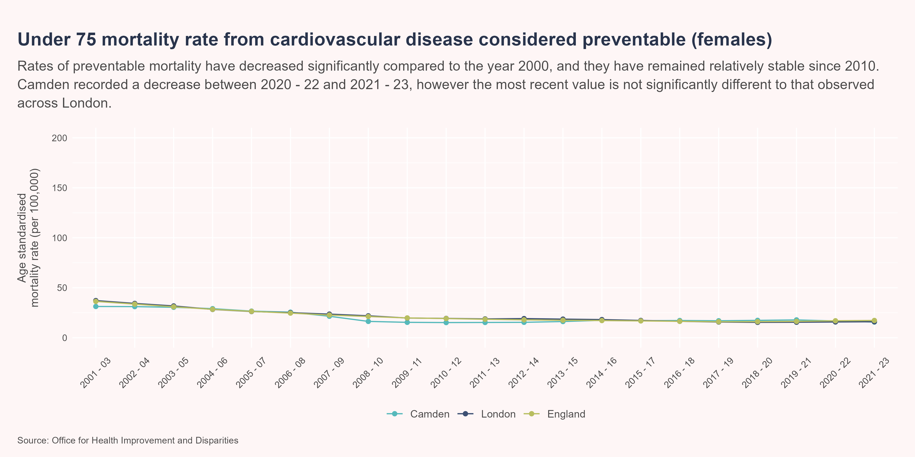
Preventable CVD mortality - females
Between 2020 - 22 and 2021 - 23, Camden experienced a decrease in the rate of preventable under 75 mortality (females) from 16.8 per 100,000 to 15.7 per 100,000. This was not a significant change. In 2021 - 23 the rate of preventable under 75 mortality (females) in Camden was statistically similar to that observed in London, with values of 15.7 per 100,000 and 16 per 100,000 respectively.

Slide 37
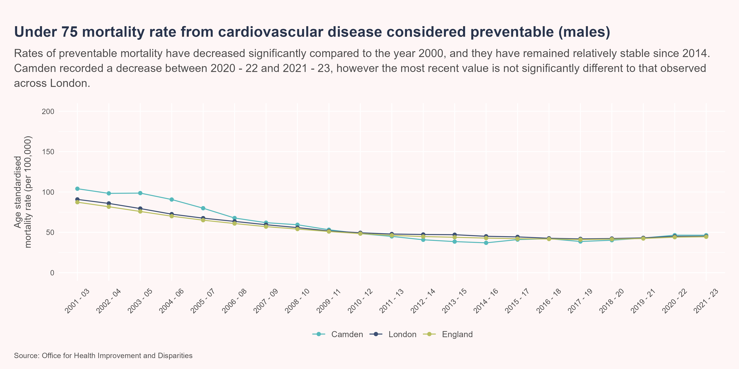
Preventable CVD mortality - males
Between 2020 - 22 and 2021 - 23, Camden experienced a decrease in the rate of preventable under 75 mortality (males) from 46.5 per 100,000 to 46.4 per 100,000. This was not a significant change. In 2021 - 23 the rate of preventable under 75 mortality (males) in Camden was statistically similar to that observed in London, with values of 46.4 per 100,000 and 45.1 per 100,000 respectively.

Slide 38
Cardiovascular disease and SMI
Individuals who have severe mental illness (SMI) are twice as likely to smoke as the general population, and have a higher risk of obesity, diabetes and cardiovascular disease. Among those aged under 75 years, individuals who are in contact with mental services have death rate that is 3.3 times higher than the general population.(Public Health England 2018)

Slide 39
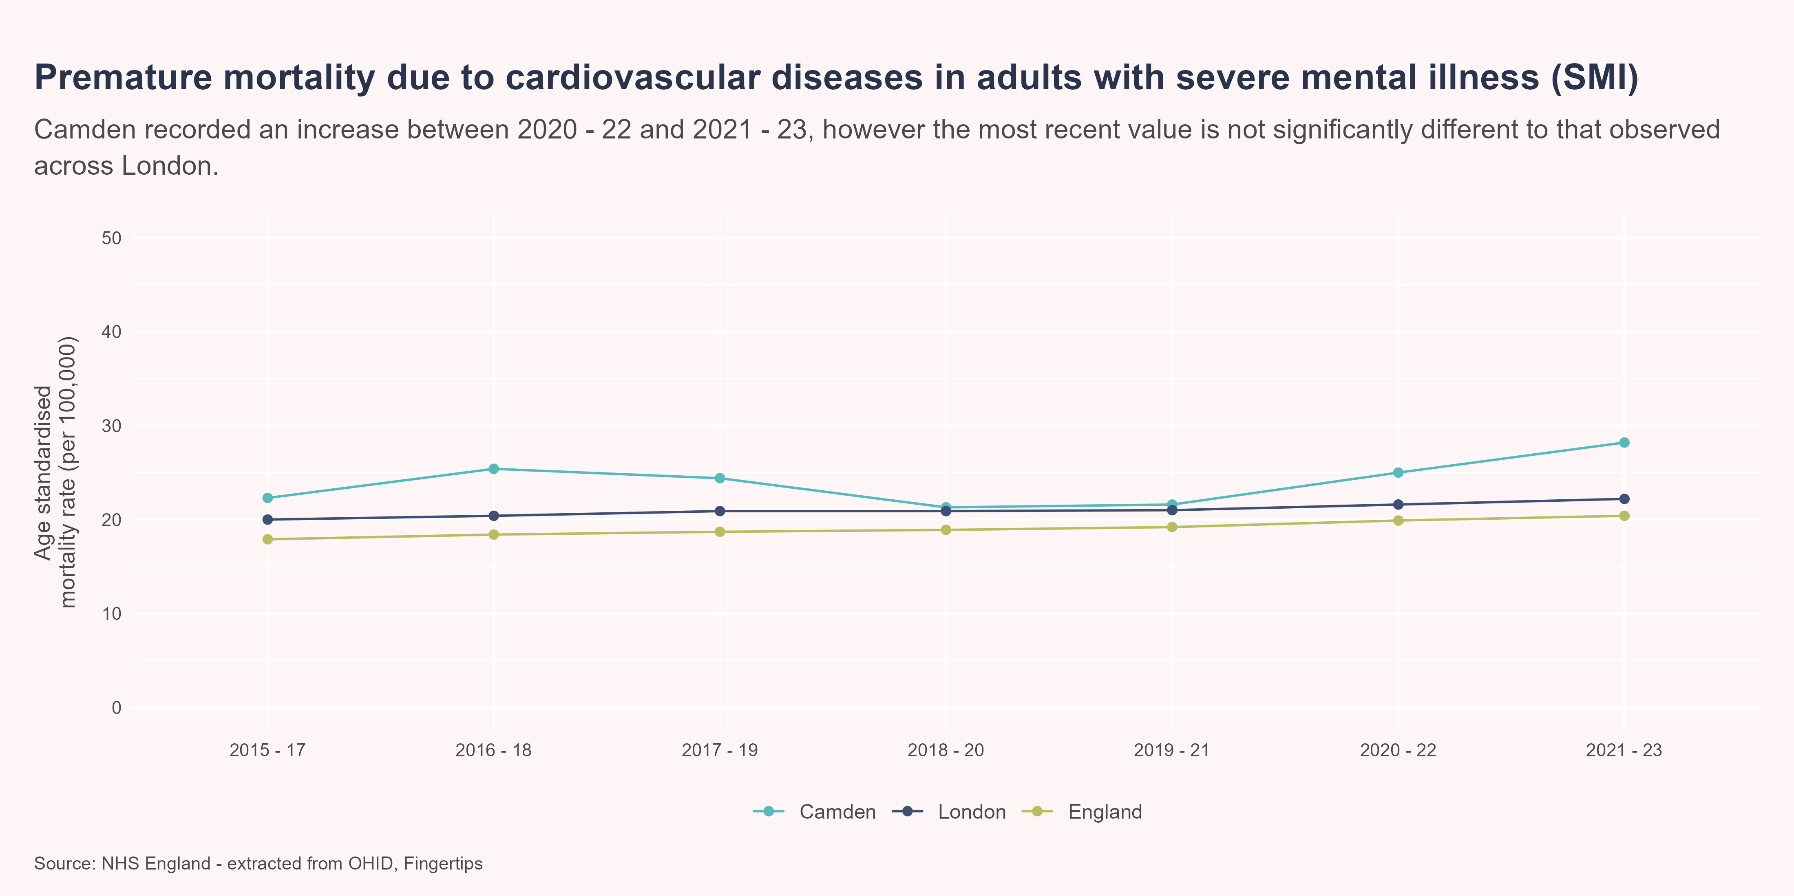
Cardiovascualr disease and SMI continued
Between 2020 - 22 and 2021 - 23, Camden experienced an increase in the rate of premature mortality in adults with SMI from 25 per 100,000 to 28.2 per 100,000. This was not a significant change. In 2021 - 23 the rate of premature mortality in adults with SMI in Camden was statistically similar to that observed in London, with values of 28.2 per 100,000 and 22.2 per 100,000 respectively. In 2021 - 23 the rate of premature mortality in adults with SMI in Camden was significantly greater than that observed in England, with a value of 28.2 per 100,000 compared to a value of 20.4 per 100,000.

Slide 40
Coronary heart disease
Coronary heart disease is often referred to as ischaemic heart disease (IHD). Coronary heart disease occurs when the coronary arteries become narrowed due to fatty deposits within their walls. This prevents blood from being pumped to the heart. The British Heart Foundation estimates that around 2.3 million people live with CHD in the UK.(British Heart Foundation 2025b)

Slide 41
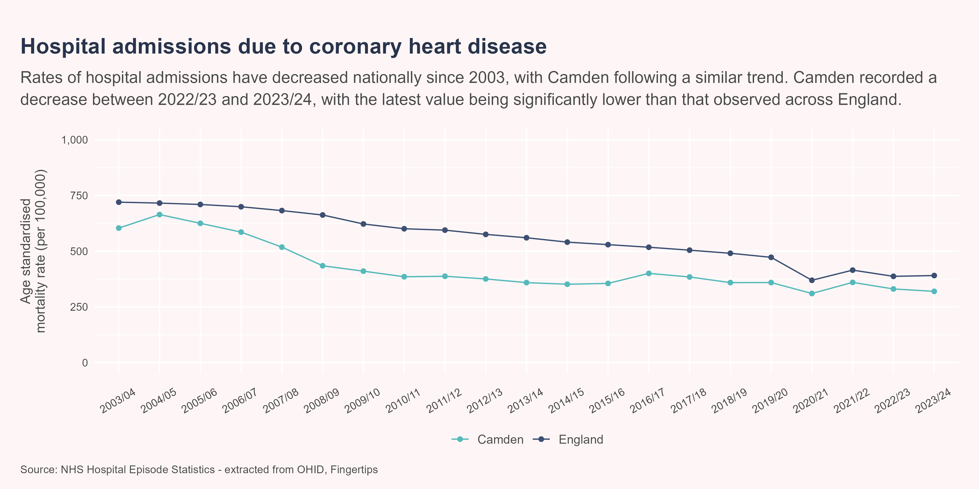
Coronary heart disease admissions
Between 2022/23 and 2023/24, Camden experienced a decrease in the IHD admission rate (all population) from 330 per 100,000 to 320 per 100,000. This was not a significant change. In 2023/24 the IHD admission rate (all population) in Camden was significantly less than that observed in England, with a value of 320 per 100,000 compared to a value of 391 per 100,000.

Slide 42
Coronary heart disease mortality
The following sections outlines mortality due to IHD by sex. Across the UK, around 66,000 individuals die due to IHD a year, with it being largest contributor to deaths in the male population group.(British Heart Foundation 2025b)

Slide 43
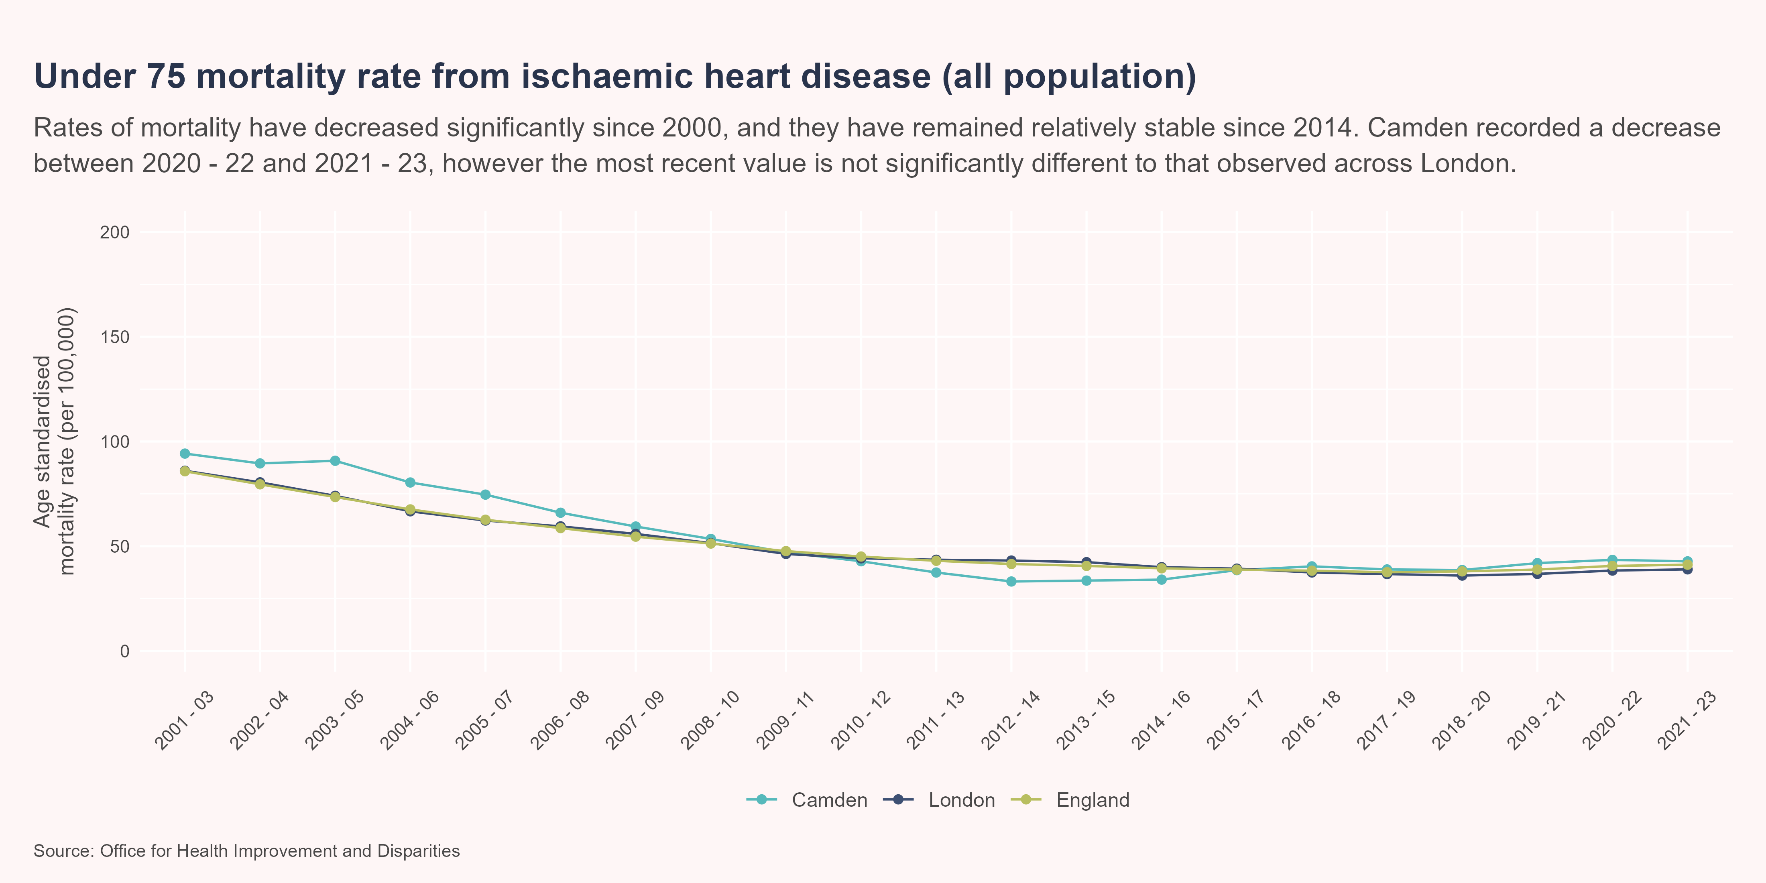
Under 75 IHD mortality - all persons
Between 2020 - 22 and 2021 - 23, Camden experienced a decrease in the under 75 IHD mortality rate (all population) from 43.5 per 100,000 to 42.8 per 100,000. This was not a significant change. In 2021 - 23 the under 75 IHD mortality rate (all population) in Camden was statistically similar to that observed in London, with values of 42.8 per 100,000 and 38.9 per 100,000 respectively.

Slide 44
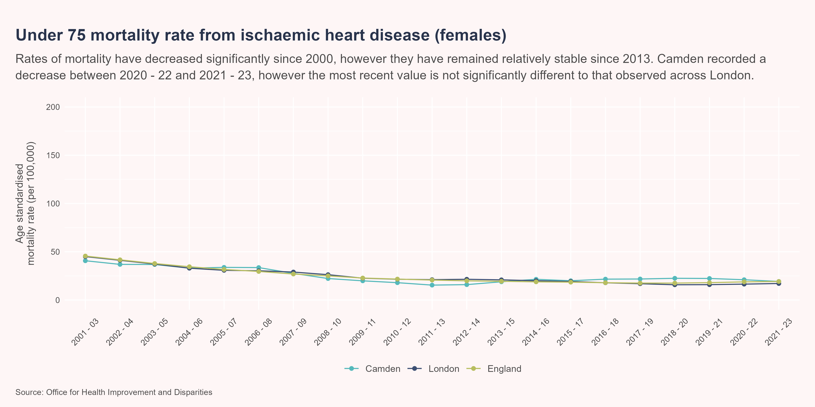
Under 75 IHD mortality - females
Between 2020 - 22 and 2021 - 23, Camden experienced a decrease in the under 75 IHD mortality rate (females) from 21 per 100,000 to 19.2 per 100,000. This was not a significant change. In 2021 - 23 the under 75 IHD mortality rate (females) in Camden was statistically similar to that observed in London, with values of 19.2 per 100,000 and 17.1 per 100,000 respectively.

Slide 45
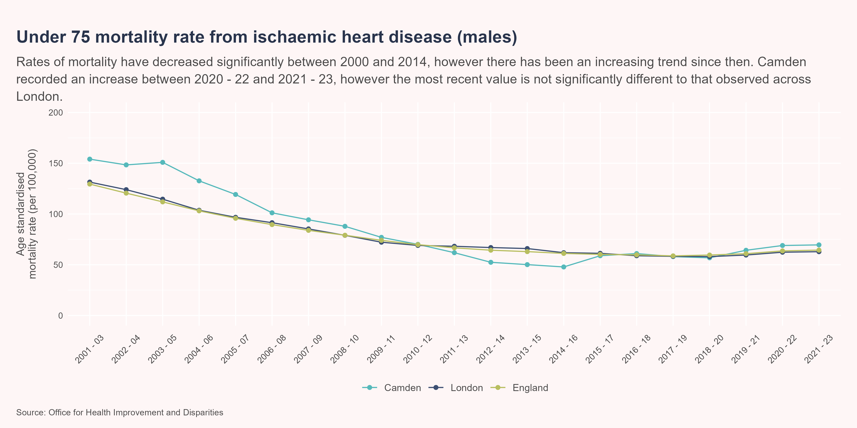
Under 75 IHD mortality - males
Between 2020 - 22 and 2021 - 23, Camden experienced an increase in the under 75 IHD mortality rate (males) from 69 per 100,000 to 69.6 per 100,000. This was not a significant change. In 2021 - 23 the under 75 IHD mortality rate (males) in Camden was statistically similar to that observed in London, with values of 69.6 per 100,000 and 62.9 per 100,000 respectively.

Slide 46
Atrial Fibrillation
Atrial Fibrillation (AF) is a form of arrhythmia, which is a problem that leads to an inconsistent or irregular heartbeat. The random nature of the heartbeat means blood may not be pumped around the body as effectively as it could be. AF is commonly associated with high blood pressure, heart valve disease, diabetes and obesity.
The prevalence of AF has increased nationally over the previous two decades.(British Heart Foundation 2025c) This is primarily down to increased diagnosis and improved survival of those with heart disease. The compounded nature of these risk factors increase the chances of heart disease, heart failure and strokes.

Slide 47
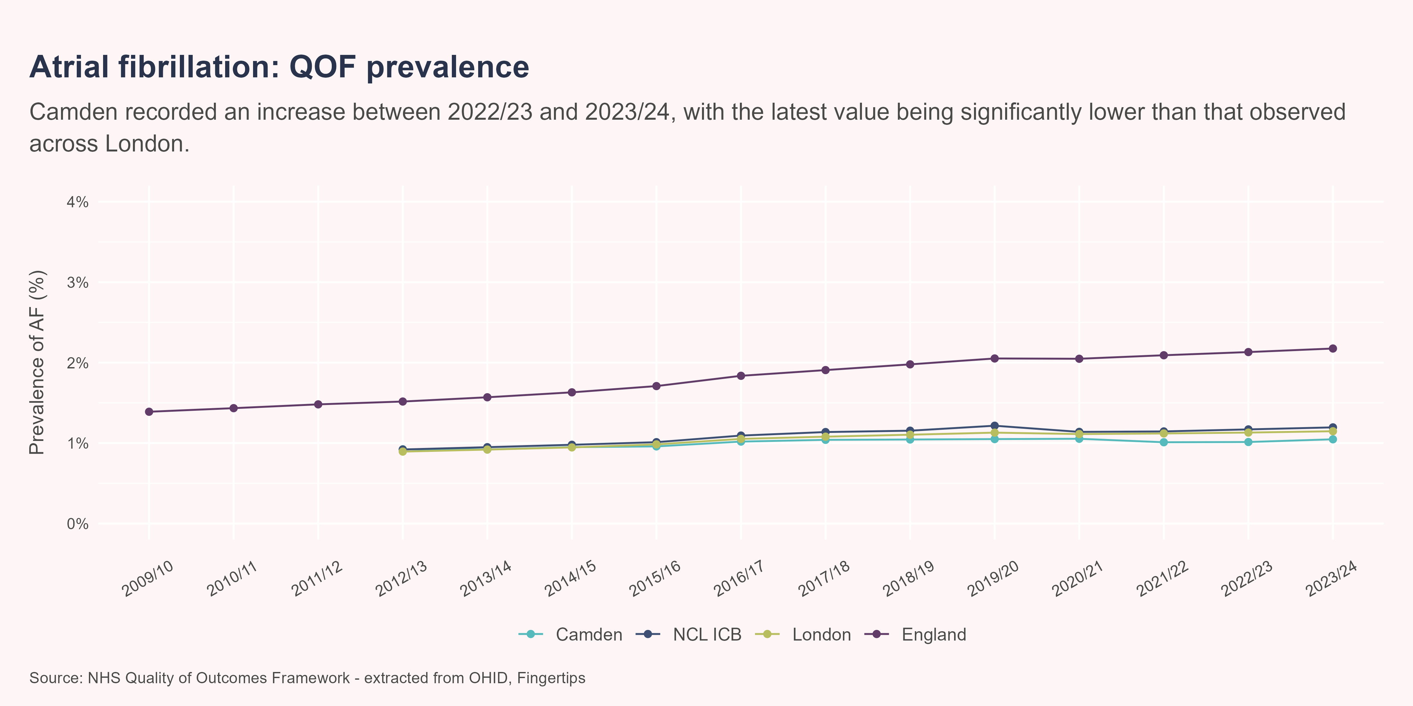
Atrial Fibrilliation
Between 2022/23 and 2023/24, Camden experienced an increase in the prevalence of AF from 1.01% to 1.05%. This was not a significant change. In 2023/24 the prevalence of AF in Camden was significantly less than that observed in London, with a value of 1.05% compared to a value of 1.15%.

Slide 48
Peripheral arterial disease (PAD)
Peripheral arterial disease (PAD) occurs when fat deposits accumulate in an individuals peripheral arteries, as opposed to the those around the heart (coronary heart disease). According to the British Heart Foundation, PAD affects roughly 1 in 5 individuals above the age of 60 in the UK.(British Heart Foundation 2014) Smoking, physical activity and hypertension are all common risk factors, and PAD itself can increase the likelihood of heart disease and stroke.
The following outlines those patients with peripheral arterial disease as recorded on practice disease registers, as per recorded on the Quality and Outcomes Framework. To note, the values for Camden have been derived by aggregating the list size and register sizes from GP’s within a Camden PCN.

Slide 49
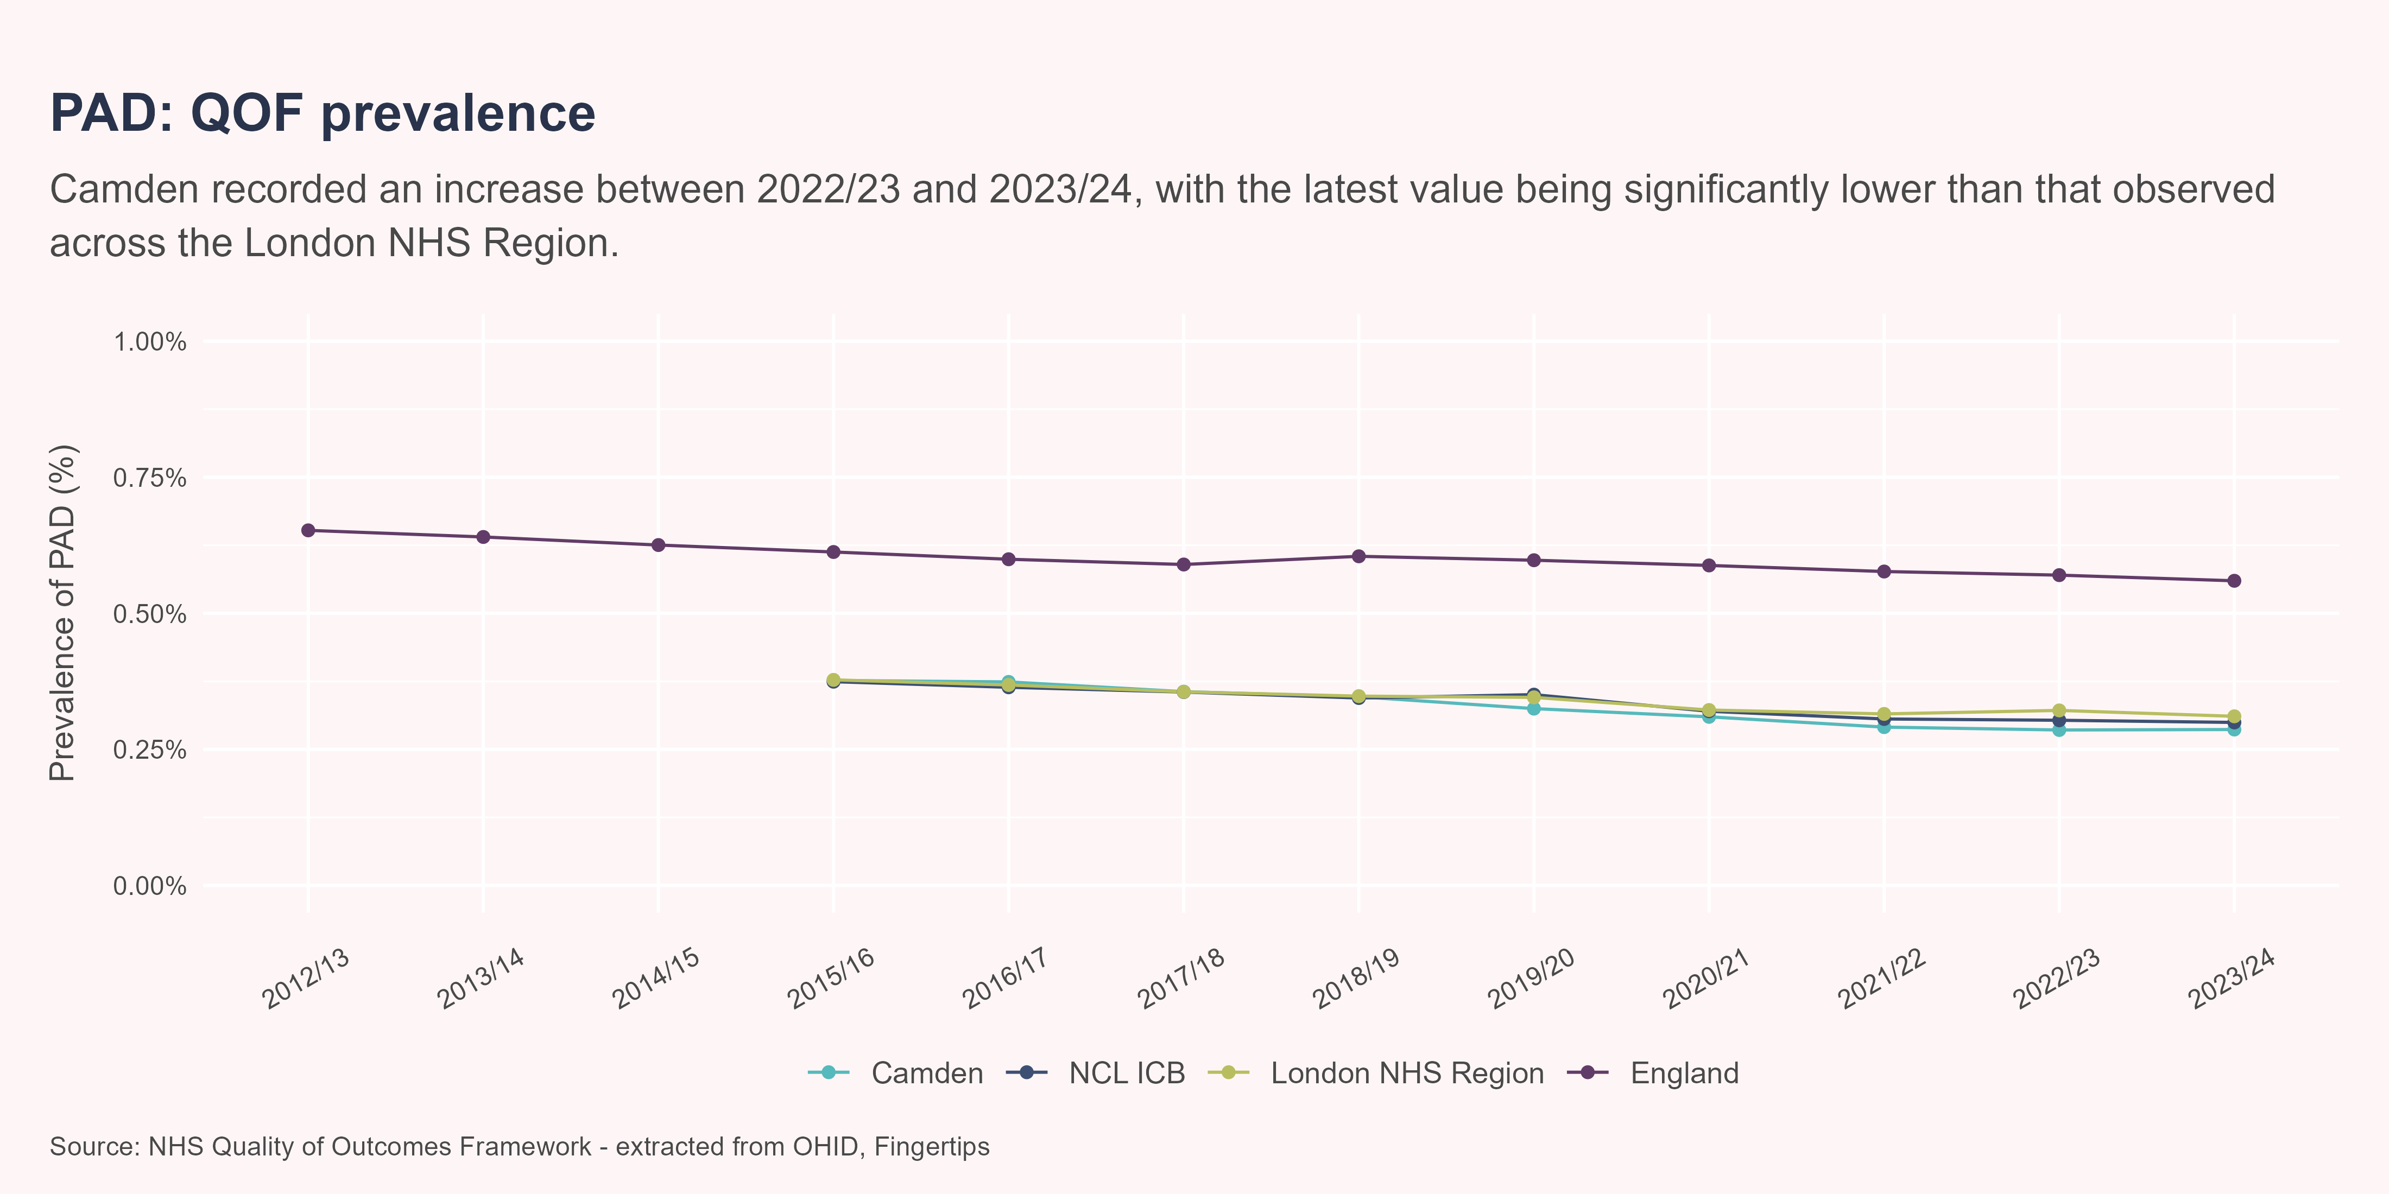
PAD
Between 2022/23 and 2023/24, Camden experienced an increase in the prevalence of PAD from 0.286% to 0.286%. This was not a significant change. In 2023/24 the prevalence of PAD in Camden was significantly less than that observed in London NHS Region, with a value of 0.286% compared to a value of 0.311%.

Slide 50
Heart failure
Heart failure is a broad term which describes the hearts inability to effectively pump blood around the body. Heart failure means oxygenated blood is not getting to the muscles and organs that need it, which can cause fatigue, shortness of breath and the feeling of being lightheaded. Heart failure can be caused by prolonged hypertension, cardiomyopathy and a heart attack.(British Heart Foundation 2022)

Slide 51
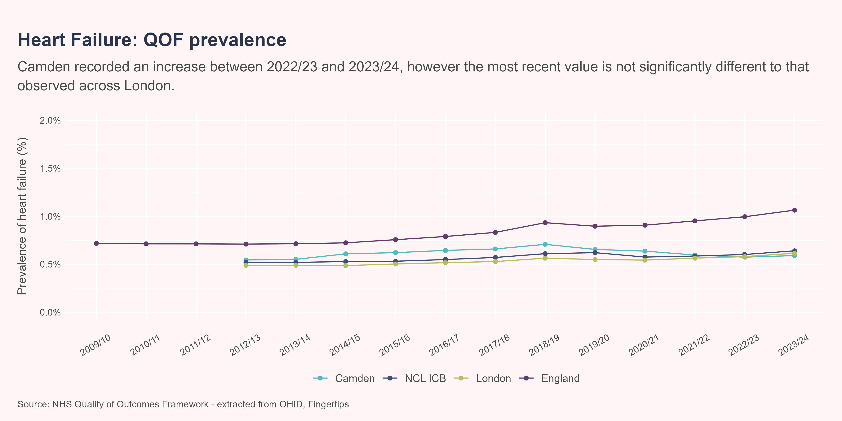
Heart failure prevalence
Between 2022/23 and 2023/24, Camden experienced an increase in the prevalence of heart failure from 0.574% to 0.59%. This was not a significant change. In 2023/24 the prevalence of heart failure in Camden was statistically similar to that observed in London, with values of 0.59% and 0.615% respectively.

Slide 52
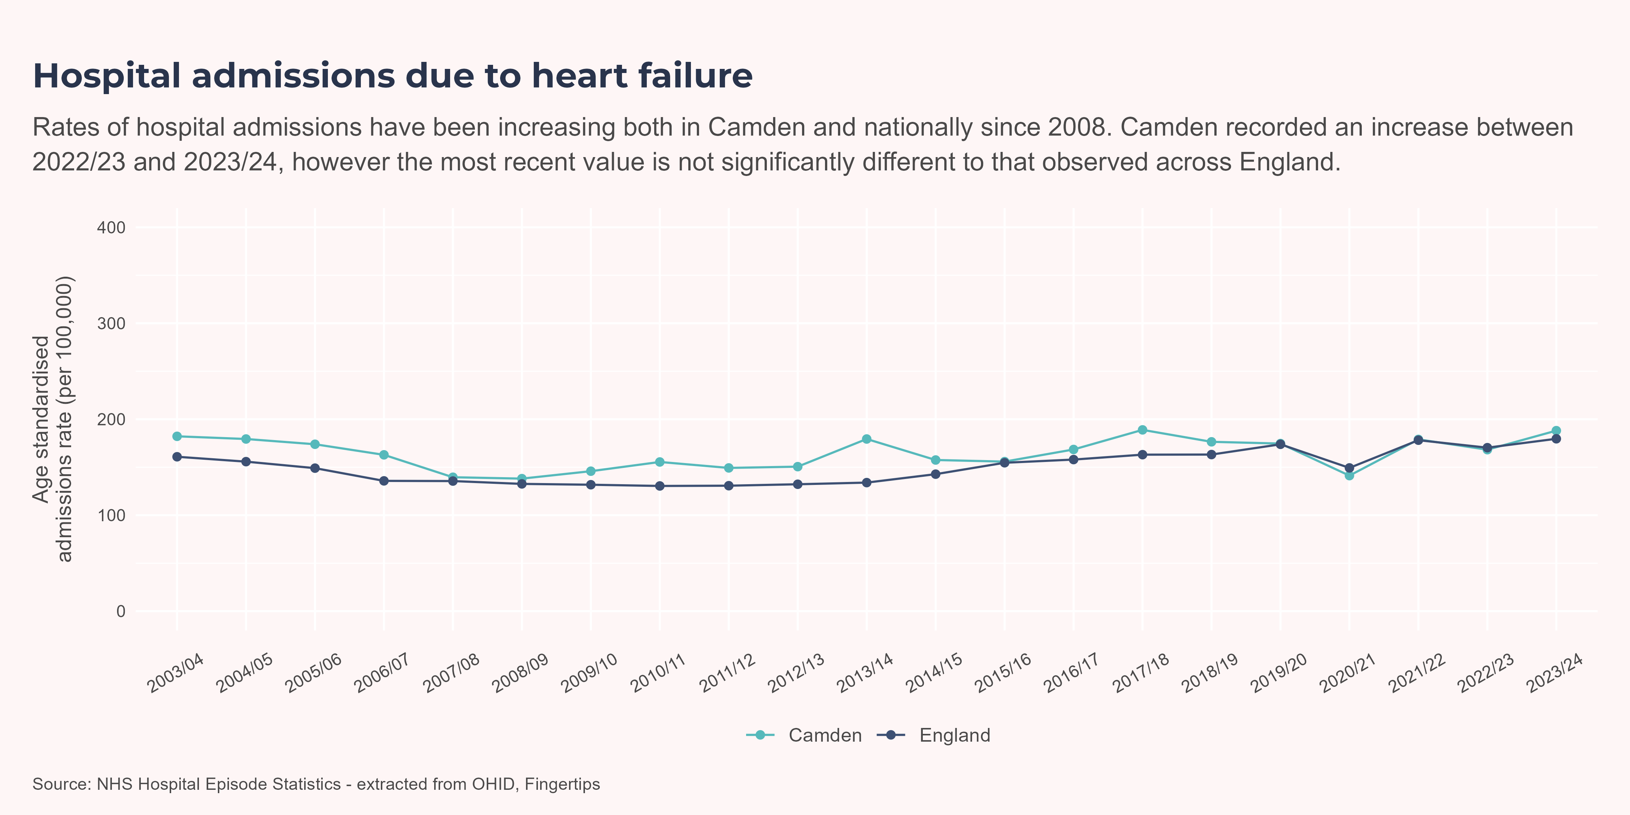
Heart failure admissions
Between 2022/23 and 2023/24, Camden experienced an increase in the heart failure admission rate (all population) from 168 per 100,000 to 188 per 100,000. This was not a significant change. In 2023/24 the heart failure admission rate (all population) in Camden was statistically similar to that observed in England, with values of 188 per 100,000 and 180 per 100,000 respectively.

Slide 53
Stroke / TIA
A stroke or a transient ischaemic attacks (TIA) occurs when there is a short or prolonged interruption of blood flow into the brain through an artery. When this happens, damage to brain cells occur due to a lack of oxygenated blood and other important nutrients.(British Heart Foundation 2024) Strokes can have a significant impact on the long term health of an individual and are the single largest cause of severe disability in the UK.(Brain Research UK n.d.) Risk factors associated with strokes include levels of physical activity, diet and smoking status. Those with diabetes are twice as likely to have a stroke.

Slide 54
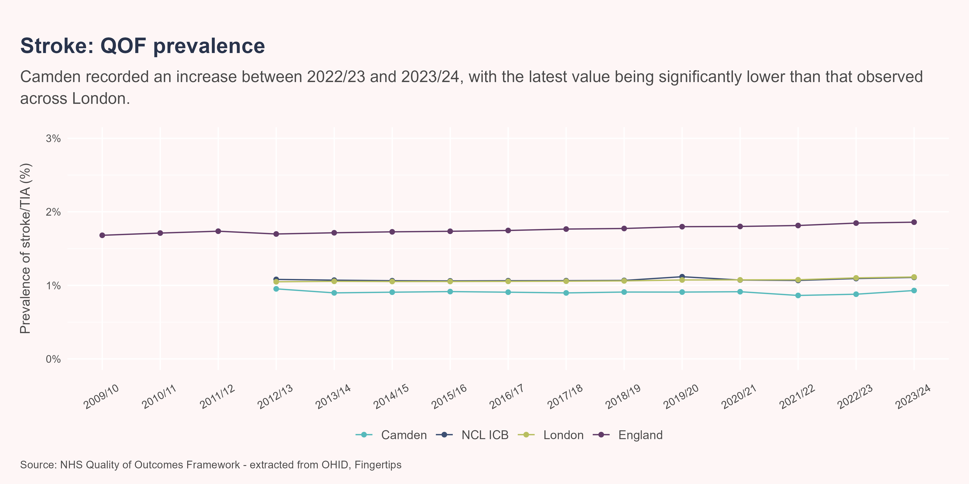
Stroke/TIA prevalence
Between 2022/23 and 2023/24, Camden experienced an increase in the prevalence of strokes/TIA’s from 0.88% to 0.93%. This was not a significant change. In 2023/24 the prevalence of strokes/TIA’s in Camden was significantly less than that observed in London, with a value of 0.93% compared to a value of 1.11%.

Slide 55
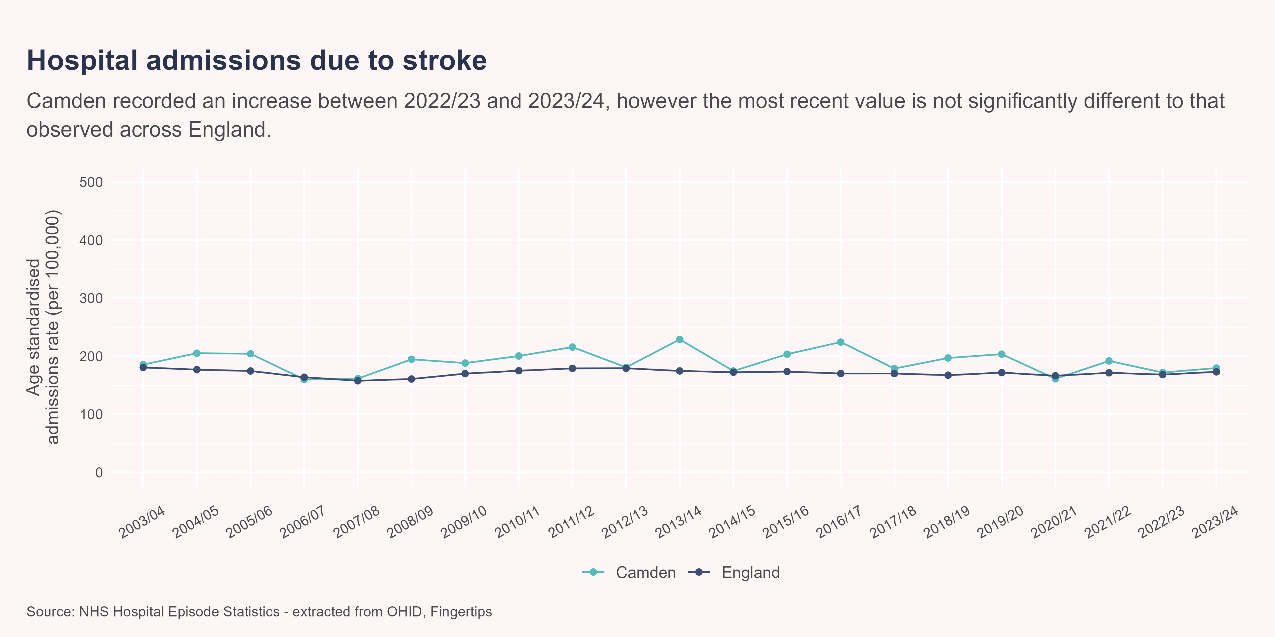
Stroke admissions
Between 2022/23 and 2023/24, Camden experienced an increase in the stroke admission rate (all population) from 172 per 100,000 to 180 per 100,000. This was not a significant change. In 2023/24 the stroke admission rate (all population) in Camden was statistically similar to that observed in England, with values of 180 per 100,000 and 173 per 100,000 respectively.

Slide 56
Mortality linked to stroke
Strokes can be severe and they cause 34,000 deaths a year in the UK.(British Heart Foundation n.d.) Although still a large contributor, mortality from strokes have decreased since the start of the century due to better identification of symptoms and treatment methods.

Slide 57
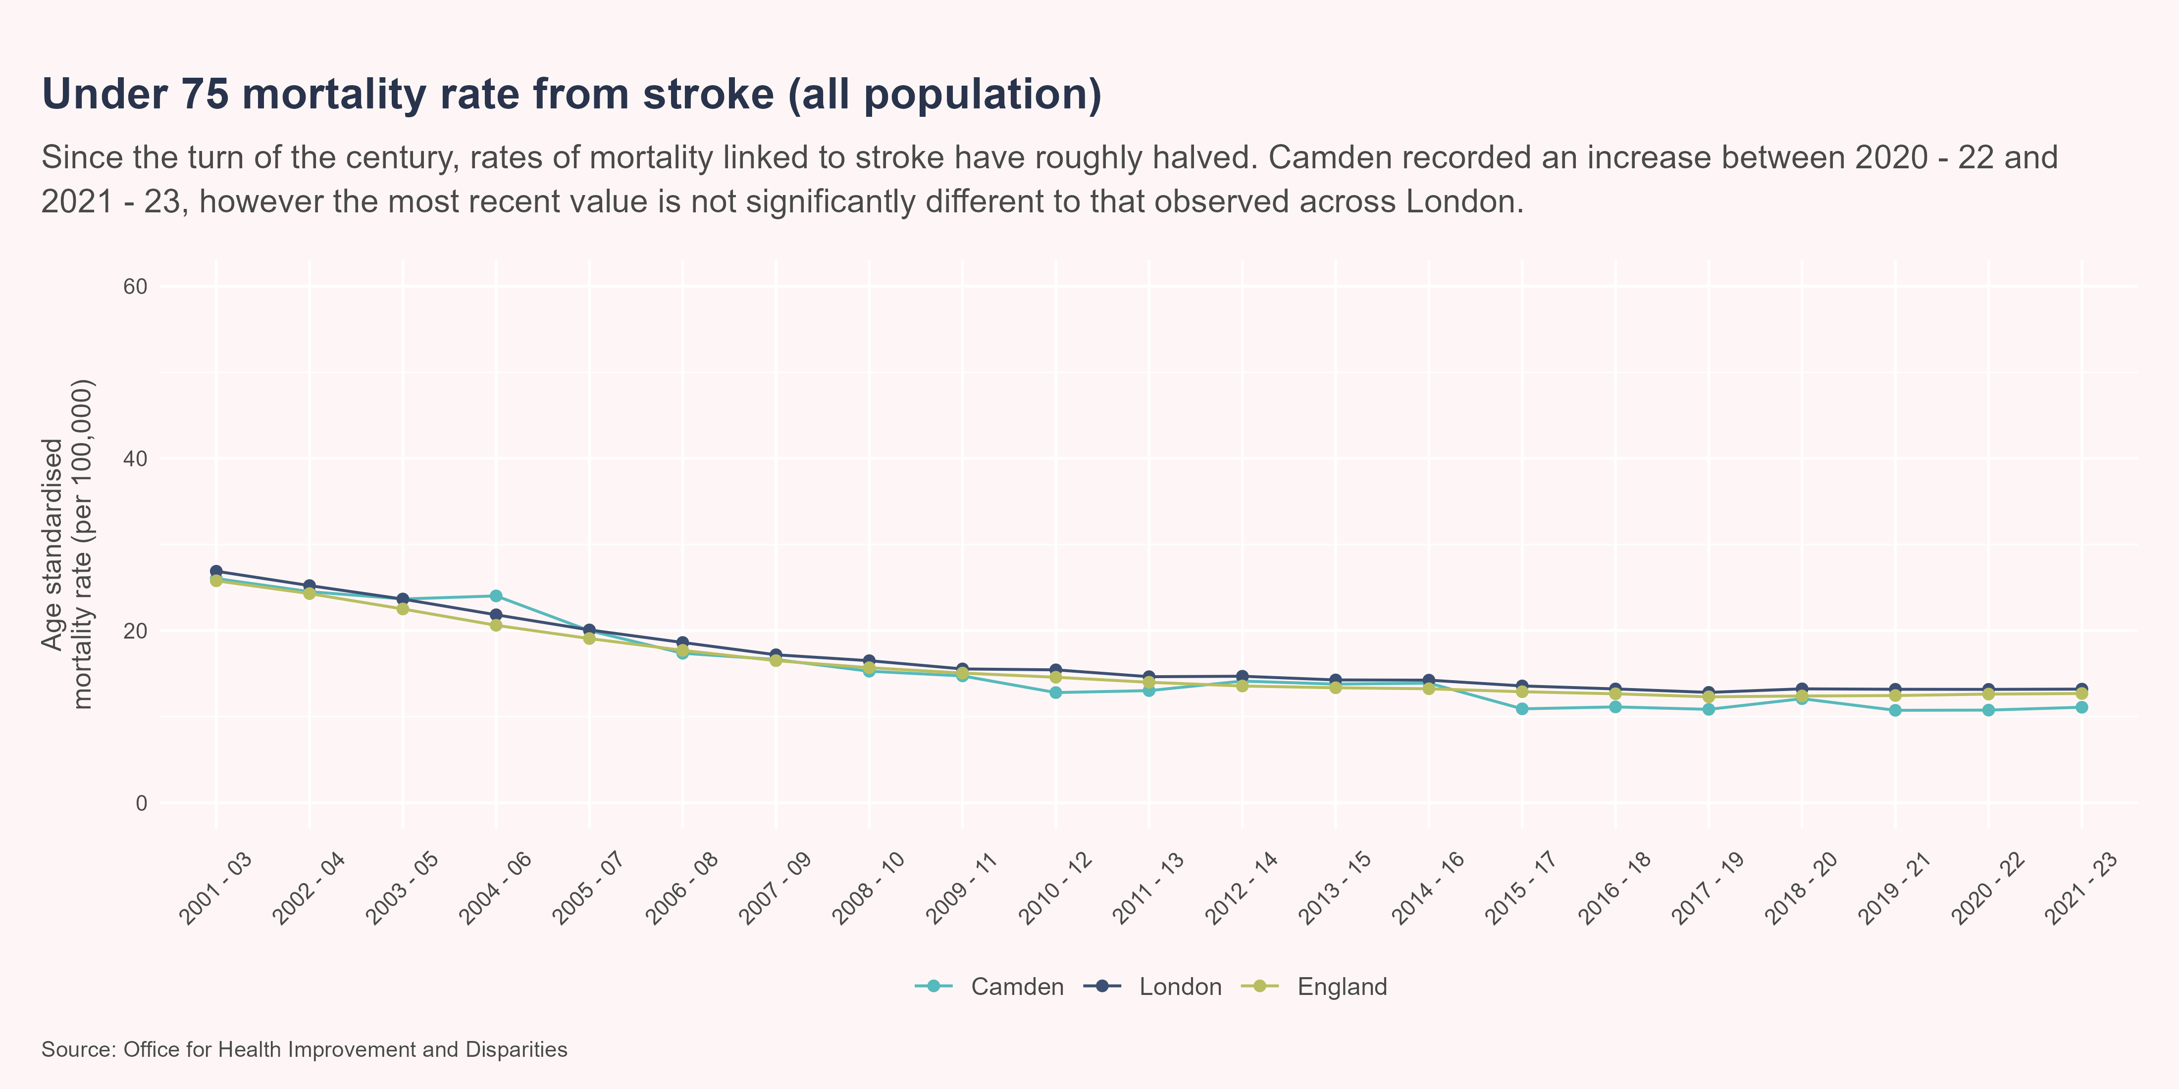
Stroke mortality rate
Between 2020 - 22 and 2021 - 23, Camden experienced an increase in the under 75 stroke mortality rate (all population) from 10.8 per 100,000 to 11.1 per 100,000. This was not a significant change. In 2021 - 23 the under 75 stroke mortality rate (all population) in Camden was statistically similar to that observed in London, with values of 11.1 per 100,000 and 13.2 per 100,000 respectively.

Slide 58
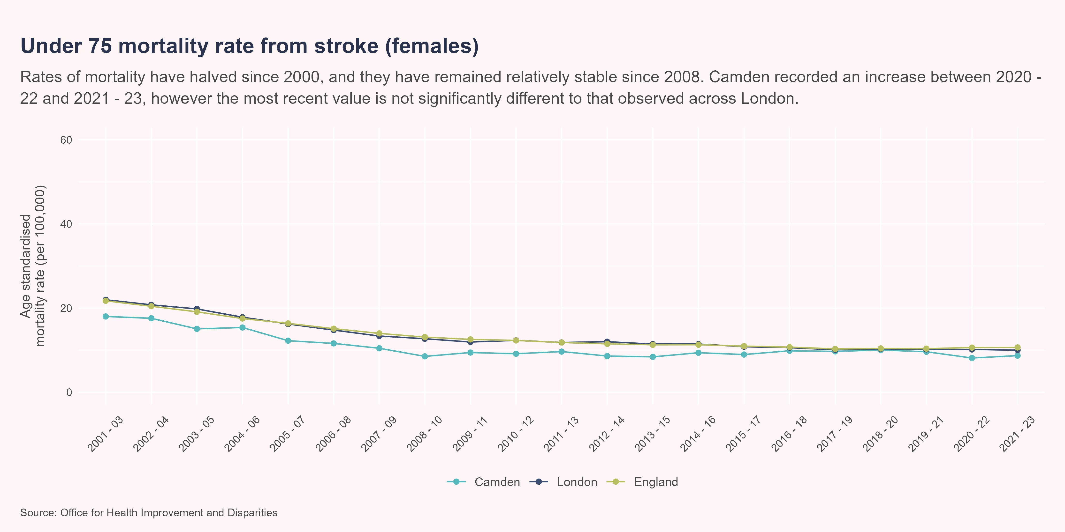
Stroke mortality rate - females
Between 2020 - 22 and 2021 - 23, Camden experienced an increase in the under 75 stroke mortality rate (females) from 8.13 per 100,000 to 8.69 per 100,000. This was not a significant change. In 2021 - 23 the under 75 stroke mortality rate (females) in Camden was statistically similar to that observed in London, with values of 8.69 per 100,000 and 10 per 100,000 respectively.

Slide 59
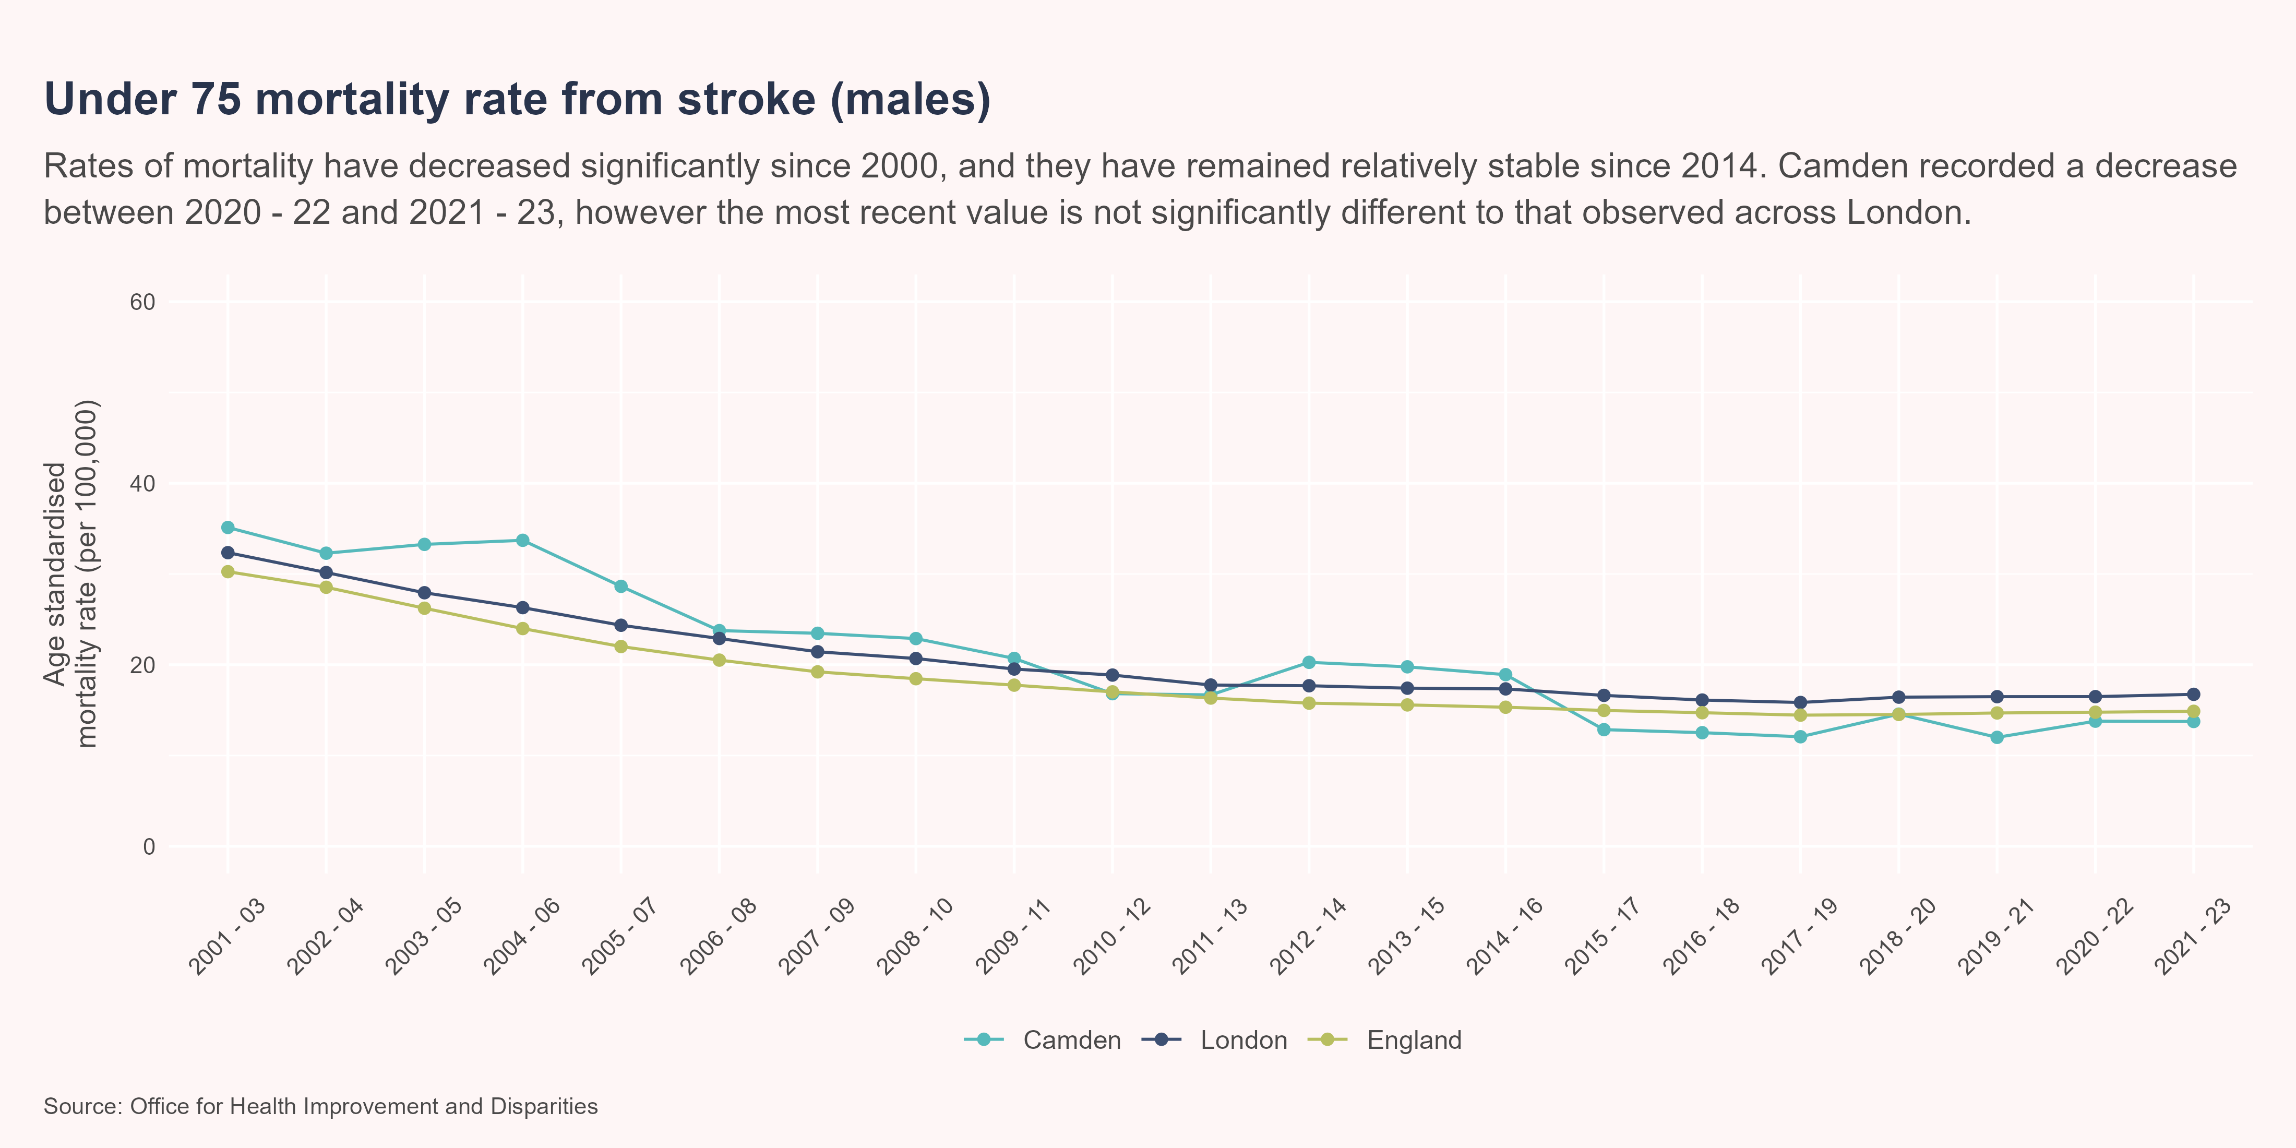
Stroke mortality rate - males
Between 2020 - 22 and 2021 - 23, Camden experienced a decrease in the under 75 stroke mortality rate (males) from 13.8 per 100,000 to 13.7 per 100,000. This was not a significant change. In 2021 - 23 the under 75 stroke mortality rate (males) in Camden was statistically similar to that observed in London, with values of 13.7 per 100,000 and 16.7 per 100,000 respectively.

Slide 60

References
Brain Research UK. n.d. “Stroke – Neurological Condition.” https://www.brainresearchuk.org.uk/neurological-conditions/stroke. Accessed June 30, 2025. https://www.brainresearchuk.org.uk/neurological-conditions/stroke.
British Heart Foundation. 2014. “Focus on: Peripheral Arterial Disease.” British Heart Foundation. https://www.bhf.org.uk/informationsupport/heart-matters-magazine/medical/peripheral-arterial-disease. https://www.bhf.org.uk/informationsupport/heart-matters-magazine/medical/peripheral-arterial-disease.
———. 2022. “Heart Failure.” British Heart Foundation. https://www.bhf.org.uk/informationsupport/conditions/heart-failure. https://www.bhf.org.uk/informationsupport/conditions/heart-failure.
———. 2024. “Stroke - Causes, Signs and Symptoms.” British Heart Foundation. https://www.bhf.org.uk/informationsupport/conditions/stroke. https://www.bhf.org.uk/informationsupport/conditions/stroke.
———. 2025a. “England Factsheet.” British Heart Foundation. https://www.bhf.org.uk/-/media/files/for-professionals/research/heart-statistics/bhf-cvd-statistics-england-factsheet.pdf?rev=cdc4caa49793475f8879fc58f7448313&hash=9A01CD8C51D9CC6979E8B19F9ED20A56. https://www.bhf.org.uk/-/media/files/for-professionals/research/heart-statistics/bhf-cvd-statistics-england-factsheet.pdf?rev=cdc4caa49793475f8879fc58f7448313&hash=9A01CD8C51D9CC6979E8B19F9ED20A56.
———. 2025b. “Facts and Figures.” British Heart Foundation. https://www.bhf.org.uk/what-we-do/news-from-the-bhf/contact-the-press-office/facts-and-figures. https://www.bhf.org.uk/what-we-do/news-from-the-bhf/contact-the-press-office/facts-and-figures.
———. 2025c. “Global Heart & Circulatory Diseases Factsheet.” https://www.bhf.org.uk/-/media/files/for-professionals/research/heart-statistics/bhf-cvd-statistics-global-factsheet.pdf?rev=e61c05db17e9439a8c2e4720f6ca0a19&hash=6350DE1B2A19D939431D876311077C7B.
———. 2025d. “Cardiovascular Inequalities in England: An Analysis.” British Heart Foundation. https://www.bhf.org.uk/what-we-do/our-research/heart-statistics/health-inequalities-research/cardiovascular-inequalities-in-england-an-analysis. https://www.bhf.org.uk/what-we-do/our-research/heart-statistics/health-inequalities-research/cardiovascular-inequalities-in-england-an-analysis.
———. n.d. “Stroke Research.” British Heart Foundation. https://www.bhf.org.uk/what-we-do/our-research/circulatory-conditions-research/stroke-research. Accessed June 30, 2025. https://www.bhf.org.uk/what-we-do/our-research/circulatory-conditions-research/stroke-research.
Commission on Race and Ethnic Disparities. 2021. “Ethnic Disparities in the Major Causes of Mortality and Their Risk Factors – a Rapid Review.” GOV.UK. https://www.gov.uk/government/publications/the-report-of-the-commission-on-race-and-ethnic-disparities-supporting-research/ethnic-disparities-in-the-major-causes-of-mortality-and-their-risk-factors-by-dr-raghib-ali-et-al. https://www.gov.uk/government/publications/the-report-of-the-commission-on-race-and-ethnic-disparities-supporting-research/ethnic-disparities-in-the-major-causes-of-mortality-and-their-risk-factors-by-dr-raghib-ali-et-al.
“GBD Compare.” 2015. Institute for Health Metrics and Evaluation. http://vizhub.healthdata.org/gbd-compare. http://vizhub.healthdata.org/gbd-compare.
Herbert, Annie, Linda Wijlaars, Ania Zylbersztejn, David Cromwell, and Pia Hardelid. 2017. “Data Resource Profile: Hospital Episode Statistics Admitted Patient Care (HES APC).” International Journal of Epidemiology 46 (4): 1093–1093i. https://doi.org/10.1093/ije/dyx015.
Keto, Jaana, Hanna Ventola, Jari Jokelainen, Kari Linden, Sirkka Keinanen-Kiukaanniemi, Markku Timonen, Tero Ylisaukko-oja, and Juha Auvinen. 2016. “Cardiovascular Disease Risk Factors in Relation to Smoking Behaviour and History: A Population-Based Cohort Study.” Openheart 3: e000358. https://doi.org/ doi:10.1136/openhrt-2015-000358.
Merritt, Eve Collyer. 2025. “Cardiovascular Disease: What Is the Government Doing about England’s Leading Cause of Premature Death?” June. https://lordslibrary.parliament.uk/cardiovascular-disease-what-is-the-government-doing-about-englands-leading-cause-of-premature-death/#ref-6.
National Institue for Health and Care Excellence. 2025. “Hypertension: What is it?” https://cks.nice.org.uk/topics/hypertension/background-information/definition/. https://cks.nice.org.uk/topics/hypertension/background-information/definition/.
NHS England. 2024. “NHS England: Priorities and Operational Planning Guidance 2024/25.” https://www.england.nhs.uk/wp-content/uploads/2024/03/2024-25-priorities-and-operational-planning-guidance-v1.1.pdf.
Office for Health Improvement and Disparities. 2024. “Public Health Profiles.” Office for Health Improvement and Disparities. https://fingertips.phe.org.uk/search/hypertension#page/3/gid/1938133106/pat/6/par/E12000007/ati/502/are/E09000007/iid/94111/age/164/sex/4/cat/-1/ctp/-1/yrr/1/cid/4/tbm/1/page-options/car-do-0. https://fingertips.phe.org.uk/search/hypertension#page/3/gid/1938133106/pat/6/par/E12000007/ati/502/are/E09000007/iid/94111/age/164/sex/4/cat/-1/ctp/-1/yrr/1/cid/4/tbm/1/page-options/car-do-0.
Office for National Statistics. 2023. “Risk Factors for Undiagnosed High Blood Pressure in England: 2015 to 2019.” https://www.ons.gov.uk/peoplepopulationandcommunity/healthandsocialcare/healthandwellbeing/articles/riskfactorsforundiagnosedhighbloodpressureinengland/2015to2019. https://www.ons.gov.uk/peoplepopulationandcommunity/healthandsocialcare/healthandwellbeing/articles/riskfactorsforundiagnosedhighbloodpressureinengland/2015to2019.
Public Health England. 2018. “Severe Mental Illness (SMI) and Physical Health Inequalities: Briefing.” GOV.UK. https://www.gov.uk/government/publications/severe-mental-illness-smi-physical-health-inequalities/severe-mental-illness-and-physical-health-inequalities-briefing. https://www.gov.uk/government/publications/severe-mental-illness-smi-physical-health-inequalities/severe-mental-illness-and-physical-health-inequalities-briefing.
The Health Foundation. 2024. “Health Inequalities in 2040.” https://www.health.org.uk/reports-and-analysis/reports/health-inequalities-in-2040. https://www.health.org.uk/reports-and-analysis/reports/health-inequalities-in-2040.
Thomas, Tobi, Tobi Thomas Health, and inequalities correspondent. 2024. “Structural Racism Leading to Stark Health Inequalities in London, Report Shows.” The Guardian, October.
Wahid, Ahad, Nishma Manek, Melanie Nichols, Paul Kelly, Charlie Foster, Premila Webster, Asha Kaur, et al. 2016. “Quantifying the Association Between Physical Activity and Cardiovascular Disease and Diabetes: A Systematic Review and Meta-Analysis.” Journal of the American Heart Association 5 (9): e002495. https://doi.org/10.1161/JAHA.115.002495.

