Slide 1
Dementia
An Overview of Dementia in the borough of Camden Profile

Slide 2

Summary
Dementia is a growing challenge for population health, quality of life, and care systems within Camden, with rising prevalence particularly as the local population ages. This profile highlights the emerging trends in dementia in Camden, and, where appropriate, compares patterns seen across London and England. Addressing dementia in Camden—including through enhanced prevention, early diagnosis and comprehensive care—should be a priority in tackling local health inequalities and improving wellbeing for residents and carers.

Slide 3
Key Points
Around three quarters of Camden residents living with dementia are estimated to have a formal diagnosis, in line with NCL ICB and London
0.4% of all Camden residents have been diagnosed with dementia, slightly below the NCL ICB and London estimate
All-cause hospital admission rates for residents with dementia are significantly higher for residents in the Black and Other Ethnic Group categories, compared to the White category
Residents living in Camden’s most deprived neighbourhoods have a higher likelihood of admission to hospital with dementia
Camden has fewer care home beds and lower bed quality ratings than London and NCL ICB
Camden residents with dementia are more likely to die at home and less likely to die in care homes than NCL ICB and London residents
Mortality rates for dementia in Camden are similar to those in NCL ICB and London

Slide 4

Background

Slide 5
What is Dementia?
Dementia is an overall term for a particular group of symptoms that occur as a result of changes in the brain, which can be caused by a wide range of different underlying conditions. Common dementia symptoms include:
trouble with memory,
difficulty with concentration, planning and problem-solving
difficulty with language and struggling to understand and express thoughts.
changes with mood, behaviour and personality
confusion and changes to perception
reduction in the ability to carry out Activities of Daily Living (ADLs)
The symptoms that occur in an individual vary from person to person and by the cause of dementia. Dementia is generally progressive, meaning that the symptoms tend to gradually worsen over time, though this varies from person to person.(“2025 Alzheimer’s Disease Facts and Figures” 2025)
Thus, dementia is not a single diagnosable medical condition, but rather an umbrella term for a range of related symptoms resulting from ongoing decline in brain functioning. The main causes and relative prevalences in over 65s, include(Sian Besley et al. 2023)
Alzheimer’s disease (62%),
Vascular Dementia (17%),
Dementia with Lewy Bodies (4%),
Frontotemporal dementia (2%)
Mixed Dementia (15%)
Dementia is usually diagnosed in stages, with GP assessment being the initial step- an assessment of history and function, normally using relevant cognitive assessment tools and ruling out any temporary or transient causes of confusion(delirium). Thereafter, if clinical suspicion of dementia persists, referrals are typically made to secondary care memory clinics, where definitive diagnoses are made, using both clinical assessment and imaging like MRI. Relevant treatment plans are then implemented, using medications where appropriate, depending on the subtype of dementia. Often, early diagnosis and timely intervention allow for the implementation of early management strategies which slow the progression of the condition, with the goal being to maximize quality of life for the patient.
It is important to note also that there is a significant rate of underdiagnosis from national estimates; only about two-thirds of people with dementia have been formally diagnosed.(“Dementia Maps” n.d.)

Slide 6
Why it matters
As mentioned, dementia is an umbrella term for a range of conditions affecting the brain, most commonly Alzheimer’s disease, vascular dementia, and Lewy body dementia. It is a leading cause of disability and dependence for older adults across England, impacting nearly one million people—a figure projected to rise to 1.4 million by 2040. Dementia is responsible for an estimated £42 billion in health and social care costs every year, a burden expected to more than double in the coming decades, with most costs falling on families and unpaid carers.(“How Many People Have Dementia in the UK? | Alzheimer’s Society” n.d.)
Dementia remains a major public health issue in London, reflecting national trends in both rising prevalence and persistent inequalities. Certain communities carry a disproportionate burden: people in socioeconomically deprived areas, and some ethnic minority groups face higher risks and receive diagnoses at a younger age. Social isolation, low physical activity, and poor access to early diagnosis further fuel the health inequality gap.(Bothongo et al. 2022)
Targeted approaches for dementia prevention, improved recognition and culturally sensitive care for diverse populations, as well as better support for carers, are essential to tackling the impact of dementia and reducing disparities within London.

Slide 7
Causes and Risk Factors
The risk factors for dementia are numerous and diverse They can be broadly split into Non-Modifiable and Modifiable categories. There are 14 core recognised risk factors.(“Addressing 14 Health and Lifestyle Factors Could Prevent Nearly Half of Global Dementia Cases” n.d.)
Non-Modifiable Risk Factors
Increasing age: The single biggest risk factor for dementia. Dementia impact is becoming increasingly higher worldwide over time as populations continue to age.(Arvanitakis 2024)
Genetic factors and family history: Inherited predisposition to dementia. A multitude of genetic loci have been associated with Alzheimer’s and other Dementias.(Bellenguez et al. 2022)
Vascular causes: Includes vascular dementia (second most common type), which is also linked to history of head injury or traumatic brain injury.(Bir et al. 2021)
Ethnic background and socioeconomics: Higher dementia prevalence is known in Black Ethnicity populations and lower income groups, likely linked to higher risk of comorbidities and lifestyle factors.(Shiekh et al. 2021)
Modifiable Risk Factors
Depression: Increased risk particularly in older adults, with general risk of dementia considered higher in those with depression or history of depression, with some literature reviews finding an increased risk as high as 1.82 times.(Fernández Fernández, Martín, and Antón 2024)
Uncorrected or insufficiently corrected hearing loss: Increases risk by 1.28-2.39 times based on recent literature reviews.(Readman et al. 2025)
Uncorrected or insufficiently corrected vision loss: Increases risk by 1.47 times based on recent literature reviews.(Shang et al. 2021)
Lower educational attainment in early life: Linked to lower cognitive reserve. Meta analyses show that each year in education reduces dementia risk.(Maccora, Peters, and Anstey 2020)
Social isolation and loneliness: Some difficulty drawing definitive conclusions due to correlation versus causation, but some clear cases including unmarried and widowed individuals being at higher risk.(“Social Isolation and Dementia Risk | Alzheimer’s Society” 2024)
Physical inactivity and obesity: Significant correlation noted, with higher dementia risk in those who are less physically active, with some differences within dementia types.(Hu et al. 2024)
Smoking and excessive alcohol consumption.(Rehm et al. 2019; Zhong et al. 2015)
Diabetes, hypertension (HTN), and high cholesterol.(Cao et al. 2024; Iwagami et al. 2021; Ou et al. 2020)
Air pollution exposure.(Peters et al. 2019)
Sleep disturbances including sleep apnoea.(Guay‐Gagnon et al. 2022)
Possible vitamin deficiencies: Vitamin D, B12, and folate.(Gil Martínez, Avedillo Salas, and Santander Ballestín 2022)
Certain medications: particularly those with anticholinergic effects.(Zheng et al. 2021)

Slide 8
What the data shows us

Slide 9
Prevalence & Diagnosis
The data below demonstrates how the prevalence of dementia is gradually rising, which could be both due to demographic changes and improved detection; however, recent evidence suggests some risk factors may be increasingly well managed, and some new cases may be delayed with healthier lifestyles.(Vidyanti et al. 2025)
The recorded dementia prevalence is the number of people with dementia recorded on Camden GP practice registers as a proportion of the people (all ages) registered at each GP practice. Prevalence data based on GP records should be interpreted alongside the estimated diagnosis rate. The estimated dementia diagnosis rate is the proportion of people aged 65 and over who are estimated to have dementia and have a formal diagnosis recorded by their GP. It compares the number of diagnosed cases on GP registers with an estimated total based on population age and sex. The indicator is designed to monitor progress towards the national ambition that two-thirds of people with dementia should have a diagnosis.
As the diagnosis rate tab shows, Camden has a higher estimated diagnosis rate for dementia than both the NCL and London averages. This suggests that Camden’s lower recorded prevalence compared to NCL and London isn’t simply due to under-diagnosis, but likely a true reflection of relatively lower prevalence in the borough. A major factor is Camden’s younger population, as dementia is much more common in older age groups.

Slide 10
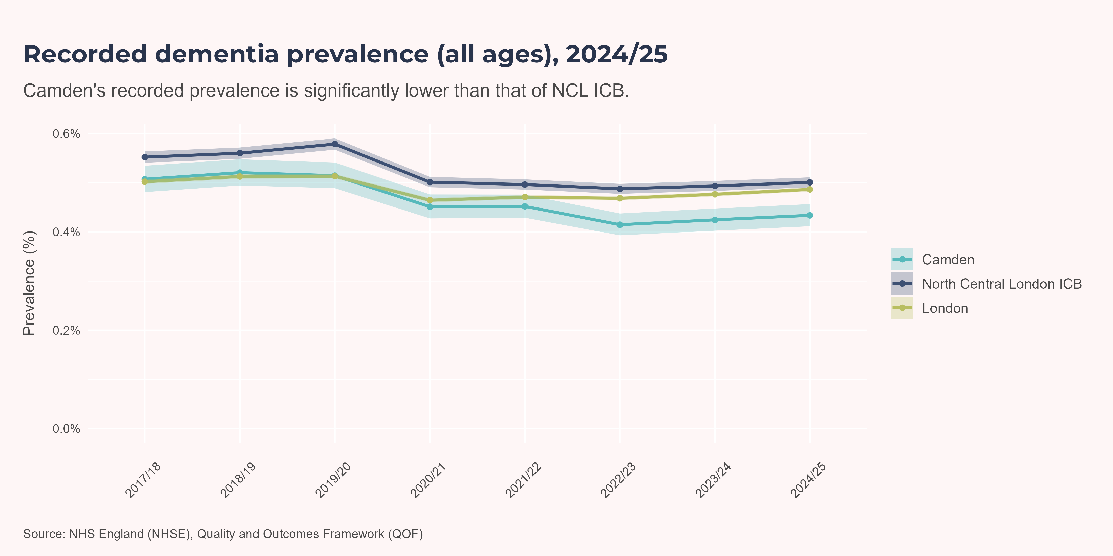
Recorded Prevalence of Dementia
The figures for Camden are based on the location of the GP practice, not the patient’s home address. This means the measure includes everyone registered with a GP practice located in Camden, even if they live outside the borough. Equally, Camden residents registered with a GP practice in another area are not included.
In 2024/25, the proportion of people on Camden GP records with a dementia diagnosis was 0.43%. This was significantly lower than London and North Central London ICB.
Recorded prevalence decreased across all geographies in 2020/21, likely due to underdiagnosis during the Covid-19 pandemic. In the years before this, recorded prevalence had been gradually increasing, and since 2022/23, all three geographies have continued to show a very gradual rise.

Slide 11
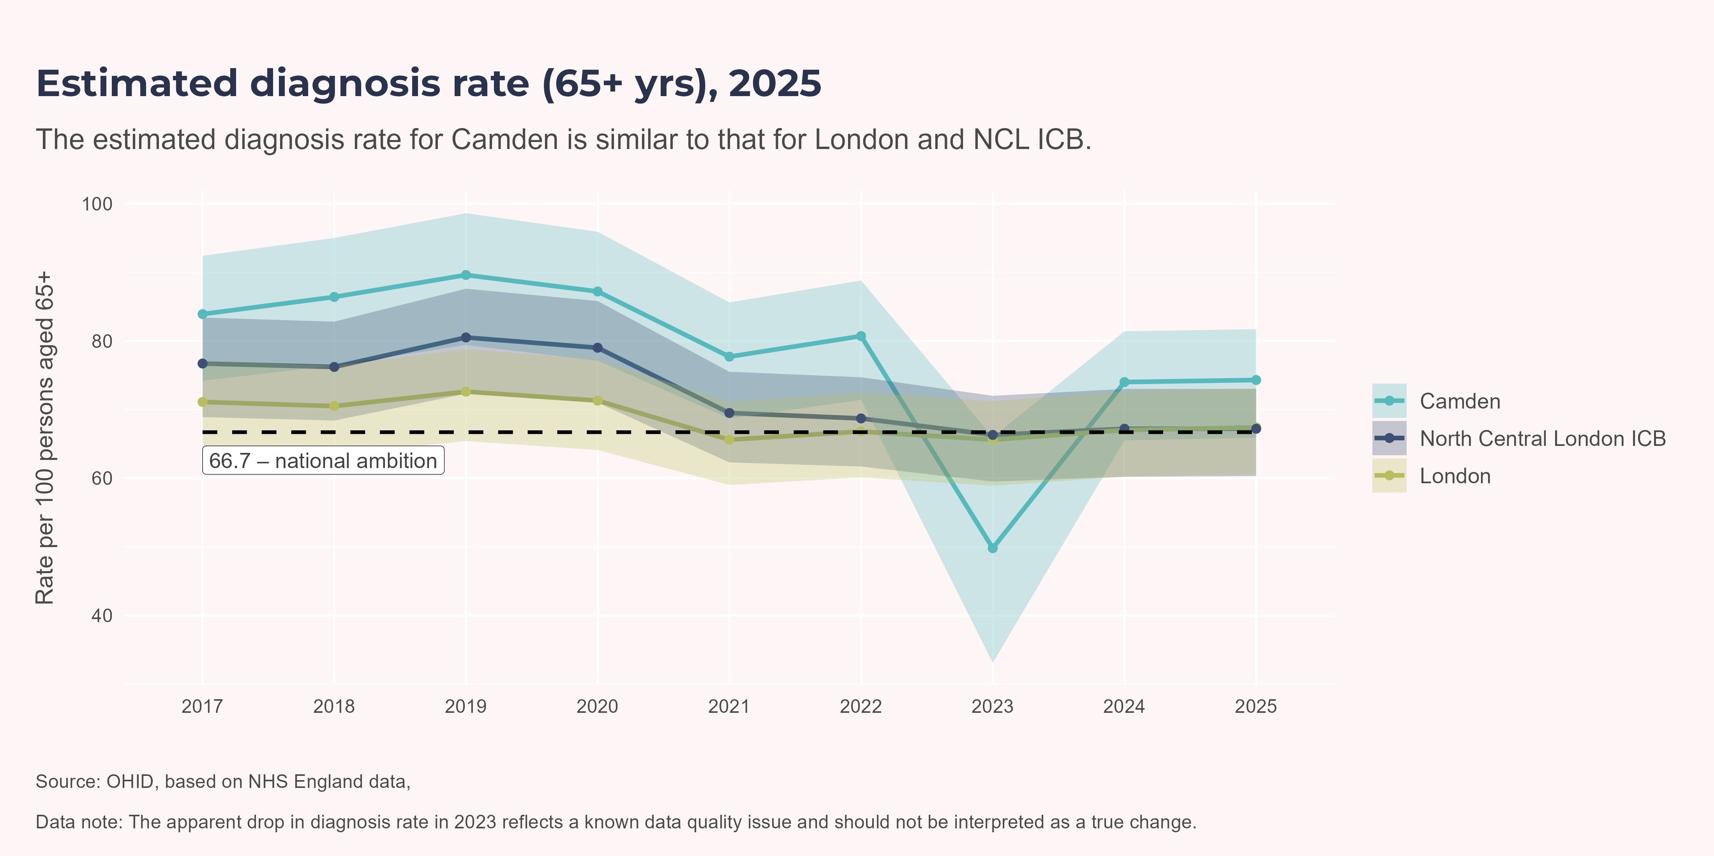
Estimated Diagnosis Rate
This measure compares how many people are thought to have dementia (based on the local population’s age and sex structure and national prevalence rates) with how many have a formal diagnosis recorded by their GP. In 2025, the estimated diagnosis rate of dementia in Camden was 74.30%. This was similar to London and North Central London ICB. The apparent drop in diagnosis rate in 2023 reflects a known data quality issue and should not be interpreted as a true change.

Slide 12

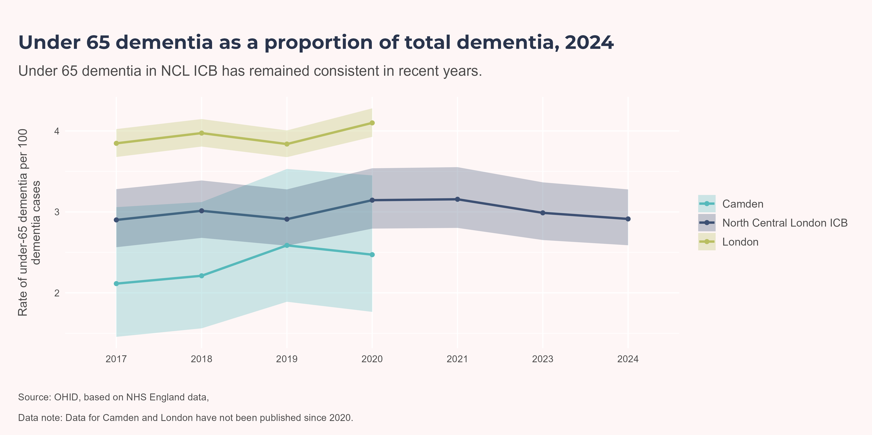
Young Onset Dementia
The young-onset dementia indicator is the number of people aged under 65 with dementia recorded on Camden GP practice registers, expressed as a proportion of all people with dementia recorded on those registers. People diagnosed with dementia under the age of 65 have different needs and commitments, often follow a different clinical pathway, and may also need different forms of support, compared to people diagnosed with dementia over the age of 65. Patterns of young-onset dementia can also reflect local risk factors, such as high blood pressure and obesity.
Camden-level data was last published in 2020, when 2.47% of dementia cases were in people under the age of 65; a value not significantly different from NCL ICB. In 2024, the proportion of people with dementia recorded on GP practice registers in North Central London ICB who were under the age of 65 was 2.91%.
Young-onset dementia is a lifelong diagnosis. However, this indicator does not show everyone currently living with dementia who was diagnosed before age 65. Instead, it counts people who, on 31st December, 2024, were aged under 65 with a recorded dementia diagnosis, as a proportion of all recorded dementia cases.
The figures for Camden are based on the location of the GP practice, not the patient’s home address. This means the measure includes everyone registered with a GP practice located in Camden, even if they live outside the borough. Equally, Camden residents registered with a GP practice in another area are not included.

Slide 13
Hospital Admissions
Dementia is a significant driver of hospital admissions nationwide, with an estimated 25% of acute hospital beds occupied by patients who have dementia. Data shows that they stay in hospital twice as long on average compared to other patients and often are admitted for infections treatable in the community.(England n.d.) Hospital admissions related to dementia are often emergency cases, and people with dementia tend to experience longer stays due to related conditions and the complexities of their care needs with corresponding discharge planning complexities. People with dementia on average spend almost a fifth of their last 6 months of life in hospital, with about 20% of deaths occurring during first unplanned hospital admission after diagnosis.(Vardy 2022) This highlights the importance of advance care planning.
Dementia impacts certain population cohorts disproportionately: risk and prevalence are higher for women, for those of lower socioeconomic status, and for people living in more deprived areas or facing greater social isolation. This is reflected in Hospital Admissions data presented below.
The following analysis uses data on emergency hospital admissions, using finished episodes, not unique patients, where dementia or Alzheimer’s was mentioned in any diagnostic field position. This could mean the patient was admitted for a reason not directly related to their dementia, but their dementia diagnosis has been recorded for clinical context or as a comorbidity.

Slide 14
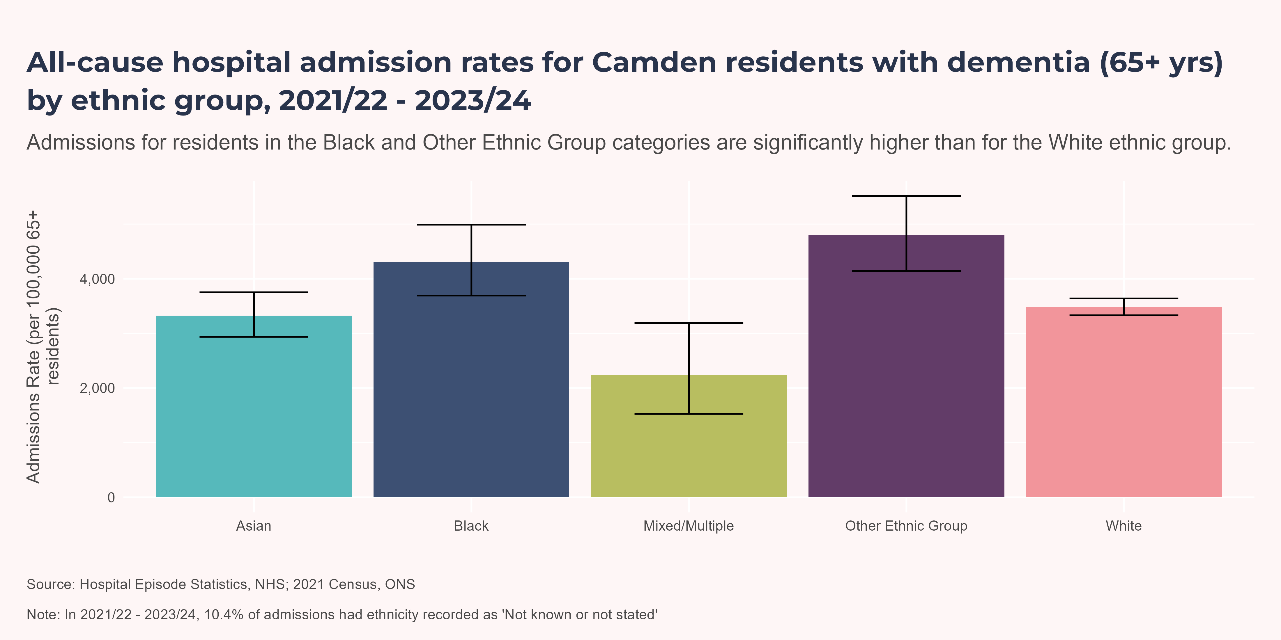
By ethnicity
Between 2021/22 - 2023/24, the emergency admissions rate was highest for the Other Ethnic Group and Black ethnic groups (4,794 and 4,304 per 100,000 65+ residents). People from the Black and Other Ethnic Group ethnic groups had a statistically significantly higher admission rate than people of White ethnicity (3,483 per 100,000 65+ residents).

Slide 15
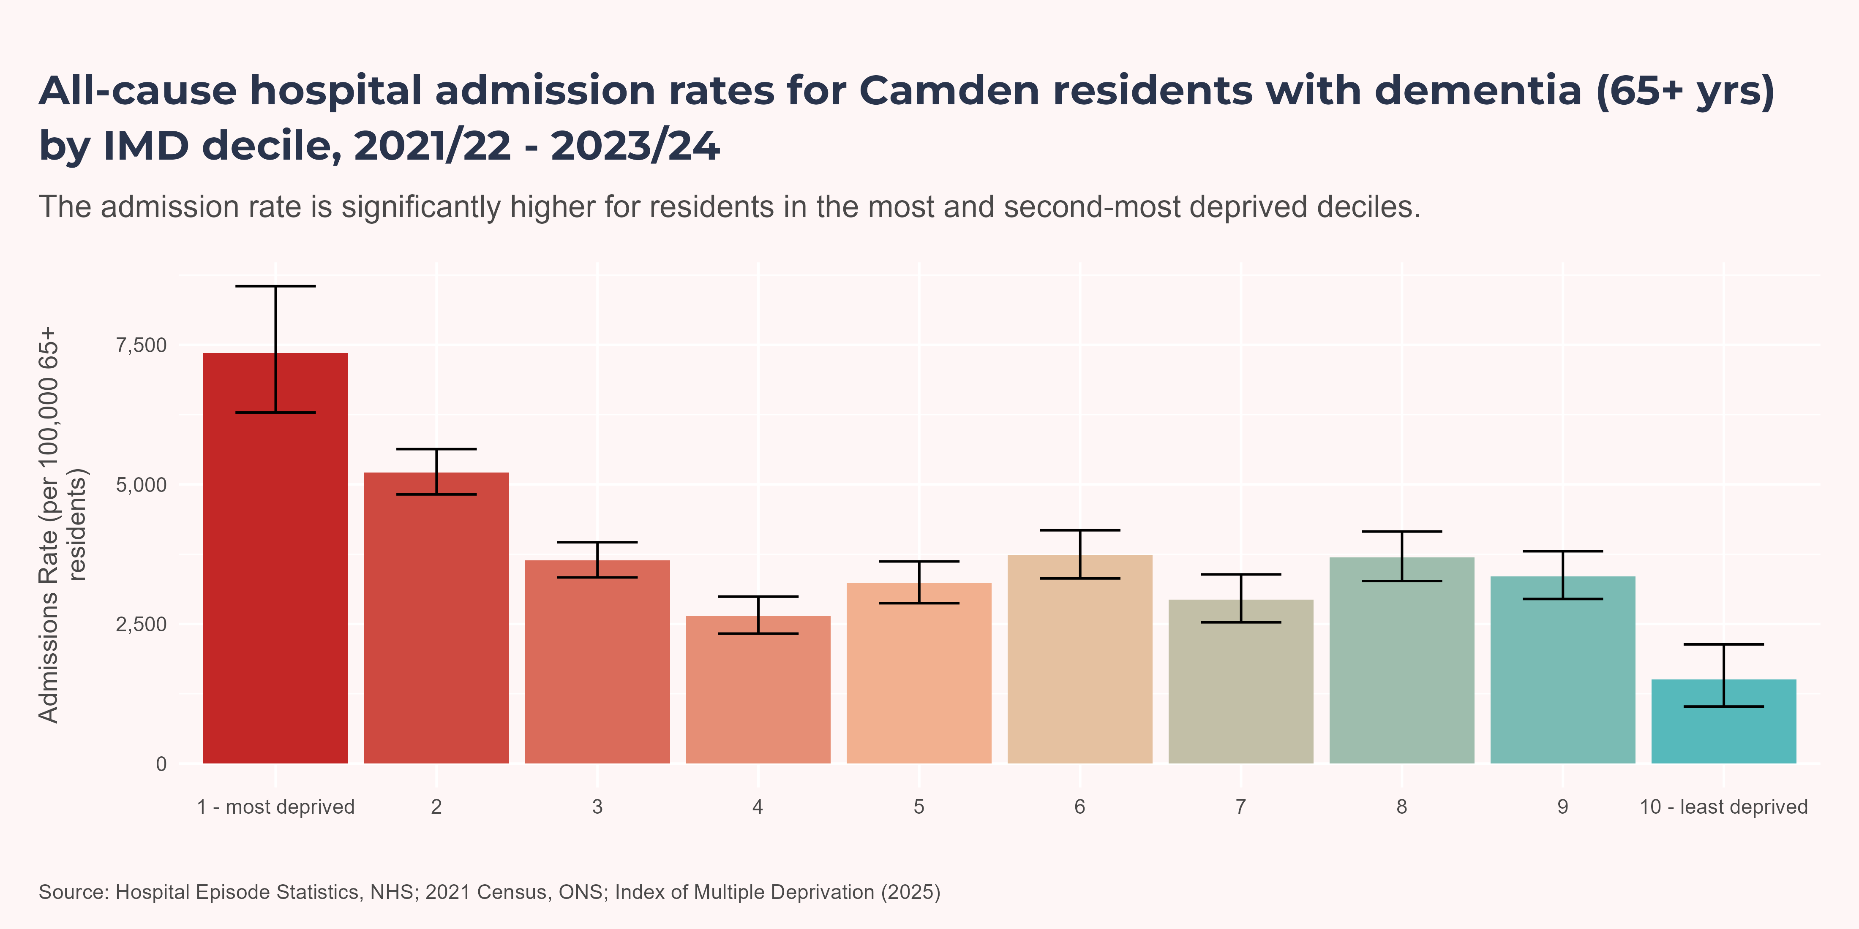
By IMD
The highest rate was for people living in deciles 1 - most deprived (7,354 per 100,000) and 2 (5,215 per 100,000). The least deprived decile had a significantly lower rate than all other deciles.

Slide 16
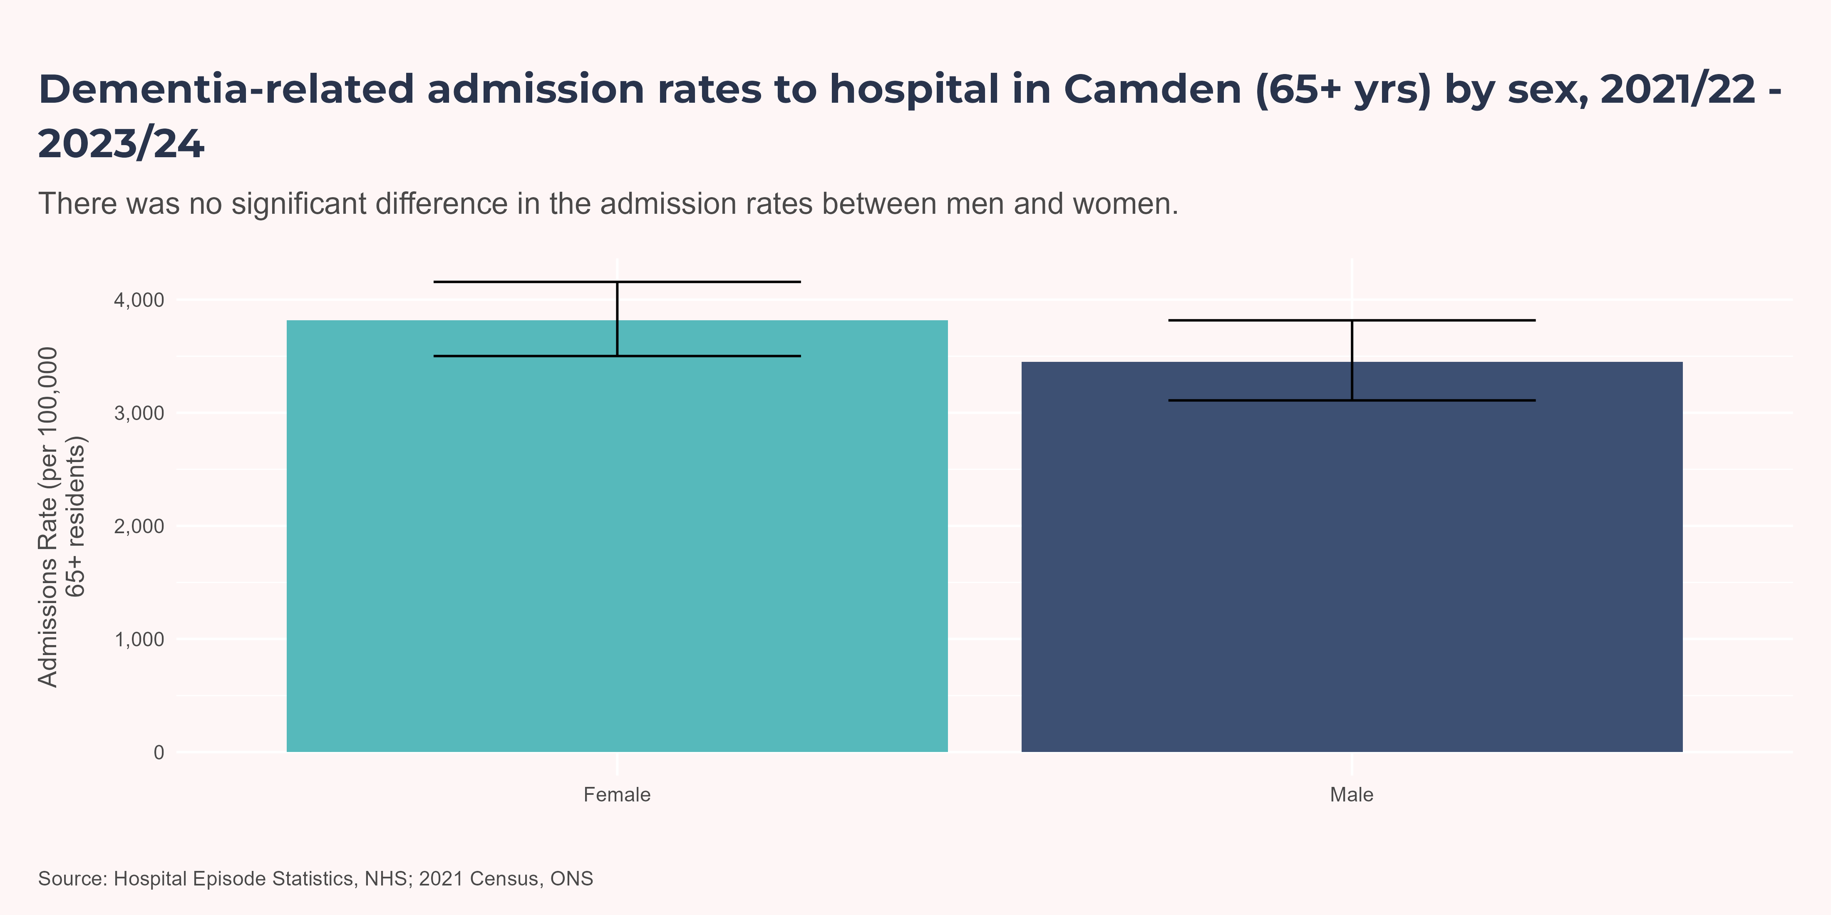
By Sex
The admission rate was 3,450 per 100,000 for men and 3,819 per 100,000 for women, with no significant difference between the sexes.

Slide 17
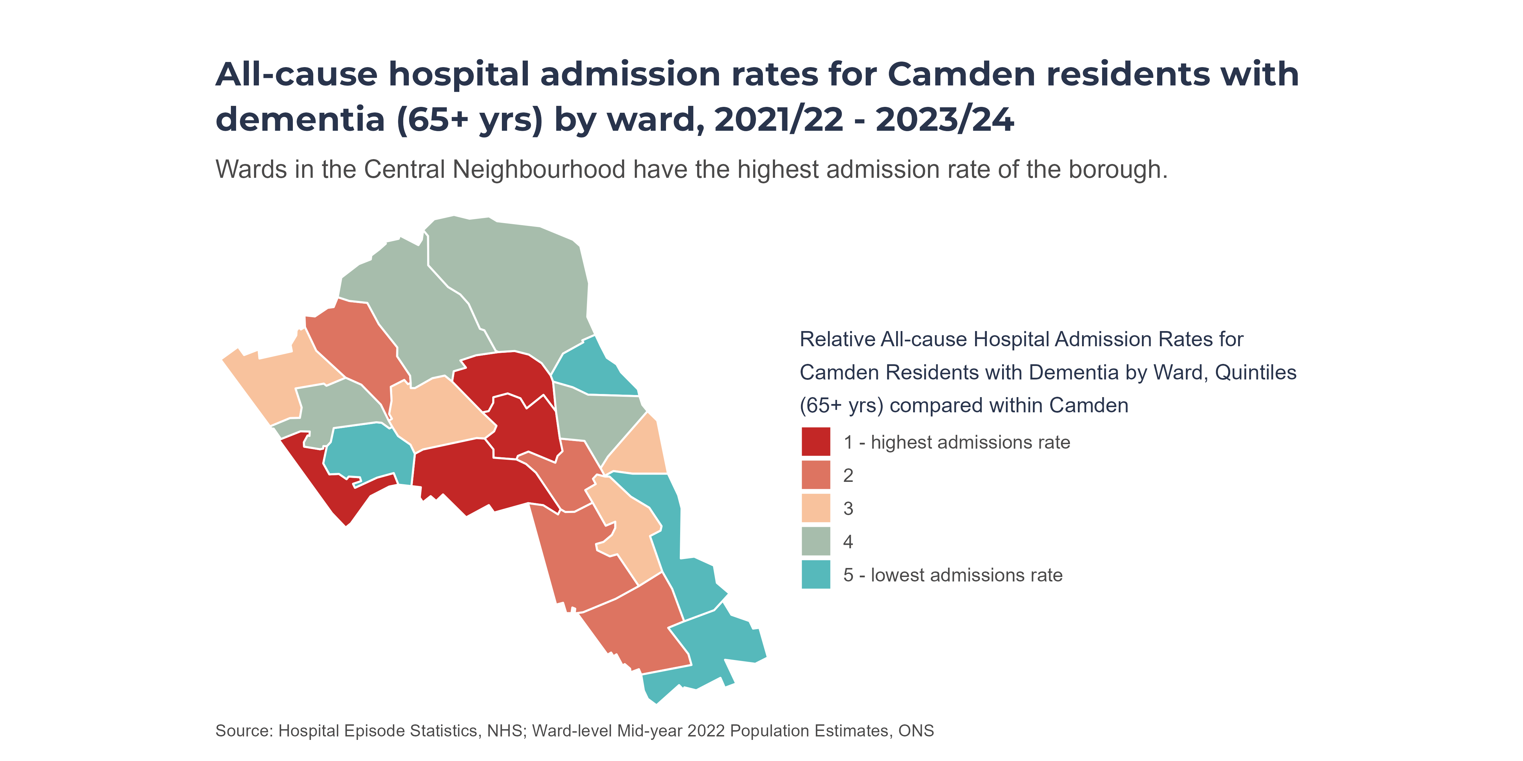
By Ward (Map)
Quintiles are calculated within Camden only. All Camden wards are ranked by prevalence; then the ranked list is split into five (roughly) equal-sized groups (“quintiles”). Colours therefore show how a ward compares to other wards in Camden, not across the whole of England.
Haverstock (8,409 per 100,000), Gospel Oak (6,544 per 100,000), Primrose Hill (5,682 per 100,000) and Kilburn (3,916 per 100,000) were the wards with the highest admission rates in Camden.

Slide 18
Short-stay Hospital Admissions
Short hospital stays can be particularly disruptive for people with dementia, often causing distress and avoidable harm, so examining short-stay admission patterns helps identify opportunities to reduce unnecessary admissions.
The following analysis uses data on emergency hospital admissions lasting one night or less, a subset of the data used above. Short-stay emergency admission rates generally follow similar patterns to all-length-of-stay emergency admissions, but as this is a subset, counts are lower and confidence intervals wider. While differences by sex and ethnic group were not statistically significant, there remained significant variation in admission rates between the least and most deprived deciles.

Slide 19
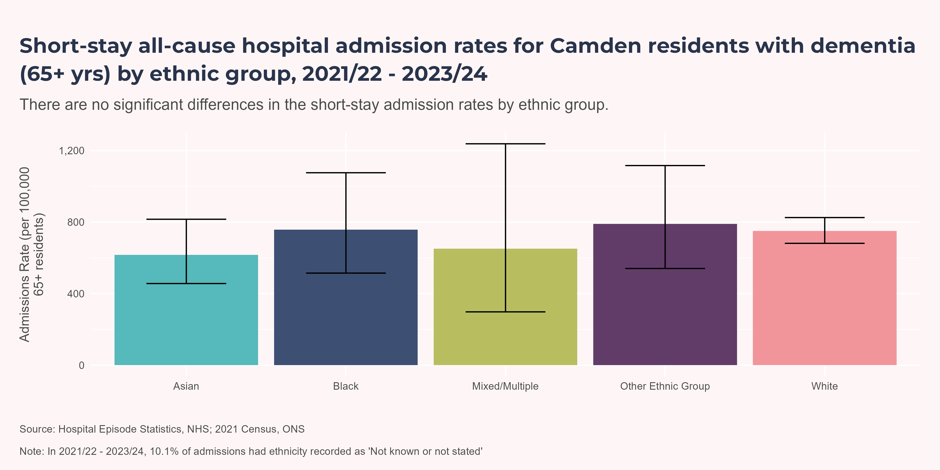
By ethnicity
Between 2021/22 - 2023/24, the short-stay emergency admissions rate was highest for the Other Ethnic Group and Black ethnic groups (791 and 758 per 100,000 65+ residents). Differences by ethnic group were not statistically significant compared with people of White ethnicity.

Slide 20
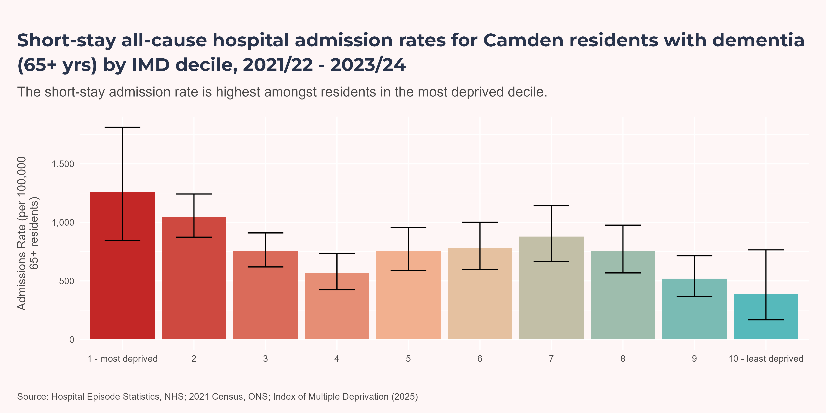
By IMD
The highest short-stay admissions rate was for people living in deciles 1 - most deprived (1,262 per 100,000), 2 (1,046 per 100,000) and 7 (879 per 100,000). The rates for deciles 1 - most deprived and 2 were significantly higher than for the least deprived decile.

Slide 21
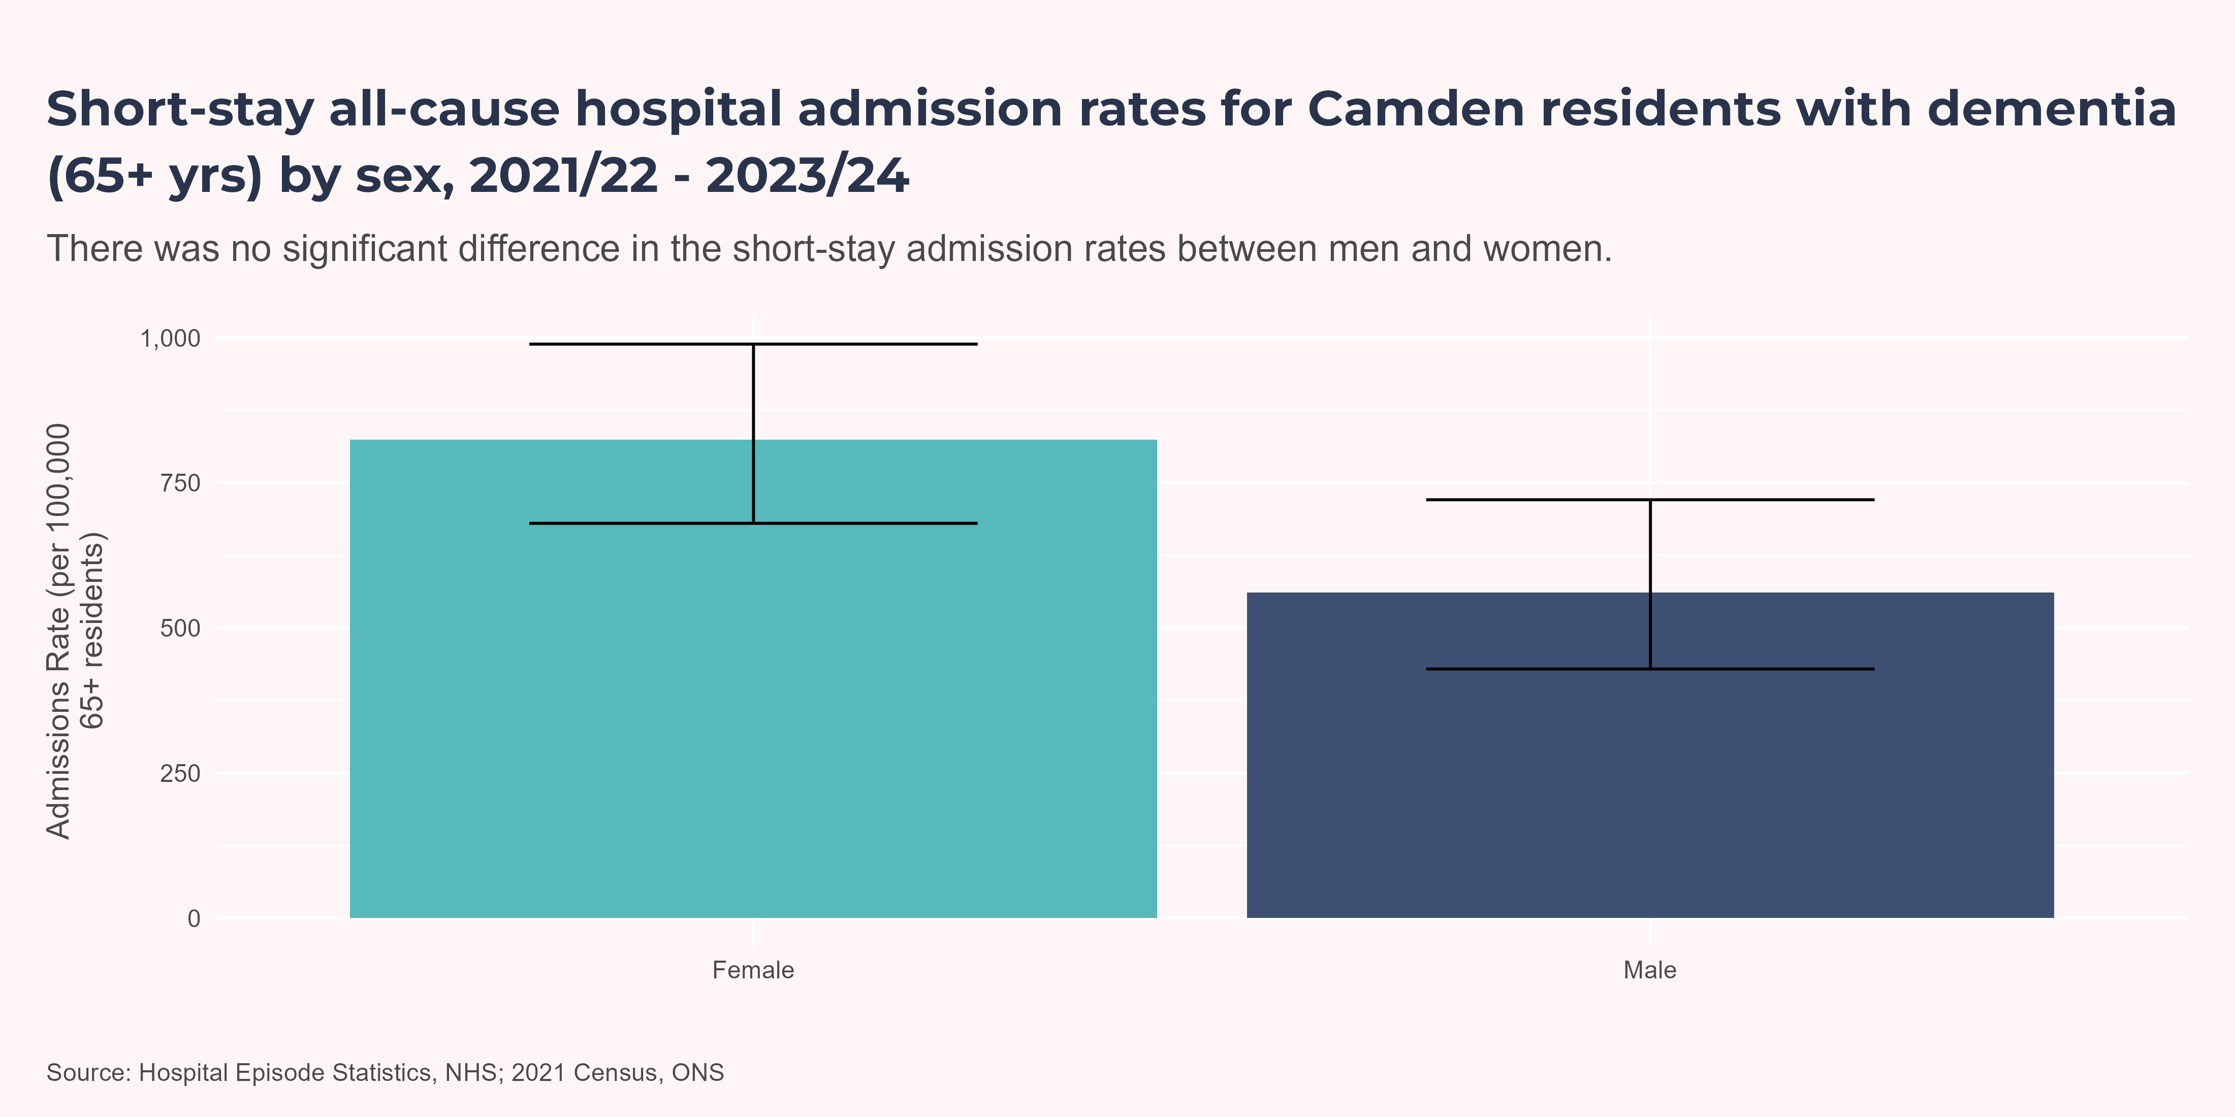
By Sex
The short-stay admission rate was 561 per 100,000 for men and 824 per 100,000 for women, with no significant difference between the sexes.

Slide 22
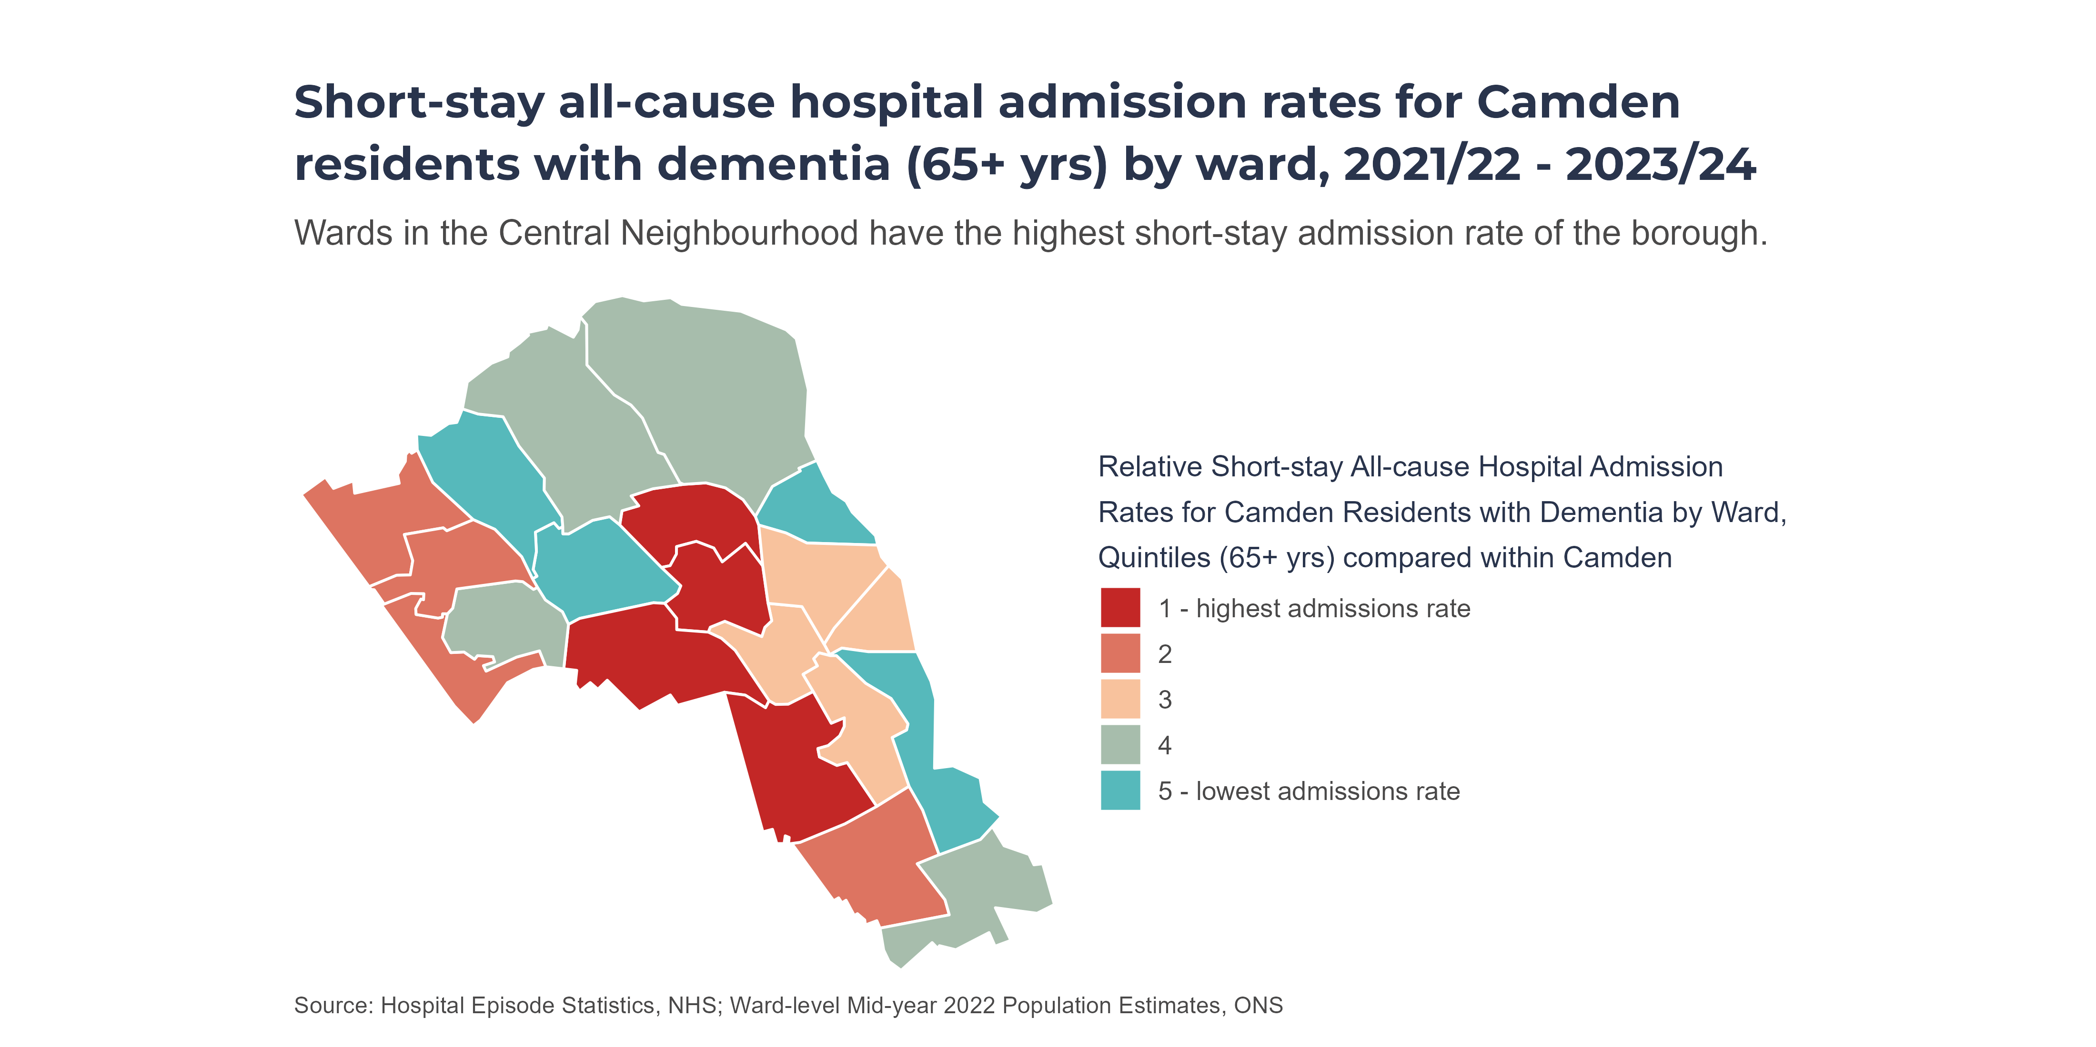
By Ward (Map)
Quintiles are calculated within Camden only. All Camden wards are ranked by prevalence; then the ranked list is split into five (roughly) equal-sized groups (“quintiles”). Colours therefore show how a ward compares to other wards in Camden, not across the whole of England.
Haverstock (1,978 per 100,000), Primrose Hill (1,360 per 100,000), Gospel Oak (1,186 per 100,000) and Regent’s Park (956 per 100,000) were the wards with the highest admission rates in Camden.

Slide 23
Mortality
In 2023, dementia was the leading cause of death for females in Camden (14.5% of deaths), and second in males (7% of deaths), as reflected also in data within the Long-Term Conditions JSNA Profile.
Overall, people with dementia die prematurely. Dementia is one of the major causes of disability and dependency among older people worldwide. Life expectancies on diagnosis vary based on factors including age at diagnosis, sex, type of dementia and comorbidities. Life expectancy is about 7–10 years in individuals diagnosed with Alzheimer’s disease in their 60s and early 70s(Edwards et al. 2024), however various higher risk population groups have life expectancies of as low as 2-3 years at diagnosis.
Directly Age-Standardised Mortality Rates
Deaths can be analysed in two ways:
From dementia: dementia was the primary cause of death
Involving dementia: dementia was recorded anywhere on the death certificate
Mortality involving dementia (all ages) has risen over the last decade, peaking at 166.2 per 100,000 in 2020 - 22, before falling after the COVID-19 pandemic. This pattern reflects the higher mortality among older people during the pandemic, who are more likely to have dementia. Camden’s rate is now similar to London and NCL ICB. For deaths involving dementia in people aged 65+, Camden has closely followed London and NCL ICB trends, albeit with a one-year lag. The Camden rate reached a peak (966.8 per 100,000) in 2021, then declined to 753.5 per 100,000 in 2022.
Where dementia was the primary cause of death, the age-standardised mortality rate has increased over the last decade. Since 2020 - 22 (93.6 per 100,000), Camden’s rate has been stable and not significantly different from London.
Directly age-standardised rates express the overall rate that would occur in a standard population age structure if it experienced the age-specific rates of the observed population. It allows the comparison of mortality rates across different populations, even if they have different age distributions.

Slide 24
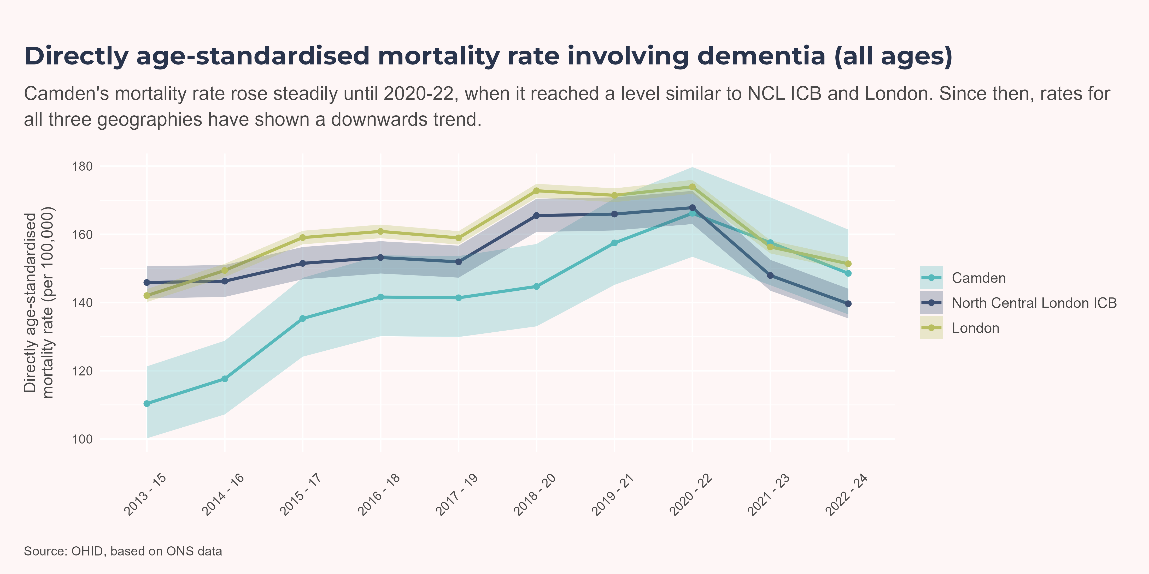
Involving dementia, all ages
Deaths involving dementia comprise deaths where dementia was recorded anywhere on the death certificate.

Slide 25
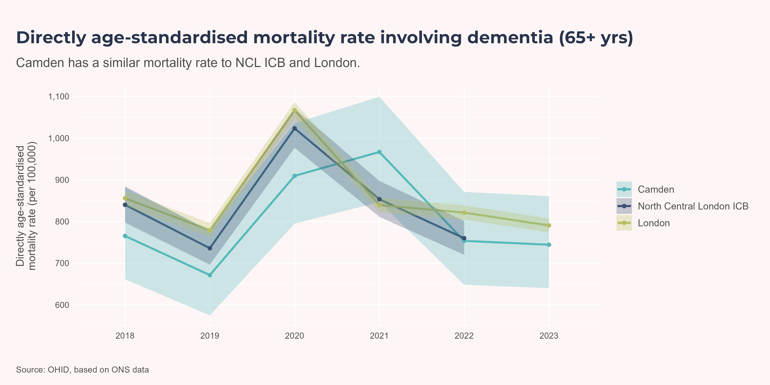
Involving dementia, 65+
Deaths involving dementia comprise deaths where dementia was recorded anywhere on the death certificate.

Slide 26
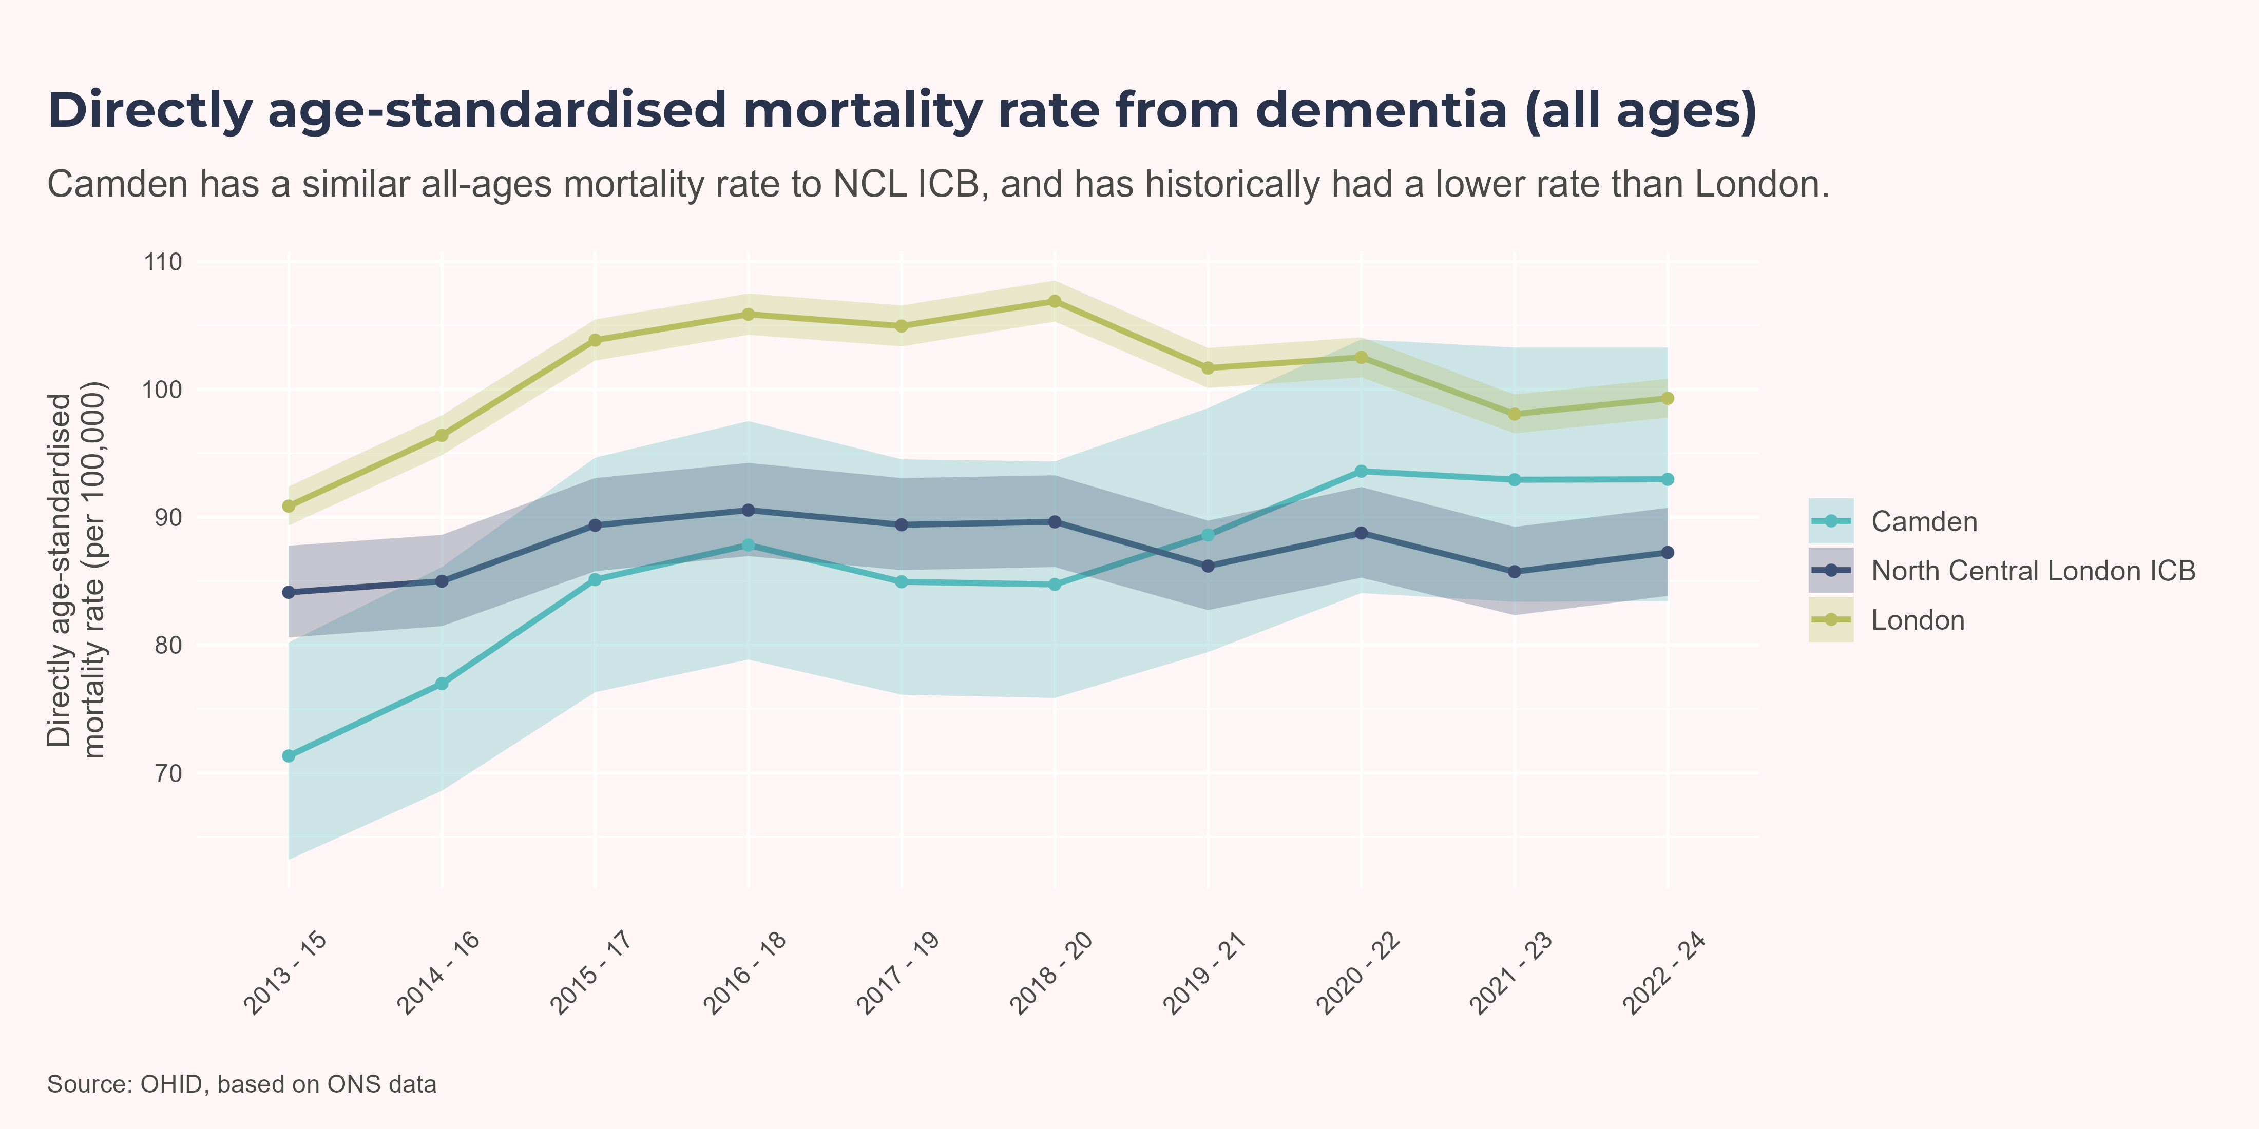
From dementia, all ages
Deaths from dementia comprise deaths where dementia was listed as the primary cause of death.

Slide 27
Mortality Rates
Looking at deaths by sex over the last 3 financial years, 2022 - 24, a similar picture emerges for deaths involving and from dementia: the rate is higher for males than females, but this is not a statistically significant difference.

Slide 28
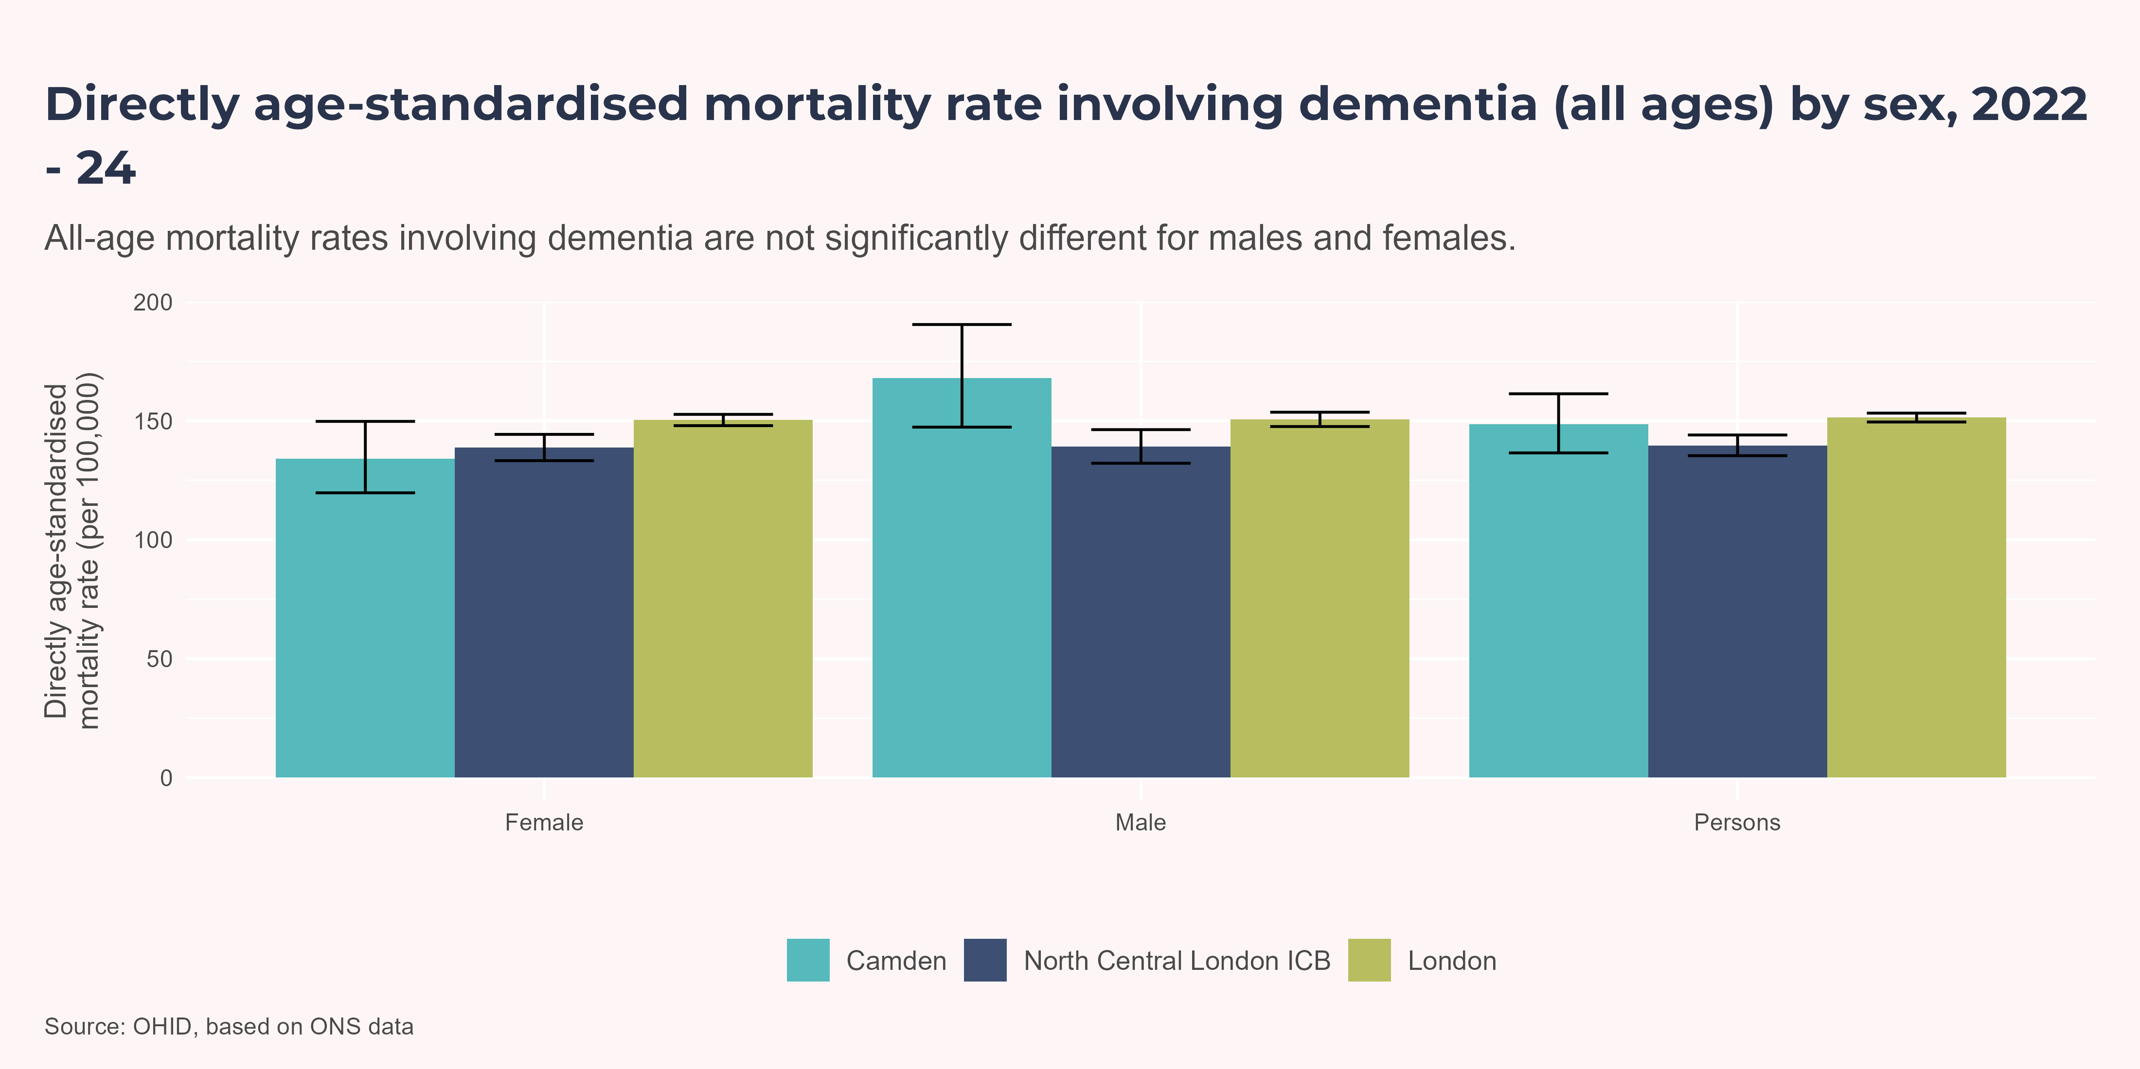
By Sex: involving dementia, all ages
Deaths involving dementia comprise deaths where dementia was recorded anywhere on the death certificate.

Slide 29
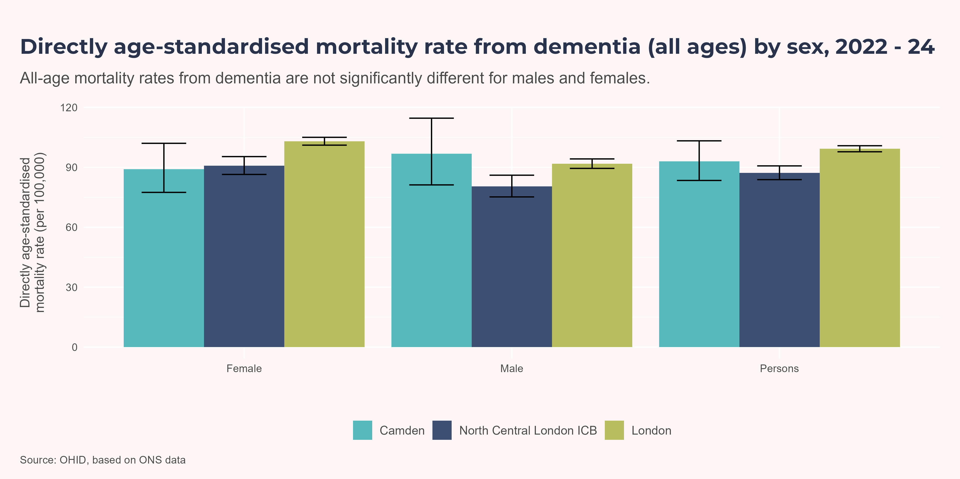
By Sex: from dementia, all ages
Deaths from dementia comprise deaths where dementia was listed as the primary cause of death.

Slide 30
Crude Mortality Rate (65+)
Crude mortality rates are based on the total number of deaths involving dementia among people aged 65+, divided by the size of the 65+ population in each group. Unlike directly age-standardised rates, these figures are not adjusted for differences in age structure within the 65+ population. They are used here to provide a picture of local variation by IMD decile and ward but should be interpreted with caution, as areas with older age profiles within the 65+ group may show higher rates even if underlying risk is similar.
Crude mortality rates are shown to illustrate how deaths relate to deprivation and vary across Camden’s wards. These figures should be interpreted with caution (see note above), as they are not age-standardised. Overall, patterns by deprivation decile and ward are similar to those seen for all-cause hospital admissions of residents with dementia. Notably, Kentish Town North has the highest crude death rate but ranks in the lowest quintile for admission rates.

Slide 31
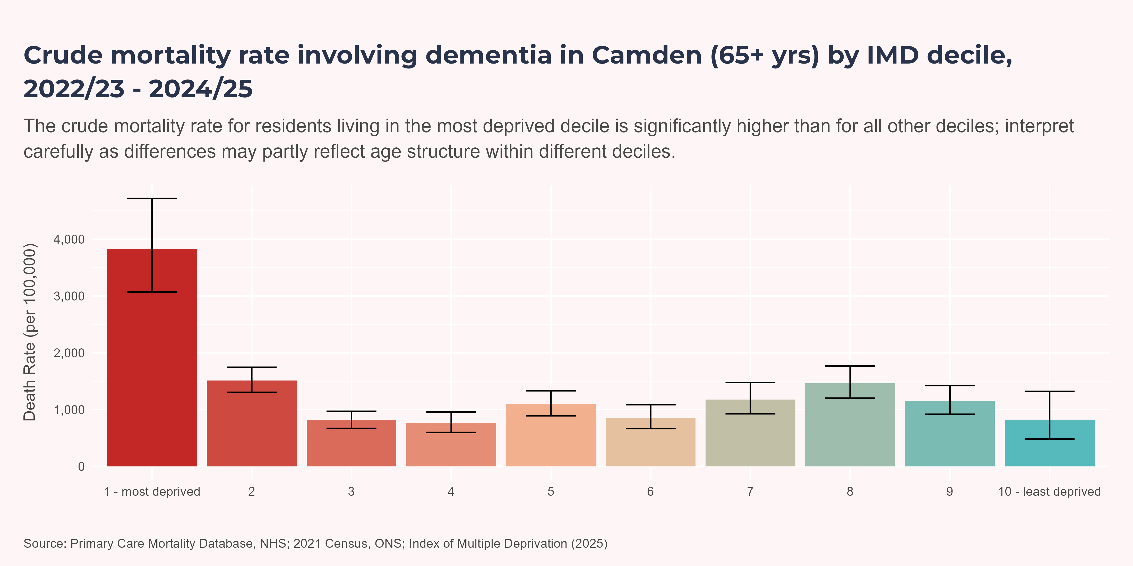
By IMD
Deaths involving dementia comprise deaths where dementia was recorded anywhere on the death certificate.

Slide 32
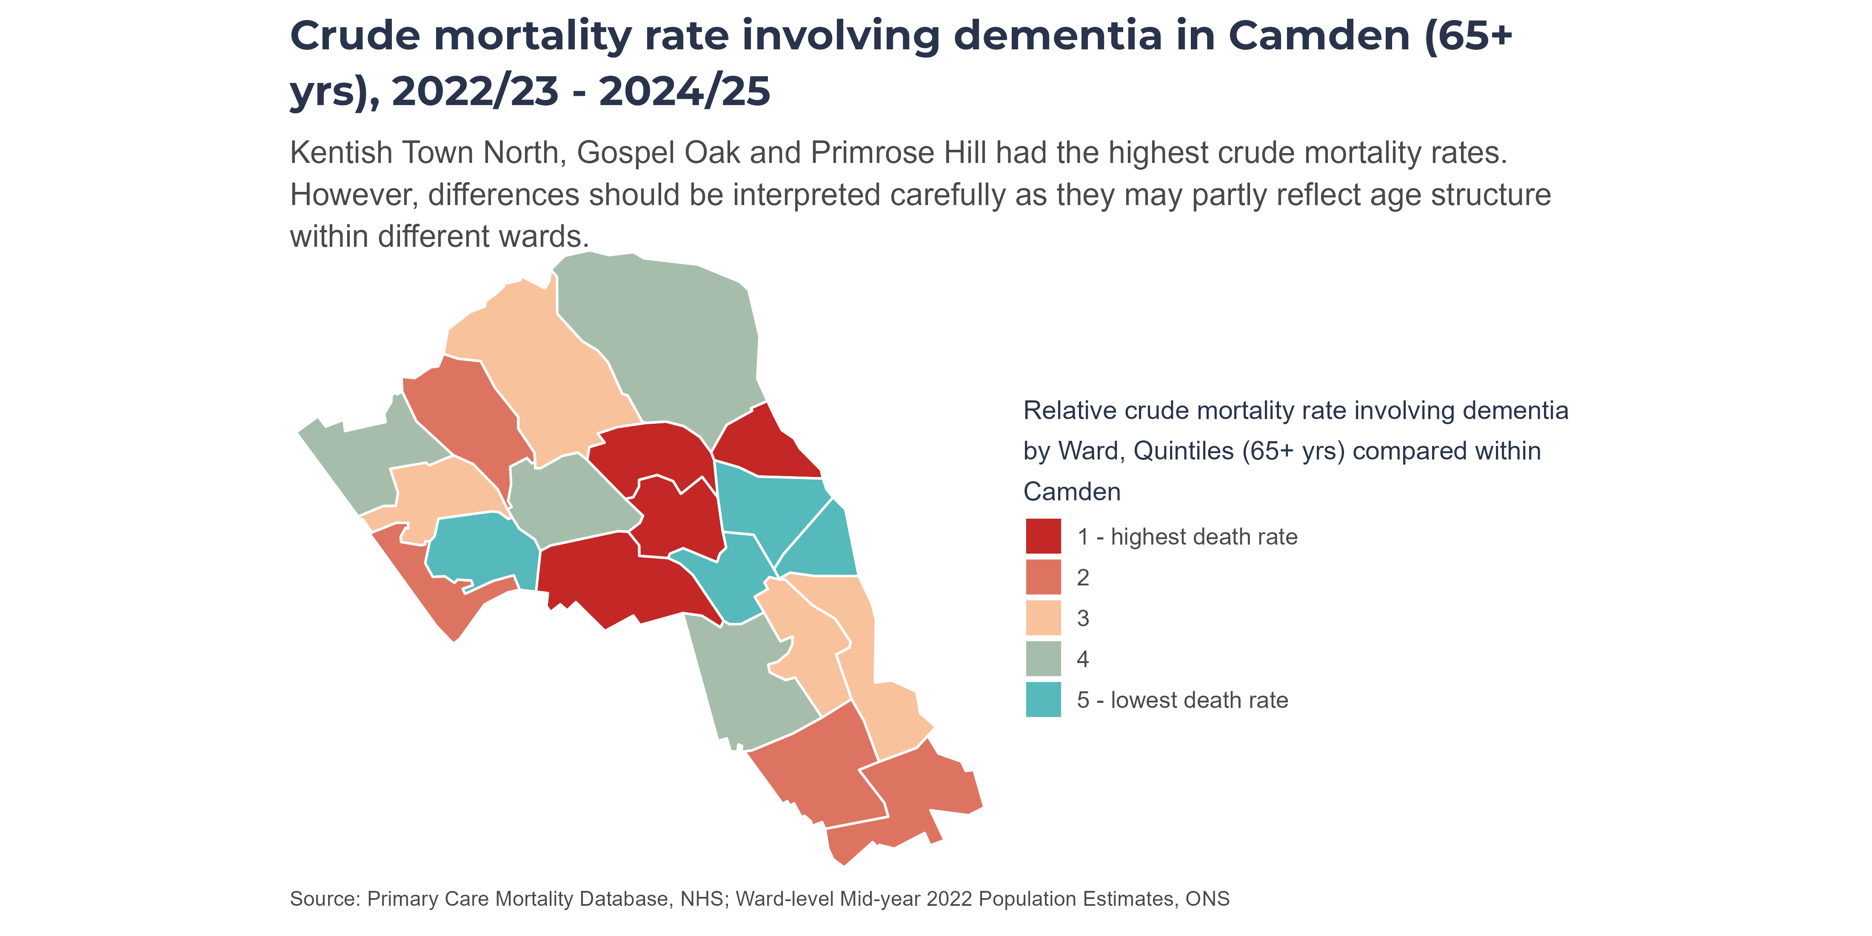
By Ward (Map)
Deaths involving dementia comprise deaths where dementia was recorded anywhere on the death certificate.
Quintiles are calculated within Camden only. All Camden wards are ranked by prevalence; then the ranked list is split into five (roughly) equal-sized groups (“quintiles”). Colours therefore show how a ward compares to other wards in Camden, not across the whole of England.

Slide 33
Place of Death
Camden shows a distinct pattern in place of death for residents with dementia: a lower proportion die in care homes and a higher proportion die at home, compared to London and NCL ICB. Hospital deaths have declined over time, while home deaths have increased.

Slide 34
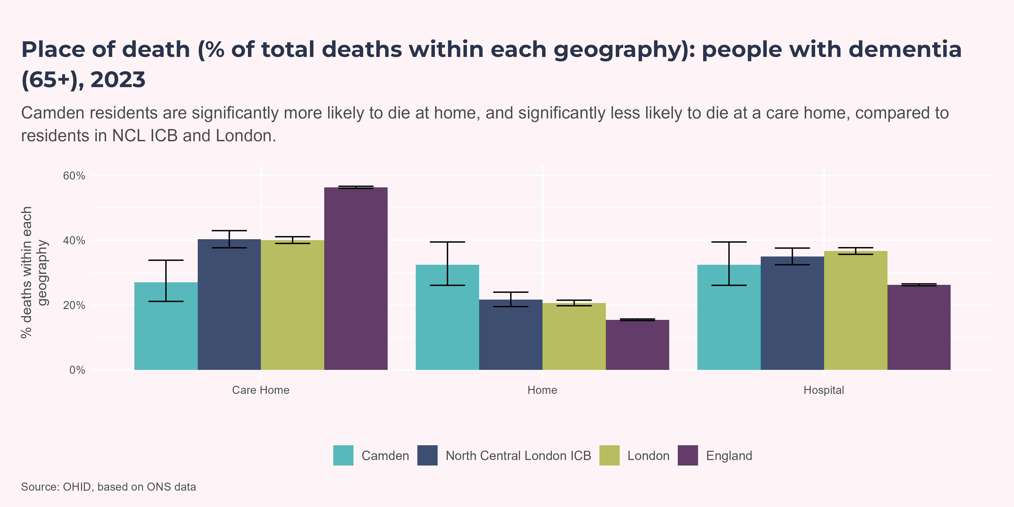
All Locations
Further investigation is needed to understand why a greater proportion of Camden residents with dementia die at home rather than in a care home, bucking the trend seen in NCL ICB, London and England.

Slide 35
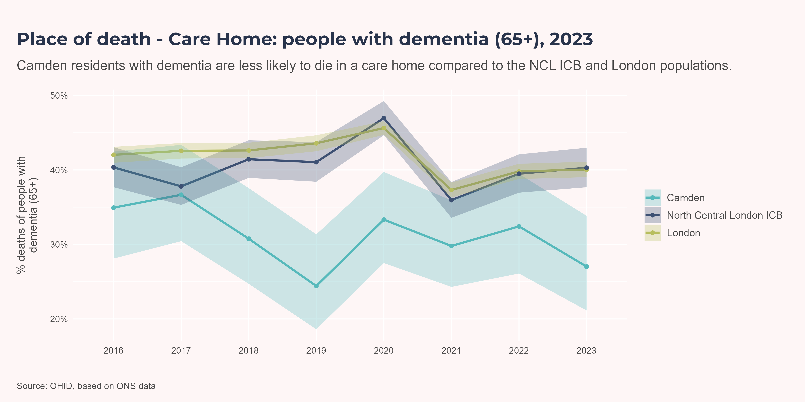
Care Home
In 2023, 27% of Camden residents with dementia died in a care home. This was significantly lower than London and North Central London ICB.
There is no clear upward or downward trend, and small numbers mean proportions fluctuate. Although not always a statistically significant difference, Camden has consistently had a lower proportion of care home deaths than NCL ICB and London since at least 2016.

Slide 36
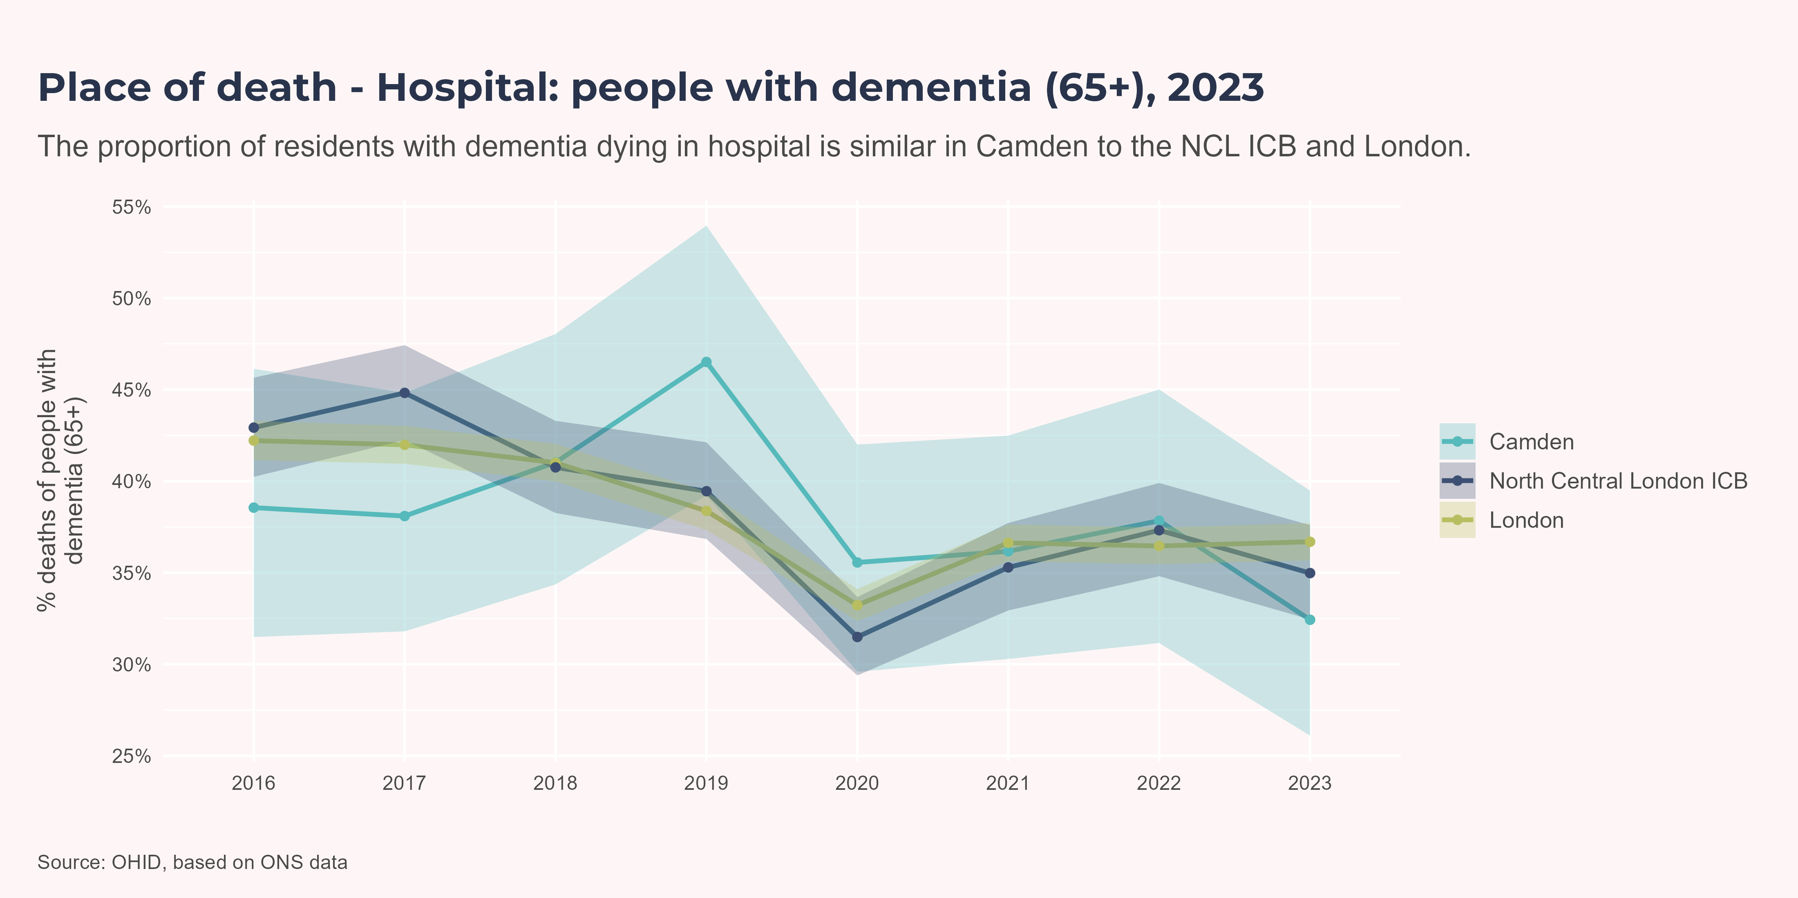
Hospital
In 2023, Camden recorded its lowest proportion of dementia-related deaths in hospital since at least 2016 (32.4%). This was similar to NCL ICB (35%) and London (36.7%).

Slide 37
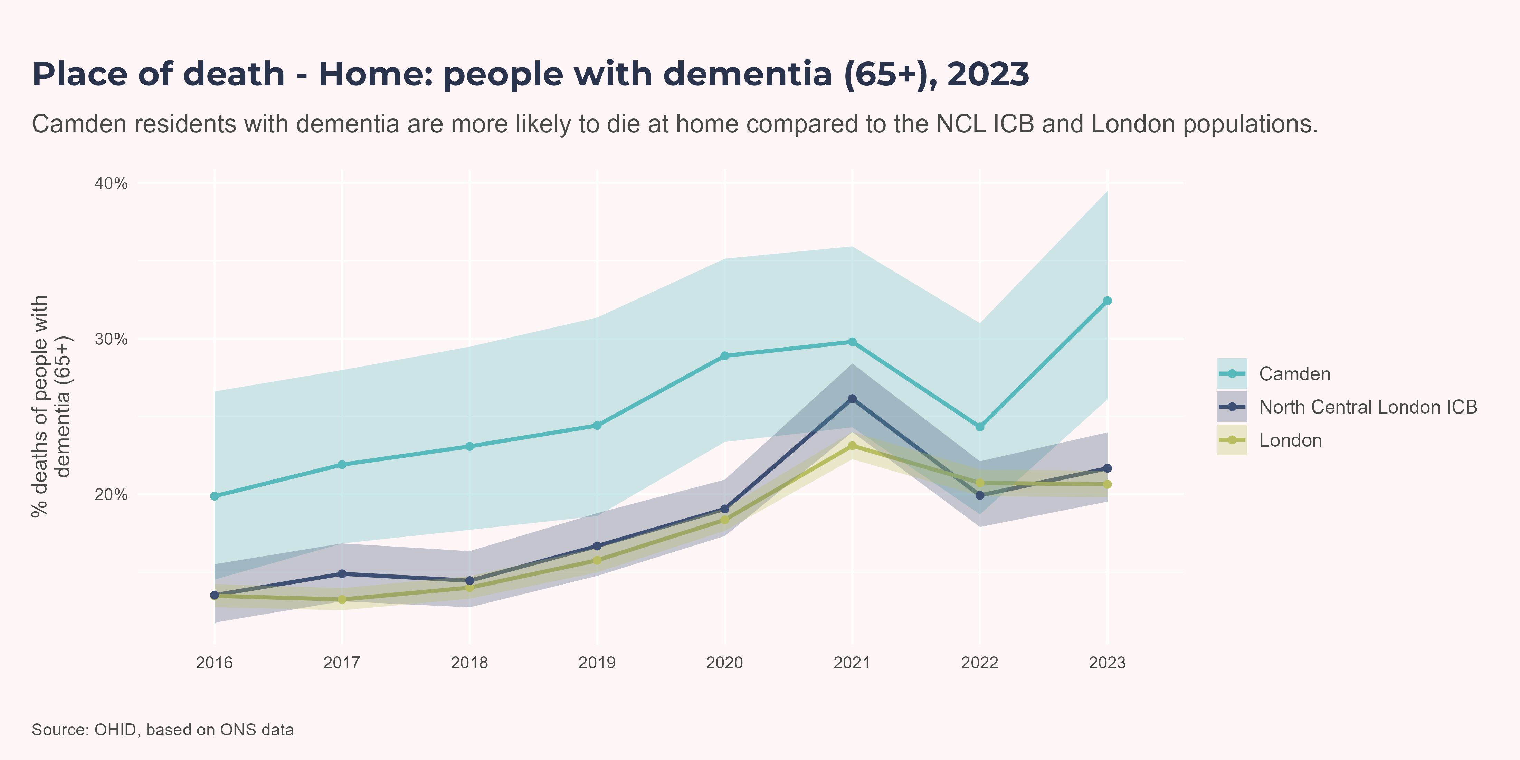
Home
In 2023, Camden recorded its highest proportion of dementia-related deaths at home since at least 2016 (32.4%). This was significantly higher than NCL ICB (21.7%) and London (20.6%), although all three geographies have shown a broadly increasing trend since 2016.

Slide 38
References
“2025 Alzheimer’s Disease Facts and Figures.” 2025. Alzheimer’s & Dementia 21 (4): e70235. https://doi.org/10.1002/alz.70235.
“Addressing 14 Health and Lifestyle Factors Could Prevent Nearly Half of Global Dementia Cases.” n.d. Alzheimer’s Research UK. Accessed January 14, 2026. https://www.alzheimersresearchuk.org/news/nearly-half-of-global-dementia-cases-could-be-prevented-or-delayed-by-addressing-14-health-and-lifestyle-factors-says-new-report/.
Arvanitakis, Zoe. 2024. “The Need to Better Understand Aging and Risk Factors for Dementia.” Frontiers in Dementia 2 (January): 1346281. https://doi.org/10.3389/frdem.2023.1346281.
Bellenguez, Céline, Fahri Küçükali, Iris E. Jansen, Luca Kleineidam, Sonia Moreno-Grau, Najaf Amin, Adam C. Naj, et al. 2022. “New Insights into the Genetic Etiology of Alzheimer’s Disease and Related Dementias.” Nature Genetics 54 (4): 412–36. https://doi.org/10.1038/s41588-022-01024-z.
Bir, Shyamal C., Muhammad W. Khan, Vijayakumar Javalkar, Eduardo Gonzalez Toledo, and Roger E. Kelley. 2021. “Emerging Concepts in Vascular Dementia: A Review.” Journal of Stroke and Cerebrovascular Diseases 30 (8): 105864. https://doi.org/10.1016/j.jstrokecerebrovasdis.2021.105864.
Bothongo, Phazha L. K., Mark Jitlal, Eve Parry, Sheena Waters, Isabelle F. Foote, Cameron J. Watson, Jack Cuzick, et al. 2022. “Dementia Risk in a Diverse Population: A Single-Region Nested Case-Control Study in the East End of London.” The Lancet Regional Health - Europe 15 (April): 100321. https://doi.org/10.1016/j.lanepe.2022.100321.
Cao, Fang, Fushuang Yang, Jian Li, Wei Guo, Chongheng Zhang, Fa Gao, Xinxin Sun, Yi Zhou, and Wenfeng Zhang. 2024. “The Relationship Between Diabetes and the Dementia Risk: A Meta-Analysis.” Diabetology & Metabolic Syndrome 16 (1): 101. https://doi.org/10.1186/s13098-024-01346-4.
“Dementia Maps.” n.d. Dementia Statistics Hub. Accessed January 14, 2026. https://dementiastatistics.org/about-dementia/maps/.
Edwards, Sophie, Dominic Trepel, Craig Ritchie, Julie Hviid Hahn-Pedersen, Danielle E Robinson, Mei Sum Chan, Benjamin D Bray, et al. 2024. “Real World Outcomes, Healthcare Utilisation and Costs of Alzheimer’s Disease in England.” Aging and Health Research 4 (1): 100180. https://doi.org/10.1016/j.ahr.2024.100180.
England, N. H. S. n.d. “NHS England » RightCare Dementia Scenario.” Accessed January 14, 2026. https://www.england.nhs.uk/long-read/rightcare-dementia-scenario/.
Fernández Fernández, Roberto, Javier Ibias Martín, and María Araceli Maciá Antón. 2024. “Depression as a Risk Factor for Dementia: A Meta-Analysis.” The Journal of Neuropsychiatry and Clinical Neurosciences 36 (2): 101–9. https://doi.org/10.1176/appi.neuropsych.20230043.
Gil Martínez, Victoria, Ana Avedillo Salas, and Sonia Santander Ballestín. 2022. “Vitamin Supplementation and Dementia: A Systematic Review.” Nutrients 14 (5): 1033. https://doi.org/10.3390/nu14051033.
Guay‐Gagnon, Martin, Sopharat Vat, Marie‐France Forget, Maxime Tremblay‐Gravel, Simon Ducharme, Quoc Dinh Nguyen, and Philippe Desmarais. 2022. “Sleep Apnea and the Risk of Dementia: A Systematic Review and Meta‐analysis.” Journal of Sleep Research 31 (5): e13589. https://doi.org/10.1111/jsr.13589.
“How Many People Have Dementia in the UK? | Alzheimer’s Society.” n.d. Accessed January 14, 2026. https://www.alzheimers.org.uk/blog/how-many-people-have-dementia-uk.
Hu, Mingyue, Kai Zhang, Kuan-Jui Su, Tian Qin, Hui Shen, and Hong-wen Deng. 2024. “Unveiling the Link Between Physical Activity Levels and Dementia Risk: Insights from the UK Biobank Study.” Psychiatry Research 336 (June): 115875. https://doi.org/10.1016/j.psychres.2024.115875.
Iwagami, Masao, Nawab Qizilbash, John Gregson, Ian Douglas, Michelle Johnson, Neil Pearce, Stephen Evans, and Stuart Pocock. 2021. “Blood Cholesterol and Risk of Dementia in More Than 1·8 Million People over Two Decades: A Retrospective Cohort Study.” The Lancet Healthy Longevity 2 (8): e498–506. https://doi.org/10.1016/S2666-7568(21)00150-1.
Maccora, Janet, Ruth Peters, and Kaarin J. Anstey. 2020. “What Does (Low) Education Mean in Terms of Dementia Risk? A Systematic Review and Meta-Analysis Highlighting Inconsistency in Measuring and Operationalising Education.” SSM - Population Health 12 (December): 100654. https://doi.org/10.1016/j.ssmph.2020.100654.
Ou, Ya-Nan, Chen-Chen Tan, Xue-Ning Shen, Wei Xu, Xiao-He Hou, Qiang Dong, Lan Tan, and Jin-Tai Yu. 2020. “Blood Pressure and Risks of Cognitive Impairment and Dementia: A Systematic Review and Meta-Analysis of 209 Prospective Studies.” Hypertension 76 (1): 217–25. https://doi.org/10.1161/HYPERTENSIONAHA.120.14993.
Peters, Ruth, Nicole Ee, Jean Peters, Andrew Booth, Ian Mudway, and Kaarin J. Anstey. 2019. “Air Pollution and Dementia: A Systematic Review.” Journal of Alzheimer’s Disease 70 (s1): S145–63. https://doi.org/10.3233/JAD-180631.
Readman, Megan Rose, Jenna Littlejohn, Imogen Dodd, Sarah Rhodes, Lettie Wareing, Megan Polden, Christopher J. Plack, and Clarissa Giebel. 2025. “Hearing Loss as a Risk Factor for Dementia: A Systematic Review and Meta-Analysis from a Global Perspective.” Aging & Mental Health 29 (10): 1831–44. https://doi.org/10.1080/13607863.2025.2515180.
Rehm, Jürgen, Omer S. M. Hasan, Sandra E. Black, Kevin D. Shield, and Michaël Schwarzinger. 2019. “Alcohol Use and Dementia: A Systematic Scoping Review.” Alzheimer’s Research & Therapy 11 (1): 1. https://doi.org/10.1186/s13195-018-0453-0.
Shang, Xianwen, Zhuoting Zhu, Wei Wang, Jason Ha, and Mingguang He. 2021. “The Association Between Vision Impairment and Incidence of Dementia and Cognitive Impairment.” Ophthalmology 128 (8): 1135–49. https://doi.org/10.1016/j.ophtha.2020.12.029.
Shiekh, Suhail Ismail, Sharon Louise Cadogan, Liang-Yu Lin, Rohini Mathur, Liam Smeeth, and Charlotte Warren-Gash. 2021. “Ethnic Differences in Dementia Risk: A Systematic Review and Meta-Analysis.” Edited by M. Arfan Ikram. Journal of Alzheimer’s Disease 80 (1): 337–55. https://doi.org/10.3233/JAD-201209.
Sian Besley, Dimitrios Kourouklis, Phill O’Neill, and Martina Garau. 2023. “Dementia in the UK: Estimating the Potential Future Impact and Return on Research Investment.” Office of Health Economics. https://www.ohe.org/wp-content/uploads/2023/07/OHE-report_Estimating-Dementia-UK.pdf.
“Social Isolation and Dementia Risk | Alzheimer’s Society.” 2024. August 2024. https://www.alzheimers.org.uk/about-dementia/managing-the-risk-of-dementia/reduce-your-risk-of-dementia/social-isolation.
Vardy, Emma. 2022. “Patterns of Unplanned Hospital Admissions in People with Dementia.” Age and Ageing 51 (6): afac123. https://doi.org/10.1093/ageing/afac123.
Vidyanti, Amelia Nur, Fitri Rahmawati, Rifki Habibi Rahman, Astuti Prodjohardjono, and Abdul Gofir. 2025. “Lifestyle Interventions for Dementia Risk Reduction: A Review on the Role of Physical Activity and Diet in Western and Asian Countries.” The Journal of Prevention of Alzheimer’s Disease 12 (2): 100028. https://doi.org/10.1016/j.tjpad.2024.100028.
Zheng, Yong-Bo, Le Shi, Xi-Mei Zhu, Yan-Ping Bao, Li-Juan Bai, Jin-Qiao Li, Jia-Jia Liu, Ying Han, Jie Shi, and Lin Lu. 2021. “Anticholinergic Drugs and the Risk of Dementia: A Systematic Review and Meta-Analysis.” Neuroscience & Biobehavioral Reviews 127 (August): 296–306. https://doi.org/10.1016/j.neubiorev.2021.04.031.
Zhong, Guochao, Yi Wang, Yong Zhang, Jeff Jianfei Guo, and Yong Zhao. 2015. “Smoking Is Associated with an Increased Risk of Dementia: A Meta-Analysis of Prospective Cohort Studies with Investigation of Potential Effect Modifiers.” Edited by Keith Laws. PLOS ONE 10 (3): e0118333. https://doi.org/10.1371/journal.pone.0118333.

