Slide 1
Deprivation
A summary of deprivation and poverty in Camden Profile

Slide 2

Introduction
This profile provides an overview of deprivation and poverty, including the impact on health, in Camden.
Deprivation is defined as a relative lack of resources or opportunities, while poverty is specifically a lack of financial resources. Relative deprivation refers to inequality and the idea that people are deprived compared with others in society.
Deprivation and poverty are associated with poorer health outcomes, whereby people living in more deprived areas typically experience worse health than those living in less deprived areas - this is known as the social gradient in health.(Marmot et al. 2010) These health inequalities arise from differences in the conditions in which people are born, grow, live, work and age - the social determinants of health.(Marmot et al. 2010)
Camden ranks in the middle quintile of deprivation both within London and nationally, however, there is considerable variation within the borough and the problems associated with relative deprivation are more common in more unequal places, with greater equality reducing these problems.(MHCLG 2019) Indicators related to the living environment, crime, barriers to housing, and income are the biggest contributors to relative deprivation in Camden.(MHCLG 2019)

Slide 3

Indices of Deprivation

Slide 4

Indices of Deprivation
The English Indices of Deprivation provide a set of relative measures of deprivation for small areas (Lower-layer Super Output Areas) across England.(MHCLG 2019) The Indices of Deprivation 2019 (IoD2019) is the most recent release and comprises seven domains, each based on a set of indicators. These seven domains are combined into an overall measure - the Index of Multiple Deprivation (IMD) - using explicitly defined domain weights. The IMD is the official measure of relative deprivation in England.
The IoD2019 measures deprivation in small areas, called Lower-Layer Super Output Areas (LSOAs), across England. All LSOAs are ranked from most deprived (rank = 1) to least deprived. It is most common to describe how relatively deprived an area is by saying whether it falls among the most deprived 10% or 20% of areas in England. Although, it is worth noting that this description does not apply to every person living in these areas as many non-deprived people will live in deprived areas, and many deprived people will live in non-deprived areas.
In addition to the IMD and seven domain indices, there are two supplementary indices, created as subsets from the Income Deprivation domain: the Income Deprivation Affecting Children Index (IDACI) and the Income Deprivation Affecting Older People Index (IDAOPI).
The next update of the IoD is expected to be published in late 2025.

Slide 5
Domains of deprivation and weights used to produce the Index of Multiple Deprivation (IMD)
Domain | Description
Income (22.5%) | The proportion of the population experiencing deprivation relating to low income.
Employment (22.5%) | The proportion of the working age population in an area involuntarily excluded from the labour market.
Education, Skills and Training (13.5%) | The lack of attainment and skills in the local population.
Health Deprivation and Disability (13.5%) | The risk of premature death and the impairment of quality of life through poor physical or mental health.
Crime (9.3%) | The risk of personal and material victimisation at local level.
Barriers to Housing and Services (9.3%) | The physical and financial accessibility of housing and local services.
Living Environment (9.3%) | The quality of both the indoor and outdoor local environment.

Slide 6
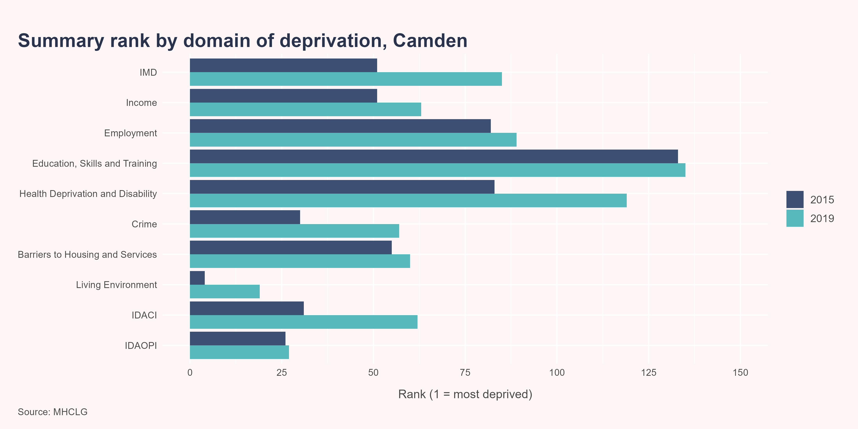
Indices of Deprivation
Overall, in 2019, Camden ranked as the 85th most deprived of the 151 local authority areas in England, compared to 51st most deprived out of the 152 local authority areas in 2015. Therefore, Camden has become relatively less deprived. When looking at the individual domains of deprivation, Camden is the most relatively deprived in relation to the Living Environment, Crime, Barriers to Housing, and Income domains.

Slide 7
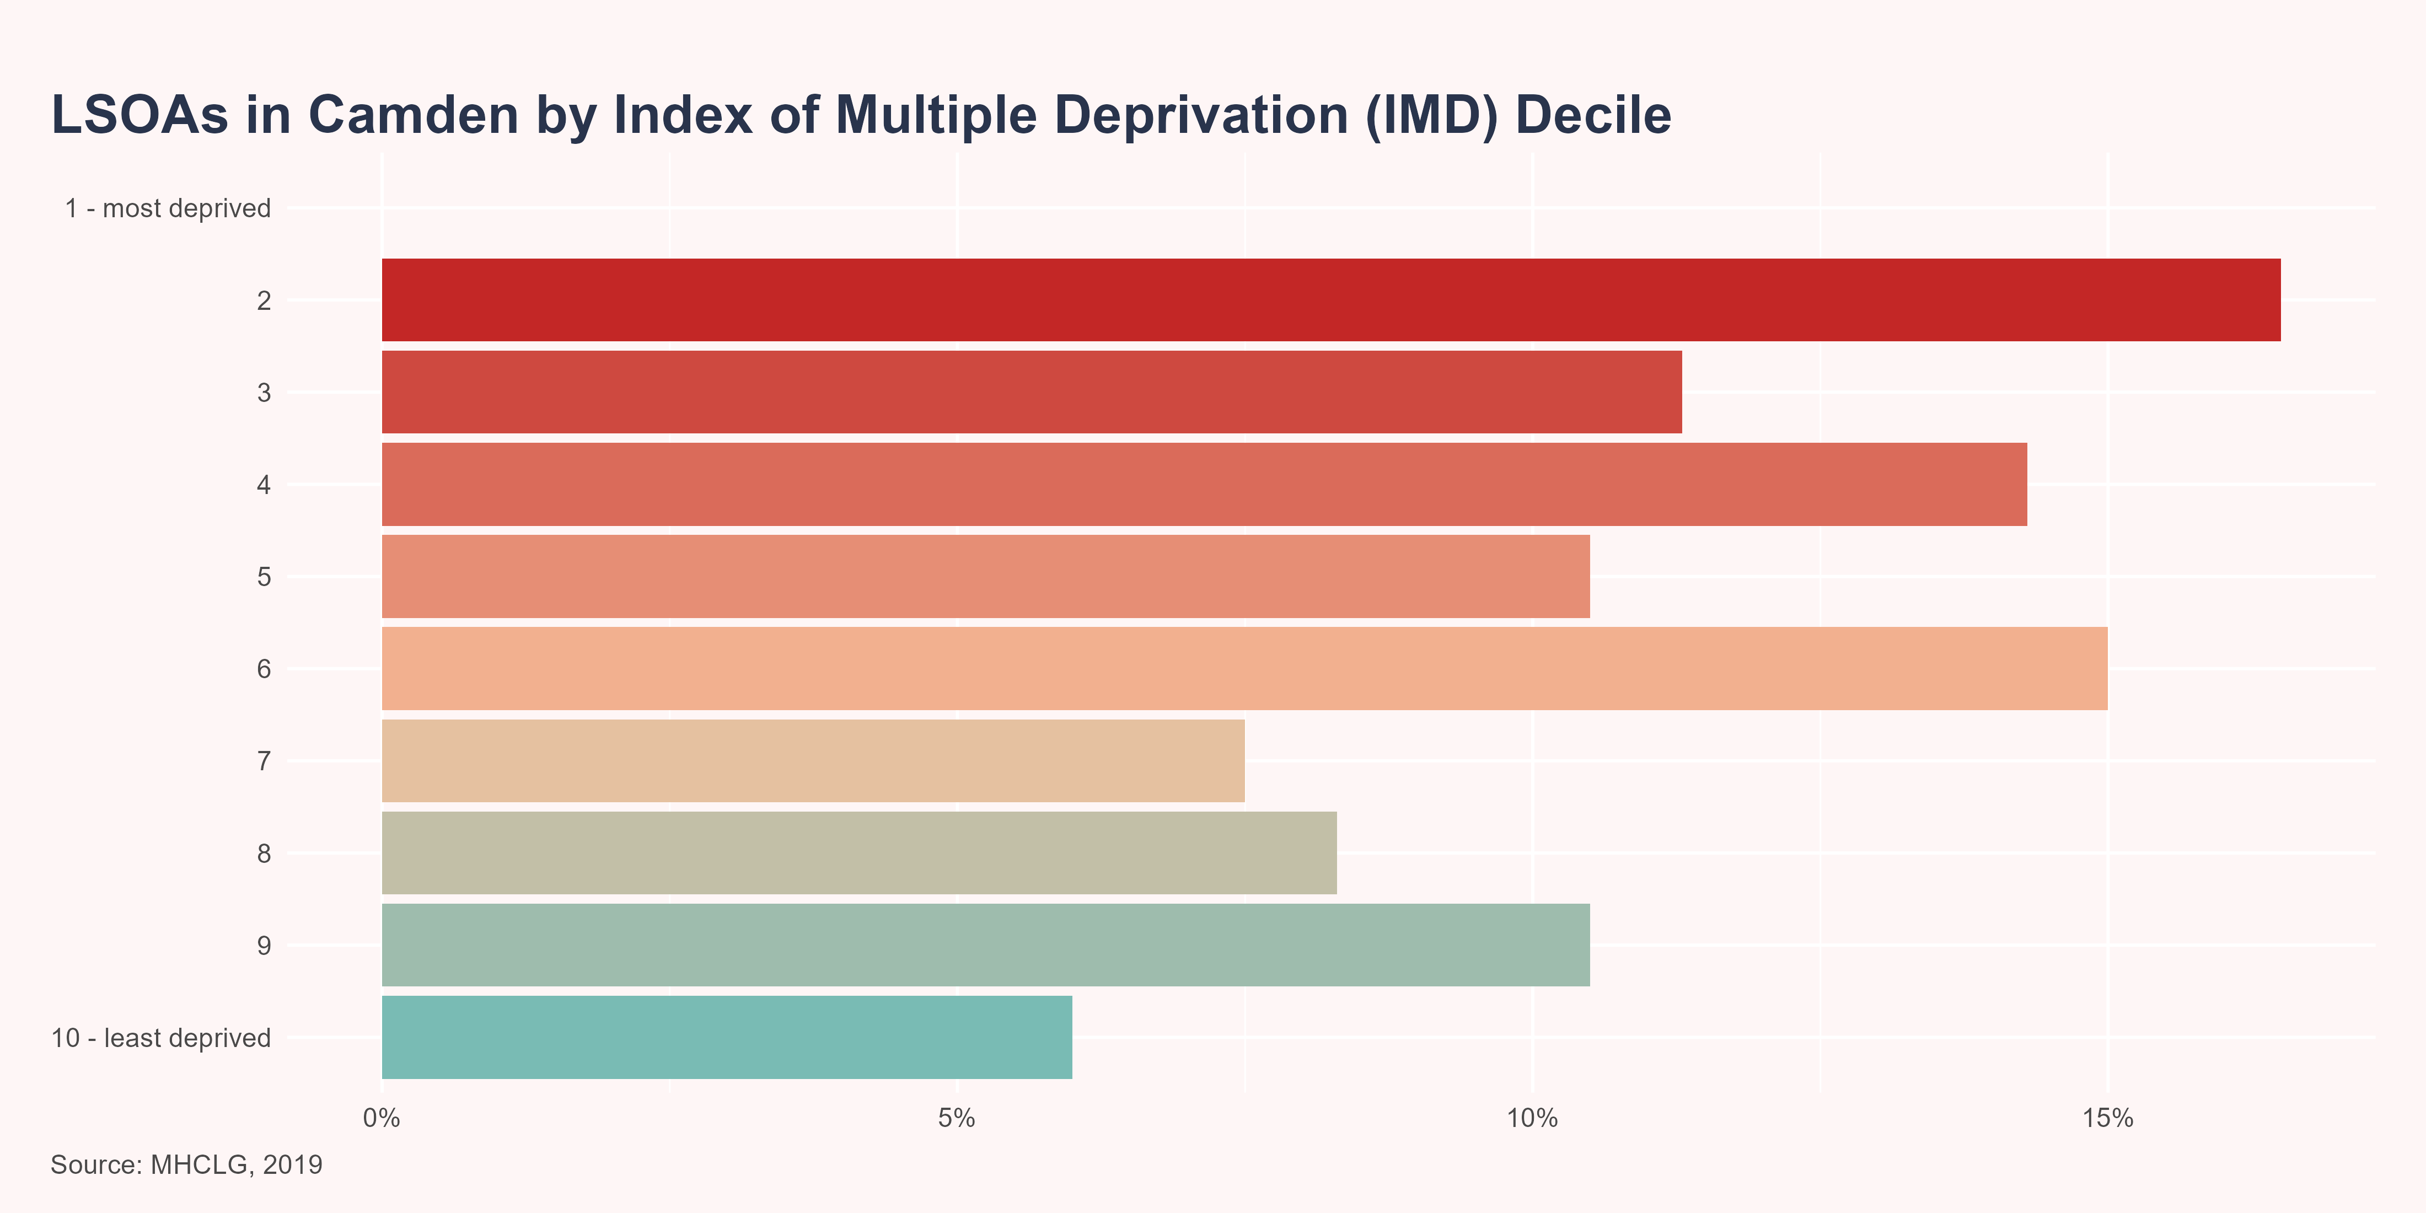
Index of Multiple Deprivation
Camden ranks 85 out of 151 Upper Tier Local Authorities (UTLA) in England (with 1 being the most deprived). Within Camden, 16.5% (n=22) of LSOAs are amongst the 20% most deprived in England, according to the IMD 2019. Notably, no LSOAs in Camden fall within the 10% most deprived nationally.

Slide 8
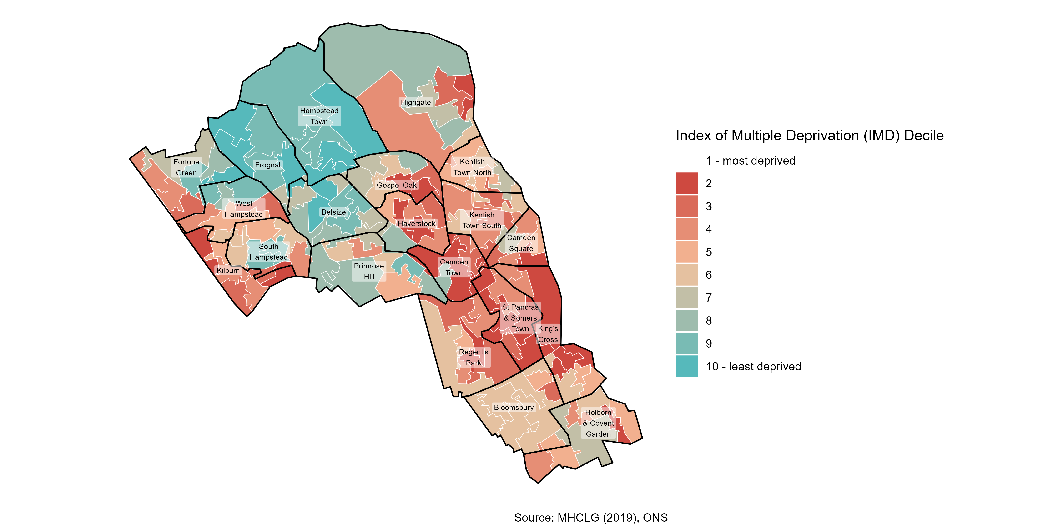
Index of Multiple Deprivation
Deprivation varies across Camden, with higher levels seen in the central and southern areas
St Pancras and Somers Town (75%), Camden Town (67%) and King’s Cross (43%) are the wards with the highest proportion of LSOAs in the 20% most deprived nationally. Meanwhile, Frognal (100%), Hampstead Town (100%) and Belsize (56%) have the highest proportion of wards in the least deprived 20% nationally.

Slide 9
Domains of deprivation

Slide 10
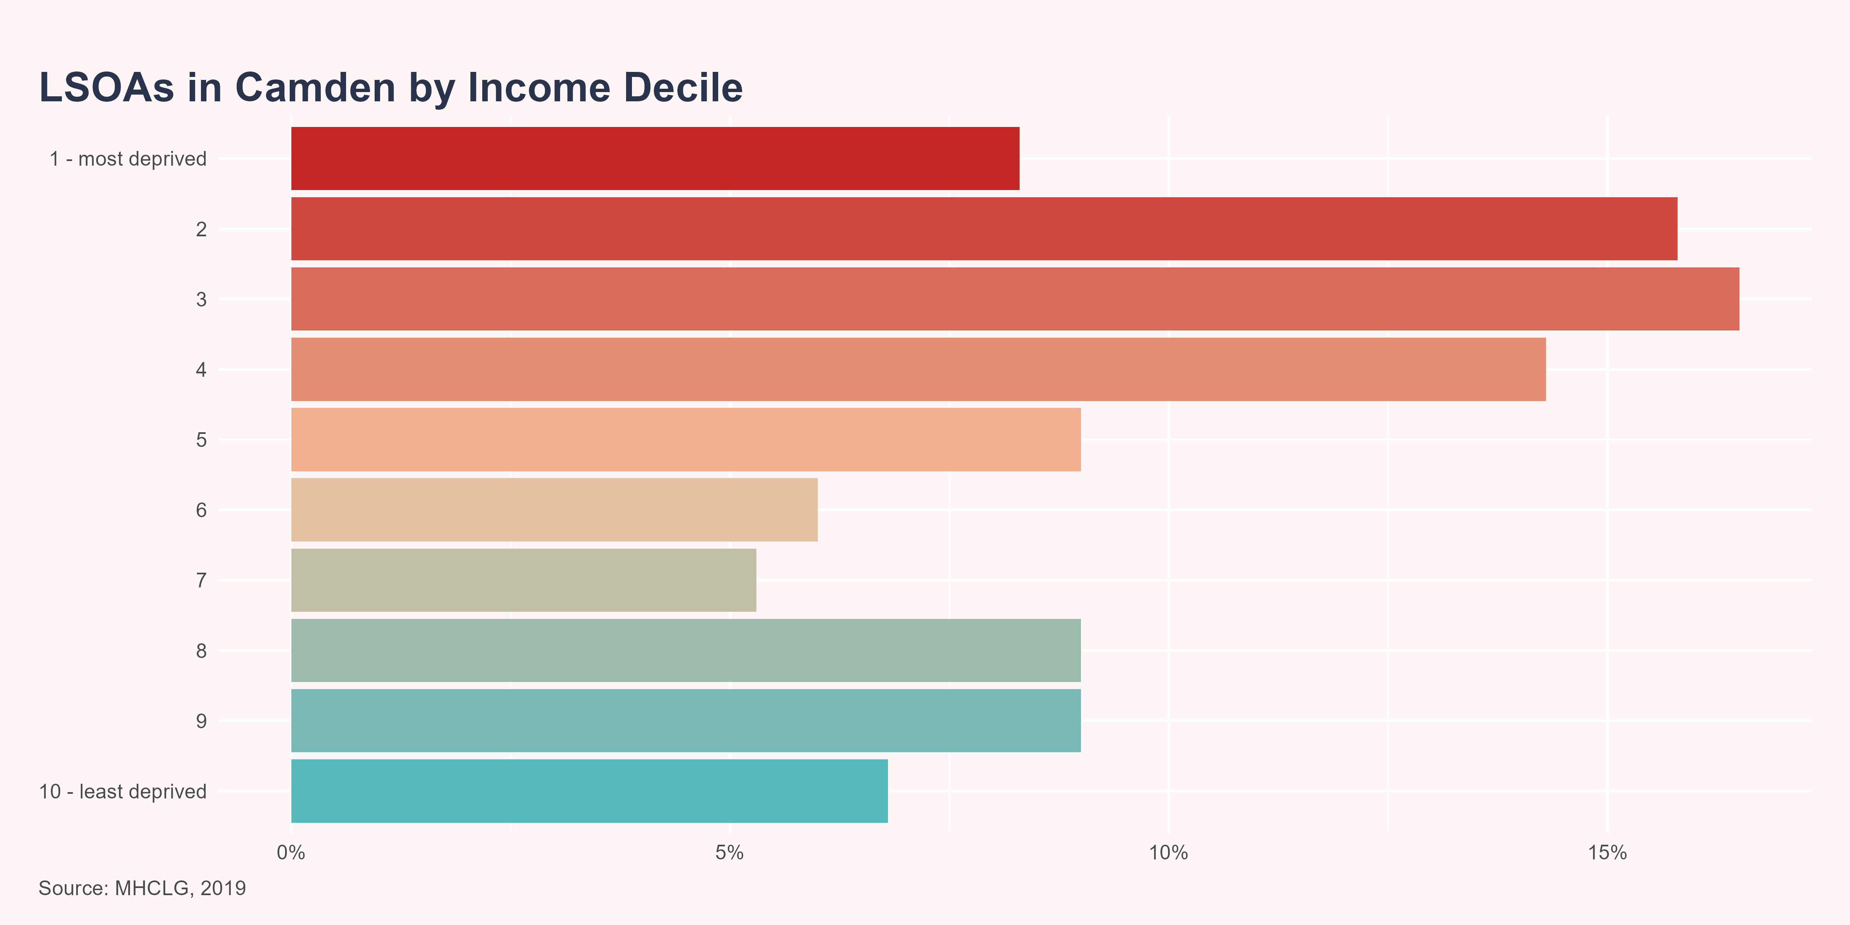
Income
The Income Deprivation Domain measures the proportion of the population in an area experiencing deprivation relating to low income. The definition of low income used includes both those people that are out of work, and those that are in work but who have low earnings (and who satisfy the respective means tests).
Camden ranks 63 out of 151 Upper Tier Local Authorities (UTLA) in England (with 1 being the most deprived). Within Camden, 24.1% (n=32) of LSOAs are amongst the 20% most deprived in England, according to the Income Domain.
A summary for the income domain supplementary indices is shown below.

Slide 11
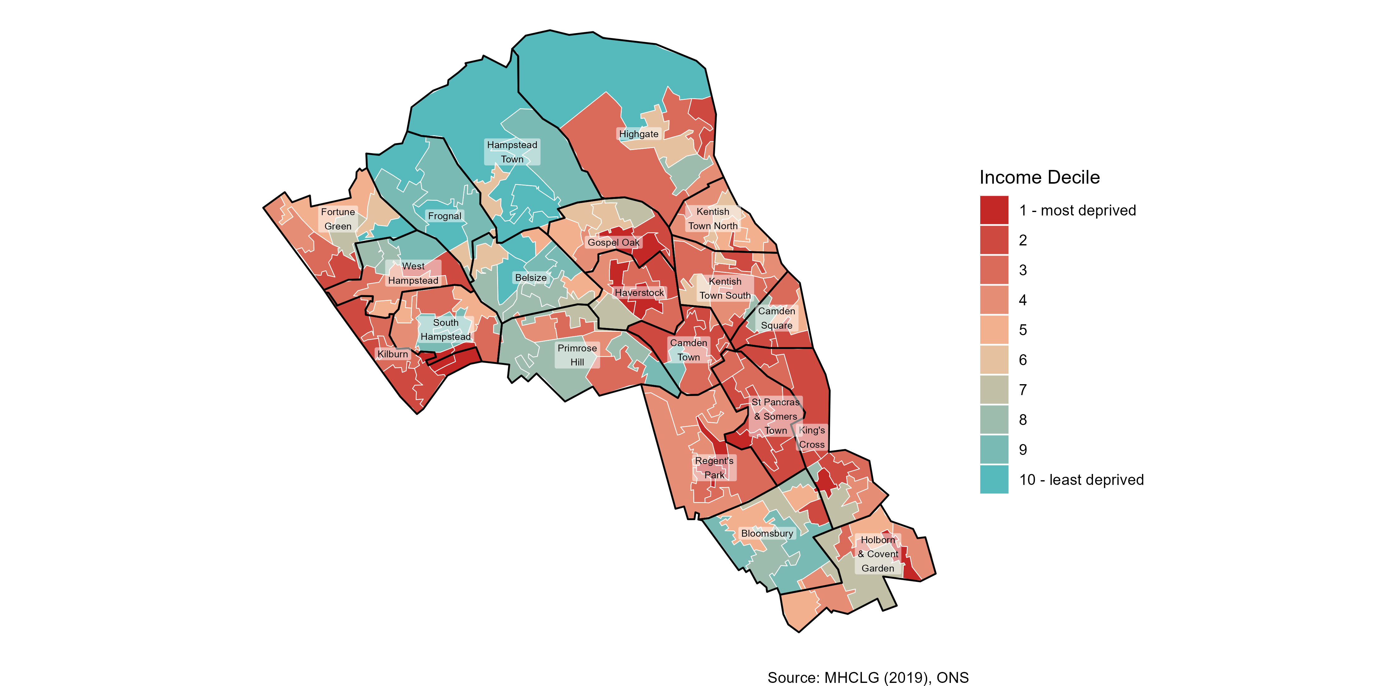
Income

Slide 12
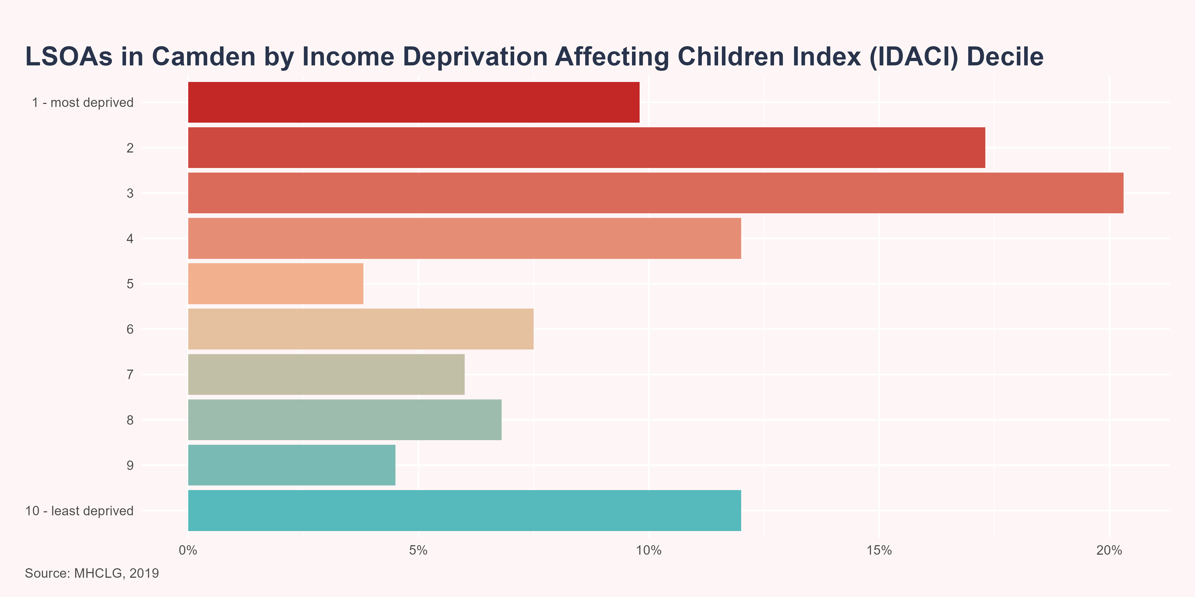
Supplementary Index: Income Deprivation Affecting Children Index
The Income Deprivation Affecting Children Index (IDACI) measures the proportion of all children aged 0 to 15 years living in income deprived families. Income deprived familes are here defined as families that were either:
receiving Income Support or income-based Jobseekers Allowance or income-based Employment and Support Allowance or Pension Credit (Guarantee) or Universal Credit (in the ‘Searching for work’, ‘No work requirements’, ‘Planning for work’, ‘Working – with requirements’ and ‘Preparing for work’ conditionality groups); or
families not in receipt of these benefits but in receipt of Working Tax Credit or Child Tax Credit with an equivalised income (excluding housing benefit) below 60 per cent of the national median before housing costs.
Camden ranks 62 out of 151 Upper Tier Local Authorities (UTLA) in England (with 1 being the most deprived). Within Camden, 27.1% (n=36) of LSOAs are amongst the 20% most deprived in England.

Slide 13
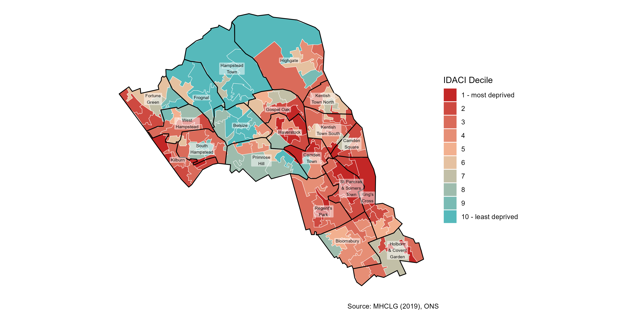
Supplementary Index: Income Deprivation Affecting Children Index

Slide 14
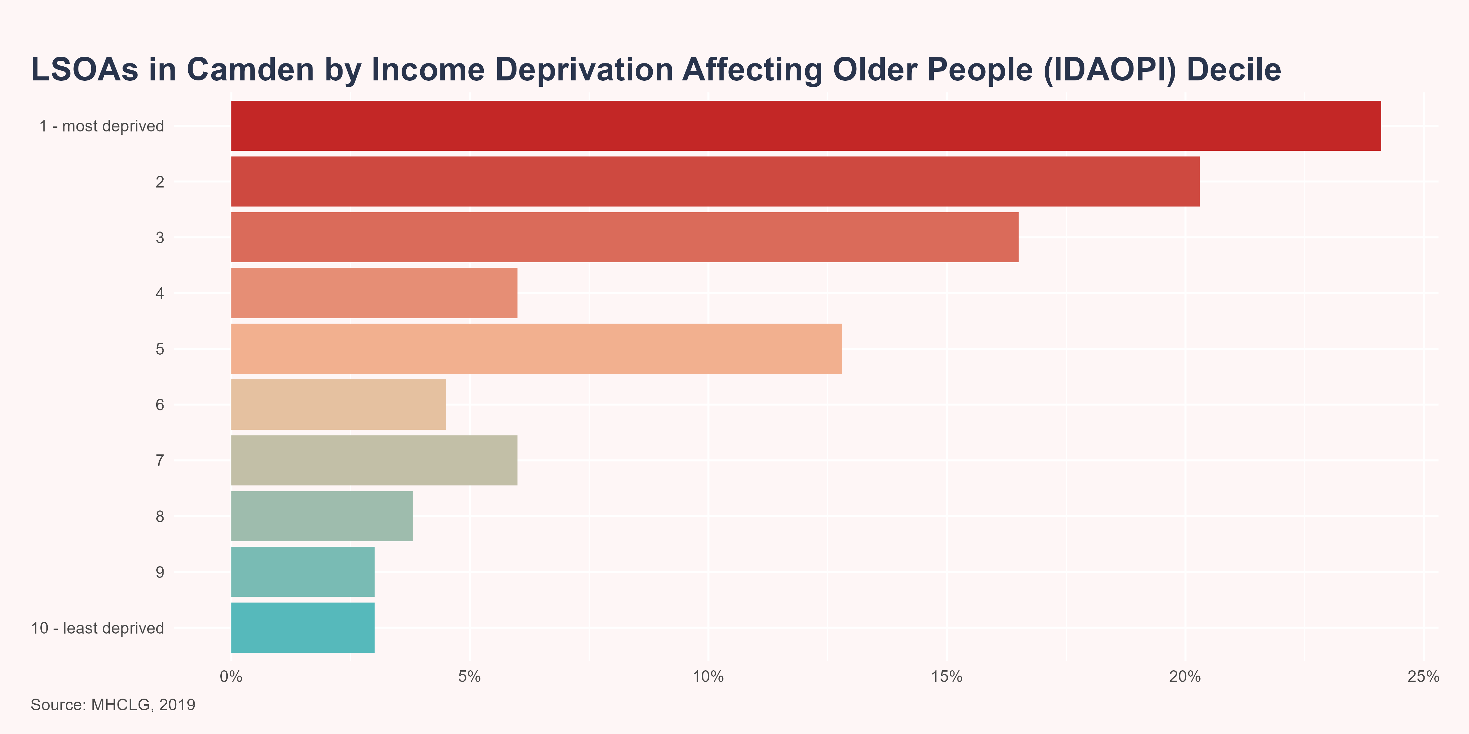
Supplementary Index: Income Deprivation Affecting Older People Index
The Income Deprivation Affecting Older People Index (IDAOPI) measures the proportion of those aged 60 years and over who experience income deprivation. Adults aged 60 years or over experiencing income deprivation are here defined as:
those receiving Income Support or income-based Jobseekers Allowance or income-based Employment and Support Allowance or Pension Credit (Guarantee) or Universal Credit (in the ‘Searching for work’, ‘No work requirements’, ‘Planning for work’, ‘Working – with requirements’ and ‘Preparing for work’ conditionality groups); or
families not in receipt of these benefits but in receipt of Working Tax Credit or Child Tax Credit with an equivalised income (excluding housing benefit) below 60 per cent of the national median before housing costs.
Camden ranks 27 out of 151 Upper Tier Local Authorities (UTLA) in England (with 1 being the most deprived). Within Camden, 44.4% (n=59) of LSOAs are amongst the 20% most deprived in England.

Slide 15
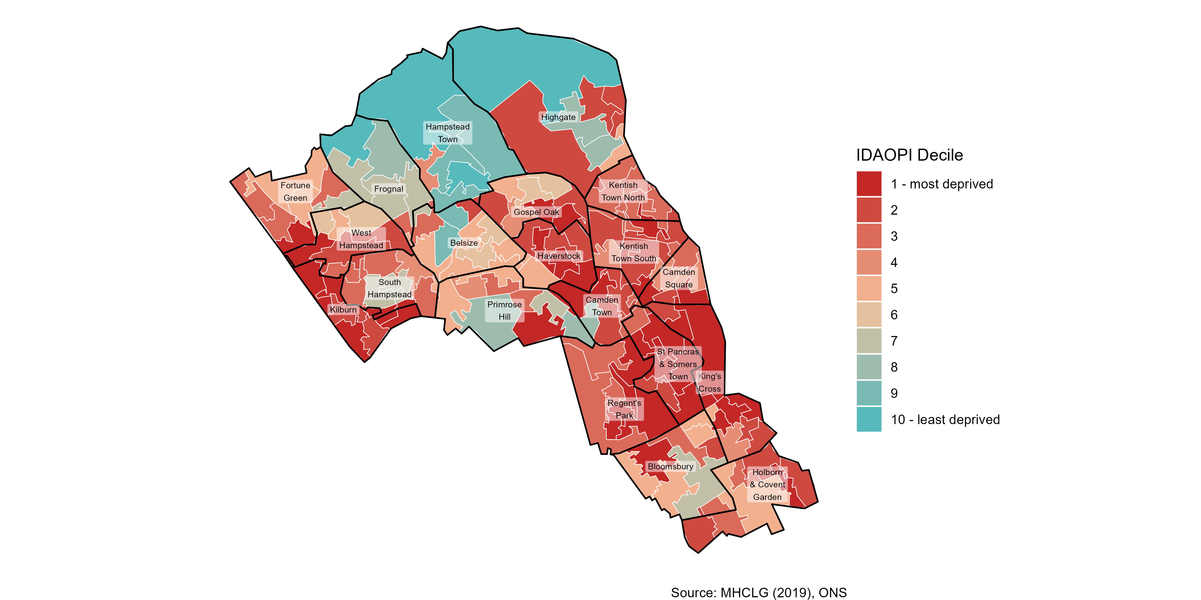
Supplementary Index: Income Deprivation Affecting Older People Index

Slide 16
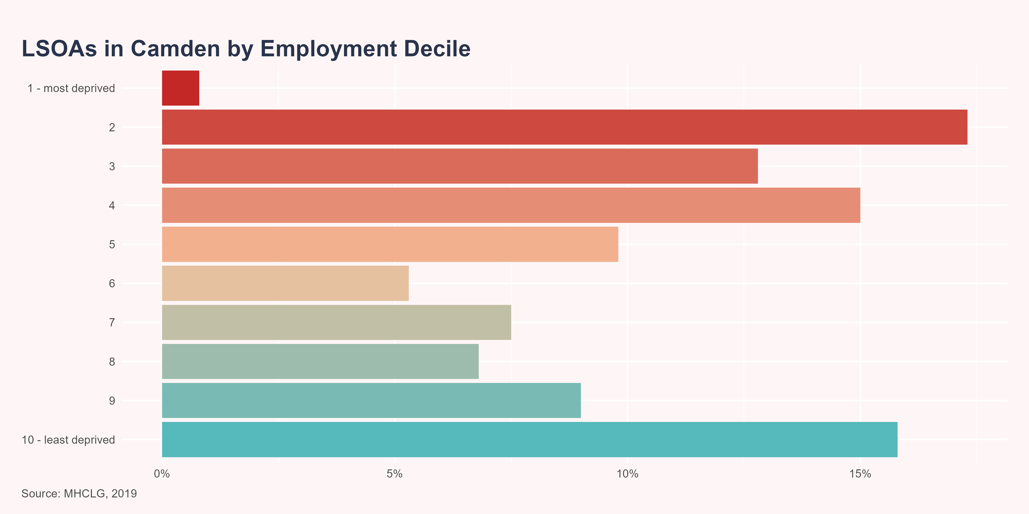
Employment
The Employment Deprivation Domain measures the proportion of the working-age population in an area involuntarily excluded from the labour market. This includes people who would like to work but are unable to do so due to unemployment, sickness or disability, or caring responsibilities.
Camden ranks 89 out of 151 Upper Tier Local Authorities (UTLA) in England (with 1 being the most deprived). Within Camden, 18% (n=24) of LSOAs are amongst the 20% most deprived in England, according to the Employment Domain.

Slide 17
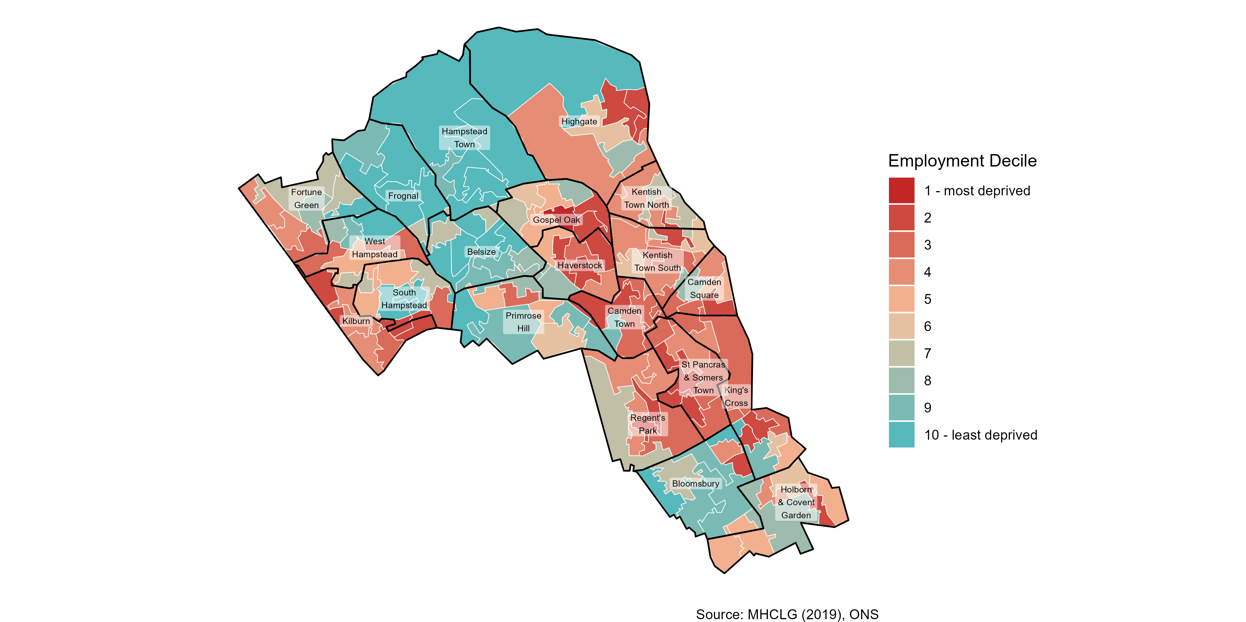
Employment

Slide 18
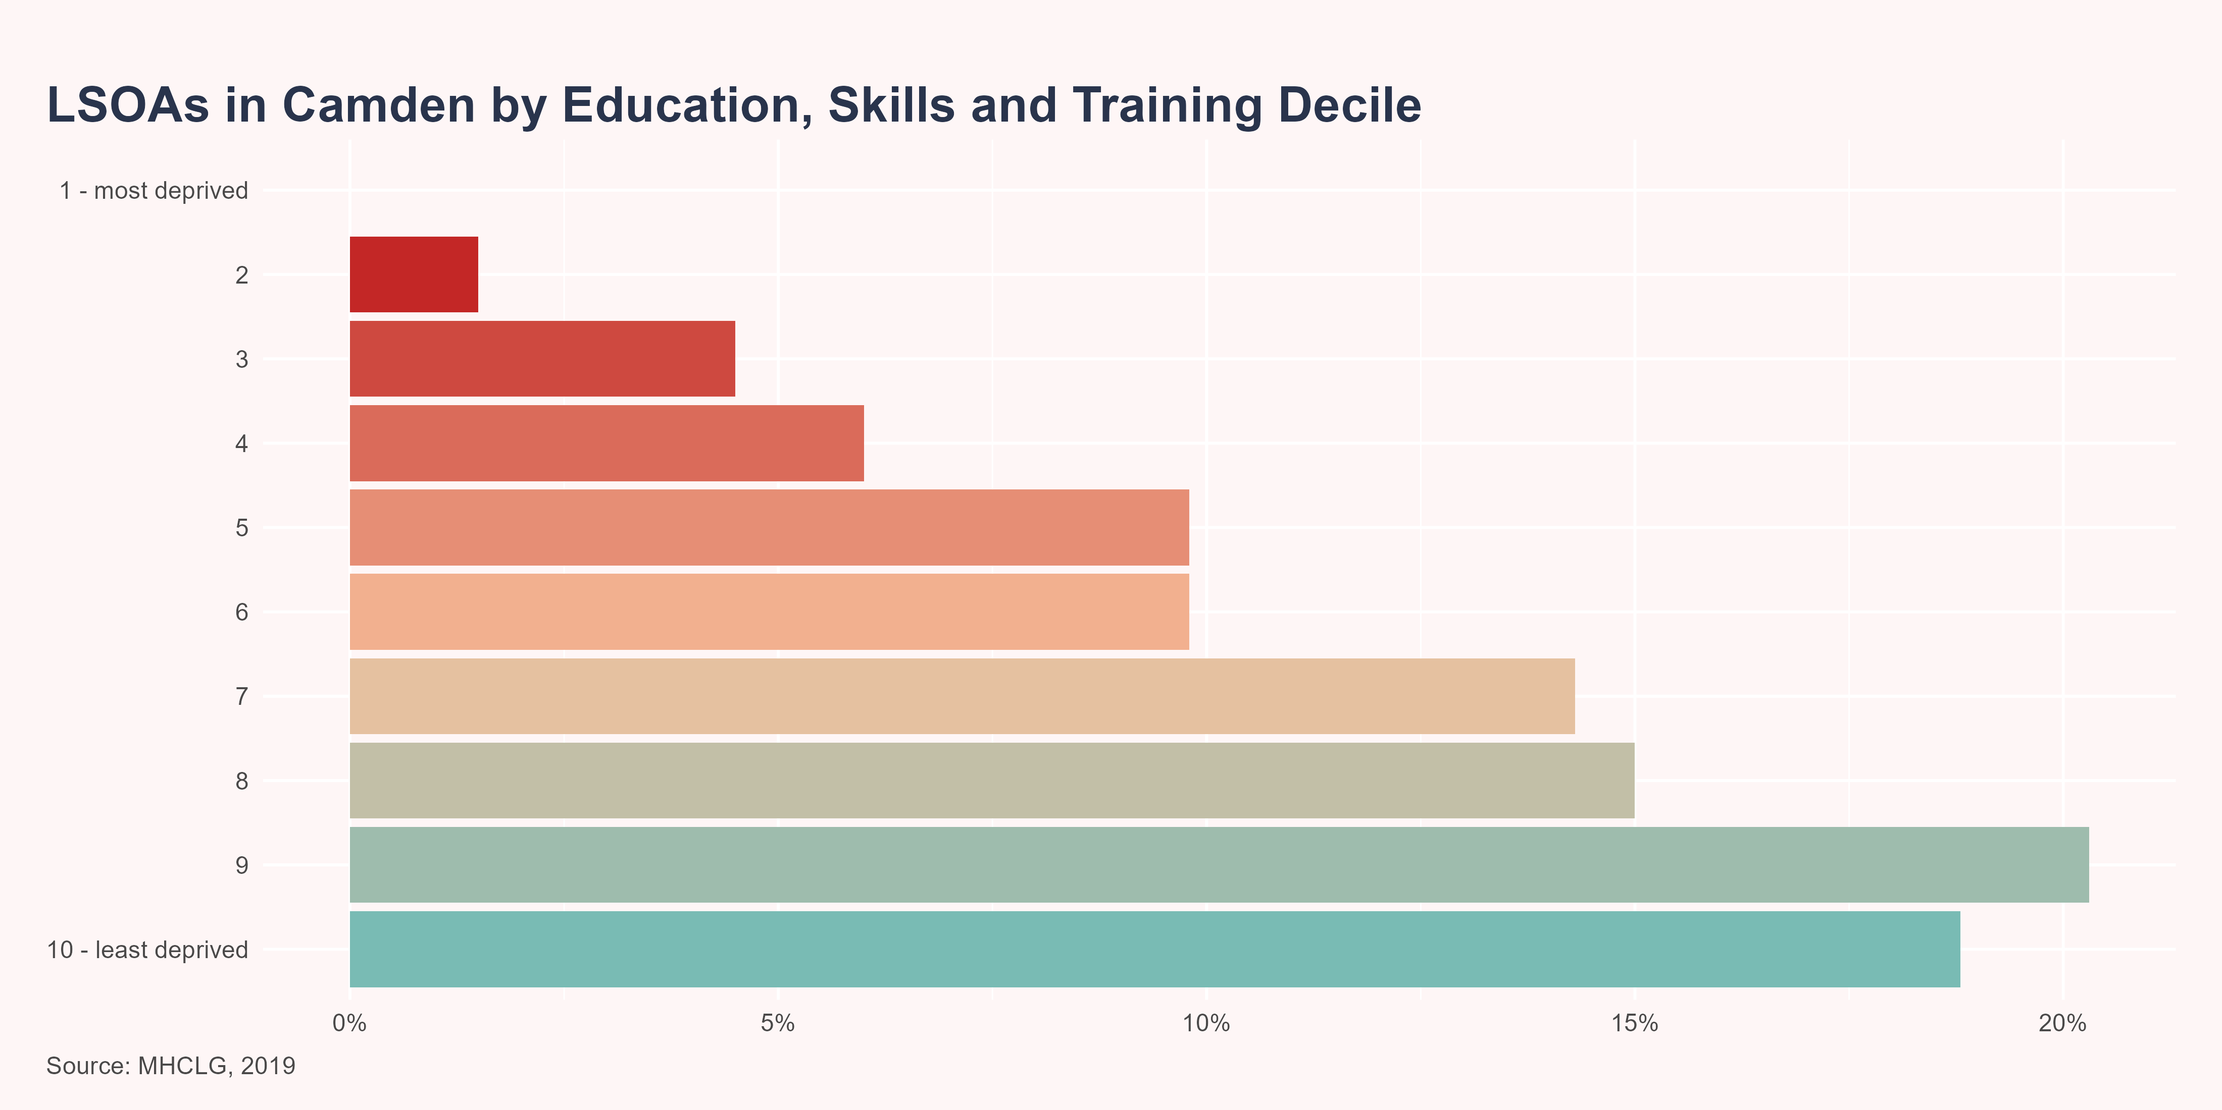
Education, Skills and Training
The Education, Skills and Training Domain measures the lack of attainment and skills in the local population. The indicators fall into two sub-domains: one relating to children and young people and one relating to adult skills. These two sub-domains are designed to reflect the ‘flow’ and ‘stock’ of educational disadvantage within an area respectively. That is, the ‘children and young people’ sub-domain measures the attainment of qualifications and associated measures (‘flow’), while the ‘skills’ sub-domain measures the lack of qualifications in the resident working-age adult population (‘stock’).
Camden ranks 135 out of 151 Upper Tier Local Authorities (UTLA) in England (with 1 being the most deprived). Within Camden, 1.5% (n=2) of LSOAs are amongst the 20% most deprived in England, according to the Education, Skills and Training Domain.

Slide 19
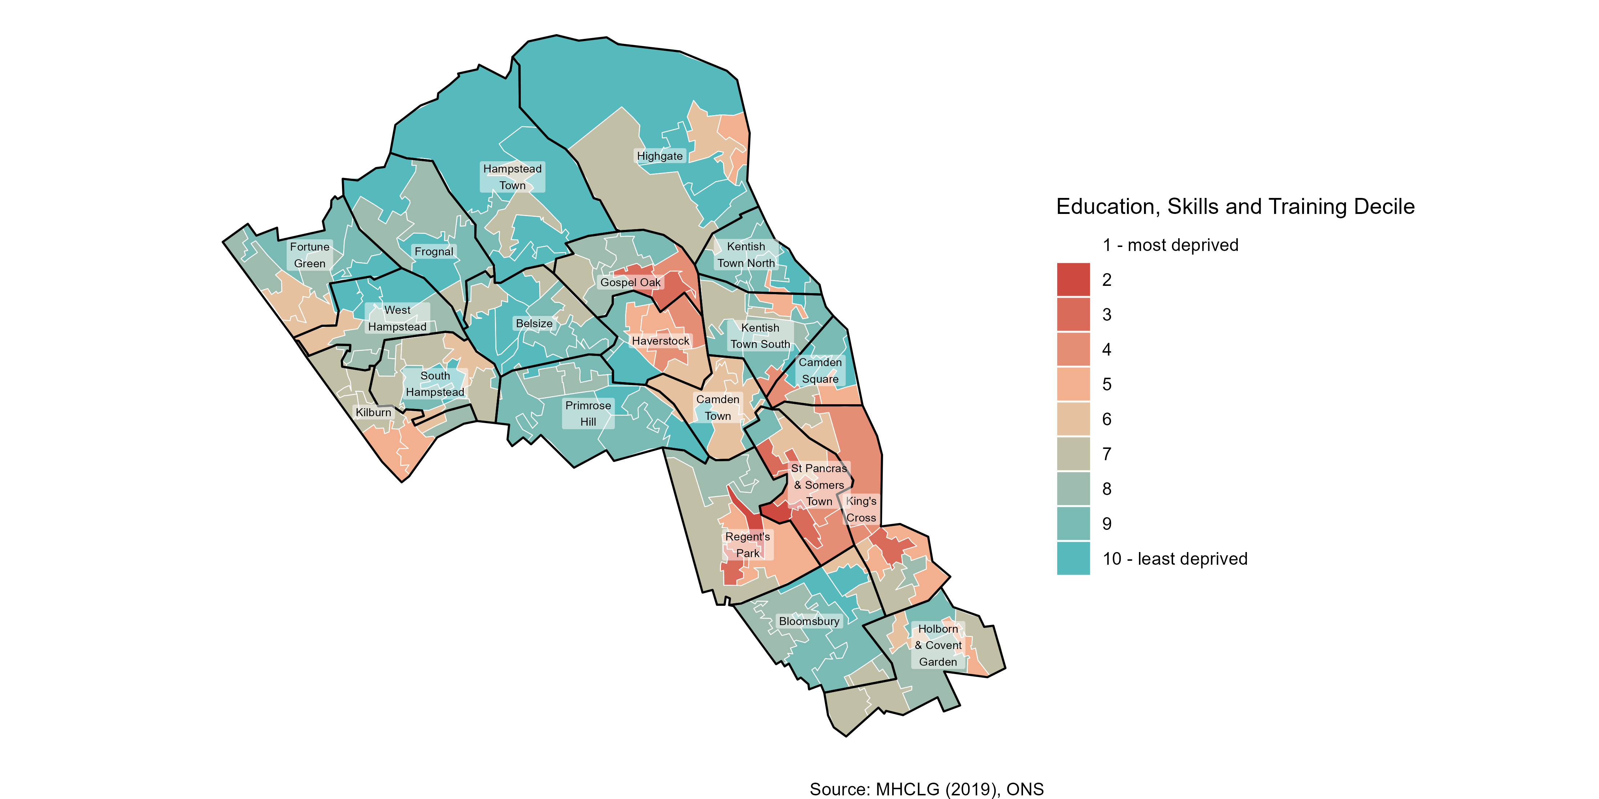
Education, Skills and Training

Slide 20
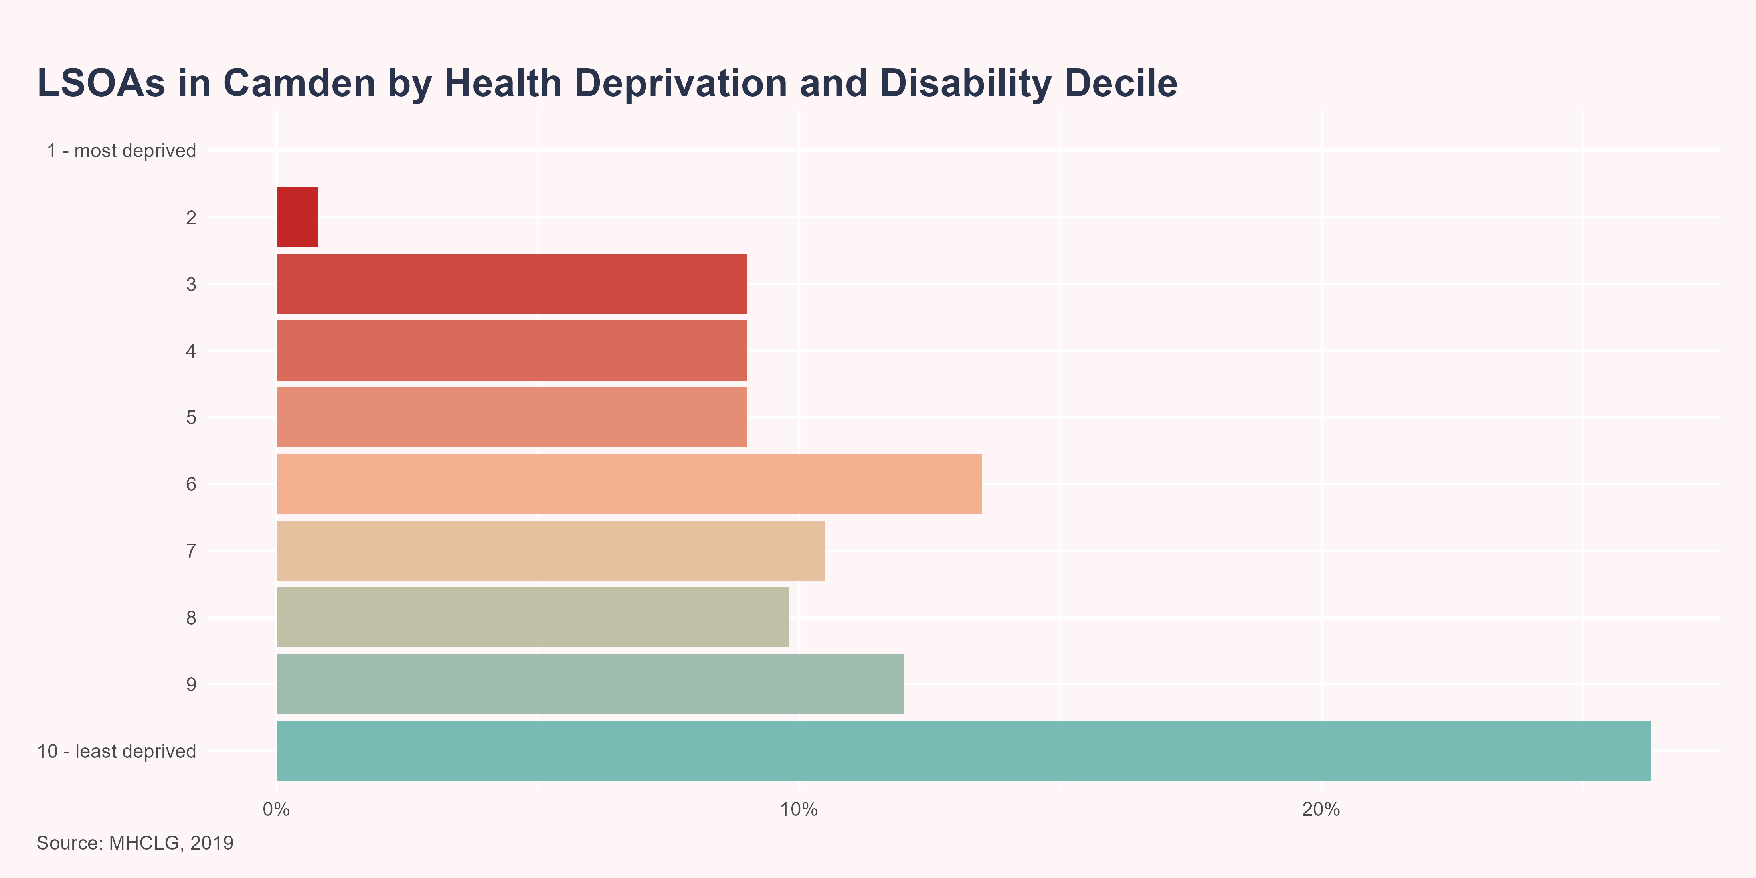
Health Deprivation and Disability
The Health Deprivation and Disability Domain measures the risk of premature death and the impairment of quality of life through poor physical or mental health. The domain measures morbidity, disability and premature mortality but not aspects of behaviour or environment that may be predictive of future health deprivation.
Camden ranks 119 out of 151 Upper Tier Local Authorities (UTLA) in England (with 1 being the most deprived). Within Camden, 0.8% (n=1) of LSOAs are amongst the 20% most deprived in England, according to the Health Deprivation and Disability Domain.

Slide 21
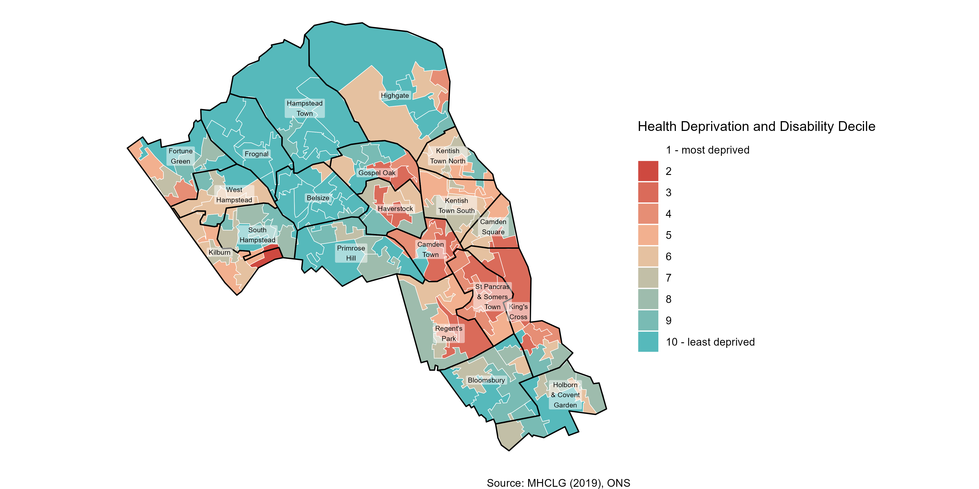
Health Deprivation and Disability

Slide 22
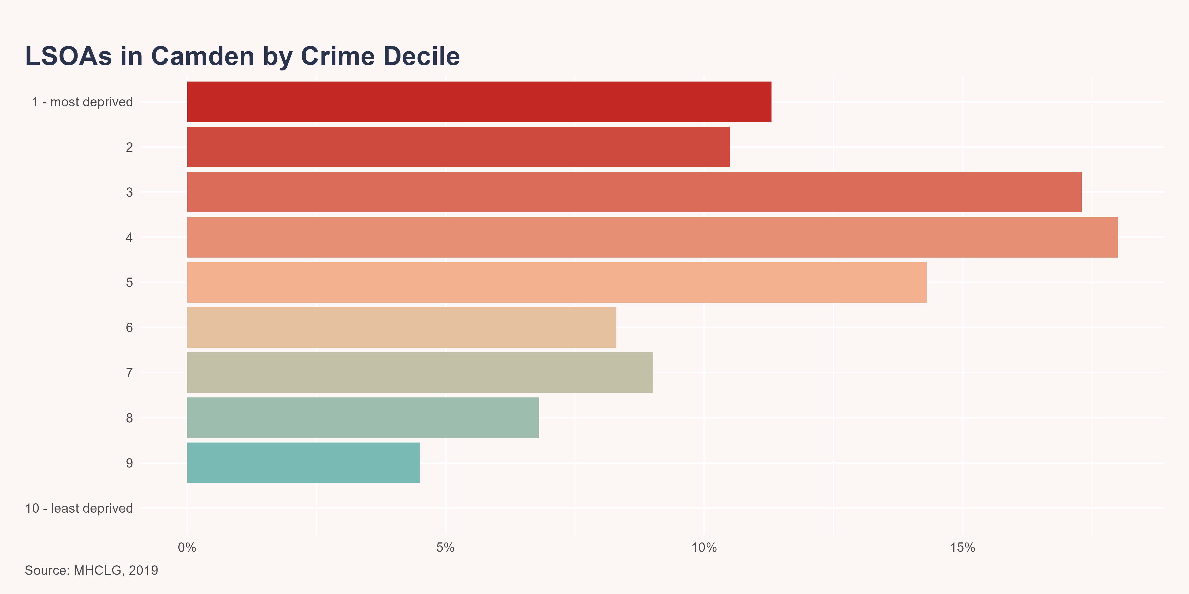
Crime
Crime is an important feature of deprivation that has major effects on individuals and communities. The Crime Domain measures the risk of personal and material victimisation at local level.
Camden ranks 57 out of 151 Upper Tier Local Authorities (UTLA) in England (with 1 being the most deprived). Within Camden, 21.8% (n=29) of LSOAs are amongst the 20% most deprived in England, according to the Crime Domain.

Slide 23
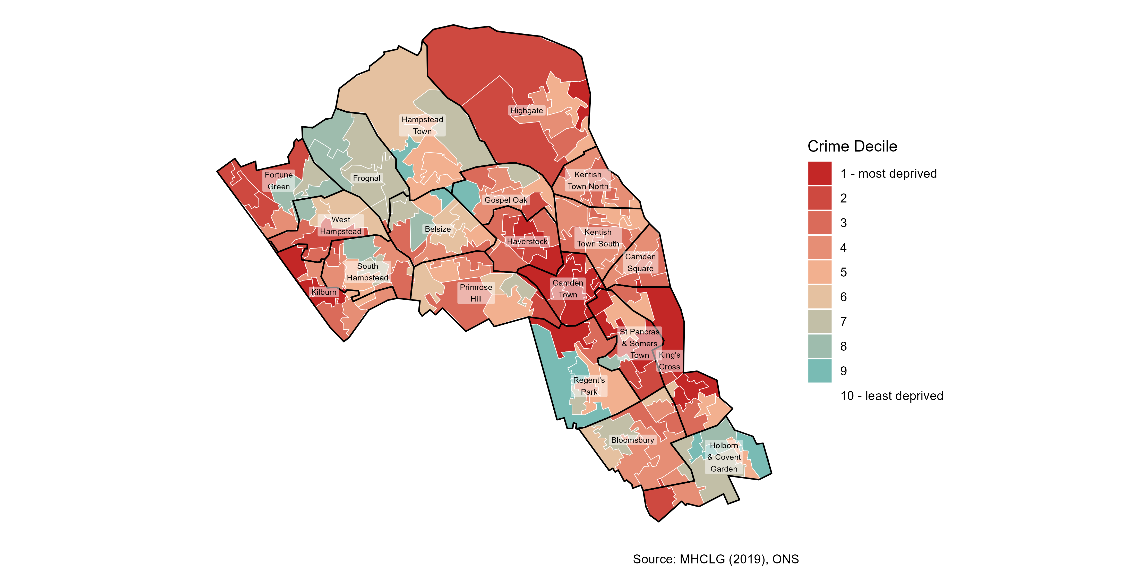
Crime

Slide 24
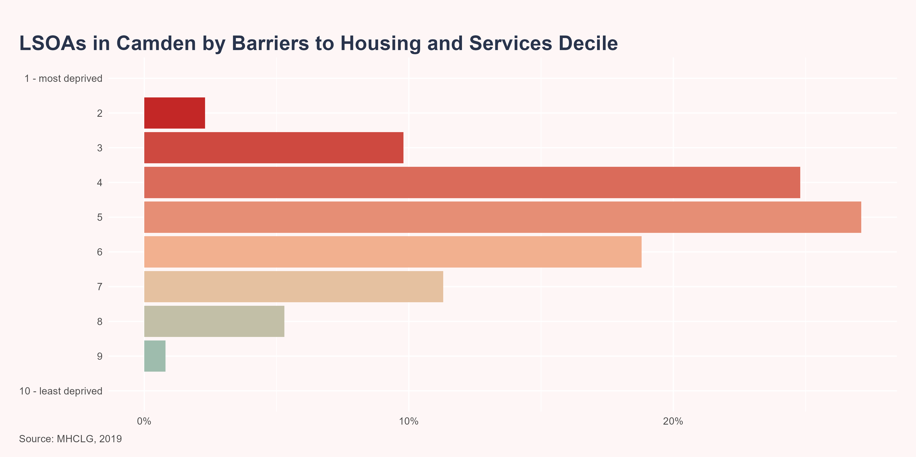
Barriers to Housing and Services
The Barriers to Housing and Services Domain measures the physical and financial accessibility of housing and local services. The indicators fall into two sub-domains: ‘geographical barriers’, which relate to the physical proximity of local services, and ‘wider barriers’ which includes issues relating to access to housing, such as affordability.
Camden ranks 60 out of 151 Upper Tier Local Authorities (UTLA) in England (with 1 being the most deprived). Within Camden, 2.3% (n=3) of LSOAs are amongst the 20% most deprived in England, according to the Barriers to Housing and Services Domain.

Slide 25
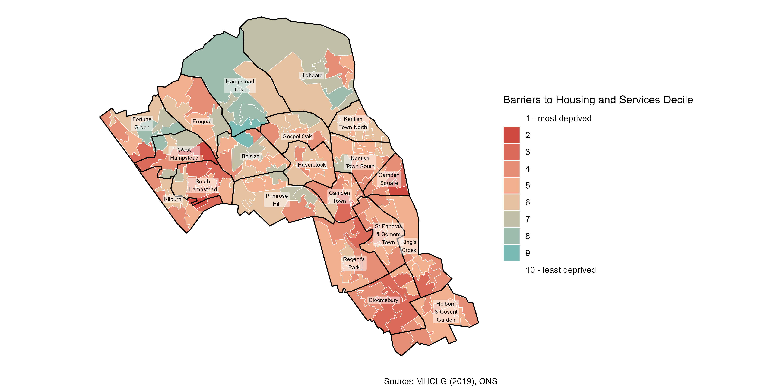
Barriers to Housing and Services

Slide 26
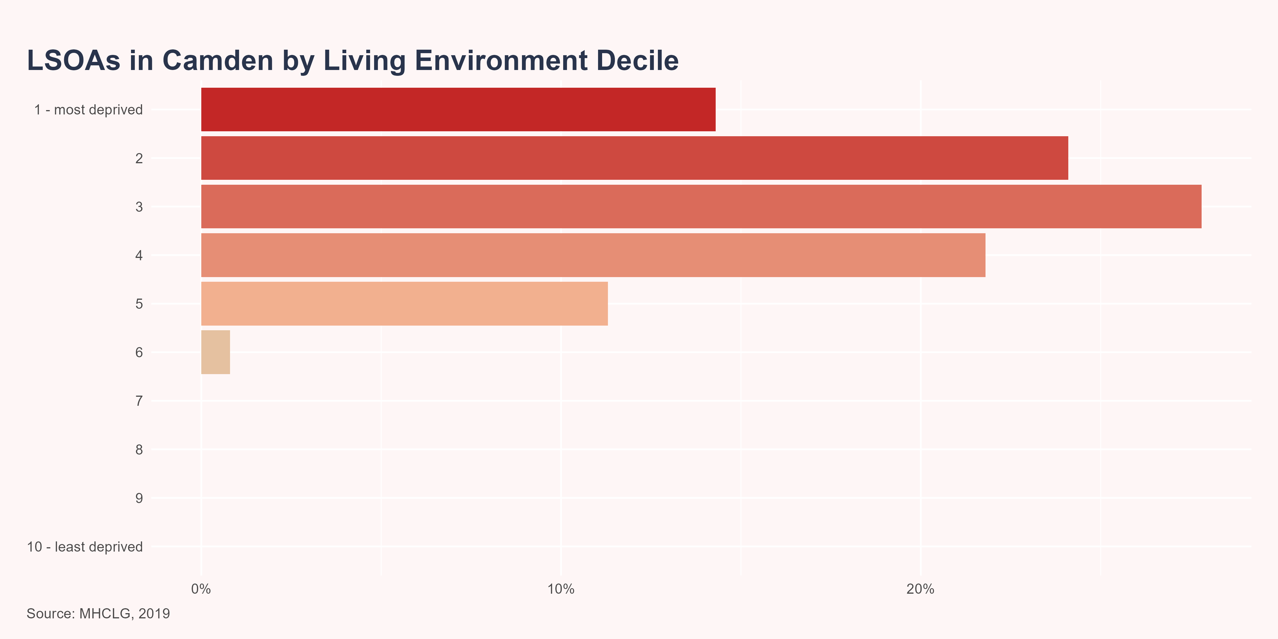
Living Environment
The Living Environment Deprivation Domain measures the quality of the local environment. The indicators fall into two sub-domains. The ‘indoors’ living environment measures the quality of housing; while the ‘outdoors’ living environment contains measures of air quality and road traffic accidents.
Camden ranks 19 out of 151 Upper Tier Local Authorities (UTLA) in England (with 1 being the most deprived). Within Camden, 38.3% (n=51) in Camden are amongst the 20% most deprived in England, according to the Living Environment Domain.

Slide 27
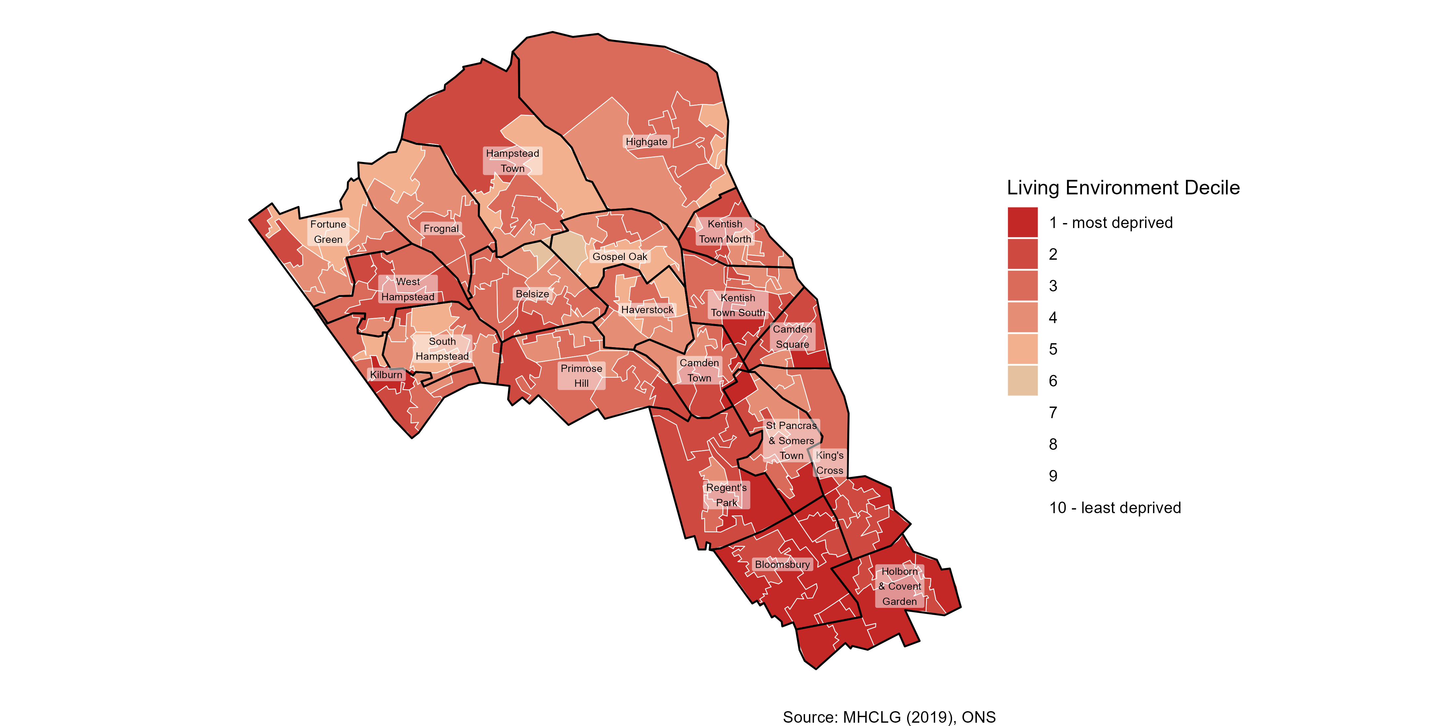
Living Environment

Slide 28

Effect of deprivation on health

Slide 29

Effect of deprivation on health
Deprivation is associated with poorer health outcomes including a greater risk of poor mental health, chronic pain, cardiovascular disease, lung disease and diabetes, lower access to healthcare services and premature mortality.(The Kings Fund 2024) As a result, people living in more deprived areas have shorter lives, and also spend a greater number of years in poor health, compared to people living in less deprived areas.(The Health Foundation 2025; The Kings Fund 2024)

Slide 30
Life expectancy
Life expectancy at birth - the average number of years a new-born baby would live if they experienced the age-specific mortality rates for that area and time period throughout their life - is commonly used as an indicator of the overall health of a population. There is a social gradient in life expectancy, whereby people who are less advantaged in terms of socioeconomic position have shorter lives than those who are more advantaged.(The Health Foundation 2025)
In Camden, life expectancy at birth for females living in the most deprived areas is 82.3 years, compared to 92.1 years in the least deprived areas, a difference of 9.8 years. For males, this gap is 12.2 years - with life expectancy at birth of 77.3 years in the most deprived areas and 89.5 years in the least deprived areas.

Slide 31
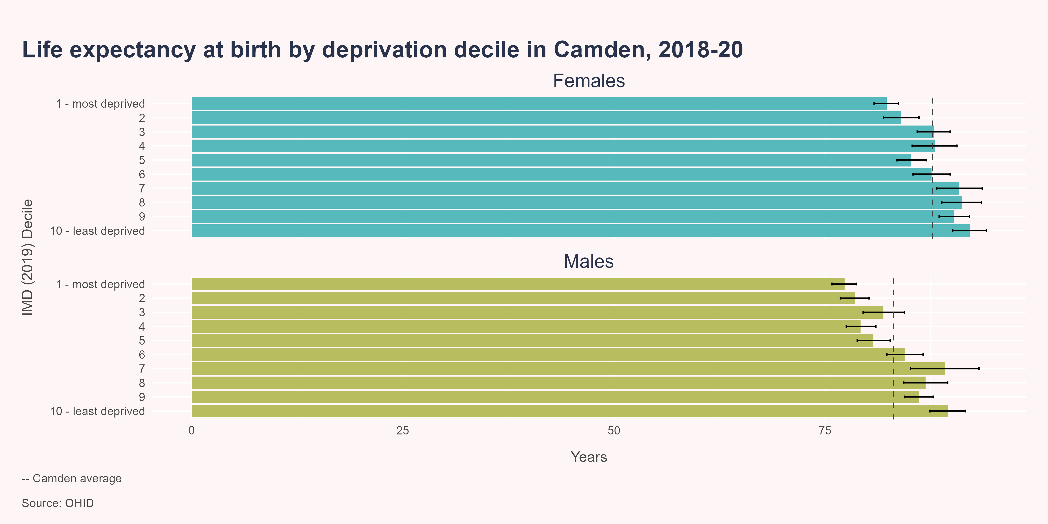
The most deprived areas in Camden have the lowest life expectancy

Slide 32
Slope index of inequality
The slope index of inequality (SII) is a measure of the social gradient in life expectancy i.e., how much life expectancy varies with deprivation. It takes account of health inequalities across the whole range of deprivation within each area and summarises this in a single number. This represents the range in years of life expectancy across the social gradient from most to least deprived, based on a statistical analysis of the relationship between life expectancy and deprivation across all deprivation deciles.
Between 2018-20, the level of inequality, or gap, in life expectancy at birth between the most and least deprived areas of Camden was 9.6 years for females and 13.5 years for males, compared to 5.4 and 7.5 years in London and 7.9 and 9.7 years in England.

Slide 33
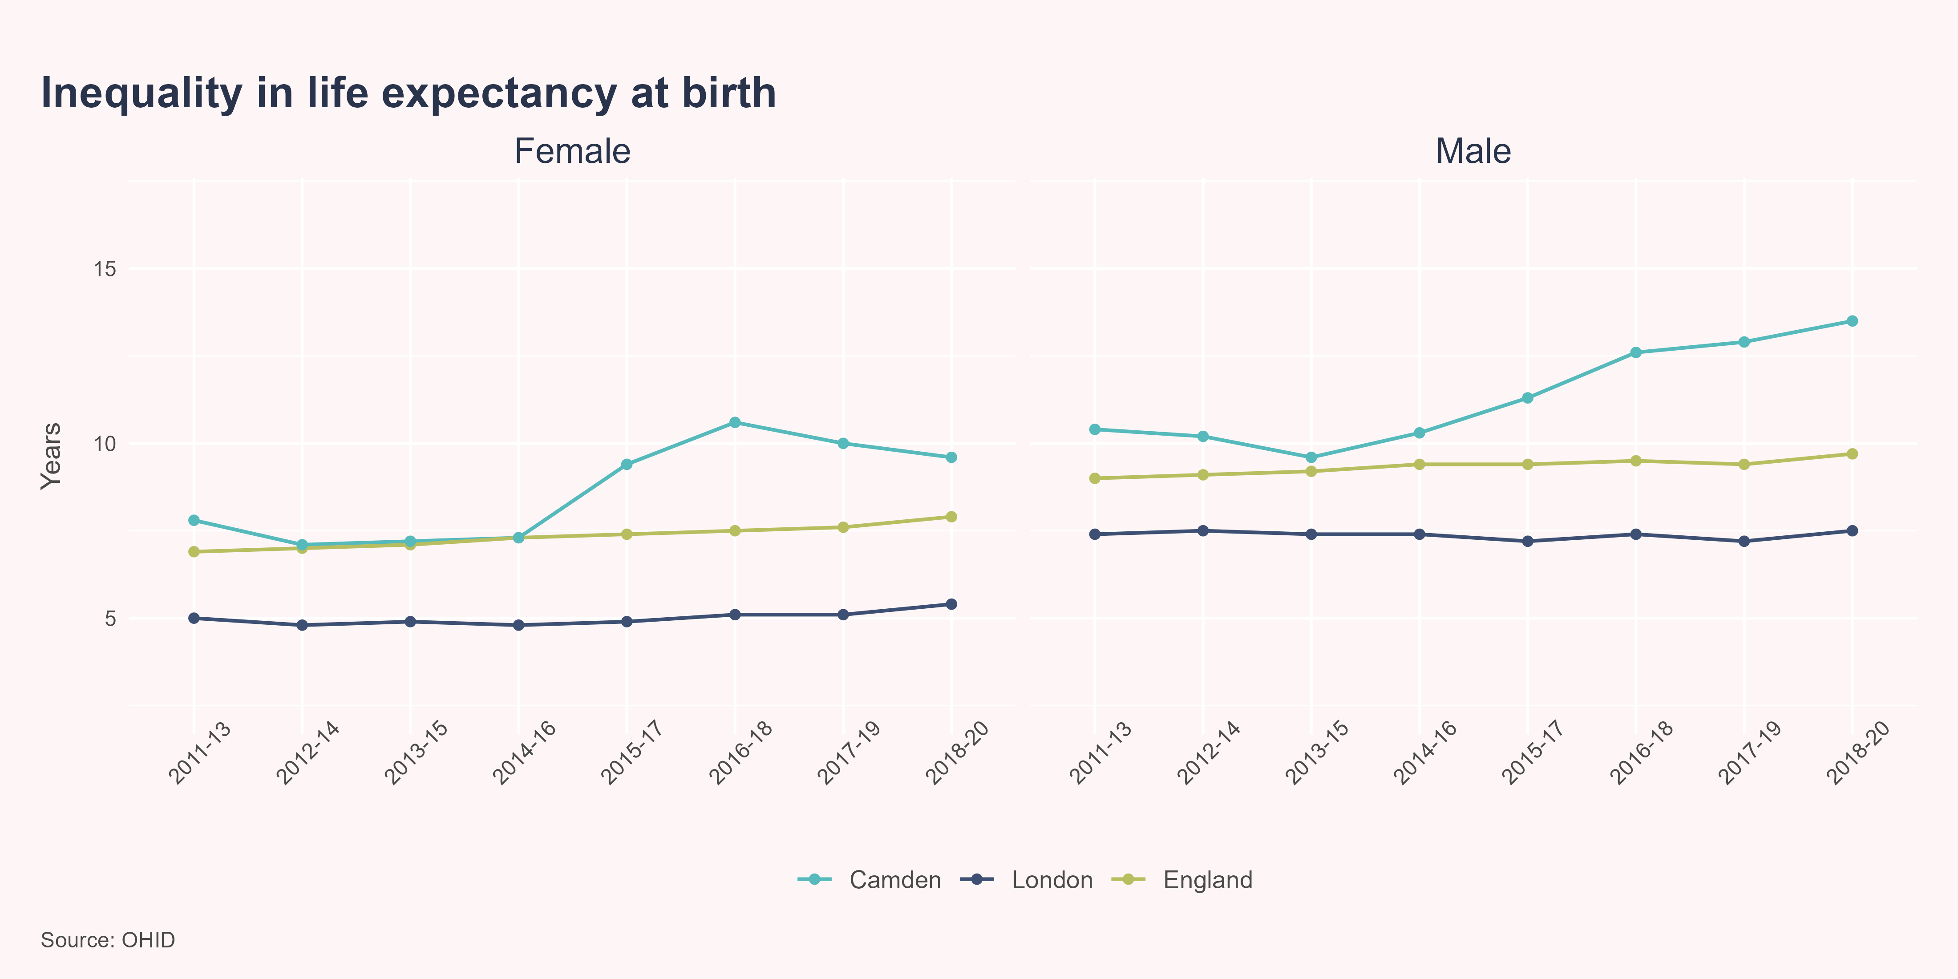
Camden has a significantly higher level of inequality in life expectancy than London and England, and this inequality has been increasing in recent years

Slide 34
Life expectancy gap
The Office for Health Improvement and Disparities (OHID) Segment Tool provides information on the causes of death that are driving inequalities in life expectancy at local area level.(Office for Health Improvement and Disparities 2021) Targeting the causes of death which contribute most to the life expectancy gap should have the biggest impact on reducing inequalities.
Between 2020 and 2021, around three-quarters of the gap in life expectancy between the most and least deprived areas in Camden was due to higher mortality rates from COVID-19, circulatory disease, cancer, and respiratory disease in the most deprived quintile, compared to the least deprived quintile.

Slide 35
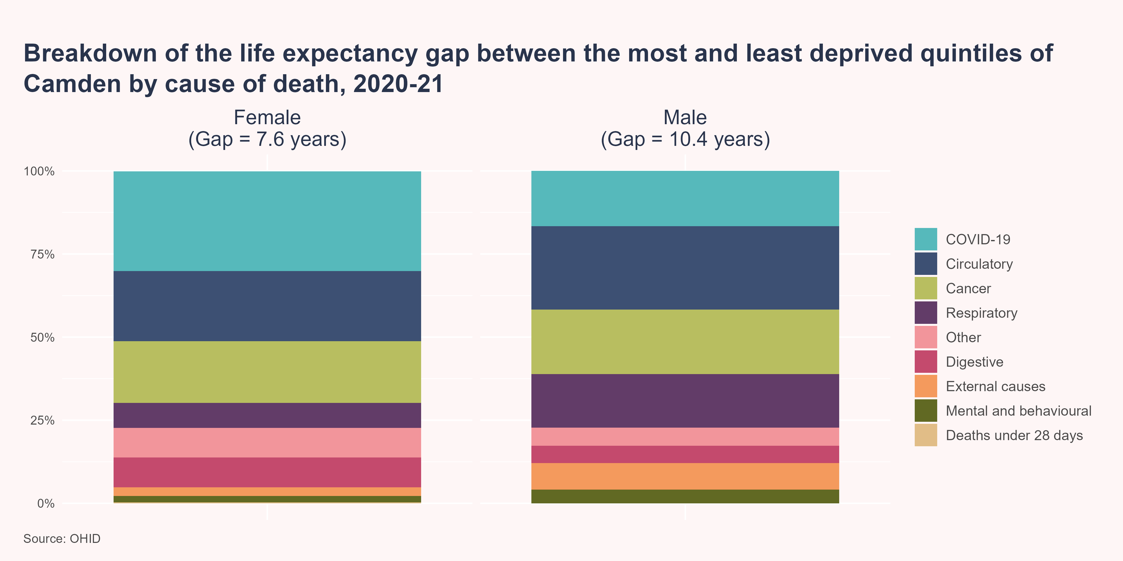
Mortality from COVID, cancer, circulatory diseases, and respiratory diseases are the main drivers of inequalities in life expectancy

Slide 36

Child poverty

Slide 37

Child poverty is linked to a wide range of poorer health outcomes
Experience of poverty during childhood is linked to many short and long term negative health outcomes, including poorer early child development, educational attainment, employment opportunities and income, mental and physical health and premature mortality.(RCPCH 2020)
There is no single, universally accepted definition of poverty. However, in general the term refers to when people lack the material resources to meet minimum needs. The UK government publishes two key measures of poverty based on disposable income:
Absolute low income - families with income below 60% of the median income in 2010/11
Relative low income - families with income below 60% of the median in the reference year.
In 2022/23, 14.8% (n=4,756) of children aged under 16 years in Camden were living in absolute low income families, compared to 12.3% in London and 15.6% nationally. Meanwhile, during the same time period, 19% (n=6,085) of children in Camden were living in relative low income families, compared to 15.8% in London and 19.8% nationally.

Slide 38
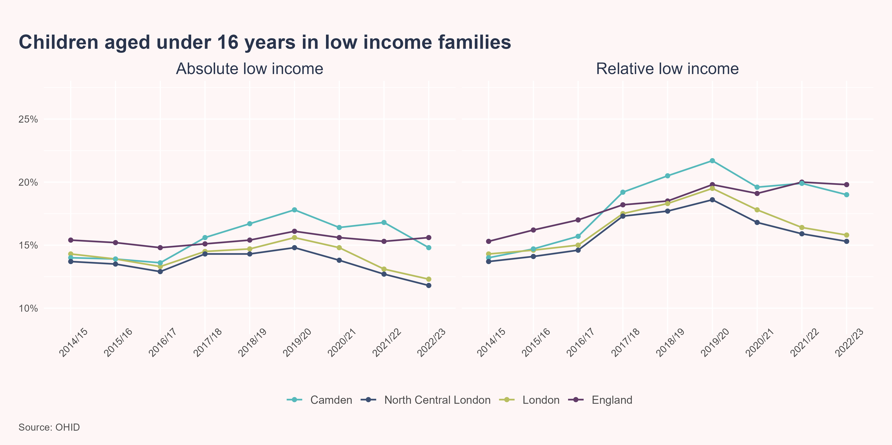
Although the proportion of children living in low income families has been decreasing locally in recent years, Camden still has significantly higher levels of child poverty than London and England

Slide 39
Further reading
GLA Economics - In work poverty in London
Marmot, M., J. Allen, P. Goldblatt, T. Boyce, D. McNeish, and M. Grady. 2010. “Fair Society, Healthy Lives: The Marmot Review.” london. https://www.instituteofhealthequity.org/resources-reports/fair-society-healthy-lives-the-marmot-review.
MHCLG. 2019. “English Indices of Deprivation 2019.” https://www.gov.uk/government/statistics/english-indices-of-deprivation-2019.
Office for Health Improvement and Disparities. 2021. “Segment Tool.” https://analytics.phe.gov.uk/apps/segment-tool/.
RCPCH. 2020. “Child Poverty.” https://stateofchildhealth.rcpch.ac.uk/evidence/family-and-social-environment/child-poverty/.
The Health Foundation. 2025. “Inequalities in Life Expectancy and Healthy Life Expectancy.” https://www.health.org.uk/evidence-hub/health-inequalities/inequalities-in-life-expectancy-and-healthy-life-expectancy#:~:text=More%20deprived%20areas%20are%20more%20likely%20to%20have,expectancy%20between%20the%20most%20and%20least%20deprived%20areas.
The Kings Fund. 2024. “Illustrating the Relationship Between Poverty and NHS Services.” https://www.kingsfund.org.uk/insight-and-analysis/long-reads/relationship-poverty-nhs-services.

