Slide 1
Gambling-related harm
An overview of gambling and gambling-related harm in Camden Profile

Slide 2
Why it matters

Slide 3
In recent decades, changes in the design, marketing and accessibility of gambling products have transformed the gambling industry in the UK into one of the most powerful and profitable in the world. Opportunities to gamble exist on most high streets and, with access to the internet, in almost every home (NHS England Digital 2023). Despite measures to enforce regulations and minimise harm, concern regarding gambling has been growing in recent years and gambling is now increasingly viewed as a public health issue because it is a risk to health that affects people in large numbers.
It is estimated that 2.7% of the adult population are currently experiencing problem gambling, with a further 11.9% gambling at risky levels (Gambling Commission 2025a). For every person experiencing problem gambling, it is suggested that a further six people (e.g., family members, friends or colleagues), known as “affected others”, are also directly impacted (Goodwin et al. 2017).
Gambling harms are the negative impacts from gambling that affect the health and wellbeing of individuals, communities and wider society. These harms are wide-ranging, often interconnected, and include (but are not limited to):
financial difficulties - debt, bankruptcy, and loss of savings or assets
relationship breakdown - domestic violence, family conflicts, divorce, and neglect
mental and physical health issues – anxiety, depression, drug and alcohol use, and suicide
poor school and work performance – absenteeism, lower attainment, job loss
cultural - tensions between gambling and cultural practices and beliefs
crime – fraud, theft, or other illegal actions.
Despite high levels of harm, many people do not seek help. This is due to several factors, including limited awareness of gambling-related harms, stigma, and a lack of knowledge about available treatment and support services among both those affected by gambling and the professionals supporting them in other areas of their lives (Gambling Commission 2023).

Slide 4
Why language matters: reframing gambling harms
Language shapes how we understand and respond to issues, and when it comes to gambling, the words we use can either stigmatise people or support them.
Much of the language used to describe gambling has historically been influenced by the gambling industry, which has sought to frame gambling as an issue of personal responsibility. This framing deflects attention from the role that gambling products, environments, and marketing practices play in creating and sustaining harm. Terms such as “problem gambler”, “gambling addict” and phrases like “gambling irresponsibly” place the emphasis on individual behaviour and infers that people experiencing harms are at fault. This type of language can lead to shame, blame, and silence, making it harder for people to seek help.
However, we know that gambling isn’t an individual problem, so we want to move away from this harmful narrative. Instead, more supportive phrases like “gambling at harmful levels” or “experiencing problem gambling” should be used. Any references of gambling as a ‘fun’, ‘safe’ or ‘social’ activity should also be avoided. This language shifts the focus away from making it seem like the person is at fault, to an issue with the gambling industry, its products and practices.
It should also be noted that gambling addiction is a recognised mental health disorder. However, many people who experience gambling harms do not identify with the term “addiction”. For this reason, using broader terms such as “gambling harms” can be more relatable and may help people recognise their experiences earlier and feel more comfortable seeking support.

Slide 5
Causes and risk factors

Slide 6
Anyone can experience gambling-related harms; however, these harms are not evenly distributed.
People living in more deprived areas may also be at a greater risk of experiencing gambling harms, despite being less likely to participate in gambling activities (Office for Health Improvement and Disparities and Public Health England 2023a). This inequality is likely to be driven by several factors, including a higher spatial concentration of physical gambling premises in areas of greater deprivation.
People experiencing homelessness, unemployment or economic inactivity may also be at a greater risk of gambling harm, although, the evidence base is limited (Office for Health Improvement and Disparities and Public Health England 2023b).
Poor mental health has been suggested as another important risk factor. Research suggests that people with poor mental health may be at a greater risk of gambling at harmful levels and to experience problem gambling (Office for Health Improvement and Disparities and Public Health England 2023a). This relationship is bidirectional, as poor mental health is also a commonly reported gambling-related harm.
There is also evidence linking gambling with alcohol and substance use, which may be partly due to shared risk factors, such as poor mental health or personality disorders (Grant and Chamberlain 2020).
Evidence regarding the relationship between ethnicity and gambling is limited. However, some studies have suggested that people from certain ethnic minority groups may be less likely to participate in gambling overall, but may face a higher risk of experiencing gambling-related harms and be less likely to seek support or treatment (Commission on Crime & Gambling Related Harms 2023). Cultural and religious norms can influence attitudes towards gambling in different ways. In some communities, gambling is seen as a normalised activity, whereas in others it is discouraged or prohibited due to cultural or religious beliefs (Commission on Crime & Gambling Related Harms 2023). In both contexts, these attitudes may make it harder to recognise gambling harm or discuss it openly and seek support.
Family influences may also play a role. Some studies have identified family history of gambling harm as a risk factor for problem gambling (Smith et al. 2025). However, family influences may also be protective. For example, positive family functioning and supportive relationships have been associated with a lower risk of gambling at harmful levels (Smith et al. 2025). Overall, the evidence in this area is mixed, with some studies finding weak or non-significant associations between family factors and gambling harm.
Among children and young people, there is relatively strong evidence that impulsivity, drug and alcohol use, male sex, and depression are associated with an increased risk of gambling at a harmful level (Office for Health Improvement and Disparities and Public Health England 2023b).
Historically, gambling has been framed as an issue of personal responsibility. However, the evidence suggests that gambling harms arise from a complex interaction of individual, social and environmental factors. Addressing these harms therefore requires a coordinated, population-based approach. This includes measures to reduce the availability and marketing of harmful gambling products, improve public awareness of gambling harms and support services, and ensure access to evidence-based treatment that is independent of the gambling industry.

Slide 7
What the data shows

Slide 8
The size of the gambling market
The UK has one of the largest gambling markets globally, and gross gambling yield (GGY) - defined as the difference between the amount wagered and the amount paid out in winnings - has risen substantially in recent years (Office for Health Improvement and Disparities and Public Health England 2023a; Gambling Commission 2025b). In 2024/25, GGY in Great Britain was £16.8 billion, representing a 7.3% increase from 2023/24. This growth was driven primarily by a 13.1% increase from online gambling, while premises-based gambling saw a 3.6% increase.
In terms of market share, online gambling accounted for 46.5% (£7.8 billion) of total GGY in Great Britain in 2024/25. Premises-based gambling comprised 28.7% (£4.8 billion), and lotteries accounted for 24.8% (£4.2 billion).
No data is available to understand how much money is being gambled at a local authority level.

Slide 9
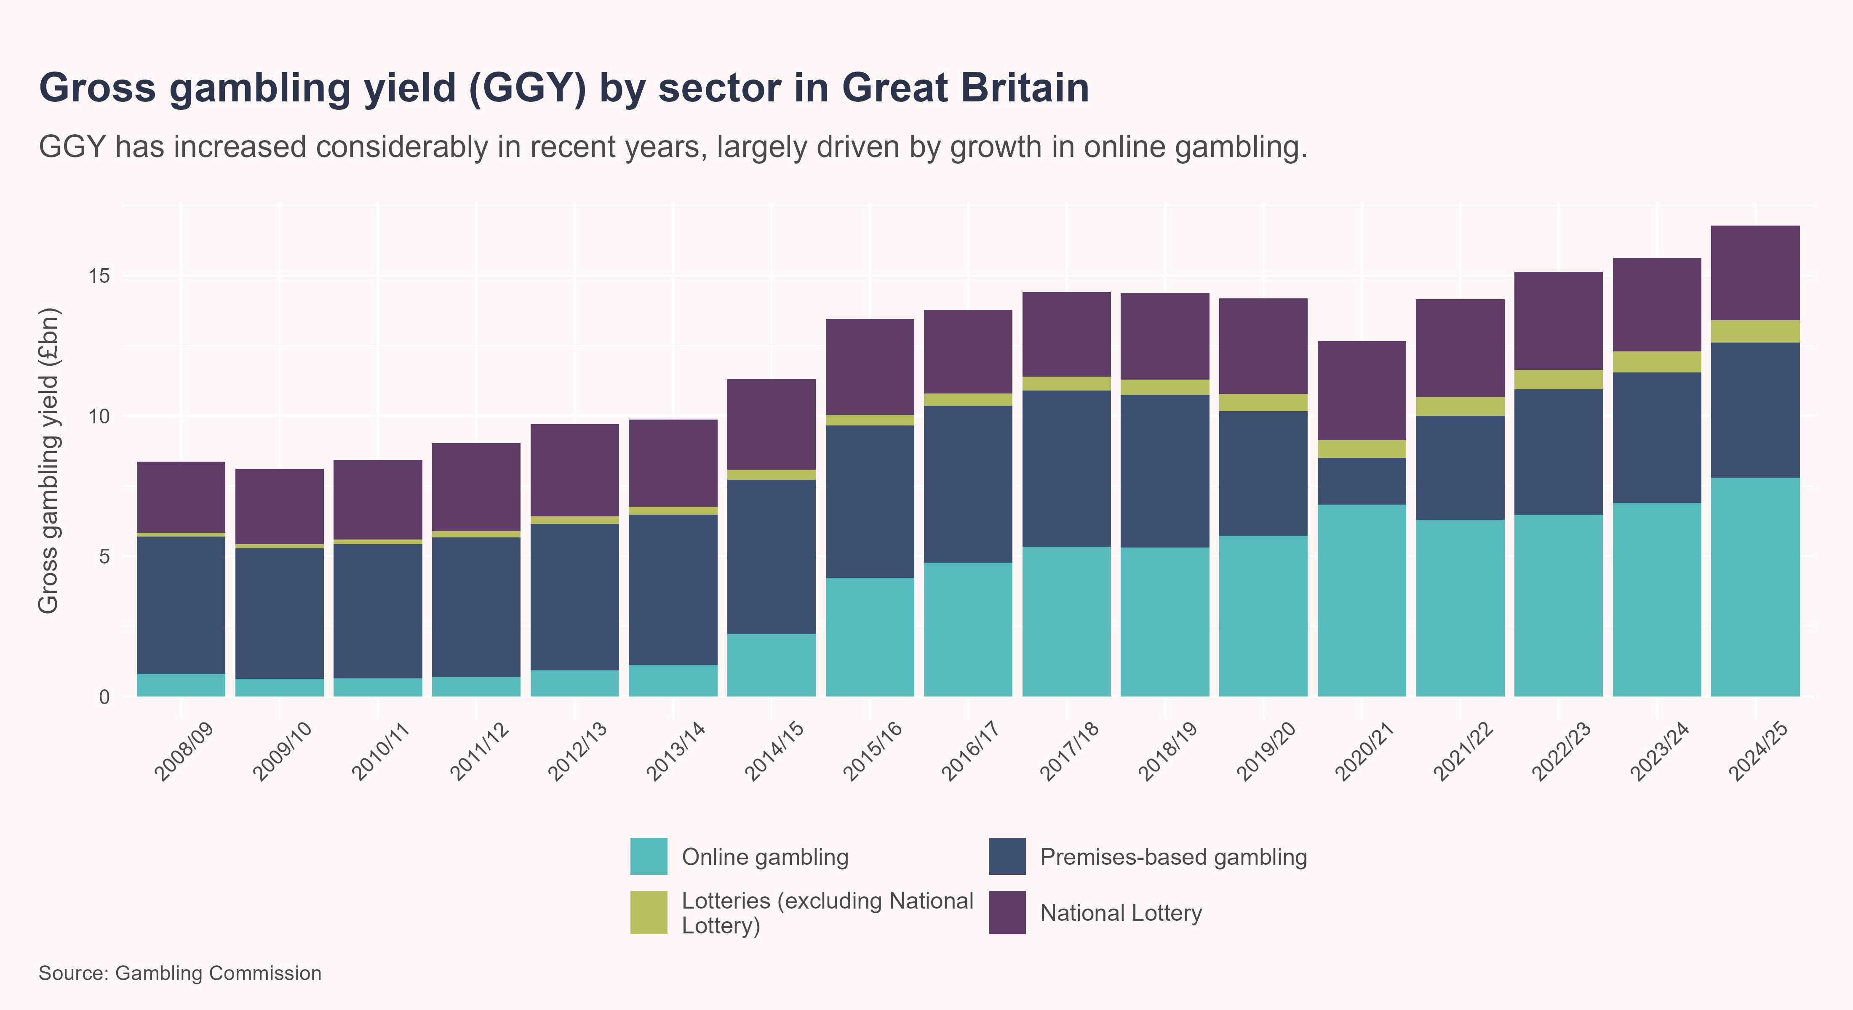
The size of the gambling market

Slide 10
Gambling industry spend on advertising and marketing
The growth in gambling industry profit can be attributed, in part, to aggressive marketing by gambling operators, with annual advertising expenditure estimated to exceed £1.5 billion in the UK (Fenton and Prochaska 2025). This figure represents less than 10% of total GGY - considerably higher than the Gambling Levy rates of 0.1-1.1% applied to most operators (Department for Culture, Media and Sport 2025).

Slide 11
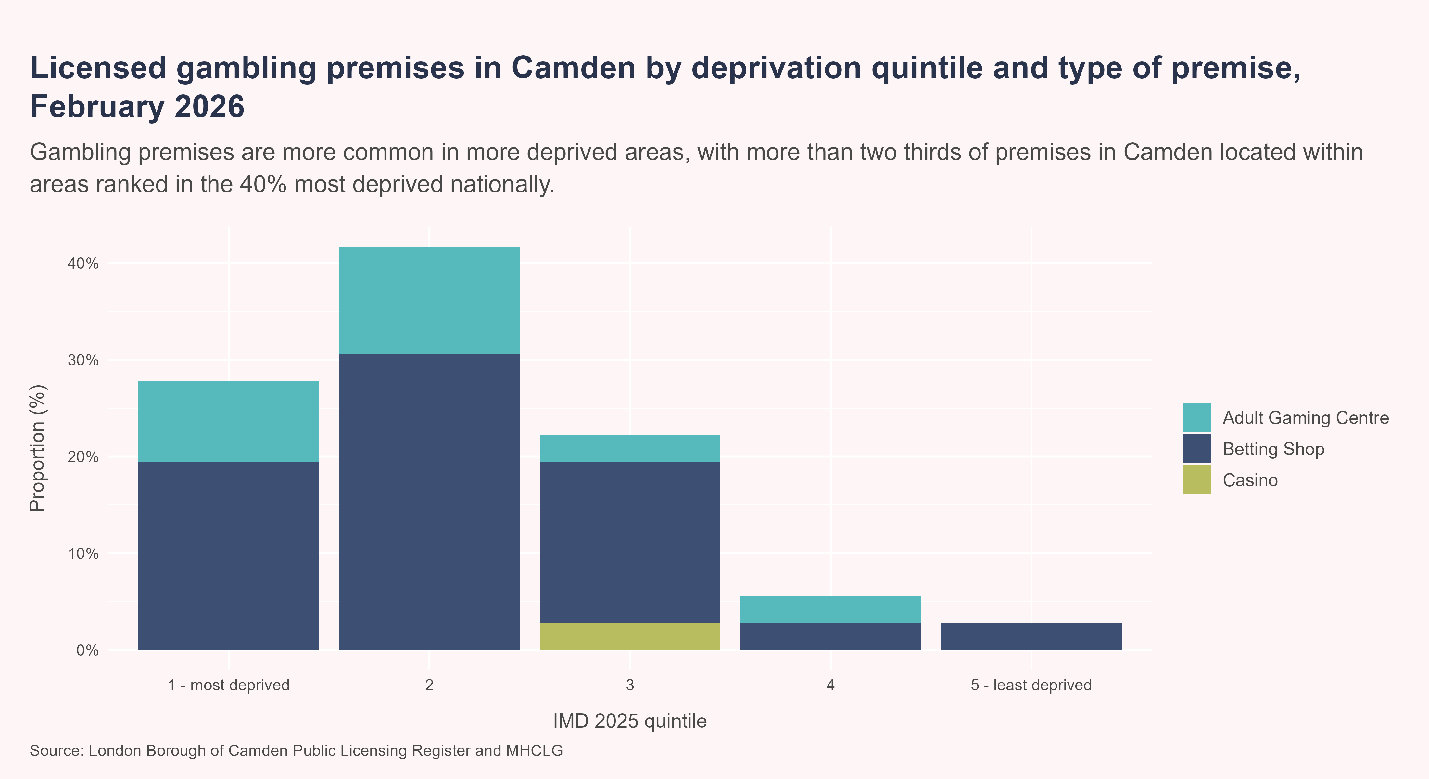
Gambling premises in Camden
Under the Gambling Act 2005, local authorities are responsible for issuing licences and permits for land-based gambling premises.
As of February 2026, there were 36 licensed land-based gambling premises in Camden, comprising 26 betting shops, 9 adult gaming centres, and 1 casino. These premises are concentrated in areas of higher deprivation; with more than two thirds (27.8%) located within areas ranked among the 20% most deprived nationally, compared with 2.8% in the least deprived quintile.
Camden has a similar rate of gambling premises per 100,000 population compared to London, but a worse rate compared to England.

Slide 12
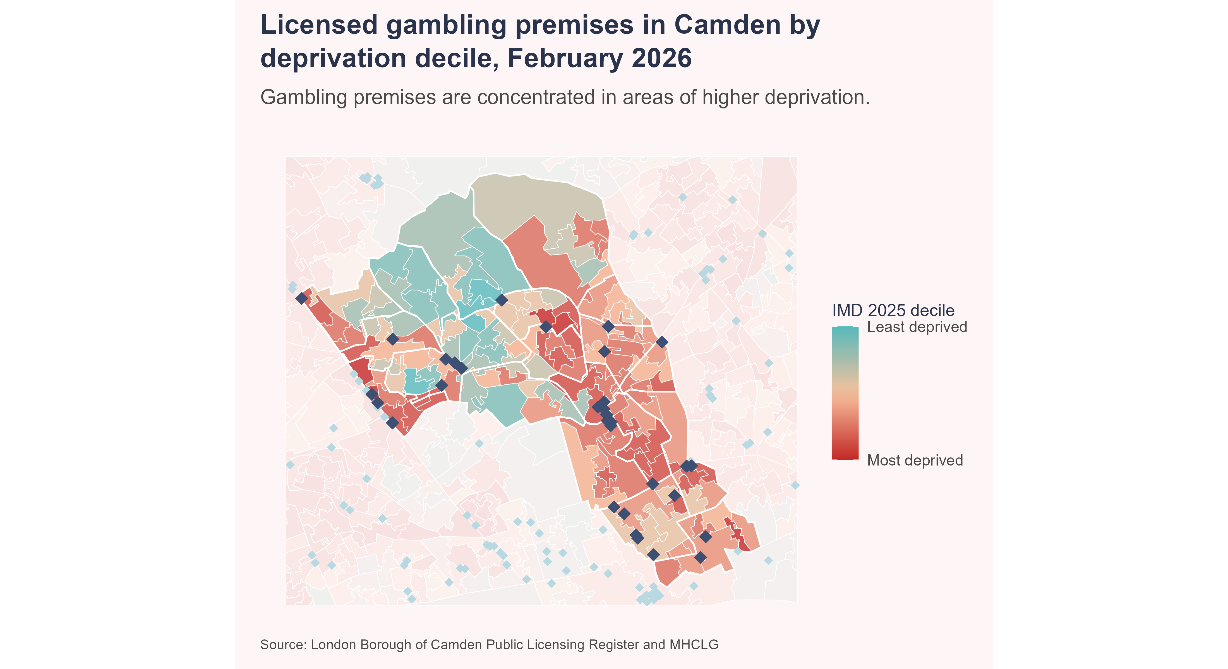
Location of gambling premises in Camden

Slide 13
Prevalence of gambling participation
Data in this section is sourced from the Gambling Survey for Great Britain (GSGB), commissioned by the Gambling Commission (Gambling Commission 2025a). The GSGB collects data to understand who participates in gambling, the type of activities they participate in, and the level of gambling-related harms. The survey is designed to be representative of the adult population. In 2024, data was collected from a sample of 19,714 adults aged 18 years and above living in Great Britain.

Slide 14
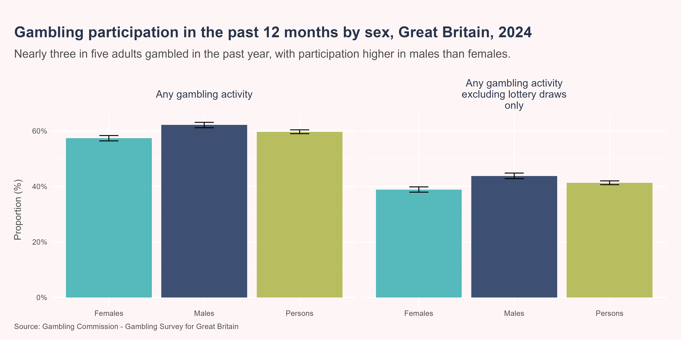
Gambling participation by sex
In 2024, 59.7% of adults aged 18 years and over reported participating in any type of gambling activity in the past 12 months, while 47.6% had participated in the previous four weeks. When those who had only participated in lotteries were excluded, 41.3% of adults had participated in any gambling in the past 12 months, while 27.9% had gambled in the previous four weeks.
Compared to females, a higher proportion of males reported taking part in any gambling activity in the past 12 months (62.2% vs 57.4%) or past four weeks (51.2% vs 44.3%). Males were also more likely to have gambled on something other than lotteries in the past year than females (43.8% vs 38.9%).

Slide 15
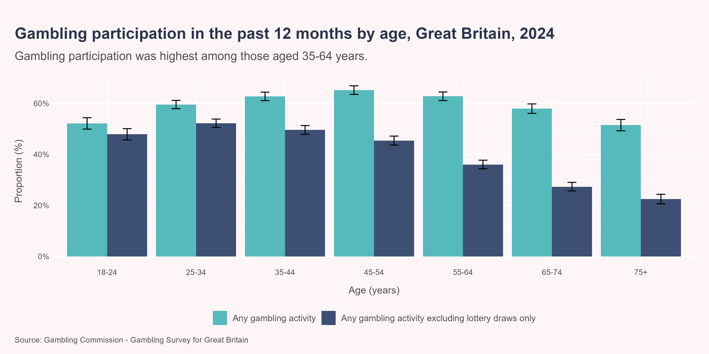
Gambling participation by age
Gambling participation was highest in those aged 45-54 years (65.2%), 55-64 years (62.8%), and 35-44 years (62.7%). However, when those who had only participated in lotteries were excluded, gambling participation was highest in those aged 25-34 years (52.2%), 35-44 years (49.6%) and 18-24 years (47.9%).

Slide 16
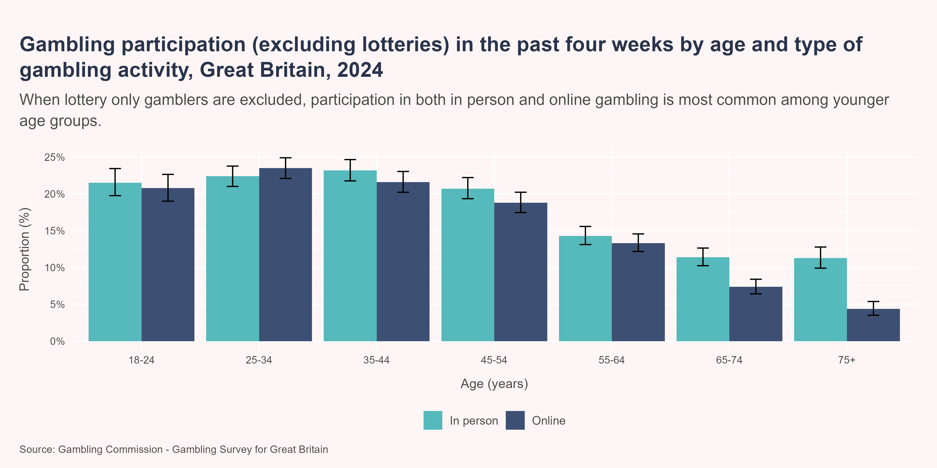
Gambling participation by type of activity
When those who had only participated in lotteries were excluded, 18.3% of adults had gambled in person and 16.5% online in the past four weeks. A similar proportion of males and females gambled in person in the past four weeks (18.2% vs 18.3%) but males were more likely to have gambled online compared to females (21% vs 12.2%).
The highest proportion of those gambling in person were aged 35-44 years (23.2%), followed by those aged 25-34 years (22.4%) and 18-24 years (21.5%). Meanwhile, online gambling participation was highest in the 25-34 years (23.5%), 35-44 years (21.6%) and 18-24 years (20.8%) age groups.

Slide 17
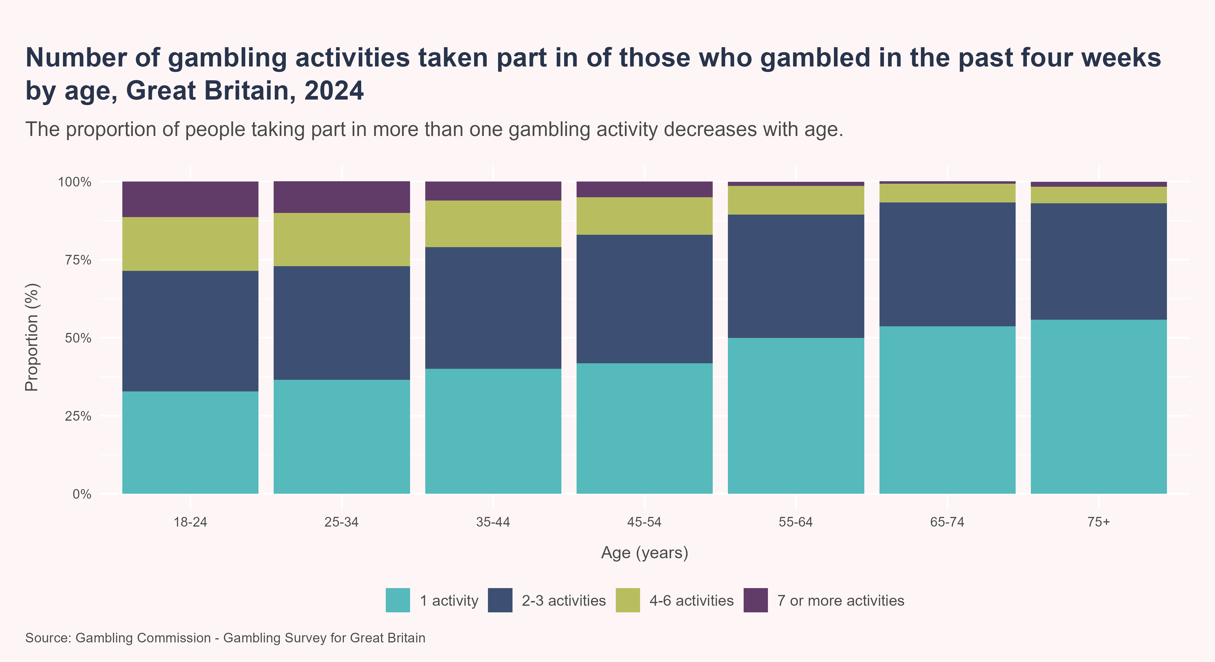
Gambling participation by number of activities
In 2024, participants who had gambled in the past 4 weeks took part in an average of 2.4 different types of gambling activities. This number was highest in those aged 18-24 years, with 3.3 activities, and decreased with advancing age. On average, males participated in more gambling activities than females (2.5 vs 2.2).

Slide 18
Gambling participation in Camden
Based on the estimated prevalence of gambling participation from the GSGB, around 109,465 Camden residents aged 18 years and over are expected to have participated in any gambling activities in the past 12 months.

Slide 19
Prevalence of problem gambling
Problem gambling is defined as “gambling behaviour that creates negative consequences for the gambler, others in his or her social network, or for the community” (Ferris and Wynn 2001).
Data in this section is sourced from the GSGB, which uses the Problem Gambling Severity Index (PGSI), the most commonly used screening tool for assessing problem gambling in the general population.
Prevalence estimates of problem gambling vary considerably depending on survey methodology (Sturgis et al. 2025). Self-completion surveys, like the GSGB, typically report much higher rates than interviewer-administered surveys (e.g., the Health Survey for England) (Sturgis et al. 2025). These differences are likely to be partly explained by non-response and social desirability biases (Sturgis et al. 2025). However, without a true value for the prevalence of problem gambling in the population, it isn’t possible to determine which surveys findings are more accurate (Sturgis et al. 2025).

Slide 20
Problem Gambling Severity Index (PGSI)
The Problem Gambling Severity Index (PGSI) is a widely used screening tool for measuring the risk of problem gambling within the general population (Gambling Commission 2021). The PGSI consists of nine items, covering gambling behaviour (e.g., frequency, spending habits), consequences of gambling (e.g., financial, emotional, social impact) and self-awareness regarding gambling-related harms. Each item is assessed on a four-point scale from ‘never’ (score = 0) to ‘almost always’ (score = 3). When scores for each item are summed, a total score ranging from 0 to 27 is possible. A score of 1-2 is considered low-risk, 3-7 is considered moderate-risk and 8+ indicates problem gambling.
Individuals scoring 8+ are likely to benefit from specialist support, while those with lower scores may also benefit. However, it should be noted that it is not necessary to establish a person’s PGSI score before referring for support or treatment - instead, simple screening questions are available to do this.

Slide 21
PGSI risk categories
PGSI score | Risk level | Description
0 | No risk | Gamblers who gamble with no negative consequences.
1 or 2 | Low risk | Gamblers who experience a low level of problems with few or no negative consequences.
3 to 7 | Moderate risk | Gamblers who experience a moderate level of problems leading to some negative consequences.
8+ | Problem gambling | Gambling with negative consequences and possible loss of control.

Slide 22
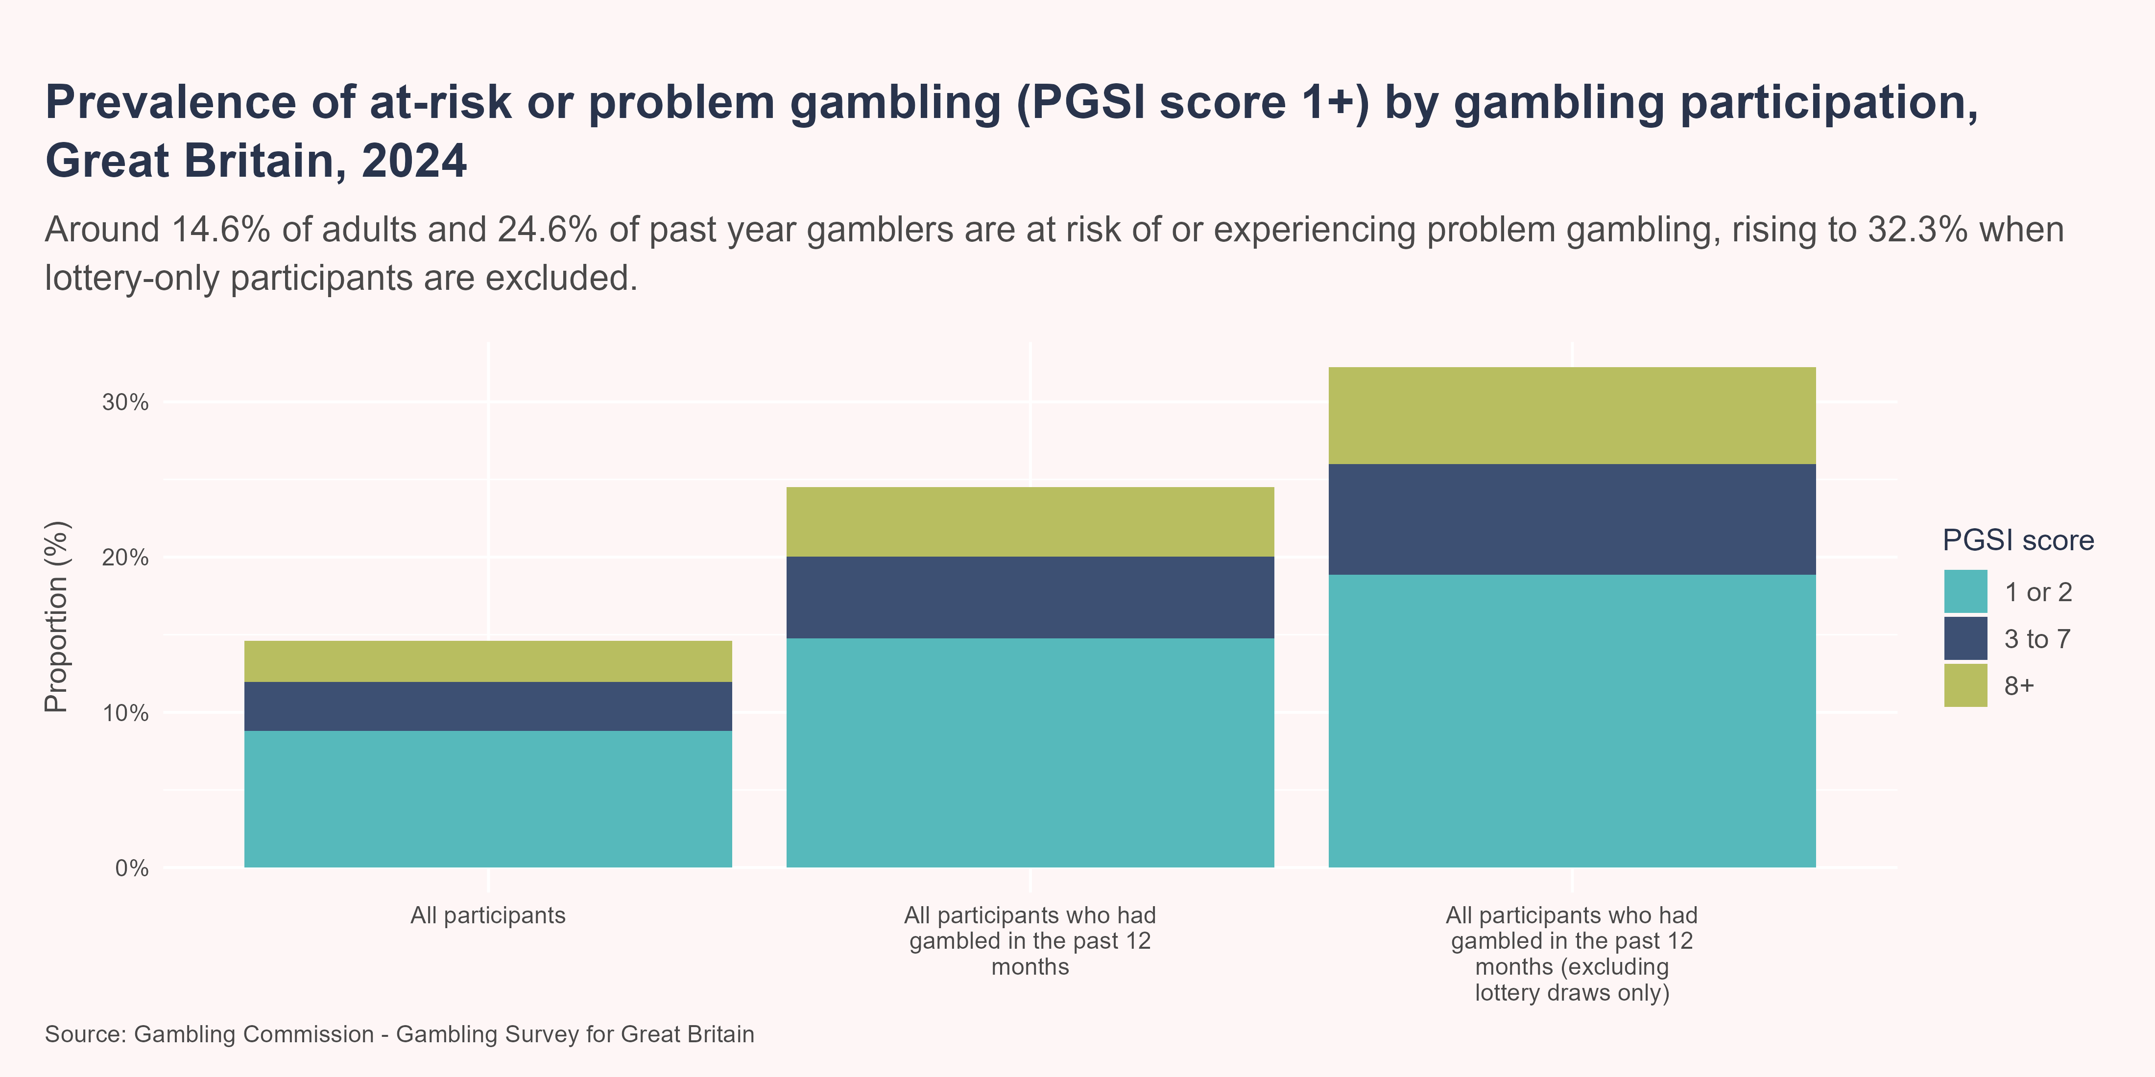
Problem gambling by type of gambling participation
In 2024, an estimated 14.6% of adults aged 18 years and over were classified as at risk of, or experiencing, problem gambling (PGSI score 1+), including 8.8% at low risk, 3.1% at moderate risk and 2.7% engaging in problem gambling.
Among those who had gambled in the past 12 months, the prevalence of at-risk or problem gambling was 24.5%, increasing to 32.2% when those who had participated only in lottery draws were excluded.

Slide 23
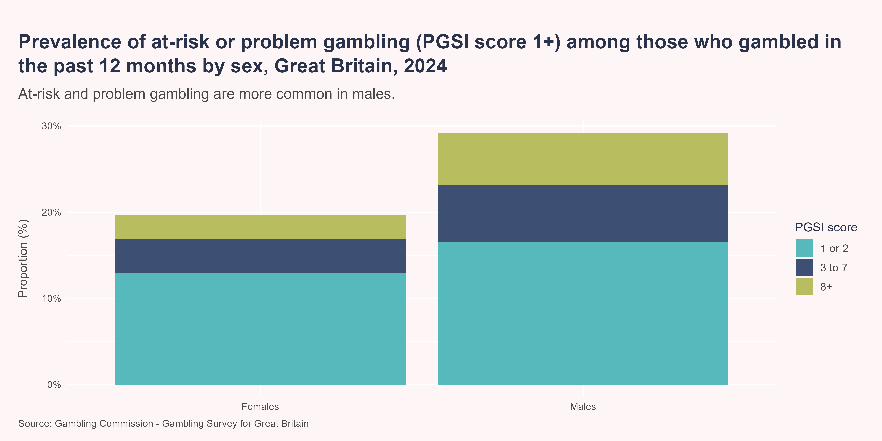
Problem gambling by sex
Males were significantly more likely to be identified as engaging in at-risk or problem gambling than females (29.2% vs 19.7%), among those who had gambled in the past 12 months. This included 6% of males and 2.8% of females that were estimated to be engaging in problem gambling.

Slide 24
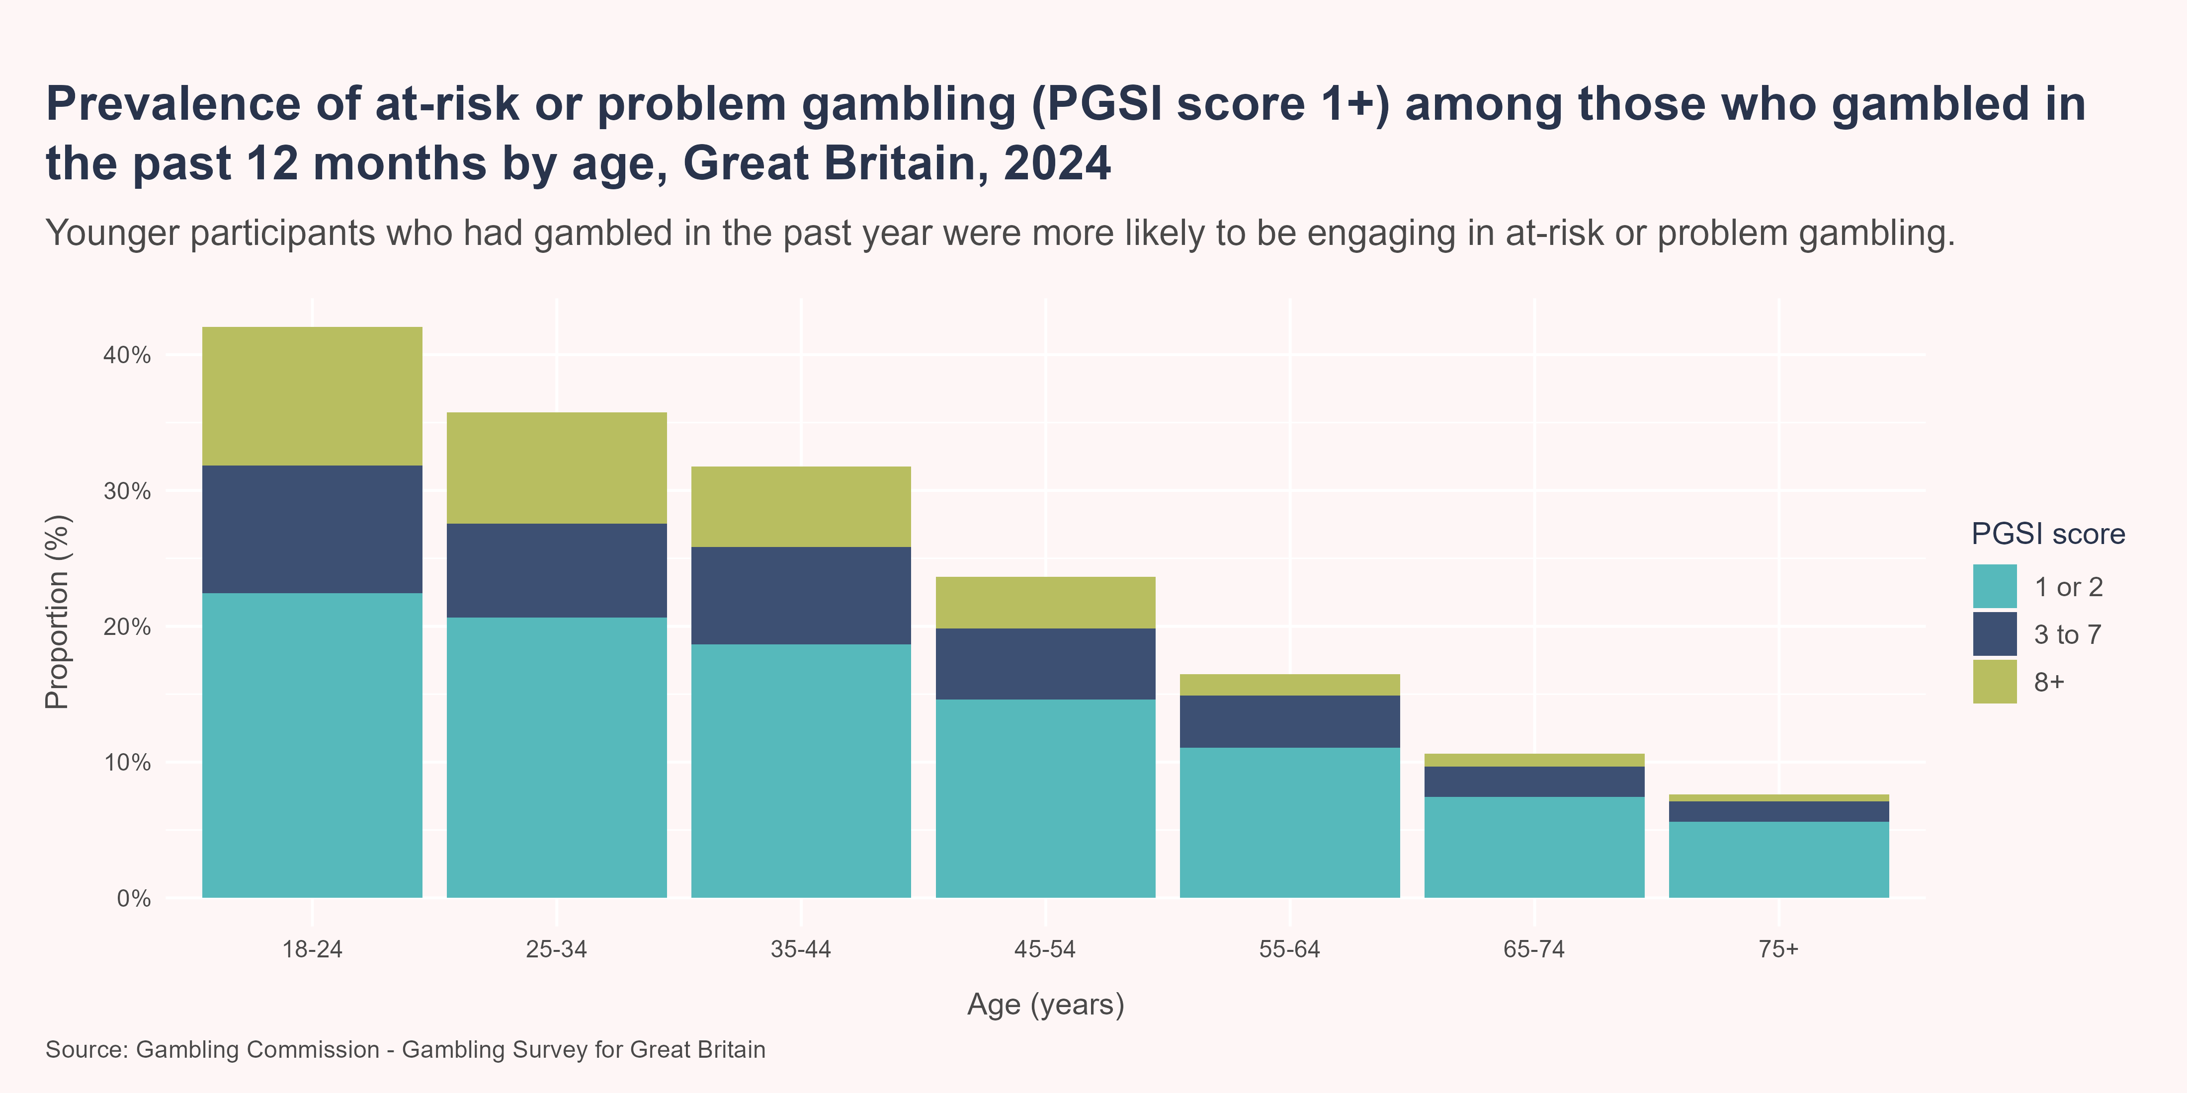
Problem gambling by age
Among those who had gambled in the past 12 months, the prevalence of at-risk or problem gambling followed an age gradient, with the highest rates observed in younger age groups and decreasing with advancing age. It was estimated that 42% of those aged 18-24 years were classified as engaging in at-risk or problem gambling, followed by 35.8% of those aged 25-34 years and 31.8% of those aged 35-44 years. The prevalence of problem gambling followed a similar pattern, with the highest rate among those aged 18-24 years (10.2%), followed by those aged 25-34 years (8.2%) and 35-44 years (5.9%).

Slide 25
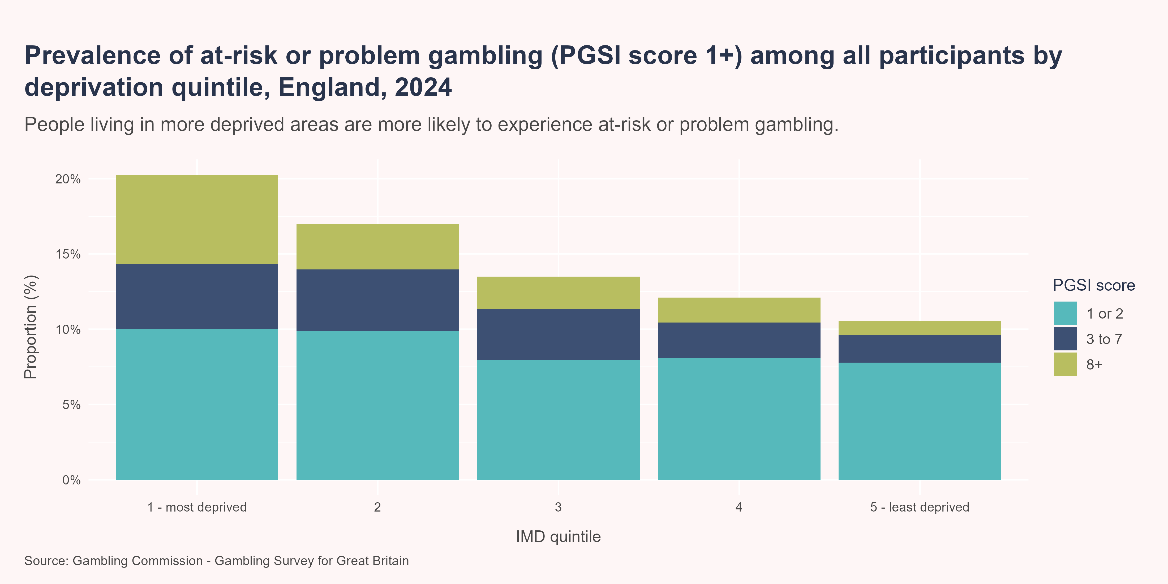
Problem gambling by deprivation
There is large variation in the proportion of people experiencing at-risk of problem gambling by level of deprivation, with those living in more deprived areas facing a significantly higher risk of harm. In 2024, in England, it was estimated that 20.3% of those living in the most deprived 20% of areas were at-risk of or engaging in problem gambling, compared with 10.6% of those living in the least deprived 20% of areas. Meanwhile, the prevalence of problem gambling was 5.9% in the most deprived areas, compared with 1% in the least deprived areas.

Slide 26
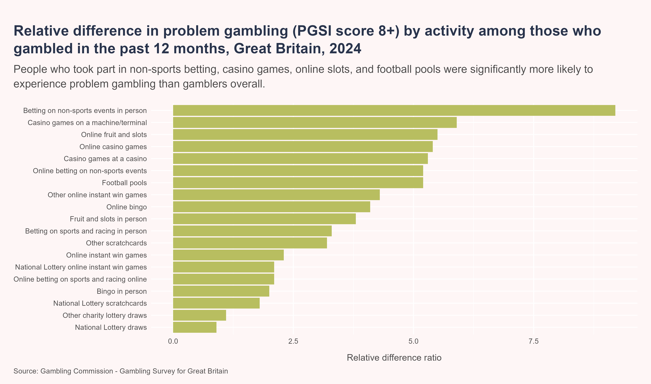
Problem gambling by type of gambling activity
There is significant variation in the risk of problem gambling depending on the type of gambling activity. In 2024, the prevalence of problem gambling was more than nine times higher among those who had bet in person on non-sports events relative to all participants who had gambled in the previous 12 months. Problem gambling prevalence was also more than five times higher among those who had participated in casino games, online fruits and slots, online betting on non-sports events and football pools in the past year.
Interpreting relative difference ratios
A relative difference equal to 1 means that the prevalence for that activity is the same as the average for all people who had gambled in the past 12 months. A relative difference higher than 1 means the prevalence for that activity is higher than average and a relative difference less than 1 means the prevalence for that activity is lower than average.

Slide 27
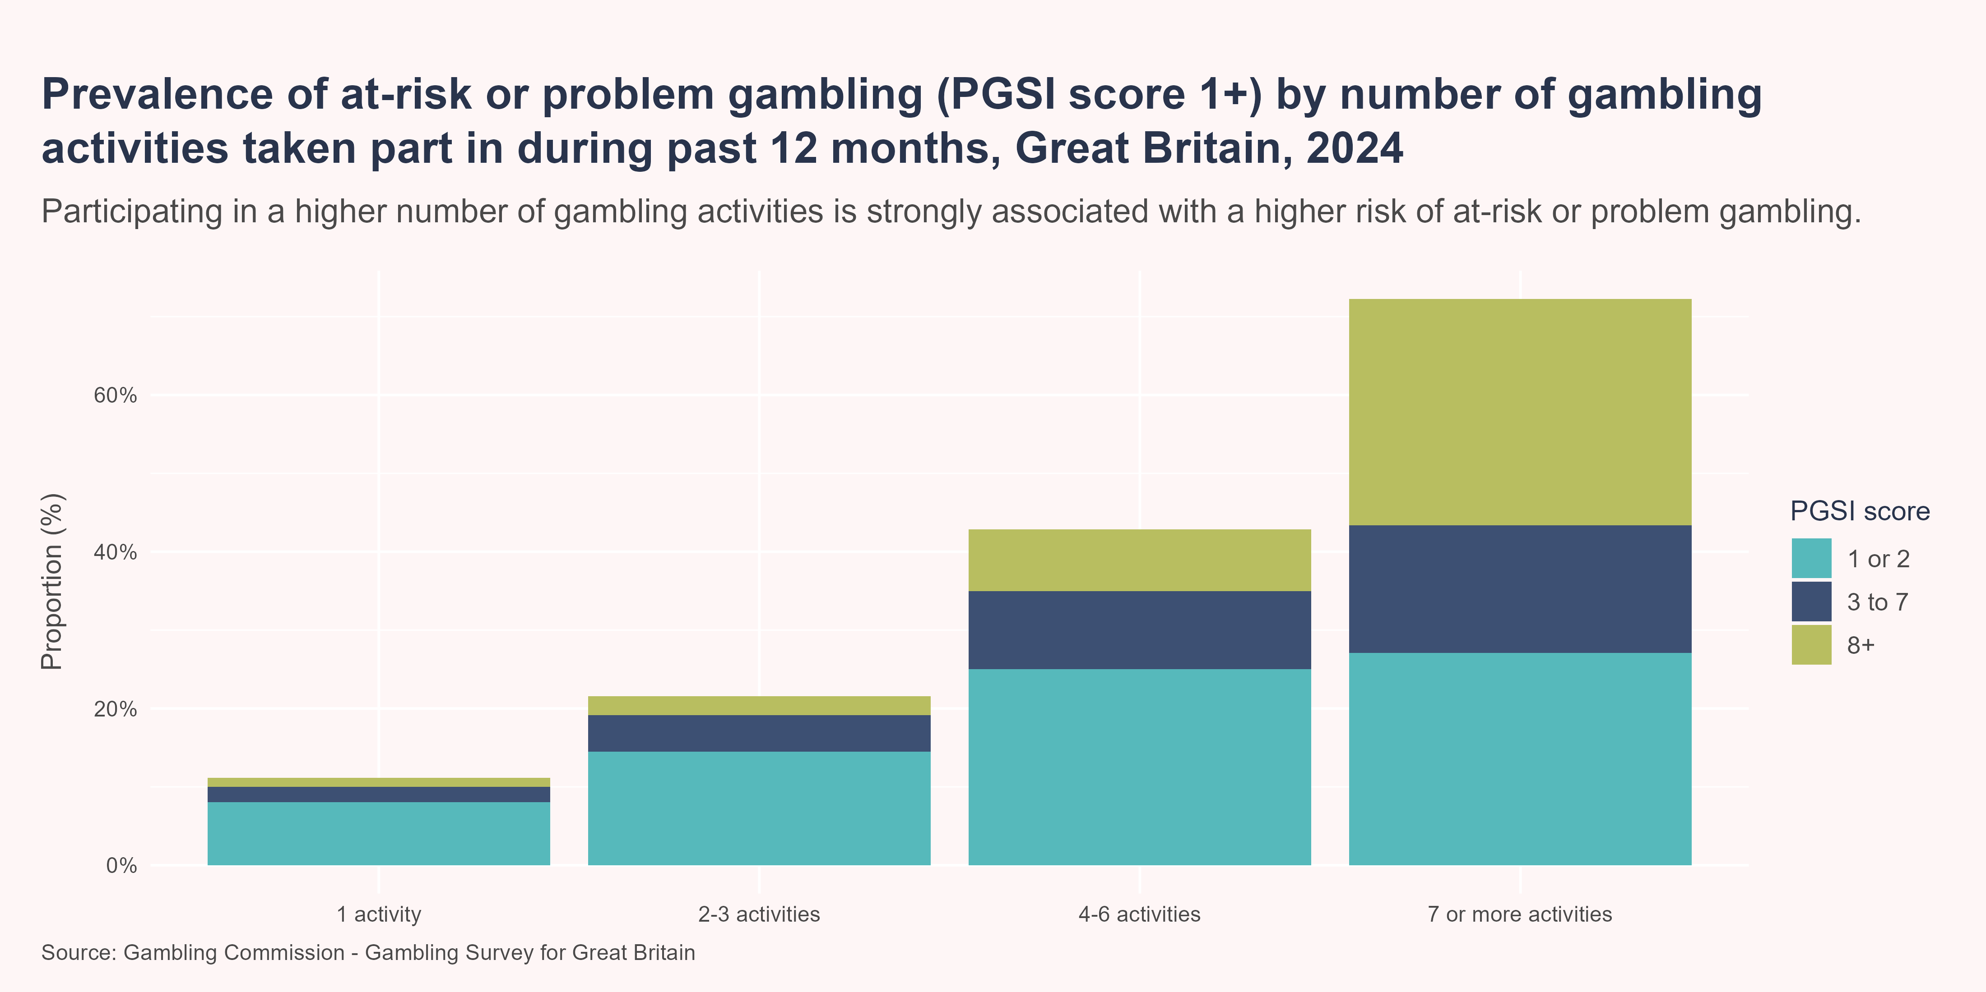
Problem gambling by number of activities
In addition to the type of gambling participated in, there is also a strong association between the number of gambling activities participated in and problem gambling, with prevalence increasing as the number of activities increases. In 2024, nearly three quarters (72.2%) of people who had gambled and spent money on seven or more different gambling activities in the previous 12 months were identified as engaging in at-risk or problem gambling, compared to 42.9% of people who had gambled on four to six different activities, 21.5% of people who gambled on two or three different activities and 11.2% of people who only gambled on one activity.

Slide 28
Problem gambling in Camden
Based on the prevalence of problem gambling in Great Britain from the GSGB, it is estimated that there are 6,163 adults aged 18 years and over in Camden engaging in problem gambling, with a further 24,814 engaging in low or moderate risk gambling.

Slide 29
The cost of gambling-related harms
In 2023, analysis by the Office for Health Improvement and Disparities (OHID) suggested the economic and societal costs associated with gambling-related harm in England to be between £1.05-1.77 billion per year (Office for Health Improvement and Disparities 2023). However, it wasn’t possible to fully quantify many costs - such as healthcare costs associated with suicide, and costs associated with crime, education, and impact on relationships - therefore, these figures are widely recognised to underestimate the true cost (Office for Health Improvement and Disparities 2023). Furthermore, beyond the overall economic burden, gambling harms are not experienced equally in society, with the greatest burden in males and those experiencing higher levels of deprivation, and often co-exist alongisde other issues such as drug and alcohol use and mental health problems.

Slide 30
Treatment
It has been estimated that fewer than 5% of adults experiencing problem gambling in England currently receive treatment (Bowden-Jones et al. 2022). This may be due to a range of factors, including feelings of stigma, shame and fear, and a lack of awareness of available support services (NICE 2025).
Note that in this section, counts below five have been suppressed and all other figures rounded to the nearest five. Therefore, the sum of subgroup totals may not equal the total count. Percentages were calculated using rounded counts.

Slide 31
GamCare
GamCare is the leading provider of information, advice, and support for people affected by gambling-related harms in the UK (GamCare 2026). They deliver the National Gambling Helpline and also provide support and treatment for people experiencing gambling harm, as well as family and friends affected by gambling (GamCare 2026).
Between 2021/22-2024/25, there were 95 referrals to GamCare treatment services by Camden residents. Nearly four in five clients identified as male (77.8%), while around one fifth were female (22.2%). Of those with a recorded ethnicity (81.0%), over two thirds (70.6%) were from a White ethnic group. A significantly higher proportion of treatment referrals in Camden came from people living in the most deprived areas nationally, with 26.3% from the most deprived quintile of areas and 36.8% from the second most deprived quintile, compared with 10.5% from the least deprived 20% of areas.
In Camden, around 72.2% of those referred to treatment had gambled online while 61.1% had gambled in person. The most common activities participated were online slots (42.1%), followed by betting shop gaming machines and online betting (both 21.1%) and betting shop betting and online casino games (both 15.8%).

Slide 32
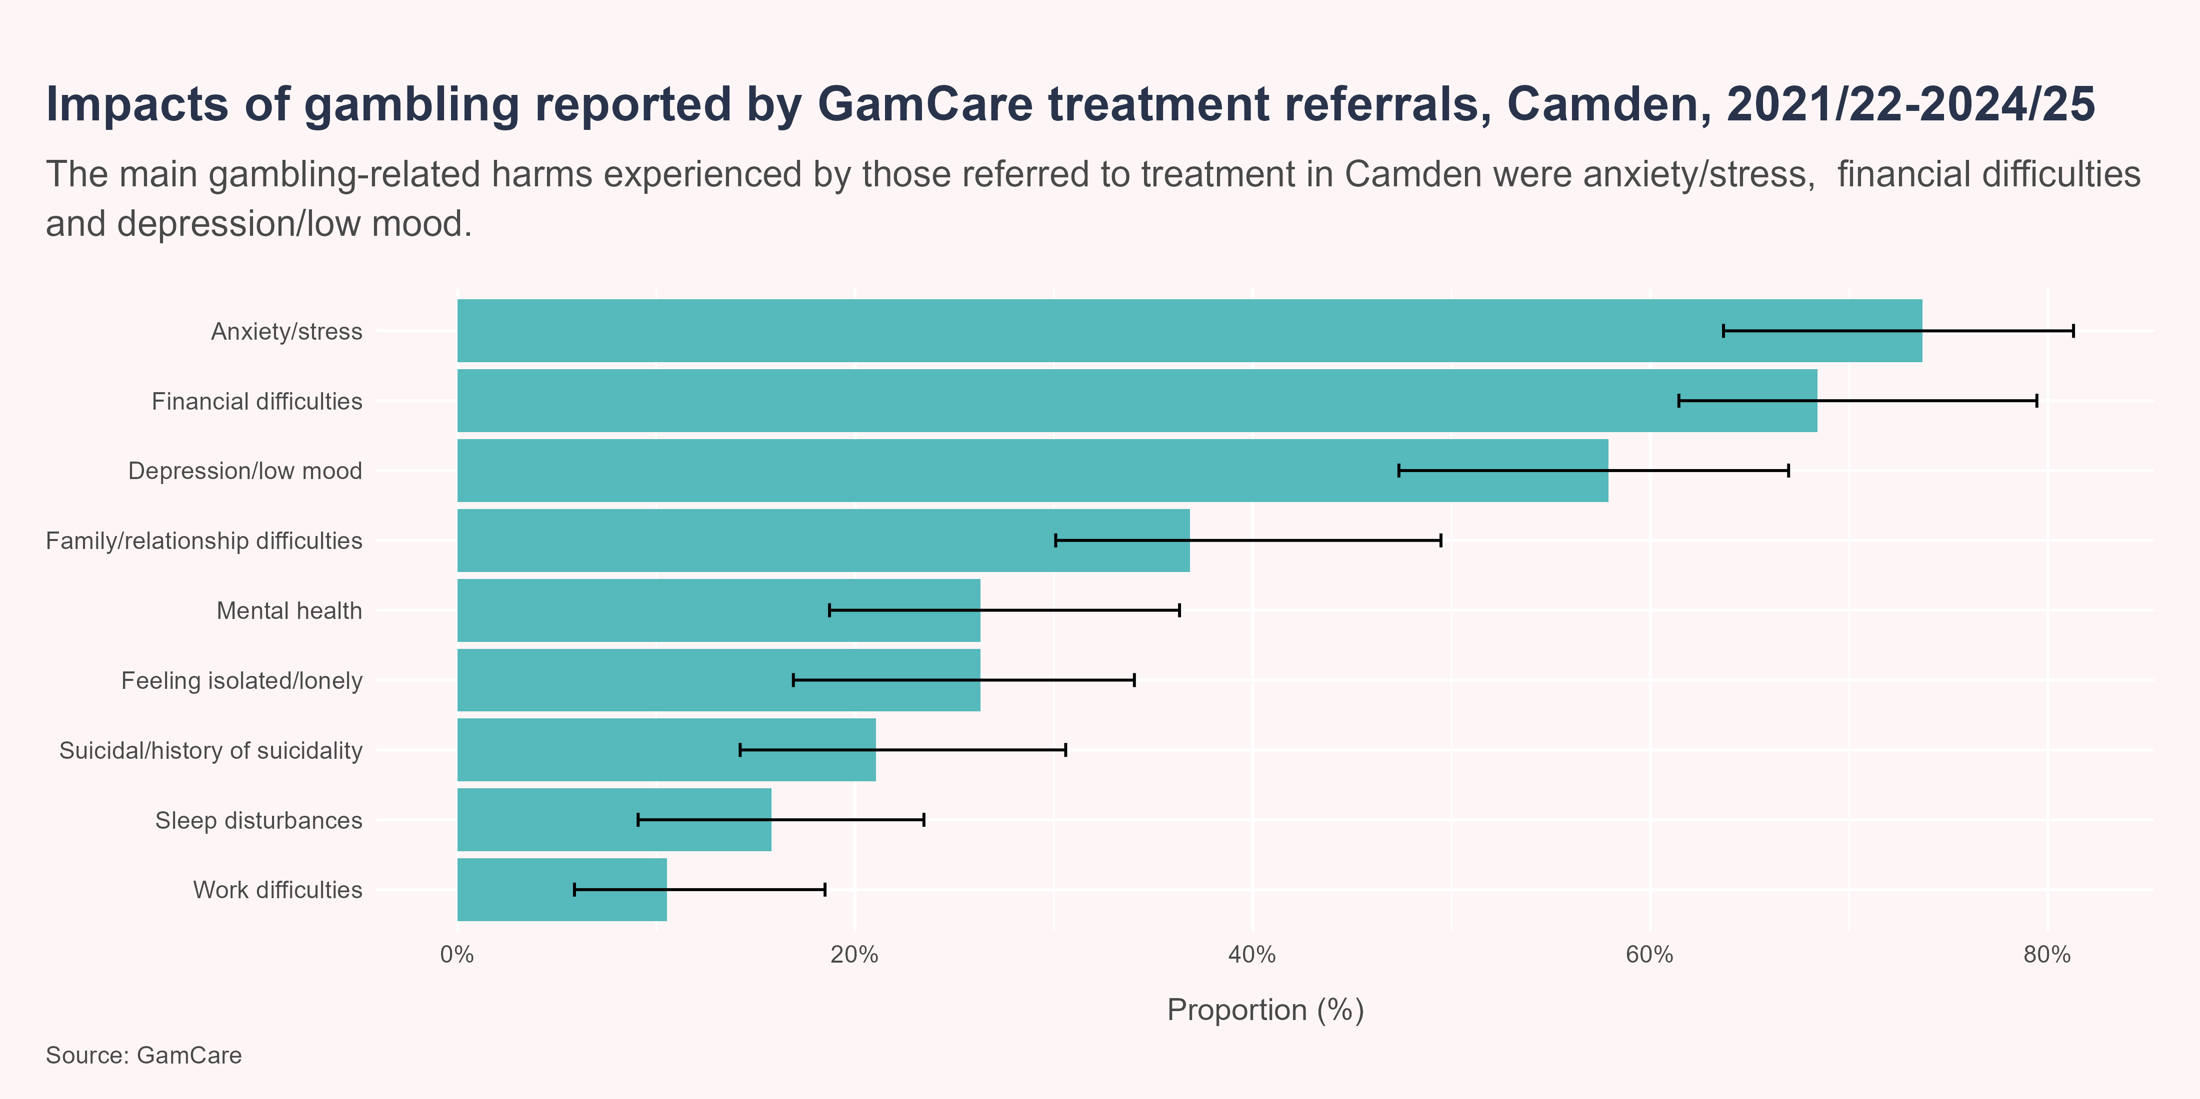
GamCare
The most common type of gambling-related harms experienced by Camden referrals were anxiety/stress (73.7%), financial difficulties (68.4%), depression/low mood (57.9%) and family/relationship difficulties (36.8%). In addition, more than one fifth of people mentioned feeling suicidal or a history of suicidality (21.1%).

Slide 33
National Gambling Clinic
The National Gambling Clinic (NGC) is a specialist NHS service for people who are experiencing harm from gambling aged 13-18 years from anywhere in England, and 18 years or over living in Greater London (Central and North West London NHS Foundation Trust 2025).
Between 2020/21-24/25, there were 60 referrals to the National Gambling Clinic by Camden residents, all of whom were gamblers themselves, rather than affected others. The majority of those referred to treatment were male (75%), aged between 25-55 years (72.7%) and from a White ethnic group (58.3%).

Slide 34
Services, strategies, and interventions

Slide 35
National and regional context
The primary law governing gambling in the UK is the Gambling Act 2005. This act established the UK Gambling Commission (UKGC) to regulate the industry based on three key objectives:
preventing gambling from being a source of crime or disorder
ensuring gambling is conducted fairly and openly
protecting children and vulnerable persons from harm.
The act legalised online gambling, introduced licensing requirements, and allowed gambling advertising with certain restrictions.
The 2023 white paper on gambling, ‘High Stakes: Gambling Reform for the Digital Age’, laid the ground for stronger affordability checks for high-stakes gamblers, stake limits for online slot machines (between £2 and £15 per spin), new powers for the UK Gambling Commission to tackle black-market gambling, increased funding for gambling treatment through a statutory levy on operators, and stricter advertising rules to reduce harm, especially for young people (Department for Culture, Media and Sport 2023).
Gambling licences are issued and regulated by the UK Gambling Commission, and aim to ensure that gambling is conducted fairly, openly, and free from crime:
Gambling (Licensing and Advertising) Act 2014 Operators require an operator’s licence, demonstrating financial stability, integrity, and a commitment to responsible gambling
a Personal Management Licence is required for individuals in key decision-making roles within a gambling business, such as compliance officers, finance directors and operations managers
Personal Functional Licence (PFL) are required for to staff who directly handle gambling activities, such as betting shop and casino staff. This aims to ensure that frontline employees are fit to work in the industry.
The Gambling (Licensing and Advertising) Act 2014 requires all online gambling operators serving UK customers to obtain a UKGC licence, regardless of location. It also imposed a 15% point-of-consumption tax on overseas operators targeting UK consumers, and gambling companies were required to hold a Gambling Commission Licence to advertise
The National Lottery Acts 1993 and 2006 regulate the National Lottery, ensuring it is operated in the public interest
Operators who have a physical premises used for gambling (betting shop, adult gaming centre, casino, racetrack, etc) must also have a premises licence from the local authority, which is also subject to the licensing conditions set out in the Gambling Act 2005. Operators who have a physical premises used for gambling must also have planning permission for use as a gambling premises.

Slide 36
Local strategies and policies
Camden Council’s Statement of Licensing Policy 2023–2026 outlines how the borough regulates gambling under the Gambling Act 2005. The policy includes a local area profile, which is an assessment of the key characteristics of Camden in the context of gambling-related harm, which can be used to assess gambling-related risks and tailor decisions to local conditions, especially in areas with higher vulnerability. The policy:
emphasises evidence-based decision-making using up-to-date data
encourages operators to understand local risks and take steps to mitigate harm
promotes community engagement and transparency in licensing decisions
aligns with Camden’s broader strategies, including We Make Camden vision, public health and equality policies.
Like the Gambling Commission, licensing authorities are bound by a statutory aim to permit and must grant premises licences so long as applications are in accordance with the Gambling Commission’s codes of practice, its guidance to local authorities, the licensing authority’s own statement of principles and the three licensing objectives. However, the 2023 white paper on gambling provides powers for local authorities to determine cumulative impact areas, providing greater scope to refuse an application for a licence in areas where there are concerns that the density of premises in a particular area is having a negative impact on the licensing objectives (Department for Culture, Media and Sport 2023).

Slide 37
Local services and interventions
Camden Council, together with Barnet, Enfield, Haringey, and Islington councils has formed the North Central London (NCL) Tackling Gambling Harms Coalition, which has secured £250,000 to reduce the impact of gambling harm across the five boroughs.
Launching in January 2026, this two-year initiative led by Mind in Haringey will create a unified approach to early identification, public awareness, and community support. By working together, we aim to ensure those most at risk - including families, young people and those across our diverse communities - have a clear path to the right support at the right time.
Identifying and referring individuals experiencing harm from gambling is crucial because early intervention can significantly reduce the level of harm experienced. Gambling-related harm often goes unnoticed until it escalates into serious issues like debt, relationship breakdowns, or mental health struggles. By recognising the signs and connecting people to appropriate support services, professionals can help prevent long-term impacts and promote recovery. Timely referral not only empowers individuals to regain control but also strengthens community resilience.
Two local gambling treatment and support organisations, Betknowmore and GamCare, have partnered with Camden to deliver training on identification and referral or gambling-related harms to upskill front line workers. The sessions are open to front line staff in the Council and partners.
The National Gambling Support Network is a UK-wide initiative offering free, confidential, and personalised support to anyone affected by gambling-related harm, including friends and family members.
The network is made up of multiple organisations working together to ensure that wherever someone seeks help, they’re connected to the most appropriate support. Referrals are coordinated across services to provide a seamless care experience.
Between them, the services offer
24/7 Helpline: The National Gambling Helpline is available 24 hours a day via phone (0808 8020 133), live chat, or WhatsApp
therapeutic support: one-to-one sessions (in-person, online, or by phone), group recovery courses, and tailored treatment plans across regions like London, Scotland, and Yorkshire Humber
online tools: self-guided resources, peer support forums, and practitioner-led digital services for flexible access
specialist clinics: the NHS National Gambling Clinic supports individuals aged 13–18 across England and adults in Greater London. Services include therapy, group sessions, and post-treatment care.
If the affected person decides against being referred to the NGSN, they can still contact the National Gambling Helpline for advice on next steps.
The UK is undergoing a major shift in how gambling treatment and support services are commissioned, aiming to create a more integrated and effective system for tackling gambling-related harms. The Office for Health Improvement and Disparities (OHID) has been appointed the lead commissioning body for prevention services in England. It’s working closely with NHS England and equivalent bodies in Scotland and Wales to align efforts across prevention, early intervention, and treatment. NHS England has taken on a more prominent role in commissioning clinical treatment services, ensuring that gambling harms are treated with the same seriousness as other public health issues. However, following the announcement of the abolition of NHS England in March 2025, it is not yet clear which body will be responsible for commissioning specialist gambling treatment.

Slide 38
References
Bowden-Jones, Henrietta, Roxanne W Hook, Jon E Grant, et al. 2022. “Gambling Disorder in the UK: Key Research Priorities and the Urgent Need for Independent Research Funding.” The Lancet Psychiatry 9 (4): 321–29. https://doi.org/10.1016/S2215-0366(21)00356-4.
Central and North West London NHS Foundation Trust. 2025. “National Gambling Clinic.” https://www.cnwl.nhs.uk/services/addictions/national-gambling-clinic.
Commission on Crime & Gambling Related Harms. 2023. Lived Experiences of Gambling, Gambling-Related Harms, and Crime Within Ethnic Minority Communities. https://howardleague.org/wp-content/uploads/2023/04/Howard-League_Summary_Lived-experiences-of-gambling-gambling-related-harms-and-crime-within-ethnic-minority-communities_Commission-on-Crime-and-Gambling-Related-Harms_April-2023.pdf.
Department for Culture, Media and Sport. 2023. High Stakes: Gambling Reform for the Digital Age. Policy paper. https://www.gov.uk/government/publications/high-stakes-gambling-reform-for-the-digital-age/high-stakes-gambling-reform-for-the-digital-age.
Department for Culture, Media and Sport. 2025. “Statutory Gambling Levy.” GOV.UK. https://www.gov.uk/government/publications/statutory-gambling-levy.
Fenton, Kevin, and Will Prochaska. 2025. “Ending Gambling Adverts Could Prevent Harm to Millions of Adults and Children in the UK.” BMJ, January 27, r158. https://doi.org/10.1136/bmj.r158.
Ferris, Jackie, and Harold Wynn. 2001. “The Canadian Problem Gambling Index: Final Report.” Canadian Centre on Substance Abuse.
Gambling Commission. 2021. “Problem Gambling Screens.” https://www.gamblingcommission.gov.uk/statistics-and-research/publication/problem-gambling-screens.
Gambling Commission. 2023. “National Strategy to Reduce Gambling Harms 2019 to 2022.” https://www.gamblingcommission.gov.uk/print/national-strategy-to-reduce-gambling-harms.
Gambling Commission. 2025a. “Gambling Survey for Great Britain - Annual Report (2024): Official Statistics.” https://www.gamblingcommission.gov.uk/report/gambling-survey-for-great-britain-annual-report-2024-official-statistics.
Gambling Commission. 2025b. “Industry Statistics - Annual Report - Financial Year April 2024 to March 2025 - Official Statistics.” https://www.gamblingcommission.gov.uk/statistics-and-research/publication/industry-statistics-annual-report-financial-year-april-2024-to-march-2025.
GamCare. 2026. “About Us.” https://www.gamcare.org.uk/about-us/.
Goodwin, Belinda C., Matthew Browne, Matthew Rockloff, and Judy Rose. 2017. “A Typical Problem Gambler Affects Six Others.” International Gambling Studies 17 (2): 276–89. https://doi.org/10.1080/14459795.2017.1331252.
Grant, Jon E., and Samuel R. Chamberlain. 2020. “Gambling and Substance Use: Comorbidity and Treatment Implications.” Progress in Neuro-Psychopharmacology and Biological Psychiatry 99 (April): 109852. https://doi.org/10.1016/j.pnpbp.2019.109852.
NHS England Digital. 2023. “Health Survey for England, 2021 Part 2: Gambling Behaviour.” https://digital.nhs.uk/data-and-information/publications/statistical/health-survey-for-england/2021-part-2/gambling.
NICE. 2025. Gambling-Related Harms: Identification, Assessment and Management: NG248. https://www.nice.org.uk/guidance/ng248/chapter/Recommendations#case-identification-initial-support-referral-and-assessment.
Office for Health Improvement and Disparities. 2023. The Economic Cost of Gambling-Related Harm in England: Evidence Update 2023. https://assets.publishing.service.gov.uk/government/uploads/system/uploads/attachment_data/file/1128002/The-economic-cost-of-gambling-related-harm-in-England_evidence-update-2023.pdf.
Office for Health Improvement and Disparities, and Public Health England. 2023a. “Gambling-Related Harms Evidence Review: Summary.” GOV.UK. https://www.gov.uk/government/publications/gambling-related-harms-evidence-review/gambling-related-harms-evidence-review-summary--2.
Office for Health Improvement and Disparities, and Public Health England. 2023b. Risk Factors for Gambling and Harmful Gambling: An Umbrella Review. https://assets.publishing.service.gov.uk/media/6151b034e90e077a2db2e7f4/Gambling_risk_factors.pdf.
Smith, Jessica, Simon Wright, Glen Dighton, Simon Dymond, and Jamie Torrance. 2025. “The Influence of Family on Gambling Behaviours: A Rapid Review of Emergent Literature.” International Journal of Mental Health and Addiction, ahead of print. https://doi.org/10.1007/s11469-025-01505-2.
Sturgis, P, J Kuha, S Howe, and I Maxineanu. 2025. Three Experiments on the Causes of Differences in Estimates of Gambling and Gambling Impacts in General Population Surveys. London School of Economics and Political Science. https://researchonline.lse.ac.uk/id/eprint/129116/.

