Slide 1
Long-term conditions
A summary of the burden of long-term conditions in Camden
Profile

Slide 2

Morbidity

Slide 3

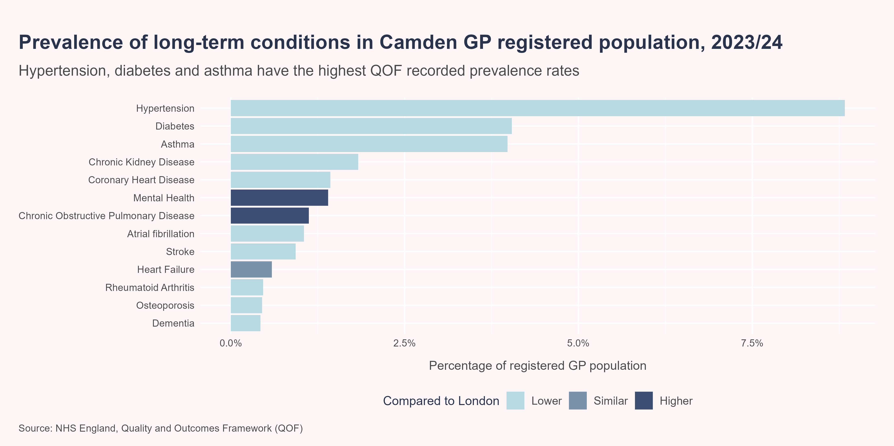
Prevalence of long-term conditions
In 2023/24, the LTCs with the highest recorded prevalence rates in patients registered with a GP in Camden were hypertension (8.83%), diabetes (4.04%) and asthma (3.98%). The prevalence of hypertension, chronic obstructive pulmonary disease, heart failure, and dementia has decreased in Camden in recent years, while there has been no significant change in the prevalence of all other conditions.

Slide 4
Incidence of depression
In addition, it was estimated that 1.81% (n=5,040) of patients aged 18 years or over who were registered with a GP in Camden received a new diagnosis of depression in 2023/24, which was significantly higher than the London average (1.25%). The incidence of depression has been increasing in recent years, both locally and regionally.

Slide 5
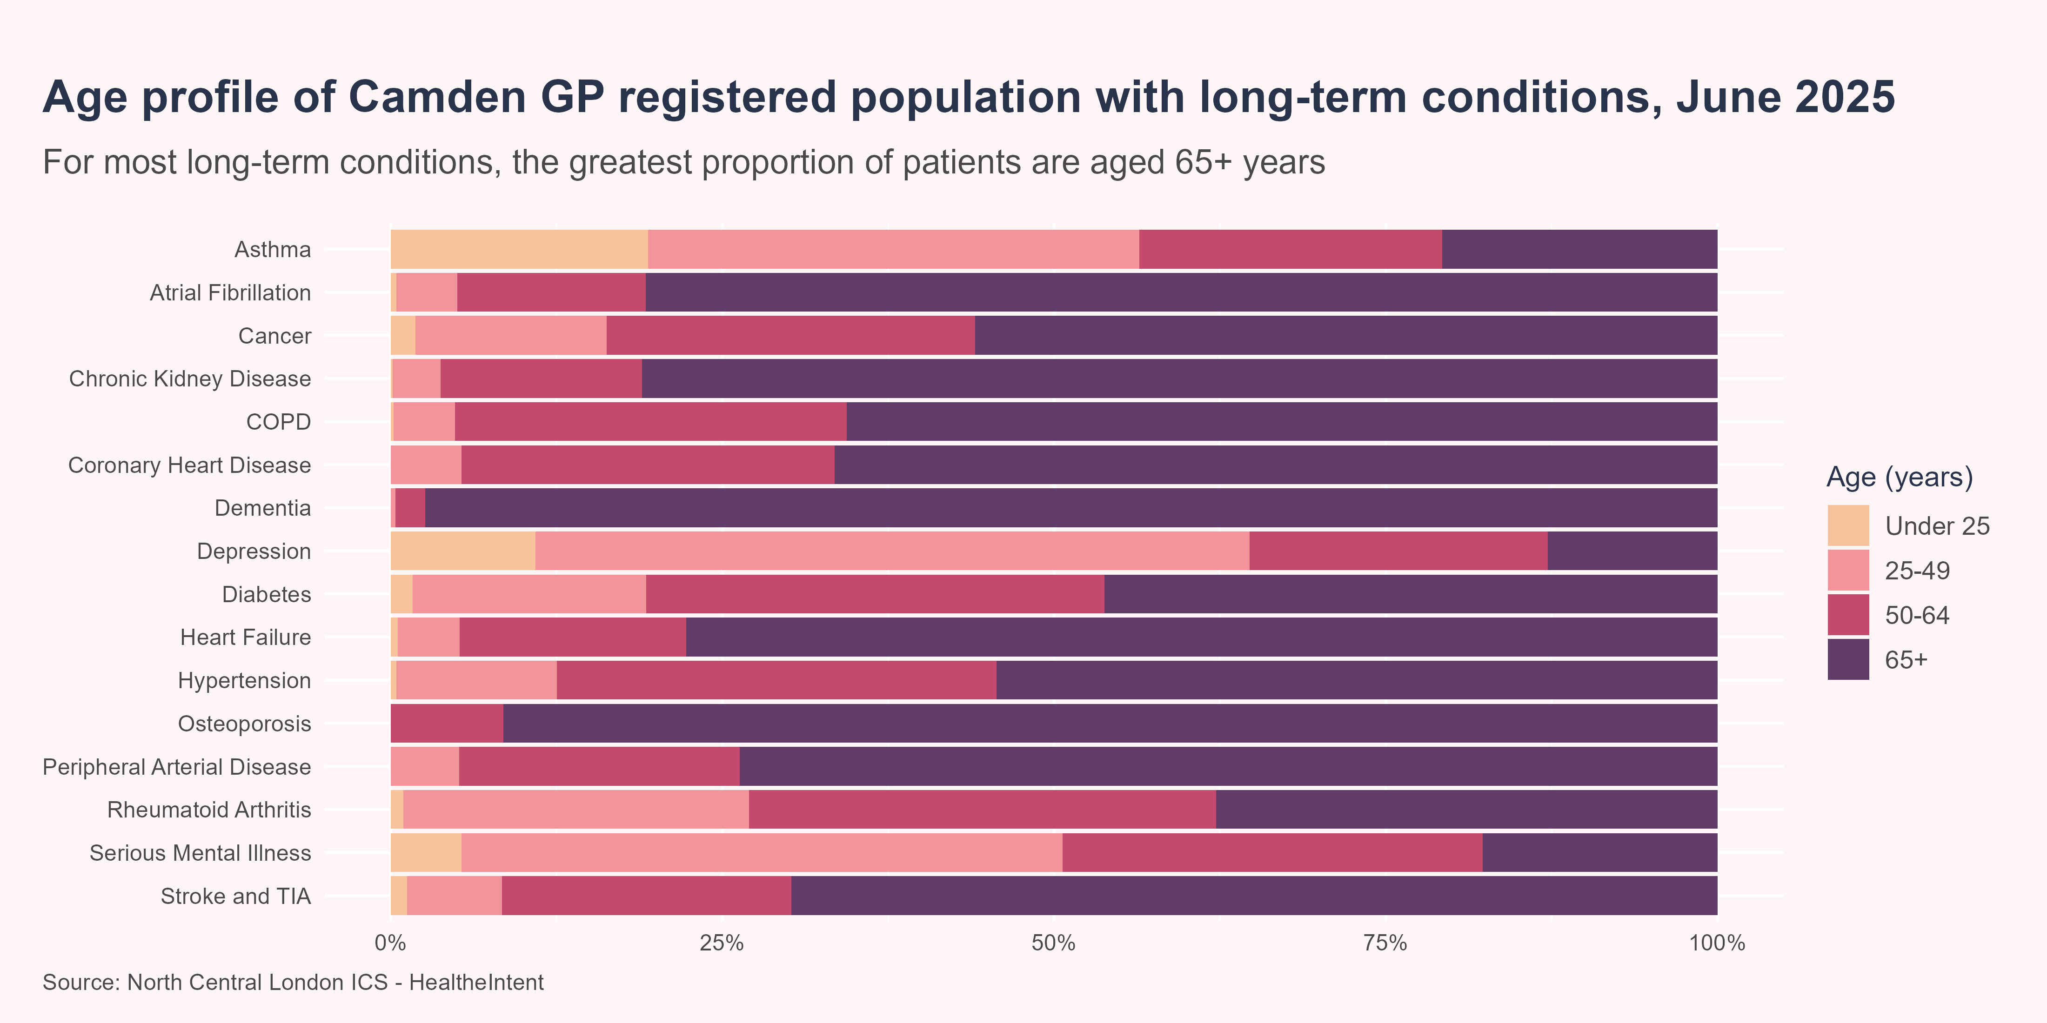
Age profile of long-term conditions
For the majority of LTCs, the greatest proportion of patients are aged 65+ years. In patients registered with a GP in Camden, this is highest for dementia, where 97.4% of diagnosed patients are aged 65+ years, followed by osteoporosis (91.5%), chronic kidney disease (81.1%) and atrial fibrillation (80.8%). However, asthma, depression and serious mental illness are the exceptions, with the greatest proportion of patients aged between 25 and 49 years.

Slide 6
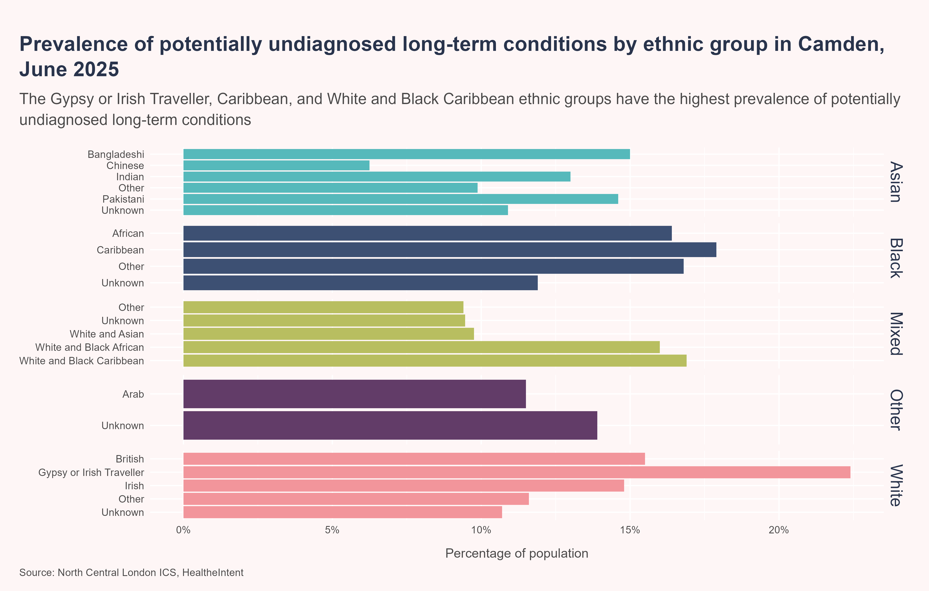
Potentially undiagnosed long-term conditions
The North Central London Integrated Care System publishes a case finding dashboard which provides a snapshot of patients at risk of developing certain LTCs, to highlight social and demographic inequalities in those who may be affected. This data allows clinicians to access a list of their patients who may benefit from intervention.
In June 2025, it was estimated that there were 40,415 patients with a potentially undiagnosed LTC in Camden, of which 56.2% were male and 43.8% were female. The conditions with the greatest number of people eligible for case finding interventions were hypertension (n=19,560), diabetes (n=14,140) and cardiovascular disease (n=6,025). Meanwhile, the prevalence of potentially undiagnosed LTCs was highest in the Gypsy or Irish Traveller (22.4%), Caribbean (17.9%), and White and Black Caribbean (16.9%) ethnic groups.

Slide 7
Disease burden
The disability-adjusted life-year (DALY) is a measure of health loss due to disease burden, and is calculated as the sum of the years of life lost (YLLs) due to premature death and years of life lived with disability (YLDs). One DALY represents one year of healthy life lost.
The total disease burden in Camden remained largely unchanged from 2010 to 2021, with slight increases in communicable disease DALYs offset by decreased DALYs due to non-communicable diseases (NCDs) and injuries [1]. In 2021, COVID-19 had the largest DALY burden in Camden, accounting for 11.2% of total DALYs. The leading causes of DALYs from NCDs were low back pain (5.1%), major depression (3.9%), ischaemic heart disease (3.6%) and type 2 diabetes (3.1%), comprising 15.7% of all DALYs. Of the leading causes, the biggest increase in disease burden between 2011 and 2021 was seen for type 2 diabetes (43.0%), major depressive disorder (28.4%), alzheimer’s disease and other dementias (16.0%), and anxiety disorders (13.8%).

Slide 8
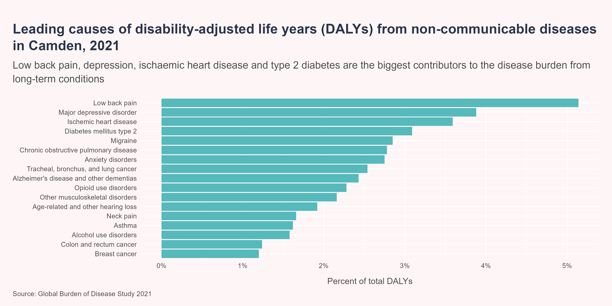
Disease burden

Slide 9
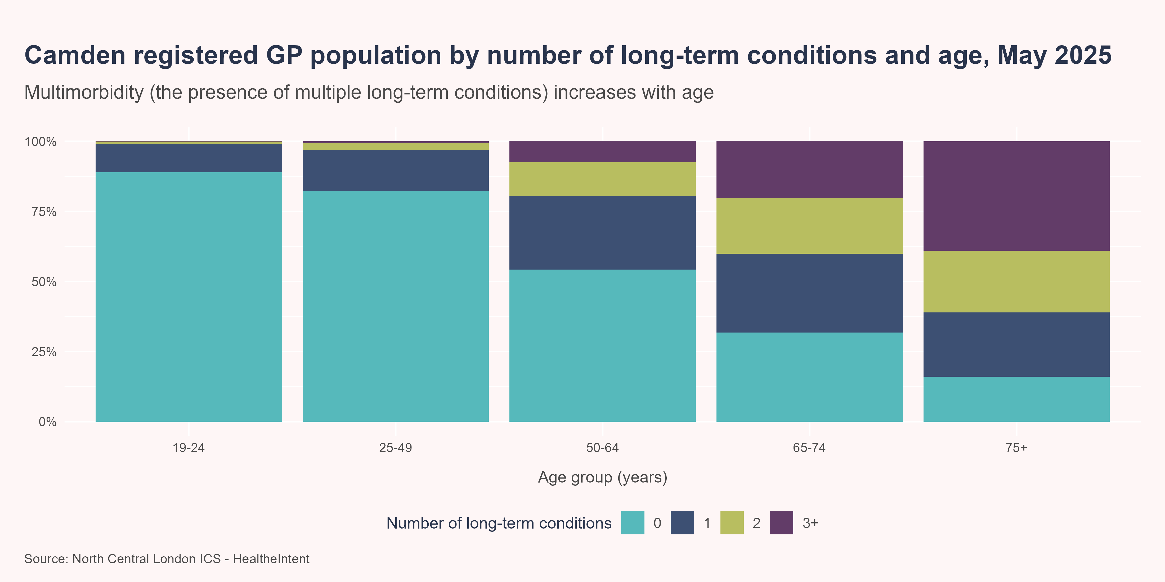
Multimorbidity
Multimorbidity is defined as the presence of two or more long-term conditions, and is associated with a greater risk of functional decline, poorer quality of life, greater healthcare use and mortality [2]. Multimorbidity is significantly associated with age and becomes almost universal in older adults. However it is also more common and occurs at an earlier age in people living in areas of higher socioeconomic deprivation [3].
In patients registered with a GP in Camden, multimorbidity increases with age, from less than 3.0% of the population aged under 50 years, to 19.6% in the 50-64 years age group, 40.2% in the 65-74 years age group and 61.0% in those aged 75+ years. In the population aged 75+ years, the greatest proportion of patients have 3 or more long-term conditions (39.0%).

Slide 10
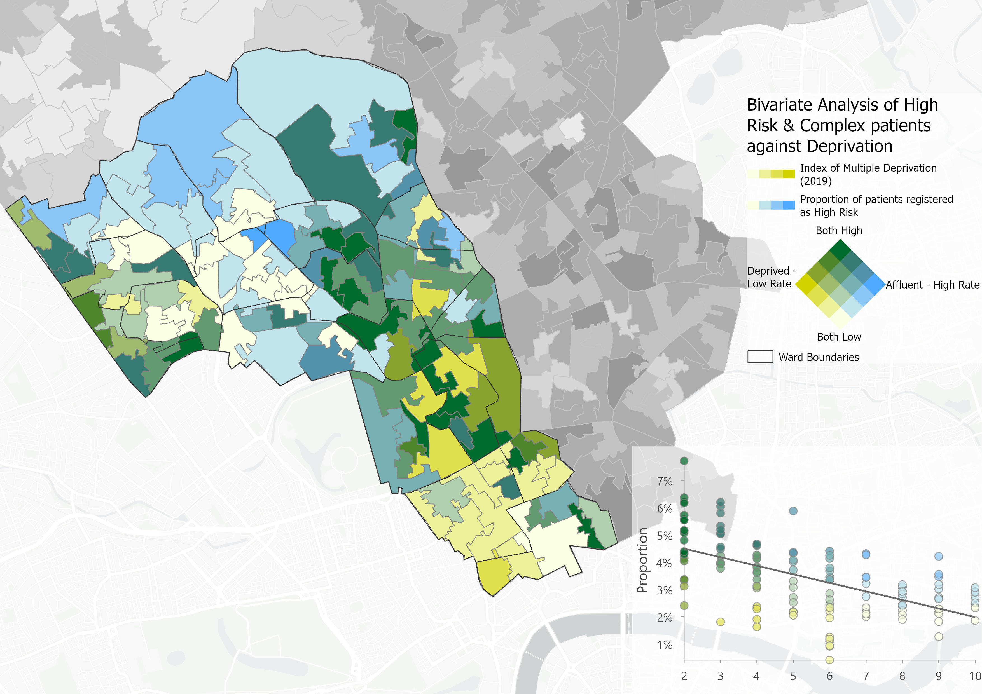
Long-term condition complexity
Age and social deprivation are leading risk factors for the development of many LTCs, therefore the burden of LTCs, and multimorbidity, tends to be higher in older and more deprived populations. Patients with multiple LTCs have higher needs for health care, and greater complexity in their management.
In Camden, the Eastern and Central parts of the borough, and those around Kilburn, exhibit both high levels of deprivation and LTC complexity, suggesting these areas are likely to have the greatest health and care needs. The North of the borough also has high levels of LTC complexity, largely due to the older age demographic, although these areas are characterised by low levels of deprivation. Meanwhile, areas around the South show high levels of deprivation but lower LTC complexity, likely due to the younger age demographic.
Bivariate analysis of high risk and complex patients with long-term conditions, against deprivation (Index of Multiple Deprivation 2019). Source: NCL ICB Population Health Analytics Team

Slide 11

Mortality

Slide 12

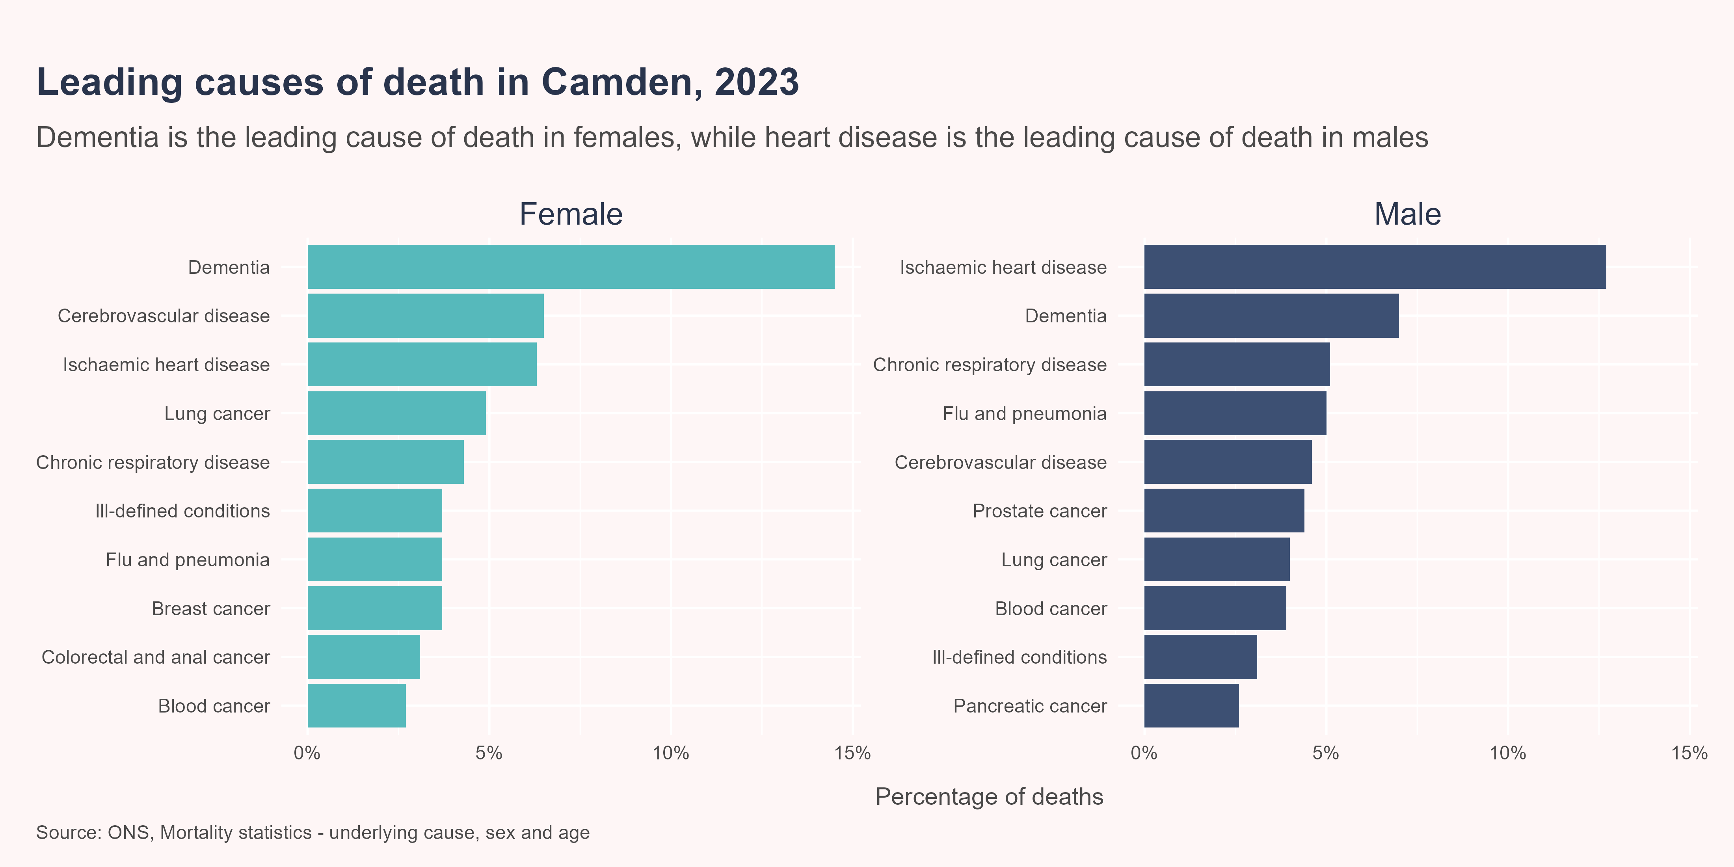
Leading causes of death
In recent decades, there has been a shift in the overall pattern of morbidity and mortality - from infectious diseases to an increasing burden of non-communicable diseases [4]. Therefore, many of the leading causes of death in Camden are now long-term conditions.
In 2023, dementia was the leading cause of death for females in Camden, accounting for 14.5% of all deaths, followed by cerebrovascular disease (6.5%) and ischaemic heart disease (6.3%). Meanwhile, in males, ischaemic heart disease was the leading cause of death, accounting for 12.7% of all deaths, followed by dementia (7%) and chronic respiratory disease (5.1%).

Slide 13
Mortality indicators
Not all deaths can be avoided but those which occur prematurely due to preventable or treatable diseases, illnesses, or injuries, offer the opportunity to reduce mortality by targeting interventions to address the underlying causes. There are several indicators which can be used to describe avoidable mortality, each of which are defined below:
Premature mortality - all deaths in people under the age of 75 years.
Preventable mortality - deaths in people under the age of 75 years which could have been avoided through effective public health and primary prevention interventions.
Treatable mortality - deaths that could have been prevented through timely and effective healthcare interventions, including secondary prevention and treatment.
Avoidable mortality - all the deaths defined as preventable or treatable.

Slide 14
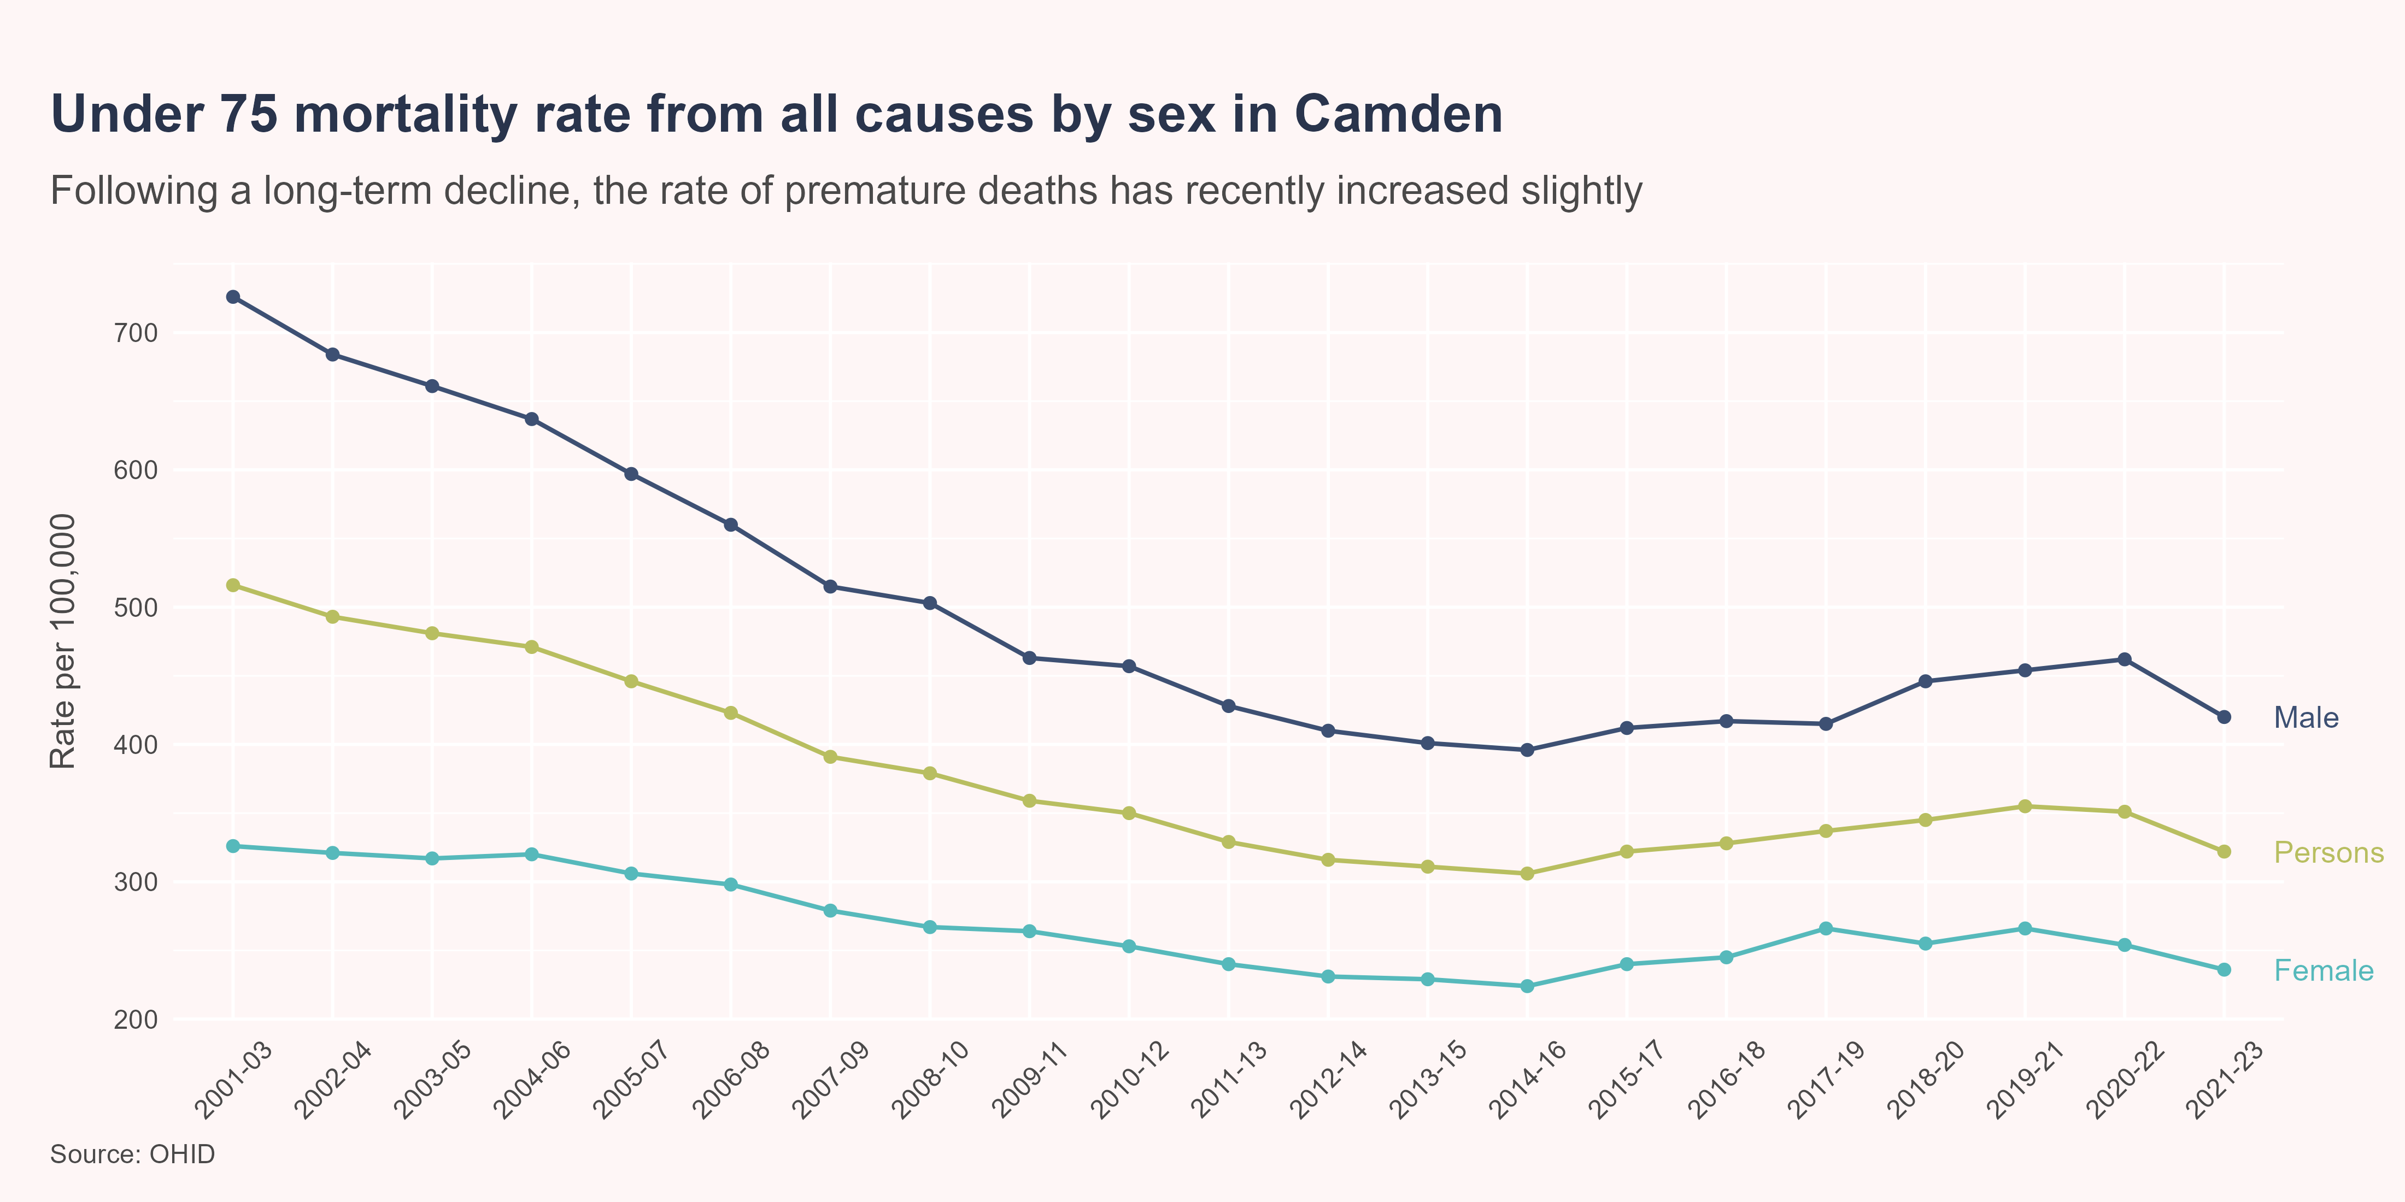
Premature mortality
Premature mortality is a good high-level indicator of the overall health of a population, and is correlated with many other measures of population health.
Since 2001-03, the rate of premature mortality in Camden has fallen by 38% (28% in females and 42% in males). However, the rate of improvement slowed in the decade before the pandemic, while the rate increased between 2014-16 and 2020-22.
In 2021-23, Camden had a similar rate of premature mortality to London (322 vs 324 deaths per 100,000), while the rate was better than the England average (349 deaths per 100,000). Both locally and nationally, the rate of premature mortality was significantly higher in males compared to females.

Slide 15
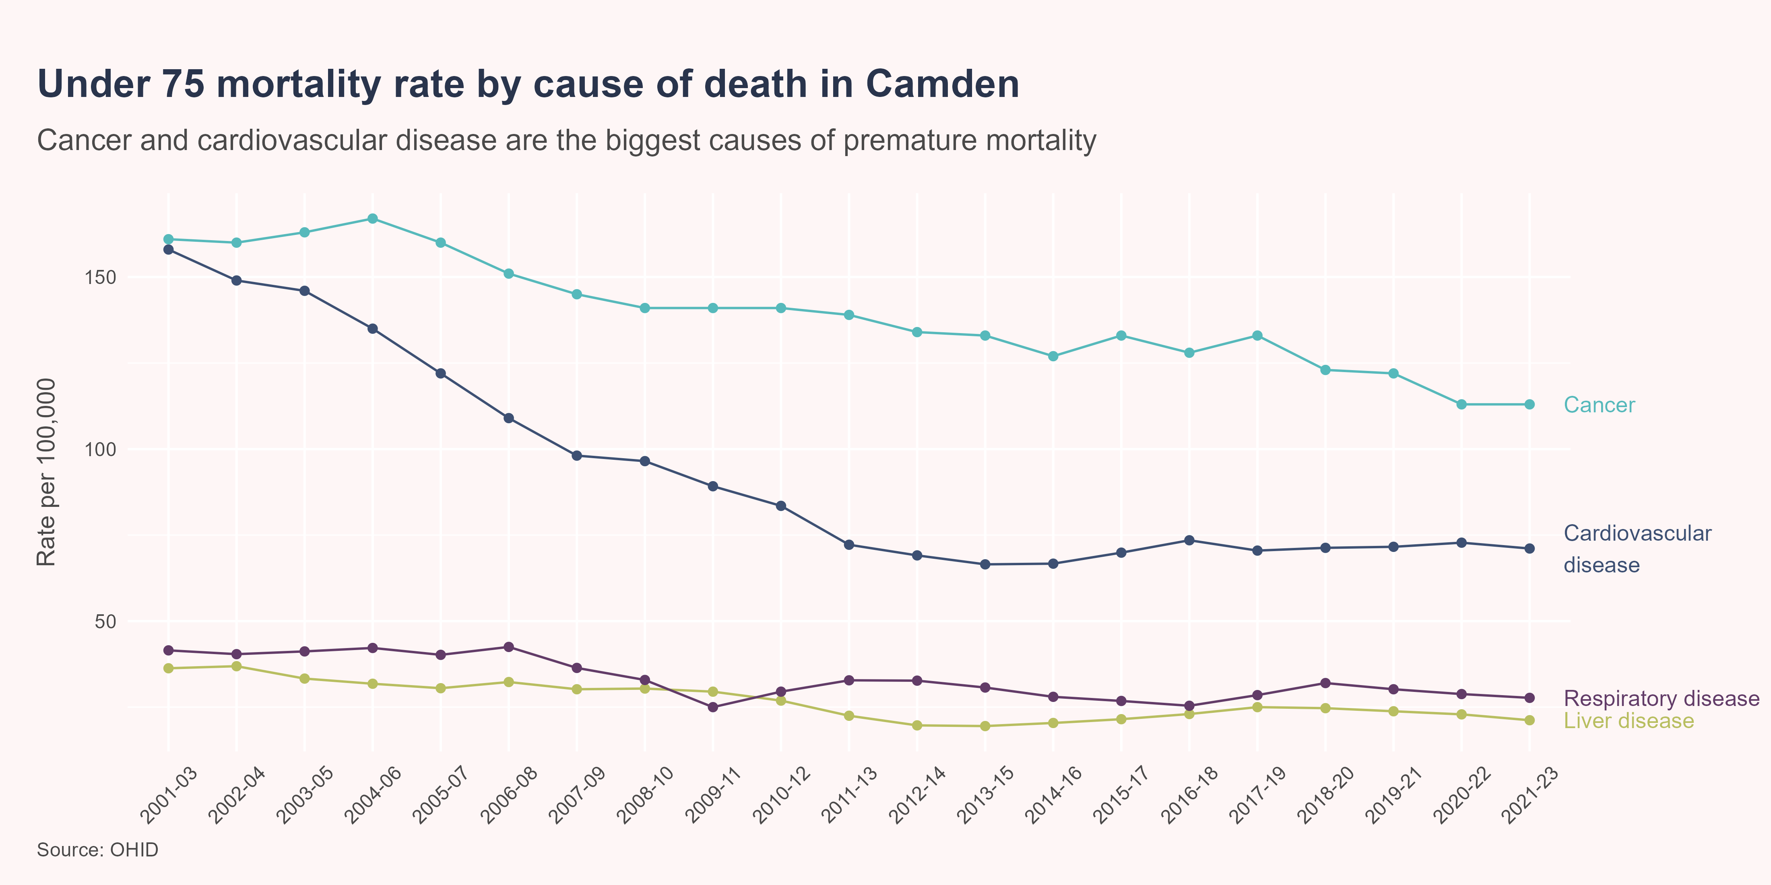
Premature mortality by cause
Between 2021-23, the highest rates of premature mortality in Camden were from cancer (113 deaths per 100,000; n=462) and cardiovascular disease (71.1 per 100,000; n=298), followed by respiratory disease (27.7 per 100,000; n=109) and liver disease (21.2 per 100,000; n=91). These rates were all similar to the London and England averages. In Camden, rates of premature mortality from cancer, respiratory disease, and liver disease have declined over the past five time periods, while the rate for cardiovascular disease increased; however, none of these trends reached statistical significance.

Slide 16
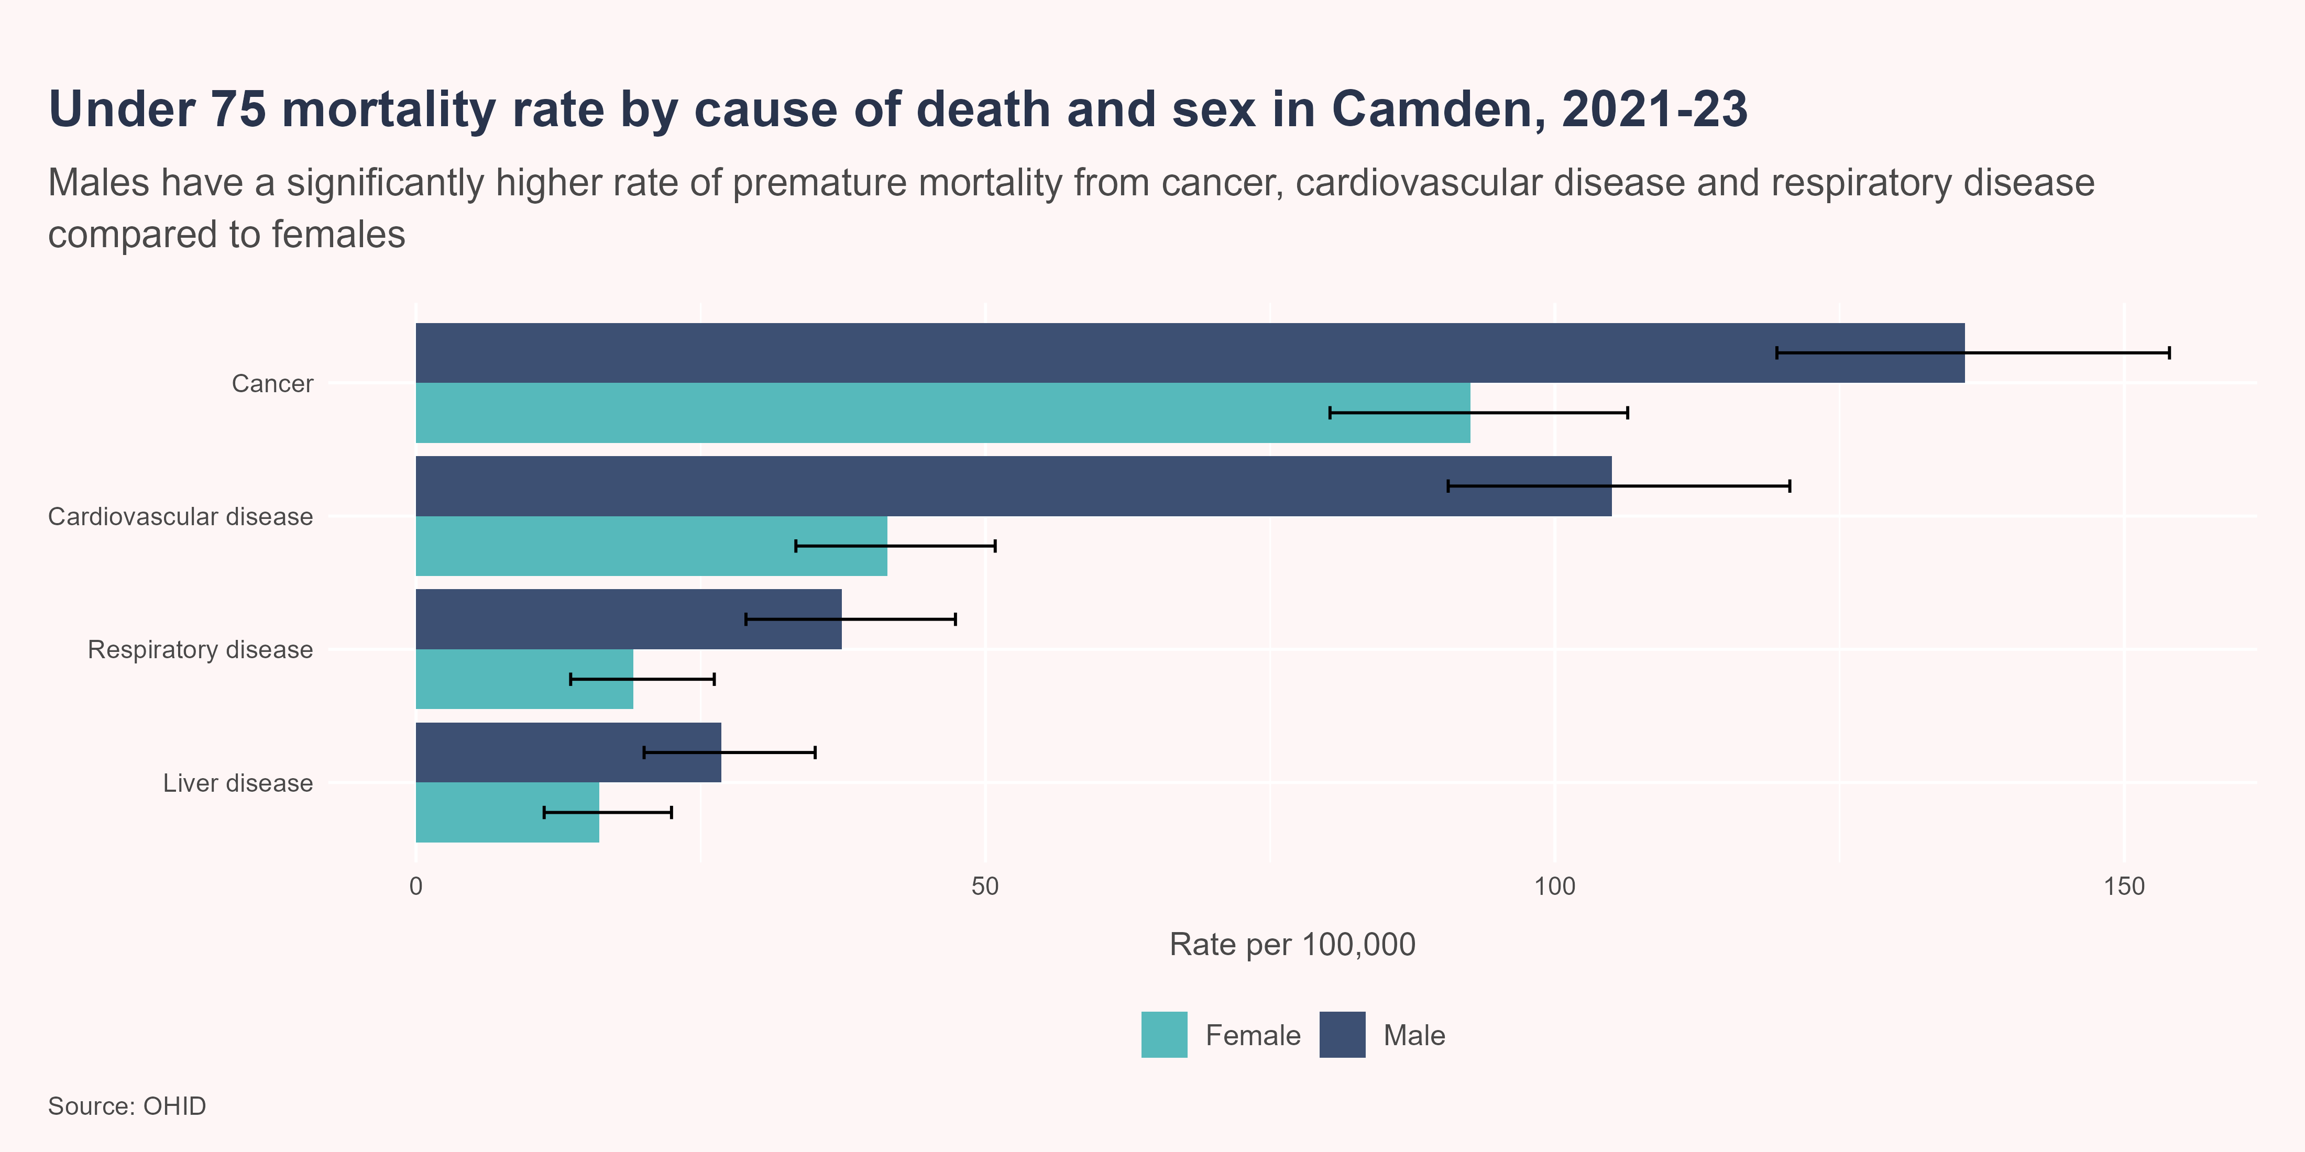
Premature mortality by cause and sex
Between 2021-23, males had a significantly higher rate of under 75 mortality from cancer, cardiovascular disease and respiratory disease compared to females, in Camden. The rate of premature death from liver disease was also higher in males than females, although this difference was not statistically significant.

Slide 17
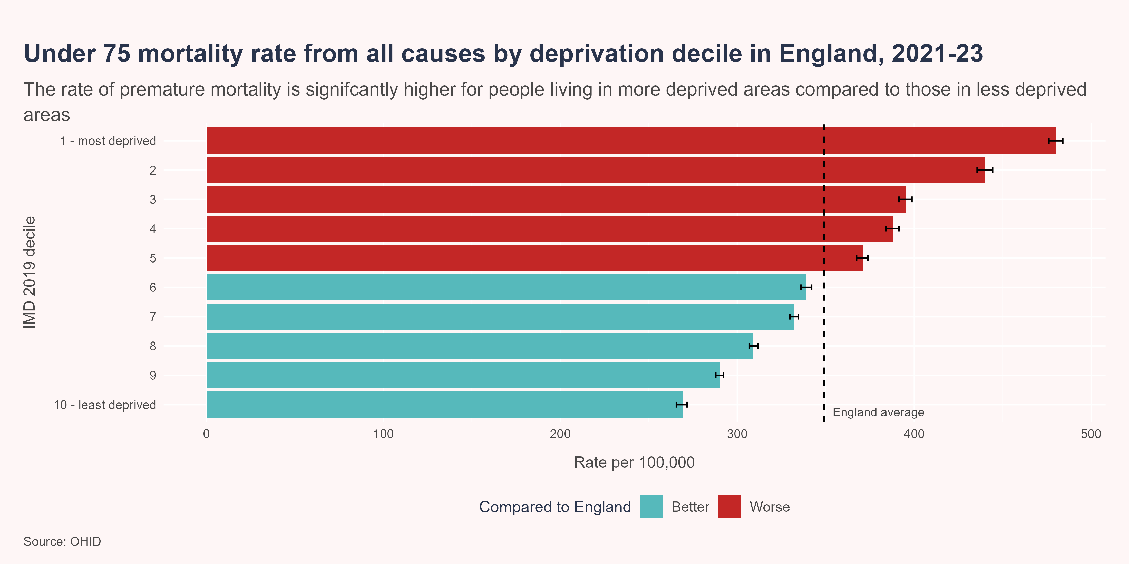
Premature mortality by deprivation
There are stark inequalities in the rate of premature mortality, and this inequality follows a strong social gradient. Between 2021-23, people living in the 10% most deprived areas in England were 1.8 times more likely to die prematurely than those living in the 10% least deprived areas (480 vs 269 deaths per 100,000).

Slide 18
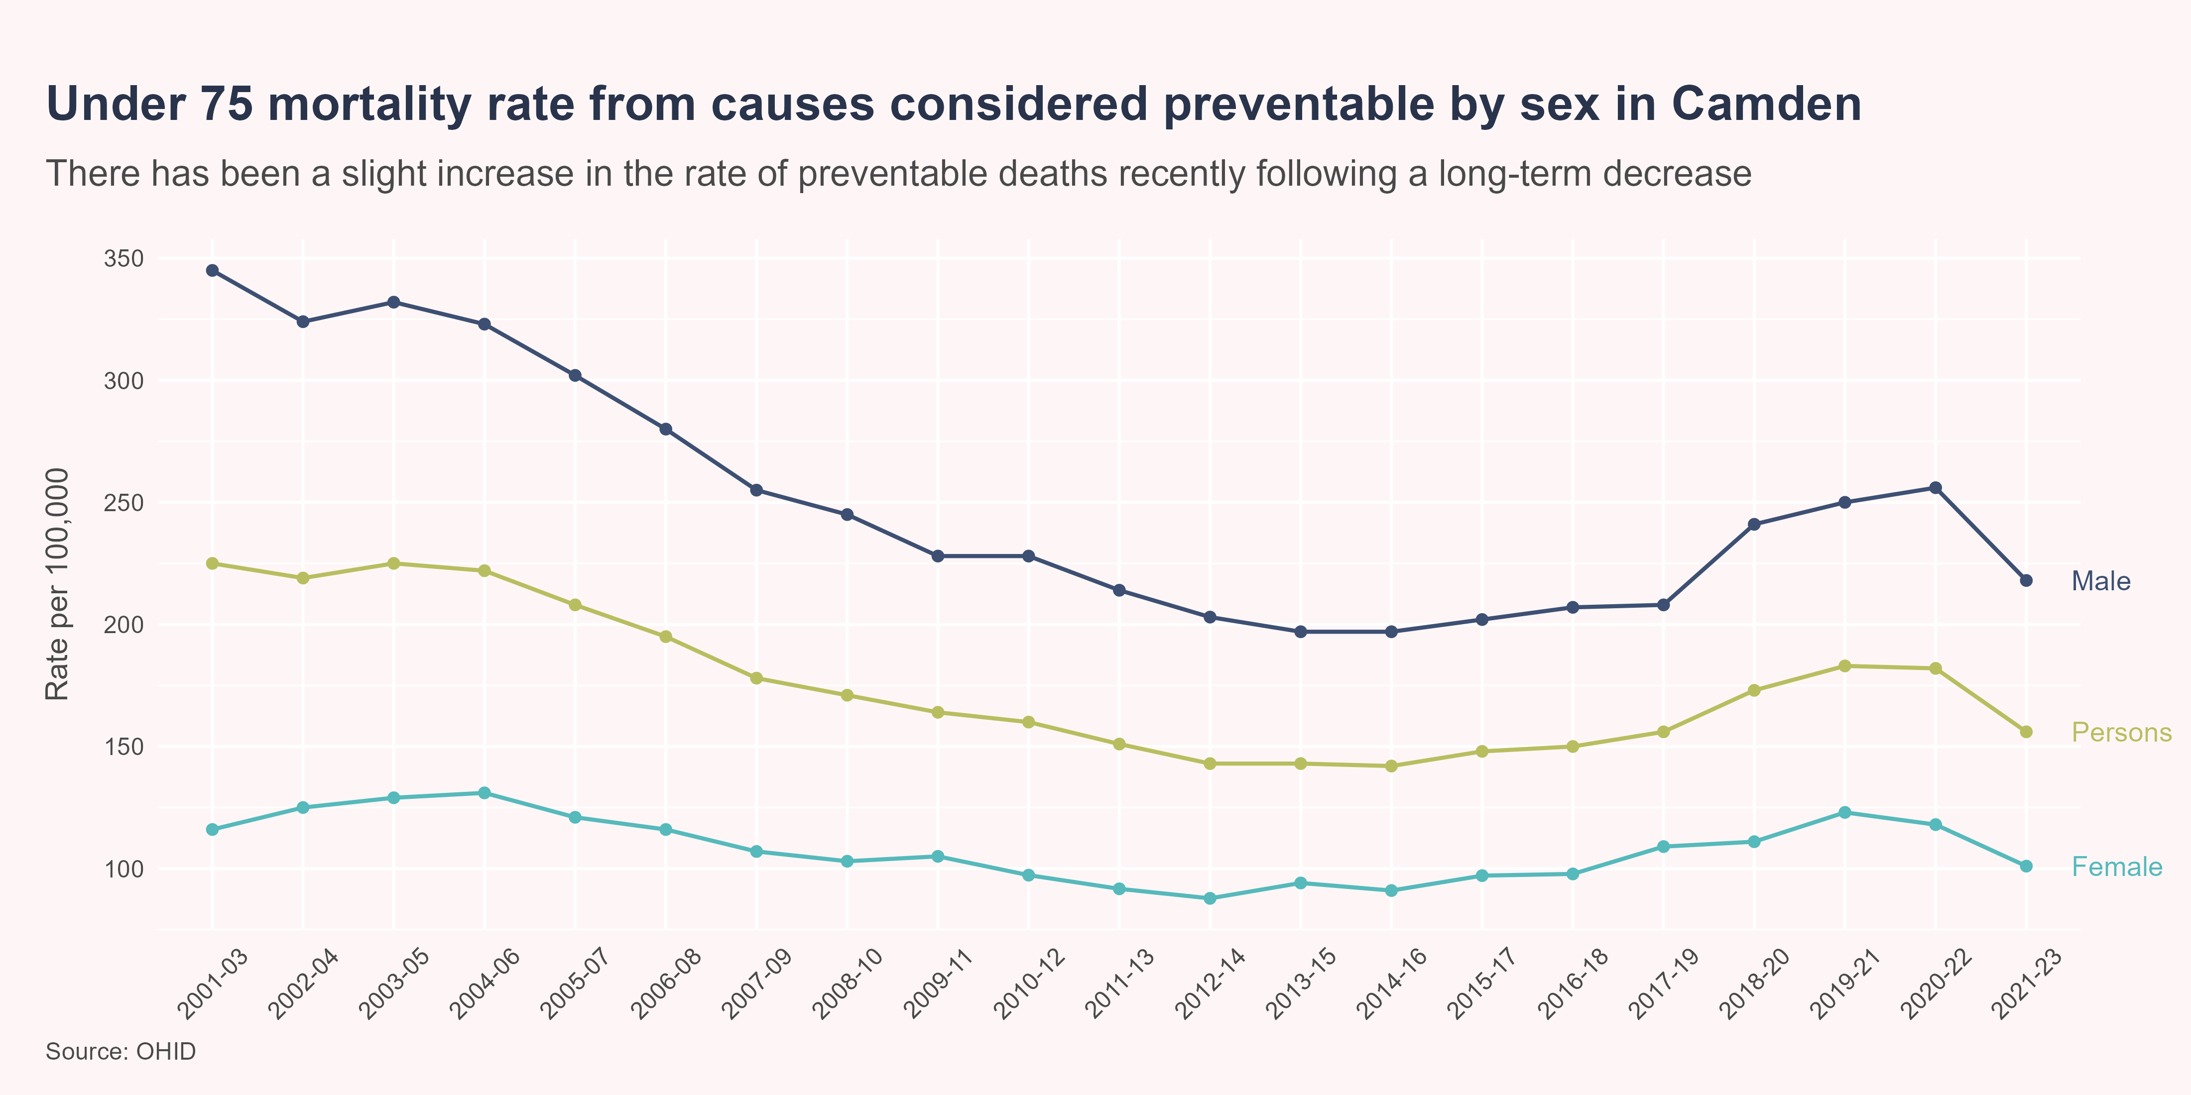
Preventable mortality
Deaths are considered preventable if, in the light of the understanding of the determinants of health at the time of death, all or most deaths from the underlying cause could mainly be avoided through effective public health and primary prevention interventions.
Since 2001-03, preventable mortality rates in Camden have declined by 13% in females and 37% in males, however the level of improvement slowed in the decade before the pandemic, before increasing during the pandemic.
In 2021-23, the rate of preventable mortality in Camden (156 deaths per 100,000) was similar to that in London (150 deaths per 100,000) and England (164 deaths per 100,000). Males had a significantly higher rate of preventable mortality than females, both locally and nationally.

Slide 19
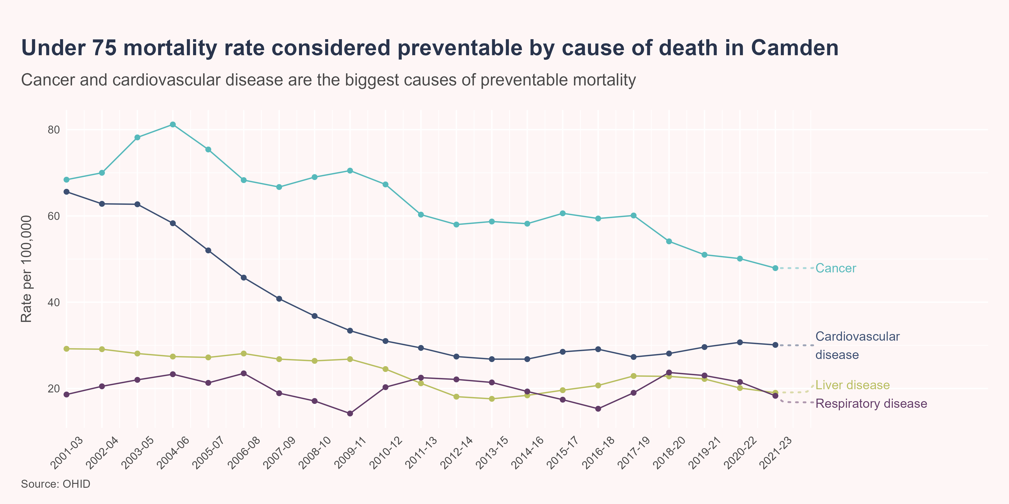
Preventable mortality by cause
Between 2021-23, the highest rates of preventable mortality in Camden were from cancer (47.9 per 100,000; n=192) and cardiovascular disease (30.1 per 100,000; n=125), followed by liver disease (19 per 100,000; n=82) and respiratory disease (18.3 per 100,000; n=70). These rates were all similar to the London and England averages. Over the last five time periods in Camden, preventable mortality rates from cancer and liver disease have declined, while the rate for cardiovascular disease increased; although, none of these differences were statistically significant.

Slide 20
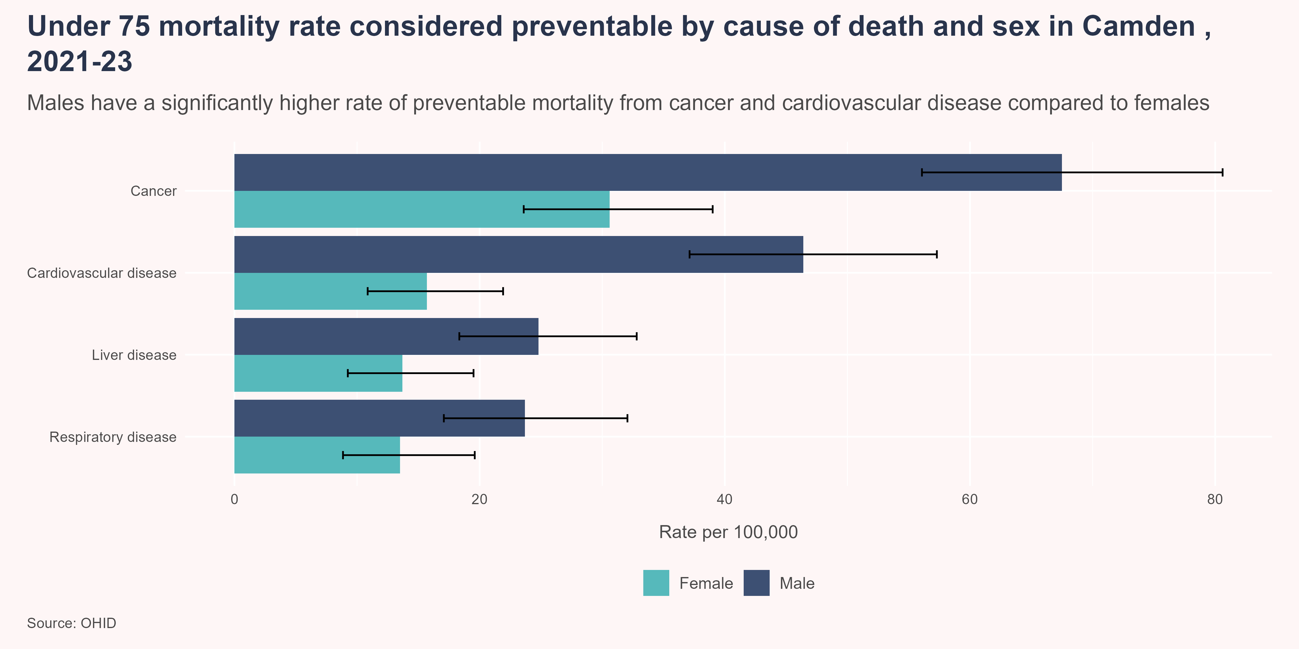
Preventable mortality by cause and sex
Between 2021-23, in Camden, the rates of preventable mortality from cancer and cardiovascular disease were significantly higher in males compared to females. Males also had a higher rate of preventable mortality from liver disease and respiratory disease than females, although these differences were not statistically significant.

Slide 21
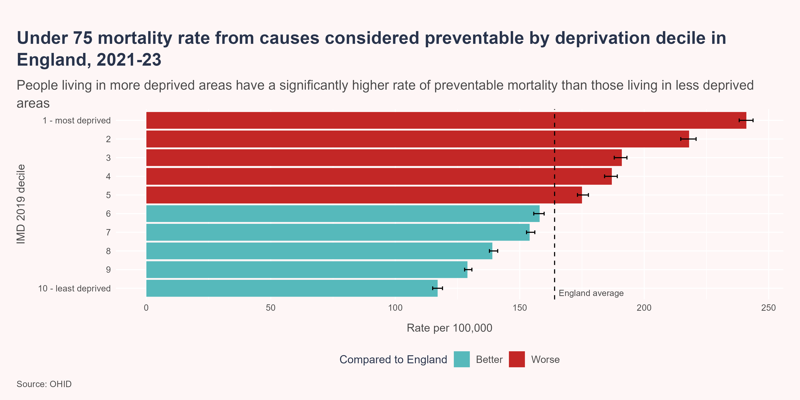
Preventable mortality by deprivation
Between 2021-23, people living in the 10% most deprived areas in England were more than twice as likely to die prematurely from a cause considered preventable than those living in the 10% least deprived areas (241 vs 117 deaths per 100,000).

Slide 22
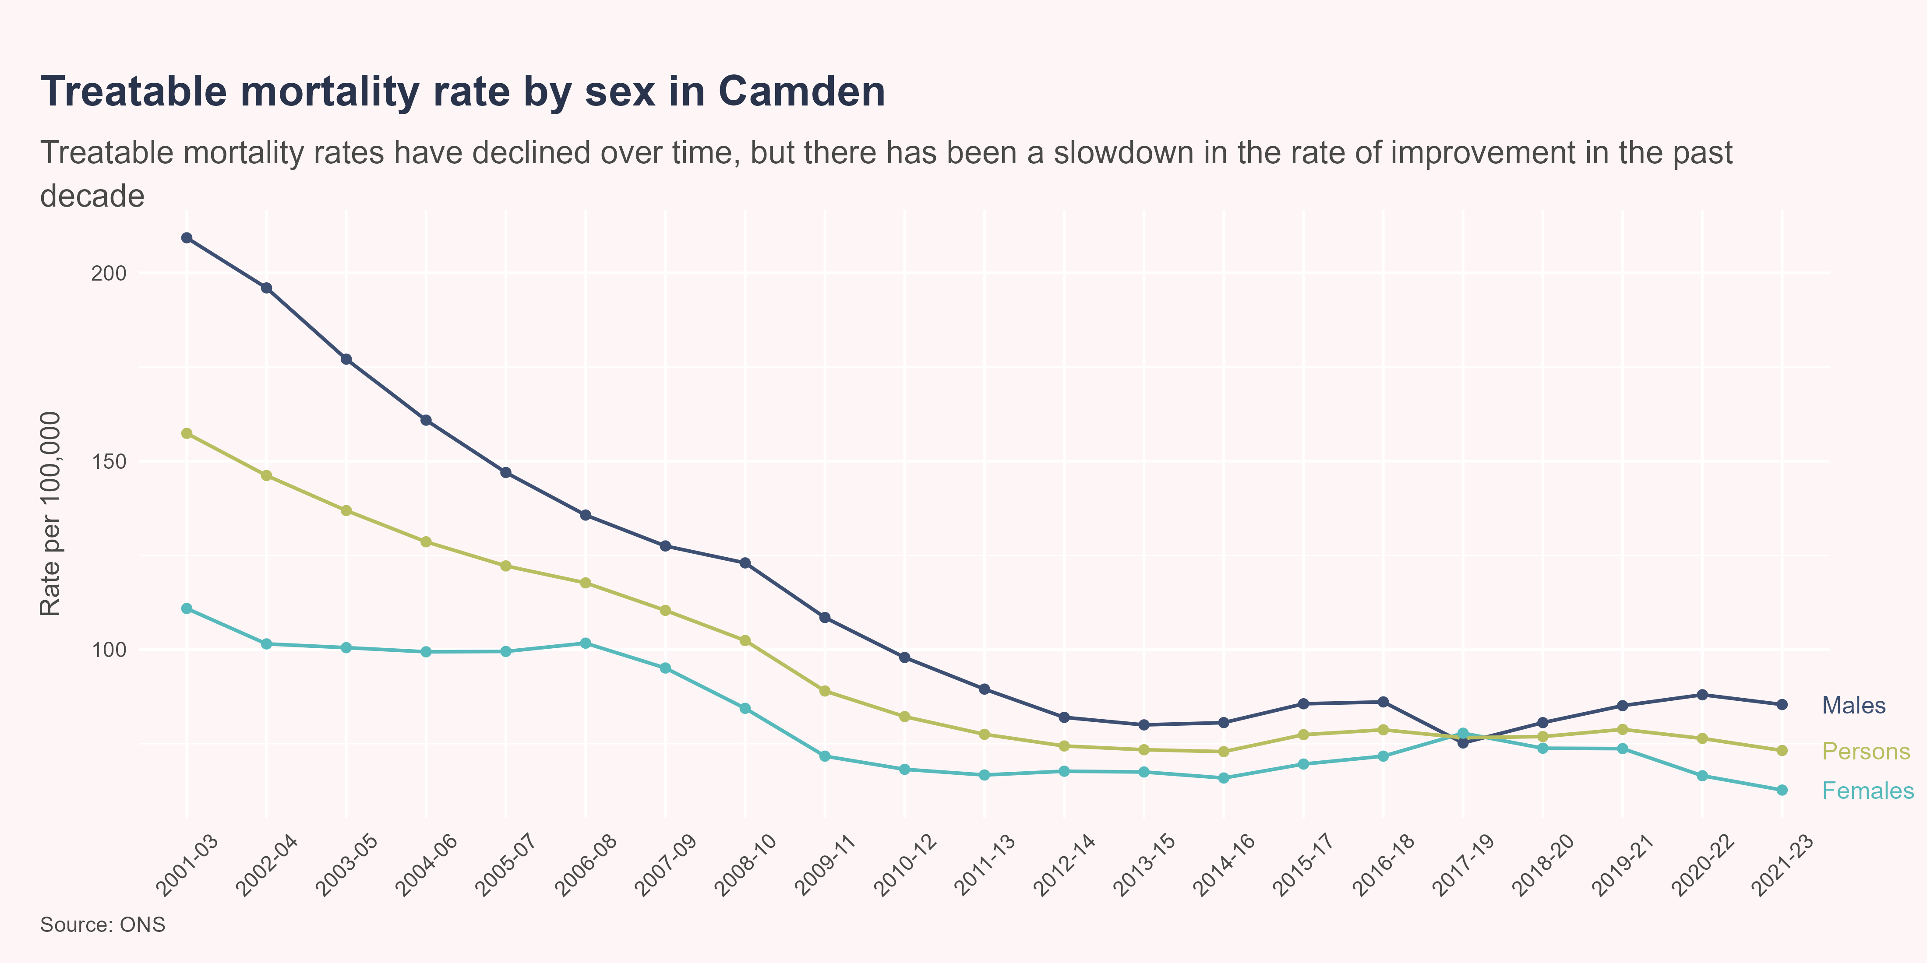
Treatable mortality
While there has been a significant decline in the rate of treatable mortality in the past 20 years, this level of improvement has slowed considerably in the past decade.
In 2021-23, the treatable mortality rate in Camden was 73.2 deaths per 100,000 population (n=306), which was similar to that for London (79.7 per 100,000) and significantly lower than that for England (82.7 per 100,000). In Camden, males had a higher rate of treatable mortality compared to females, although this difference was not statistically significant.

Slide 23
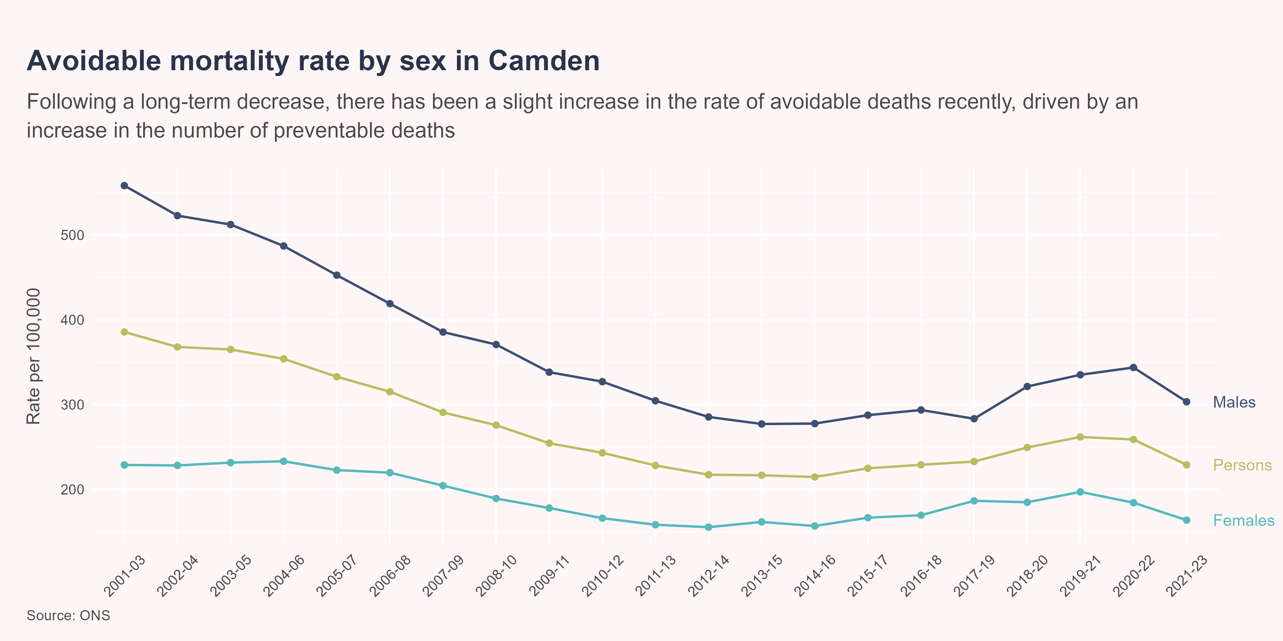
Avoidable mortality
While there has been a considerable decrease in the rate of avoidable mortality in the past 20 years, this pattern reversed during the covid pandemic, and the most recent data shows the rate remains higher than pre-pandemic levels.
In 2021-23, the avoidable mortality rate in Camden was 228.9 deaths per 100,000 population (n=978), which was similar to that for London (229.6 per 100,000) and significantly lower than that for England (246.4 per 100,000). Males have a significantly higher rate of avoidable mortality compared to females.
Of the 978 avoidable deaths in Camden between 2021-23, 68.7% (n=672) were attributable to conditions considered preventable and 31.3% (n=306) to conditions considered treatable.

Slide 24

Life expectancy gap

Slide 25

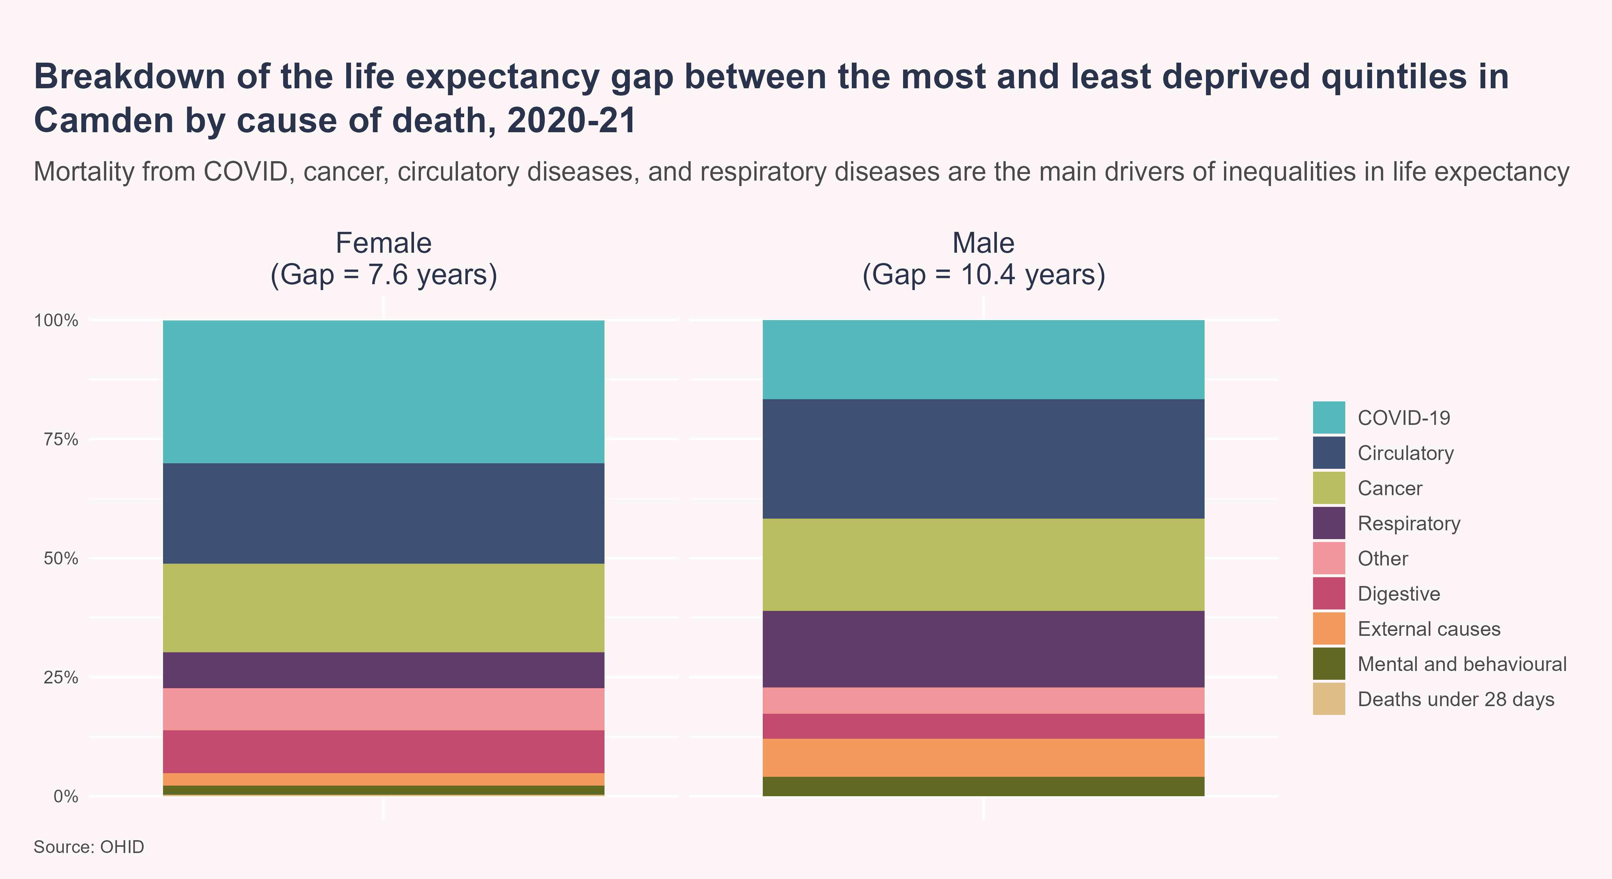
Life expectancy gap
The Office for Health Improvement and Disparities (OHID) Segment Tool provides information on the causes of death that are driving inequalities in life expectancy at local area level [5]. Targeting the causes of death which contribute most to the life expectancy gap should have the biggest impact on reducing inequalities.
Between 2020 and 2021, around three-quarters of the gap in life expectancy between the most and least deprived areas in Camden was due to higher mortality rates from COVID-19, circulatory disease, cancer, and respiratory disease in the most deprived quintile, compared to the least deprived quintile.

Slide 26

References
[1] Institute for Health Metrics and Evaluation. GBD Compare 2025.
[2] Yarnall AJ, Sayer AA, Clegg A, Rockwood K, Parker S, Hindle JV. New horizons in multimorbidity in older adults. Age and Ageing 2017;46:882–8. https://doi.org/10.1093/ageing/afx150.
[3] Skou ST, Mair FS, Fortin M, Guthrie B, Nunes BP, Miranda JJ, et al. Multimorbidity. Nature Reviews Disease Primers 2022;8:48. https://doi.org/10.1038/s41572-022-00376-4.
[4] McKee M, Dunnell K, Anderson M, Brayne C, Charlesworth A, Johnston-Webber C, et al. The changing health needs of the UK population. The Lancet 2021;397:1979–91. https://doi.org/10.1016/S0140-6736(21)00229-4.
[5] OHID. Segment Tool 2021.

